Slide 1
Instructor: Lilian de Greef
Quarter: Summer 2017
CSE 373: Data Structures and Algorithms
Lecture 3: Asymptotic Analysis part 2
Math Review, Inductive Proofs, Recursive Functions
Notes:
Laptops
Question series
Where are we? (classroom / school / university)
Why are we here? (to learn!)
One of best ways to learn: if you come up with answers. I'm going to make you think!
Could spew info 3 hours/week, no way for you or me to check understanding.
I will ask you lots of questions in class
If you don't know or say the correct answer, that's one of the greatest opportunity for us!
Give others chance to answer if you know it
I strongly encourage you to ask questions!
Interrupt me!
Not telling you all the answers, asking you to come up with them
Who's had classes done this way before?
I know this is probably different from what you're used to
Learning takes effort. I can't do it for you. Analogy to weight lifting.
I'll do a lot of talking for the beginning of this lecture as we cover logistics.

Slide 2
Today:
Brief Math Review (review mostly on your own)
Continue asymptotic analysis with Big-O
Proof by Induction
Recursive Functions

Slide 3
Common Big-O Names
O(1) constant (same as O(k) for constant k)
O(log n) logarithmic
O(n) linear
O(n log n) “n log n”
O(n²) quadratic
O(n³) cubic
O(n^{k}) polynomial (where is k is any constant)
O(k^{n}) exponential (where k is any constant > 1)
Notes:
Note: “exponential” does not mean “grows really fast”, it means “grows at rate proportional to k^{n} for some k>1”
A savings account accrues interest exponentially (k=1.01?)
If you don’t know k, you probably don’t know it’s exponential

Slide 7
Powers of 2: Fun Facts
A bit is 0 or 1 (just two different “letters” or “symbols”)
A sequence of n bits can represent 2^{n} distinct things
(For example, the numbers 1 through 2^{n})
2¹⁰ is 1024 (“about a thousand”, kilo in CSE speak)
2²⁰ is “about a million”, mega in CSE speak
2³⁰ is “about a billion”, giga in CSE speak
Java: an int is 32 bits and signed, so “max int” is “about 2 billion”
a long is 64 bits and signed, so “max long” is 2⁶³-1

Slide 8
Which means…
You could give a unique id to…
Every person in the U.S. with 29 bits
Every person in the world with 33 bits
Every person to have ever lived with 38 bits (estimate)
Every atom in the universe with 250-300 bits
So if a password is 128 bits long and randomly generated,
do you think you could guess it?

Slide 9
Math Review: Logs & Exponents
(Interlude #2 from Big-O)

Slide 10
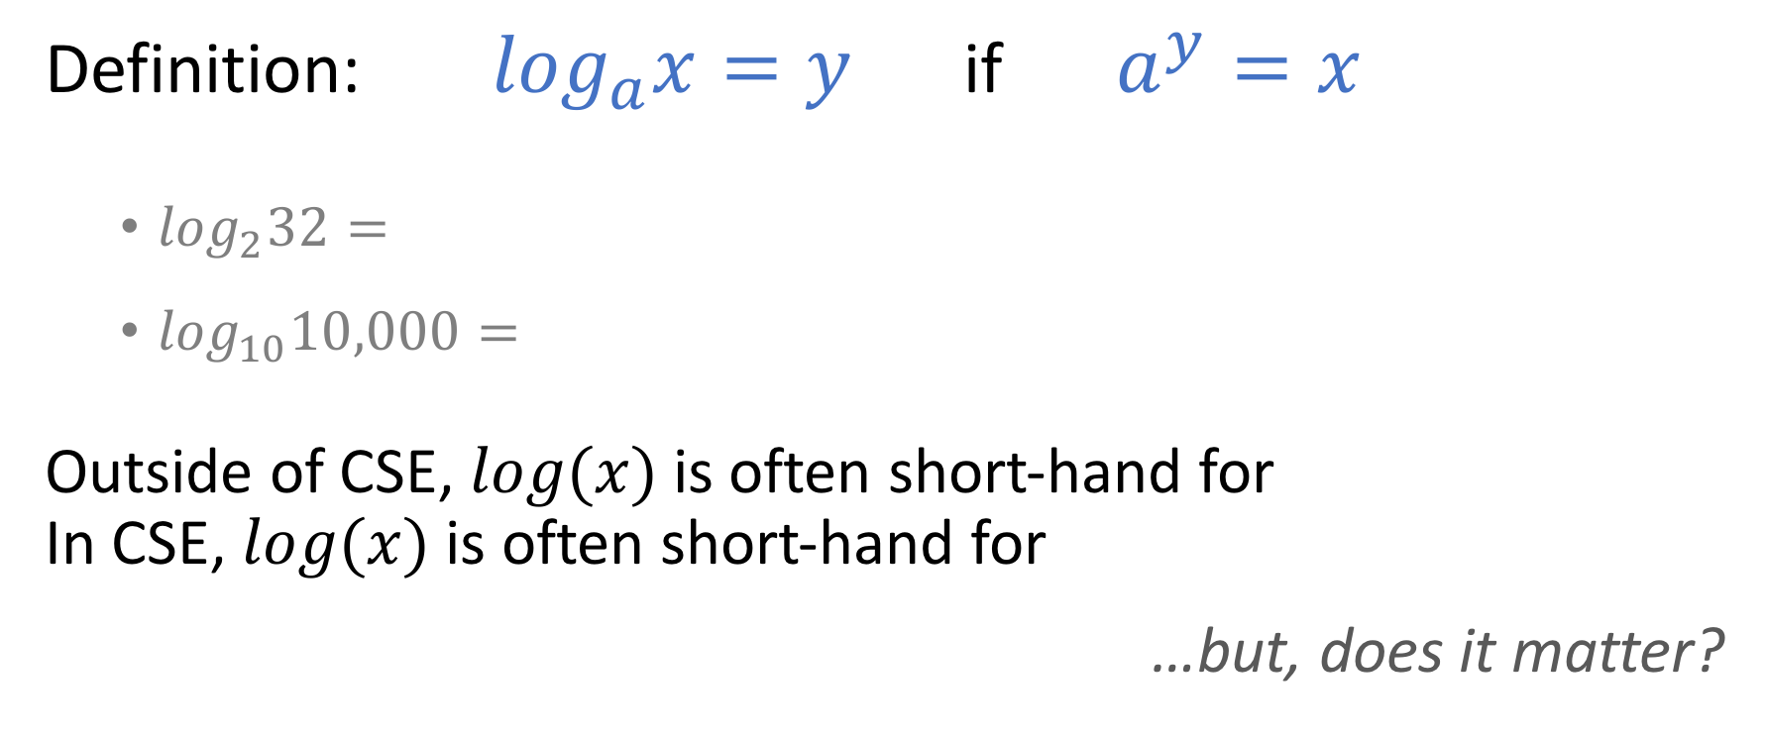
Logs & Exponents
Definition: $\log_{a}x=y$ if $a^{y}=x$
  $\log_{2}32=$
  $\log_{10}10,000=$
Outside of CSE, $log(x)$ is often short-hand for
In CSE, $log(x)$ is often short-hand for
…but, does it matter?

Slide 11

Can Make a log₂ Out of Any log!
$$\log_{A}x=\frac{\log_{B}(x) }{\log_{B}(A)}$$
so
$$\log_{2}x=\frac{\log_{whatever}(x) }{\log_{whatever}(2)}$$

Slide 12
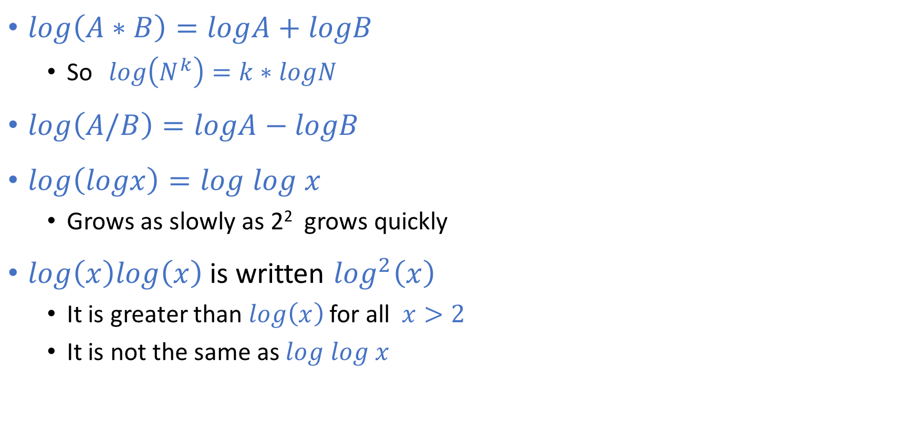
Other Properties of Logarithms
(to review on your own time)
$log\left(A∗B\right)=logA+logB$
  So $log\left(N^{k}\right)=k∗logN$
$log\left(A/B\right)=logA−logB$
$log\left(logx\right)=log$ $log x$
  Grows as slowly as 2² grows quickly
$log\left(x\right)log\left(x\right)$is written $\log^{2}\left(x\right)$
  It is greater than $log\left(x\right)$for all $x>2$
  It is not the same as $log$ $log x$

Slide 13
Floor and Ceiling
(to review on your own time)
Floor function: the largest integer < X
Ceiling function: the smallest integer > X

Slide 14
Floor and Ceiling Properties
(to review on your own time)

Slide 15
Back to Big-O

Slide 16
What’s the asymptotic runtime of this (semi-)pseudocode?
x := 0;
for i=1 to N do
for j=1 to i do
x := x + 3;
return x;
O(n)
O(n²)
O(n + n/2)
None of the above
(Some textbooks format algorithms in this style of semi-pseudocode)

Slide 17
What’s the asymptotic runtime of this (semi-)pseudocode?
x := 0;
for i=1 to N do
for j=1 to i do
x := x + 3;
return x;
O(n)
O(n²)
O(n + n/2)
None of the above
How do we prove the right answer?
Proof by Induction!

Slide 18
Inductive Proofs
(Interlude from Asymptotic Analysis)

Slide 19
Steps to Inductive Proof
If not given, define n (or “x” or “t” or whatever letter you use)
Base Case
Inductive Hypothesis (IHOP):
Assume what you want to prove is true for some arbitrary value k (or “p” or “d” or whatever letter you choose)
Inductive Step:
Use the IHOP (and maybe base case) to prove it's true for n = k+1

Slide 20
Example #0:
Proof that I can climb any length ladder
Let n = number of rungs on a ladder.
Base Case: for n = 1
Inductive Hypothesis (IHOP):
Assume true for some arbitrary integer n = k.
Inductive Step: (aiming to prove it's true for n = k+1)
  By IHOP, I can climb k steps of the ladder.
  If I’ve climbed that far, I can always climb one more.
  So I can climb k+1 steps.
  I can climb forever!

Slide 21

Example #1
Prove that the number of
loop iterations is
x := 0;
for i=1 to N do
for j=1 to i do
x := x + 3;
return x;
$$\frac{\left.n∗(n+1\right)}{2}$$

Slide 22
(Extra room for notes)

Slide 23
Example #2:
Prove that 1 + 2 + 4 + 8 + … + 2^{n} = 2^{n+1} - 1

Slide 24
(Extra room for notes)

Slide 25
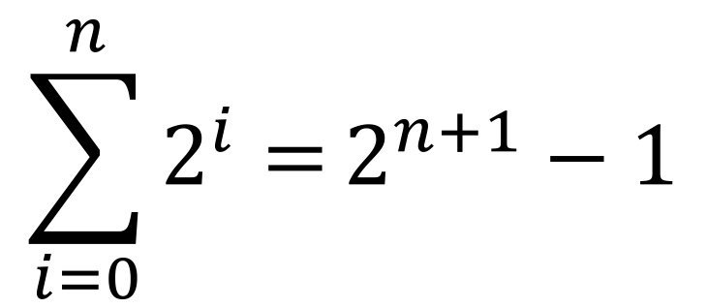
Useful Mathematical Property!
$$\sum_{i=0}^{n}{2^{i}=}2^{n+1}−1$$
You’ll use it or see it again before the end of CSE 373.

Slide 26
Example #3: (Parody) Reverse Induction!
Proof by Reverse Induction That You Can Always Cage a Lion:
Let n = number of lions
Base Case: There exists some countable, arbitrarily large value of M such that when n = M, the lions are so packed together that it's trivial to cage one.
IHOP: Assume this is also true for n = k for some arbitrary value k.
Inductive Step: Then for n = k-1, release a lion to reduce the problem to the case of n = k, which by the IHOP is true.
QED :)
Fun fact: Reverse induction is a thing! The math part of the above is actually correct.

Slide 27
Big-O: Recursive Functions
How do we asymptotically analyze recursive functions?

Slide 28
Example #1: Towers of Hanoi

Slide 29
Example #1: Towers of Hanoi
// Prints instructions for moving disks from one
// pole to another, where the three poles are
// labeled with integers "from", "to", and "other".
// Code from rosettacode.org
public void move(int n, int from, int to, int other) {
if (n == 1) {
System.out.println("Move disk from pole " + from +
" to pole " + to);}
else {
move(n - 1, from, other, to);
move(1, from, to, other);
move(n - 1, other, to, from);
}
}

Slide 30
Example #1: Towers of Hanoi
if (n == 1) {
System.out.println("Move disk from pole " + from +
" to pole " + to);}
else {
move(n - 1, from, other, to);
move(1, from, to, other);
move(n - 1, other, to, from);
}

Slide 31
Example #1: Solving the Recurrence Relation
Recurrence Relation:

Slide 32
(continued)

Slide 33
Example #2: Binary Search
2
3
5
16
37
50
73
75
126
Find an integer in a sorted array
  (Can also be done non-recursively)
// Requires the array to be sorted.
// Returns whether k is in array.
public boolean find(int[]arr, int k){
return help(arr,k,0,arr.length);
}
private boolean help(int[]arr, int k, int lo, int hi) {
int mid = (hi+lo)/2; // i.e., lo+(hi-lo)/2
if(lo==hi) return false;
if(arr[mid]==k) return true;
if(arr[mid]< k) return help(arr,k,mid+1,hi);
else return help(arr,k,lo,mid);

Slide 34
What is the recurrence relation?
// Requires the array to be sorted.
// Returns whether k is in array.
public boolean find(int[]arr, int k){
return help(arr,k,0,arr.length);
}
private boolean help(int[]arr, int k, int lo, int hi) {
int mid = (hi+lo)/2; // i.e., lo+(hi-lo)/2
if(lo==hi) return false;
if(arr[mid]==k) return true;
if(arr[mid]< k) return help(arr,k,mid+1,hi);
else return help(arr,k,lo,mid);
2T(n-1) + 3
T(n-1)*T(n-1) + 3
T(n/2) + 3
T(n/2) * T(n/2) + 3

