Slide 1
Instructor: Lilian de Greef Quarter: Summer 2017
CSE 373: Data Structures and Algorithms
Lecture 2: Wrap up Queues, Asymptotic Analysis, Proof by Induction
Notes:
Laptops
Question series
Where are we? (classroom / school / university)
Why are we here? (to learn!)
One of best ways to learn: if you come up with answers. I'm going to make you think!
Could spew info 3 hours/week, no way for you or me to check understanding.
I will ask you lots of questions in class
If you don't know or say the correct answer, that's one of the greatest opportunity for us!
Give others chance to answer if you know it
I strongly encourage you to ask questions!
Interrupt me!
Not telling you all the answers, asking you to come up with them
Who's had classes done this way before?
I know this is probably different from what you're used to
Learning takes effort. I can't do it for you. Analogy to weight lifting.
I'll do a lot of talking for the beginning of this lecture as we cover logistics.

Slide 2
Today:
Announcements
Wrap up Queues
Begin Asymptotic Analysis: Big-O
Proof by Induction

Slide 3
Announcement: Office Hours
Announced! See course webpage for times
Most held in 3rd floor breakouts in CSE (whiteboards near stairs)
Lilian’s additional ”actual office” office hours
CSE 220 (a more private environment)
During listed times
And by appointment! (email me >24 hours ahead of time with several times that work for you)
Come talk to me about anything! (feedback, grad school, Ultimate Frisbee, life problems, whatever)

Slide 4
Announcement: Sections
When & where: listed on course webpage
What: TA-led…
Review sessions of course material
Practice problems
Question-answering
Optional, but highly encouraged!
I wouldn't have passed 332 (Data Structures and Parallelism) without regularly going to section! – Vlad (TA)

Slide 5
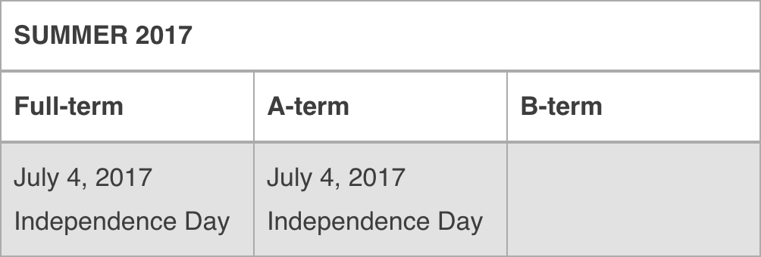
Other Announcements
Homework 1 is out
On material covered in Lecture 1
Go forth!
…or at least get Eclipse set up today.
Only required course reading:
10 pages, easy read on commenting style
Due beginning of class on Monday
July 3rd
Not an official UW holiday (sorry guys)
But I’m declaring it an unofficial holiday! Go enjoy a 4-day July 4th weekend
🇺🇸 🎉

Slide 6
Finishing up Queues
Let’s resolve that cliff-hanger!

Slide 7
If we can assume the queue is not empty, how can we implement dequeue()?
Public E dequeue() {
size--;
E e = array[front];
<Your code here!>
return e;
}
size-1
0
1
2
rear
i
h
g
f
e
front
C)
A)
for (int i = 0; i < rear; i++) {
array[i] = array[i+1]
}
front++;
if (front == array.length)
front = 0;
front++;
if (front == array.length)
front = 0;
B)
rear = rear-1;
if (rear < 0)
rear = array.length-1;
D)
None of these are correct
Notes:
Correct: A

Slide 8
(Notes for yourself)

Slide 9
If we can assume the array is not full, how can we implement enqueue(E e)?
Public enqueue(E e) {
<Your code here!>
size++;
}
size-1
0
1
2
rear
i
h
g
f
e
front
A)
rear++;
if (rear == array.length)
rear = 0;
array[rear] = e;
C)
for (int i=front; i<rear; i++) {
array[i] = array[i+1]
}
array[rear] = e;
rear++;
B)
rear++;
array[rear] = e;
D)
None of these are correct
Notes:
In the safety of your own minds, I want you to silently answer this multiple choice question. Just to yourself, no talking yet.

Slide 10
(Notes for yourself)

Slide 11
Between arrays and linked-lists which one *always* is the fastest at enqueue, dequeue, and seeKthElement operations?
(where seeKthElement lets you peek at the kth element in the stack)
Fastest: | enqueue | dequeue | seeKthElement
A) | Arrays | Linked-Lists | Neither
B) | Linked-lists | Neither | Neither
C) | Linked-lists | Neither | Arrays
D)
They’re all the same
Notes:
Silent vote!

Slide 12
(Notes for yourself)

Slide 13
Which one’s better?
Arrays
Linked-lists
Notes:
It depends! You'll hear that a lot in this course.
Another example: space
Array uses more space if it's nearly empty
Linked-list uses more space if array is full (more space per element)

Slide 14
Trade-offs!
The ability to choose wisely between trade-offs is why it’s important to understand underlying data structures.
Common Trade-offs
Time vs space
One operation’s efficiency vs another
Generality vs simplicity vs performance

Slide 15
Asymptotic Analysis
Oh ho! The Big-O!

Slide 16
Algorithm Analysis
Why: to help choose the right algorithm or data structure for the job
Often in asymptotic terms
Most common way: Big-O Notation
General idea:
A common way to describe “worst-case running time”
Notes:
Asymptotic: behavior as value approaches infinity
General idea: mathematical upper bound describing the behavior of how long a function takes to run in terms of N.

Slide 17
Example #1:
Important! Always begin by specifying what “n” is! (or “x”or “y” or whatever letter)
The barn is an array of Cows, excitement is an integer, and Cow.addHat()runs in constant time.
println("The alien is visiting!");
println("Party time!");
excitement++;
for (int i=0; i<barn.length; i++) {
Cow cow = barn[i];
cow.addHat();
}
Let's assume that one line of code takes 1 "unit of time" to run
This is not always true, i.e. calls to non-constant-time methods)

Slide 18
Example #1:
println("The alien is visiting!");
println("Party time!");
excitement++;
for (int i=0; i<barn.length; i++) {
Cow cow = barn[i];
cow.addHat();
}

Slide 19
Example #2: Your turn!
for (Person player: sportsTeam) {
player.smile();
for (Person teamMate: sportsTeam) {
player.say(”Good game!");
player.highFive(teamMate);
}
Assume that the above Person method calls run in constant time

Slide 20
What’s the asymptotic runtime of this (semi-)pseudocode?
x := 0;
for i=1 to N do
for j=1 to i do
x := x + 3;
return x;
O(n)
O(n²)
O(n + n/2)
None of the above

Slide 21
What’s the asymptotic runtime of this (semi-)pseudocode?
x := 0;
for i=1 to N do
for j=1 to i do
x := x + 3;
return x;
O(n)
O(n²)
O(n + n/2)
None of the above
How do we prove the right answer?
Proof by Induction!

Slide 22
Inductive Proofs
(Interlude from Asymptotic Analysis)

Slide 23
Steps to Inductive Proof
If not given, define n (or “x” or “t” or whatever letter you use)
Base Case
Inductive Hypothesis (IHOP): Assume what you want to prove is true for some arbitrary value k (or “p” or “d” or whatever letter you choose)
Inductive Step: Use the base case and IHOP to prove it's true for n = k+1

Slide 24
Example #0: Proof that I can climb any length ladder
Let n = number of rungs on a ladder.
Base Case: for n = 1
Inductive Hypothesis (IHOP): Assume true for some arbitrary integer n = k.
Inductive Step: (aiming to prove it's true for n = k+1)
If I climb k steps of the ladder, then I have one step left to go.
By IHOP, I can climb k steps of the ladder.
By Base Case, I can climb the last step.
So I can climb k+1 steps.
I can climb forever!

Slide 25
Example #1
Prove that the number of
loop iterations is
x := 0;
for i=1 to N do
for j=1 to i do
x := x + 3;
return x;
$$\frac{\left.n∗(n+1\right)}{2}$$

Slide 26
(Extra room for notes)

Slide 27
Example #2: Prove that 1 + 2 + 4 + 8 + … + 2^{n} = 2^{n+1} - 1

Slide 28
(Extra room for notes)

Slide 29
Useful Mathematical Property!
$$\sum_{i=0}^{n}{2^{i}=}2^{n+1}−1$$
You’ll use it or see it again before the end of CSE 373.

Slide 30
Powers of 2
A bit is 0 or 1 (just two different “letters” or “symbols”)
A sequence of n bits can represent 2^{n} distinct things (For example, the numbers 0 through 2^{n}-1)
2¹⁰ is 1024 (“about a thousand”, kilo in CSE speak)
2²⁰ is “about a million”, mega in CSE speak
2³⁰ is “about a billion”, giga in CSE speak
Java: an int is 32 bits and signed, so “max int” is “about 2 billion”
a long is 64 bits and signed, so “max long” is 2⁶³-1

Slide 31
Which means…
You could give a unique id to…
Every person in the U.S. with 29 bits
Every person in the world with 33 bits
Every person to have ever lived with 38 bits (estimate)
Every atom in the universe with 250-300 bits
So if a password is 128 bits long and randomly generated,
do you think you could guess it?

Slide 32
Example #3: (Parody) Reverse Induction! Proof by Reverse Induction That You Can Always Cage a Lion:
Let n = number of lions
Base Case: There exists some countable, arbitrarily large value of M such that when n = M, the lions are so packed together that it's trivial to cage one.
IHOP: Assume this is also true for n = k.
Inductive Step: Then for n = k-1, release a lion to reduce the problem to the case of n = k, which by the IHOP is true.
QED :)
Fun fact: Reverse induction is a thing! The math part of the above is actually correct.

