Slide 1
Instructor: Lilian de Greef Quarter: Summer 2017
CSE 373: Data Structures and Algorithms
Lecture 1: Introduction, ADTs, Stacks & Queues

Slide 2
Welcome!
Today’s Structure:
Introductions and course mechanics
Start material
Abstract Data Types (ADTs)
Stacks
Queues

Slide 3
Lilian de Greef
CSE PhD Student
Working with Shwetak Patel on health applications of CS
Interests & Hobbies
Ultimate Frisbee
Piano
Hiking / backpacking
Some TV shows
ldegreef@cs.washington.edu
cse373-staff@cs.washington.edu

Slide 4
Kyle Thayer

Slide 5
Ben Jones

Slide 6
Vlad Shamalov

Slide 8
Course Logistics

Slide 9
Classroom environment
Laptop policy
Lectures starting promptly at 10:50
Will have discussions in class
With neighbors
With entire class
Hence, pack yourselves to the front and sit together
Somewhere we can feel comfortable making mistakes
One of the best ways to learn!

Slide 10
General Logistics
Website: http://cs.washington.edu/373
Mailing list: cse373a_17su@uw.edu
Piazza discussion board
Textbook: Weiss 3rd Edition in Java
Computers for homework assignments
College of Arts & Sciences Instructional Computing Lab: http://depts.washington.edu/aslab/
Or your own machine
Java
Used for programming assignments
Recommended environment: Eclipse

Slide 11
Sections & Office Hours
TBA by Tuesday, in class on Wednesday
Lilian’s office hours (for just today):
1:00 – 2:00pm
CSE 220

Slide 12
Contact
Use Piazza!
https://piazza.com/washington/summer2017/cse373
Don’t post code or solutions publicly
For questions with code, solutions, grades, etc., make private posts to instructors
Can post anonymously
Email me
For "Lilian's eyes only" concerns
I'll reply within 24 hours
Put [CSE 373] at beginning of subject

Slide 13
Collaboration and Academic Integrity
DON’T CHEAT!
Seriously, read the policy online.

Slide 14
Using PollEverywhere
How:
You anonymously vote on multiple choice questions in lecture
Via text messaging (SMS) or web browser (don’t need to buy a clicker)*
Why:
A way for me to check in
A way for you to check in
Research shows using Peer Instruction with polling improves learning!
* If access to SMS or a web browser in class is a challenge for you, please come talk to me

Slide 15
Using PollEverywhere: for Peer Instruction
Format
I'll pose a question
Vote individually, invisible to class
Discuss!
Group vote
Discussion is key!
"Just getting the right answer" is not enough - need to be able to explain/argue for it!
Testing yourself helpful ("right answer"), but learning happens during discussion

Slide 16
Take part in class-wide discussion!
I know, can be intimidating
Your questions and explanations are critical for fellow students' learning
If you have a question, it’s likely that others have the same one. You're not alone!

Slide 17
Let’s get started with Data Structures!
Today: Abstract Data Types (ADTs), Stacks, Queues

Slide 18
Expectations: Basic Understanding of
Conditionals
Loops
Methods
Fundamentals of defining classes and inheritance
Basic algorithm analysis (e.g. O(n) vs O(n^2) etc.)
Arrays
Singly linked lists
Simple binary trees
Recursion
A few sorting and searching algorithms

Slide 19
What is a Data Structure?

Slide 20
What is a Data Structure?
What should I put my sandwich in?

Slide 21
The crux of this course
Understanding your data structures and algorithms to choose the right one for the job.
Fundamental CS skill
After this course, I want you to be able to
Make good design choices
Justify and communicate design decisions

Slide 22
Terminology
Abstract Data Type (ADT)
Mathematical description of “thing”
Meaning
Operations
No implementation details
Data structure
Specific way to implement ADT (organization of data & family of algorithms)

Slide 23
Terminology
Algorithm
Language-independent description of step-by-step process
Implementation of a data structure
Specific implementation in a specific language

Slide 24
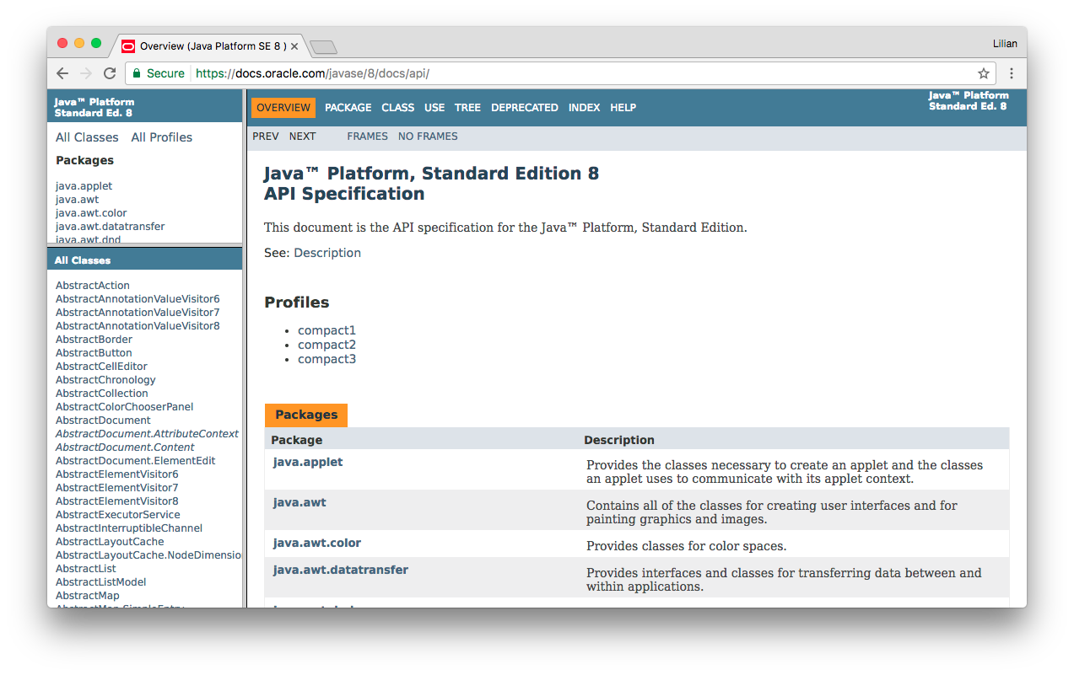
Terminology
Interface to an ADT in particular language is said to be the Application Programmer Interface (API) for the ADT in that language

Slide 25
Computer Science example: Stacks!
Notes:
Quick review: What are the two parts of an ADT?

Slide 26
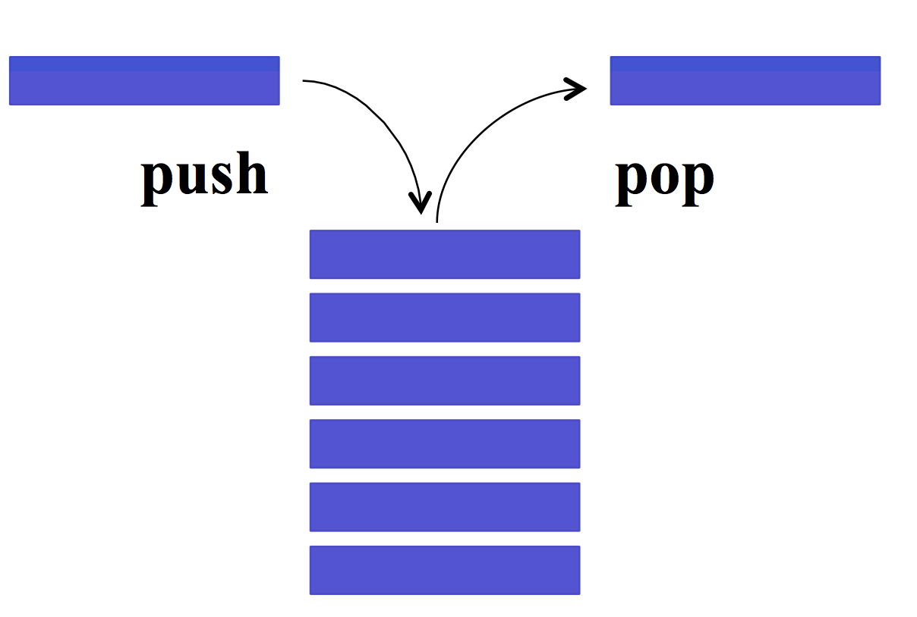
Stack ADT
Meaning
Operations
Notes:
Stack ADT
Question: Meaning?
LIFO (last-in-first-out)
Stack of pizza boxes
Blocks (see Lauren's lecture)
Question: Operations?
isEmpty
Push
Pop
Others
Size
Peek

Slide 27
Stack data structures
Specific kinds of stacks:
Example implementation: library “java.util.Stack”
Notes:
Question: examples?
Array
Linked-list

Slide 28
Stack Practice!
As an array
As a linked list
new Stack
push(☺)
push(☆)
pop()

Slide 29
Stacks are used a lot!
Undo / redo
Back / forward on browsers
Recursion
Matching braces
… and much more!
{ ( (a + b) * c – (d / (e + f)) }

Slide 30
Another example: Queues!

Slide 31
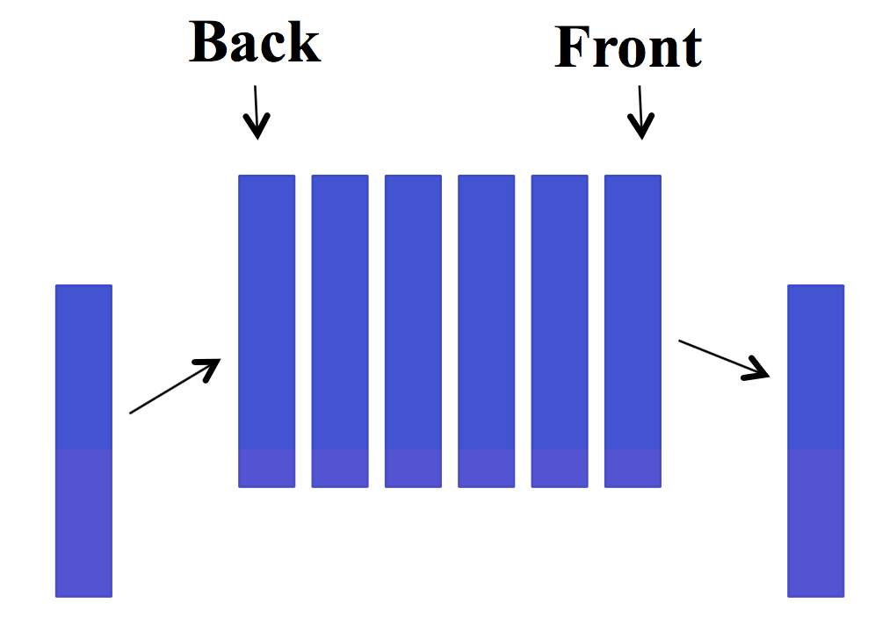
Queue ADT
Meaning
Operations
Notes:
Question: meaning?
FIFO (first-in-first-out)
picture of people waiting in line at the HUB
Blocks (see Lauren's lecture)
Question: operations?
enqueue
dequeue
isEmpty
etc.

Slide 32
Queue Data Structure: Linked List
b
c
d
e
front
rear

Slide 33
Queue Data Structure: Linked List
b
c
d
e
f
front
rear
// Basic idea only!
enqueue(x) {
rear.next = new Node(x);
rear = rear.next;
}
What if queue is empty?
Enqueue?
Dequeue?
Can you find the k^{th} element in the queue?
Can list be full?
How to test for empty?
What is the complexity of the operations?
// Basic idea only!
dequeue() {
x = front.item;
front = front.next;
return x;
}

Slide 34
Queue Data Structure: Array
0
size - 1
b
c
d
e
f
front
rear
What happens when we dequeue several times, and front catches up to rear?

Slide 35
Queue Data Structure: Array
0
size - 1
b
c
d
e
f
g
h
i
front
rear
Hmmm…
How do we enqueue to the rear now?

Slide 36
Queue Data Structure: Circular Array!
size-1
0
1
View the array as circular and allow both front and rear to advance through (around) the array
We wouldn’t need to move elements for enqueues and dequeues!
2
rear
i
h
g
f
e
front

Slide 37
If we can assume the queue is not empty, how can we implement dequeue()?
Public E dequeue() {
size--;
E e = array[front];
<Your code here!>
return e;
}
size-1
0
1
2
rear
i
h
g
f
e
front
C)
A)
for (int i = 0; i < rear; i++) {
array[i] = array[i+1]
}
front++;
if (front == array.length)
front = 0;
front++;
if (front == array.length)
front = 0;
B)
rear = rear-1;
if (rear < 0)
rear = array.length-1;
D)
None of these are correct
Notes:
In the safety of your own minds, I want you to silently answer this multiple choice question. Just to yourself, no talking yet.
Now, remember the structure for voting:
Silent vote
Discuss
Group vote
Class discussion
Take out your devices now!

Slide 38
(Notes for yourself)

Slide 39
If we can assume the array is not full, how can we implement enqueue(E e)?
Public enqueue(E e) {
<Your code here!>
size++;
}
size-1
0
1
2
rear
i
h
g
f
e
front
A)
rear++;
if (rear == array.length)
rear = 0;
array[rear] = e;
C)
for (int i=front; i<rear; i++) {
array[i] = array[i+1]
}
array[rear] = e;
rear++;
B)
rear++;
array[rear] = e;
D)
None of these are correct
Notes:
In the safety of your own minds, I want you to silently answer this multiple choice question. Just to yourself, no talking yet.

Slide 40
(Notes for yourself)

Slide 41
Between arrays and linked-lists which one *always* is the fastest at enqueue, dequeue, and seeKthElement operations?
(where seeKthElement lets you peek at the kth element in the stack)
Fastest: | enqueue | dequeue | seeKthElement
A) | Arrays | Linked-Lists | Neither
B) | Linked-lists | Neither | Neither
C) | Linked-lists | Neither | Arrays
D)
They’re all the same
Notes:
Silent vote!

Slide 42
(Notes for yourself)

Slide 43
Which one’s better?
Arrays
Linked-lists
Notes:
It depends! You'll hear that a lot in this course.
Another example: space
Array uses more space if it's nearly empty
Linked-list uses more space if array is full (more space per element)

Slide 44
Trade-offs!
The ability to choose wisely between trade-offs is why it’s important to understand underlying data structures.
Common Trade-offs
Time vs space
One operation’s efficiency vs another
Generality vs simplicity vs performance

