Slide 1
Cse 373
December 6th – Computability and Complexity

Slide 2
Assorted Minutiae
P3P3 feedback out – grades up soon
Written assignment
Due at 11:30 tonight! No late days!
Next Monday office hours
12:00-2:00 – last minute exam questions
Also available for meetings before/after
Practice exams on webpage
Section09-solutions
Up – error in up-trees

Slide 3
Assorted Minutiae
Submit a submission for the p3 resubmission (unless you’ve got all 50s)
Easier for us to get grades back to you quickly
All grades up and finalized by Sunday morning
If something is missing/incorrect, I need to know by next Monday

Slide 4
Assorted Minutiae
Course evaluations
You thought I was kidding
47 of you so far... I need 100 more!

Slide 5
Assorted Minutiae
Course evaluations
You thought I was kidding
47 of you so far... I need 100 more!
Learning Styles
Collaborative university

Slide 6
Computer science
Lots of interesting problems
Not much discussion of “computers”
Subset of “Math” dedicated to solving problems that can be solved with the structure of a computer as we know it

Slide 7
Computer science
Turing Machines and John von Neumann architecture

Slide 8
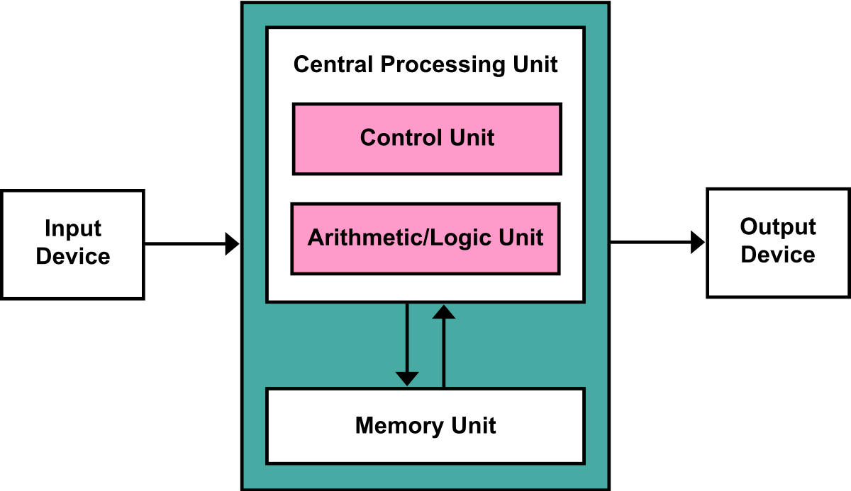
Computer science

Slide 9
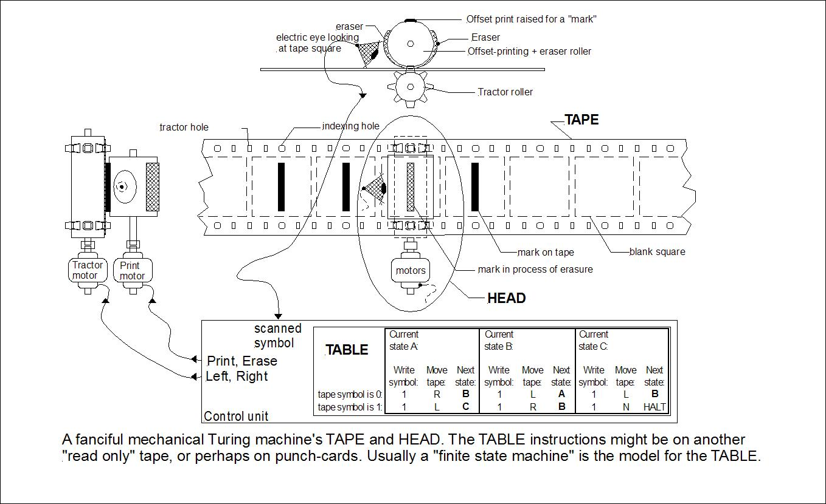
Computer science

Slide 10
Computer science
These simple descriptions are the fundamental basis for discussing what computers are capable of doing
Von Neumann Architecture
Universal Turing Machine

Slide 11
Computer science
These assumptions may be changing!
But we are constrained not only by the time, but also by computability
Given our structure of the “computer”, can we solve all problems?

Slide 12
Computer science
Assembly of three slide decks, all to be posted on the website
These topics are so important to CS, they need to be discussed in a level of depth…

Slide 13
Computer science
Assembly of three slide decks, all to be posted on the website
These topics are so important to CS, they need to be discussed in a level of depth…
Plus, Adam’s slides have such pretty colors!

Slide 14
Computer science
Assembly of three slide decks, all to be posted on the website
Halting problem: https://courses.cs.washington.edu/courses/cse311/16au/slides/lecture27-halting.pdf
Reductions:
https://courses.cs.washington.edu/courses/cse332/17wi/lectures/p-np-1/efficient-reductions.pdf
P / NP
https://courses.cs.washington.edu/courses/cse332/17wi/lectures/p-np-2/p-np.pdf

Slide 15
conclusion
Course evaluations!
https://uw.iasystem.org/survey/183488

