Slide 1
Cse 373
December 1st – Graph Madness

Slide 2
Assorted Minutiae
Project 3
Maximum of 3 late days
Resubmission for all 3 parts by next Wednesday
Written Assignment
Extra Credit
Next week:
Monday office hours: 12:00-2:00 in my office
No office hours next Friday: email me to make an appointment

Slide 3
Today’s lecture
Isometric Graphs
Last graphs problem
Network Flow (Disclaimer)
Graph problem symmetry

Slide 4
Next week
Algorithm Design
Computability and Complexity
Exam Review

Slide 5
Final Exam
Topics list out this weekend
Tue; December 12, 2017, 2:30-4:20
Kane 220
Section, exam review
Next Friday, exam review
Practice Exam by next Tuesday

Slide 6
Graphs
Talked a lot about graph representations
Runtimes and memory
How difficult can graphs be?
Is it easier or more difficult to understand certain parts?

Slide 7
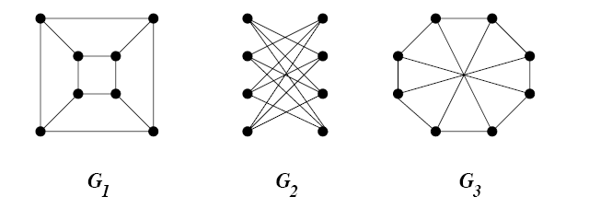
Graphs
Which of these 3 graphs do you think would be easiest to run Dijkstra’s algorithm on?

Slide 8
Graphs
Which of these 3 graphs do you think would be easiest (for the computer) to run Dijkstra’s algorithm on?

Slide 9
Graphs
G₁ and G₂ are the same graph, i.e. they are isomorphic

Slide 10
Graphs
G₁ and G₂ are the same graph, i.e. they are isomorphic
G₃ is not

Slide 11
Graphs
G₁ and G₂ are the same graph, i.e. they are isomorphic
G₃ is not. Can you prove it?

Slide 12
Graphs
Graphs have a sneaky way of appearing different all the time
This isn’t just true of the graph itself, but it can also be true of graph problems that we want to solve

Slide 13
Graphs
Graphs have a sneaky way of appearing different all the time
This isn’t just true of the graph itself, but it can also be true of graph problems that we want to solve
Makes graph theory incredibly interesting, but difficult to discuss

Slide 14
Network Flow
Determine the maximum flow from a source vertex to a sink in a graph

Slide 15
Network Flow
Determine the maximum flow from a source vertex to a sink in a graph
Graph: G(V,E)
Source vertex, s
Sink vertex, t
Each edge’s weight represents the traffic a particular edge can carry (must be non-negative)

Slide 16
Maximum flow
Consider breaking graph into two subgraphs
G(V,E₁) and G(V,E₂) where |E₁| = |E₂|, but their weights are different
For each weight in E, E_{1w}+E_{2w} = E_{w}
The first is the flow graph and the second is the residual graph

Slide 17
Maximum flow
Consider breaking graph into two subgraphs
G(V,E₁) and G(V,E₂) where |E₁| = |E₂|, but their weights are different
For each weight in E, E_{1w}+E_{2w} = E_{w}
The first is the flow graph and the second is the residual graph

Slide 18
Maximum flow
Consider breaking graph into two subgraphs
For the flow graph, except the source and sink, the weights of all edges in must equal the weight of edges out
The residual graph can never have negative weights

Slide 19
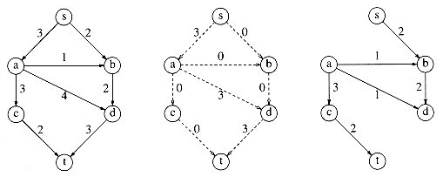
Maximum flow
Graph Flow Residual

Slide 20
Naïve Algorithm
Start where the the residual is the graph and the flow is empty
While there is a path from s to t in the residual
Find the minimum edge weight along the path
For each in the path
Add the minimum weight for each edge in the path to the flow
Subtract the minimum weight for each edge from the residual

Slide 21
Example

Slide 22
Example
What went wrong?

Slide 23
Example
What went wrong?
If we select paths in the wrong order, we might not get the correct solution
This is an example of a greedy-first algorithm
Need to have an opportunity to back-track
Well, let’s add a reversal (augmenting) edge into the residual!

Slide 24
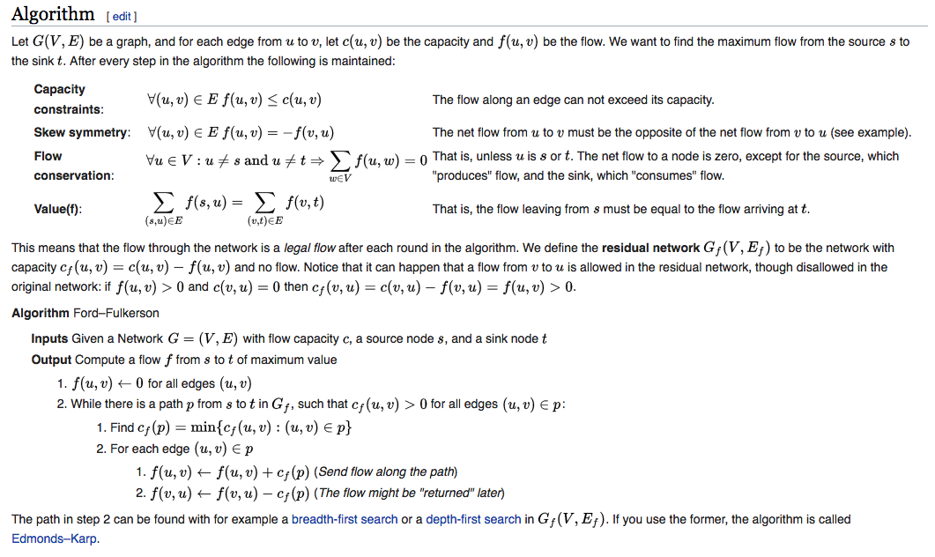
Ford-Fulkerson

Slide 25
Example
Oh boy, that got complicated really quickly
O(|V||E|²)

Slide 26
Example
Oh boy, that got complicated really quickly
O(|V||E|²)
Can we solve this problem a different way?

Slide 27
Example
Oh boy, that got complicated really quickly
O(|V||E|²)
Can we solve this problem a different way?

Slide 28
Mincut

Slide 29
Problem symmetry
Solving max-flow is the same as solving the min-cut
What algorithm do we use to solve the min-cut?

Slide 30
Ford-Fulkerson

Slide 31
Ford-Fulkerson
Bleh. Garbage. Who has the time?

Slide 32
Ford-Fulkerson
Bleh. Garbage. Who has the time?
Can we estimate the min-cut?

Slide 33
Ford-Fulkerson
Bleh. Garbage. Who has the time?
Can we estimate the min-cut?
What might be an easy estimator?

Slide 34
Ford-Fulkerson
Bleh. Garbage. Who has the time?
Can we estimate the min-cut?
What might be an easy estimator?

Slide 35
Karger's algorithm
Bleh. Garbage. Who has the time?
Can we estimate the min-cut?
What might be an easy estimator?
Contract edges at random!
How many edges will you contract to get two subgraphs?

Slide 36
Karger's algorithm
Bleh. Garbage. Who has the time?
Can we estimate the min-cut?
What might be an easy estimator?
Contract edges at random!
How many edges will you contract to get two subgraphs?
Only |V|-2

Slide 37
Karger's algorithm
Does this work?

Slide 38
Karger's algorithm
Does this work?
Success probability of 2/|E|

Slide 39
Karger's algorithm
Does this work?
Success probability of 2/|E|
Run it O(E) times, and you have a bounded success rate!
O(|V||E|)

Slide 40
Reductions
Anytime you can use one algorithm to solve another, this is called a reduction

Slide 41
Reductions
Anytime you can use one algorithm to solve another, this is called a reduction
Suppose we have an unweighted graph, how might we find the max-cut?

Slide 42
Reductions
Anytime you can use one algorithm to solve another, this is called a reduction
Suppose we have an unweighted graph, how might we find the max-cut?
Swap all the edges in the graph and solve the min-cut!

Slide 43
Reductions
Anytime you can use one algorithm to solve another, this is called a reduction
What if we wanted to find the graph of maximum flow that also has minimum weight?

Slide 44
Reductions
Anytime you can use one algorithm to solve another, this is called a reduction
What if we wanted to find the graph of maximum flow that also has minimum weight?
This problem is so difficult, no one has found a way to solve it efficiently

Slide 45
Take aways
We’ll talk about approximation and algorithm design more next week
Graph problems can get very difficult very quickly
Many problems are related
Proving that solving one problem gives a solution to another is called a reduction

