Slide 1
Cse 373
November 20th – Topological sort

Slide 2
Project 3
500 Internal Error problems
Hopefully all resolved (or close to)
P3P1 grades are up (but muted)
Leave canvas comment
Emails tomorrow
End of quarter

Slide 3
Graphs
A graph is composed of two things
A set of vertices
A set of edges (which are ordered vertex tuples)
Trees are types of graphs
Each of the nodes is a vertex
Each pointer from parent to child is an edge
Represented as G(V,E) to indicate that V is the set of vertices and E is the set of edges

Slide 4
Graphs
Graphs are not an ADT
There is no “functions” that a graph supports
Rather, graphs are a theoretical framework for understanding certain types of problems.
Travelling salesman, path finding, resource allocating

Slide 5
Analyzing graphs
In graphs, there are two important variables, |V| and |E|
Our analysis can now have two inputs
Before, our input size was n, now we use |V| and |E|
What is the maximum size of |E|? O(|V|²)
For any vertices a,b, there can exist at most one edge (a,b)
A can equal B (this is a self loop)
There can be (b,a) -- directed

Slide 6
Graphs
Paths and Cycles
A path: a set of edges connecting two vertices where all of the edges are connected and neither edges nor vertices are repeated
A cycle: a path that starts and ends on the same

Slide 7
Graphs
Paths and cycles can not have repeated vertices or edges
A path that can repeat vertices or edges is called a walk
A path that can repeat vertices but not edges is called a trail
A circuit is a trail that starts and ends at the same vertex

Slide 8
Graphs
Graphs can be either directed or undirected
Undirected graph, if (A,B) is in the set of edges, (B,A) must be in the set of edges
Directed graphs, both can be in the set of edges, but those graphs have different connectivity
We call a graph connected if there is a path between every pair of vertices

Slide 9
Graphs
Edges can have weights
This becomes important when we consider path finding algorithms
Usually, we consider the weights to be the some attribute pertaining to the edge
Each edge has exactly one weight

Slide 10
Graphs
When we consider graphs, we determine them to be either dense or sparse
Dense graphs are very connected, each vertex is connected to a fraction of the total vertices
Sparse graphs are less connected and can be more clustered, each vertex is connected to some constant number of vertices

Slide 12
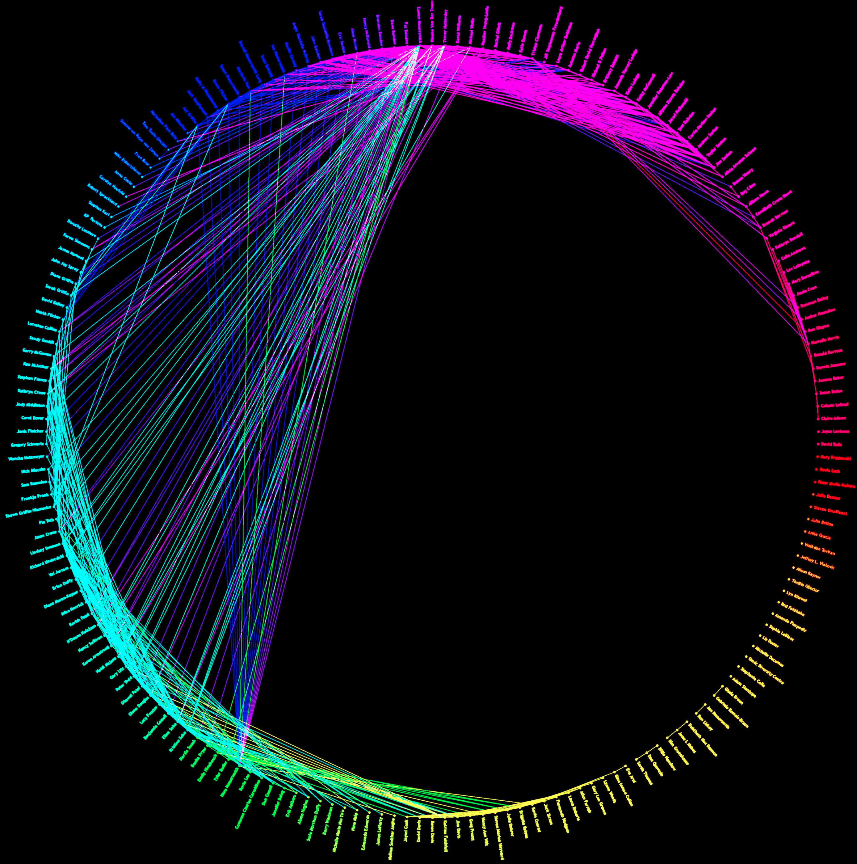

Slide 13
Graphs
When graphs are small, it is difficult to distinguish between the two
If we represent Facebook as a graph, where users are vertices and “friendships” are edges, what can we say about the graph?
Directed?
Connected?
Cyclic?
Sparse/Dense?

Slide 14
Graphs
When graphs are small, it is difficult to distinguish between the two
If we represent Facebook as a graph, where users are vertices and “friendships” are edges, what can we say about the graph?
Directed? No, (A,B) means (B,A)
Connected? Maybe not!
Cyclic? Yes, mutual friends
Sparse/Dense? Sparse! 338 average!

Slide 15
Graphs
This “value” is called the degree of the vertex
If you have 338 friends, then that vertex has degree 338.
In directed graph, we separate this into in-degree and out-degree
Consider Twitter, where friendship isn’t symmetric. The number of followers you have is your in-degree and the number of people you follow is your out degree

Slide 16
Representation
How do we represent graphs on a computer?
Two main approaches

Slide 17
Representation
How do we represent graphs on a computer?
Two main approaches
Adjacency List
Adjacency Matrix

Slide 18
Adjacency List
If (u,v) is an edge, then we say v is adjacent to u.
If we want to store these edges then,
For each vertex, we maintain a list of all edges coming out of that vertex
The number of elements coming out of the vertex is called the out-degree
The number of elements coming into the vertex is the in-degree

Slide 19
Adjacency Matrix
Imagine a two dimensional |V| x |V| matrix.
Let the rows be source vertices, and let the rows be destination vertices
If the edge (u,v) is in the graph, then matrix[u][v] is set to true
Alternatively, we can set matrix[u][v] to be the weight of the edge

Slide 20
Adjacency Matrix
Imagine a two dimensional |V| x |V| matrix.
Let the rows be source vertices, and let the rows be destination vertices
If the edge (u,v) is in the graph, then matrix[u][v] is set to true
Alternatively, we can set matrix[u][v] to be the weight of the edge
What is the memory consumption?
O(|V|²), but it implicitly stores in and out vertices
If the graph is dense, then this is more efficient

Slide 21
Terminology
Know the following terms
Vertices and Edges
Directed v. Undirected
In-degree and out-degree
Connected (Strongly connected)
Weighted v. unweighted
Cyclic v. acyclic
DAG: Directed Acyclic Graph

Slide 22
Traversals
Since graphs are abstractions similar to trees, we can also perform traversals.
If a graph is connected, i.e. there is a path between all pairs of vertices, then a traversal can output all nodes if you do it cleverly

Slide 23
Traversal
E
C
F
A
G
D
B
Depth-first search (prev graph with (D,G) added to make it connected
Traverse the tree with DFS, if there are multiple nodes to choose from, go alphabetically. Start at A.

Slide 24
Traversal
E
C
F
A
G
D
B
Output: A
Current Node: A
Out-vertices: B, D, E

Slide 25
Traversal
E
C
F
A
G
D
B
Output: A,B
Current Node: B
Out-vertices: D

Slide 26
Traversal
E
C
F
A
G
D
B
Output: A,B, D
Current Node: D
Out-vertices: A,G

Slide 27
Traversal
E
C
F
A
G
D
B
Output: A,B, D, A
Current Node: A
Out-vertices: B,D,E

Slide 28
Traversal
E
C
F
A
G
D
B
Output: A,B, D, A Oh, no! We have repeated output!
Current Node: A
Out-vertices: B,D,E

Slide 29
Traversal
Depth first search needs to check which nodes have been output or else it can get stuck in loops.
This increases the runtime and memory constraints of the traversal
In a connected graph, a BFS will print all nodes, but it will repeat if there are cycles and may not terminate

Slide 30
Traversal
As an aside, in-order, pre-order and post-order traversals only make sense in binary trees, so they aren’t important for graphs. However, we do need some way to order our out-vertices (left and right in BST).

Slide 31
Traversals
For an arbitrary graph and starting node v, find all nodes reachable from v.
There exists a path from v
Doing something or “processing” each node
Determines if an undirected graph is connected? If a traversal goes through all vertices, then it is connected
Basic idea
Traverse through the nodes like a tree
Mark the nodes as visited to prevent cycles and from processing the same node twice

Slide 32
Abstract Idea in Pseudocode
void traverseGraph(Node start) {
Set pending = emptySet()
pending.add(start)
mark start as visited
while(pending is not empty) {
next = pending.remove()
for each node u adjacent to next
if (u is not marked visited) {
mark u
pending.add(u)
}
}
}

Slide 33
Runtime and options
Assuming we can add and remove from our “pending” DS in O(1) time, the entire traversal is O(|E|)
Our traversal order depends on what we use for our pending DS.
Stack : DFS
Queue: BFS
These are the main traversal techniques in CS, but there are others!

Slide 34
Comparison
Breadth-first always finds shortest length paths, i.e., “optimal solutions”
Better for “what is the shortest path from x to y”
But depth-first can use less space in finding a path
If longest path in the graph is p and highest out-degree is d then DFS stack never has more than d*p elements
But a queue for BFS may hold O(|V|) nodes
A third approach (useful in Artificial Intelligence)
Iterative deepening (IDFS):
Try DFS but disallow recursion more than K levels deep
If that fails, increment K and start the entire search over
Like BFS, finds shortest paths. Like DFS, less space.

Slide 35
Topological sort

Slide 36
Topological sort
It’s never too late to start your xkcd addiction

Slide 37
Topological sort
Topological ordering
One final ordering for graphs
Ordering with a focus on dependency resolutions
Example, consider a graph where courses are vertices and prerequisites are edges.
A topological ordering is any valid class order

Slide 38
Topological Sort
Problem: Given a DAG G=(V,E), output all vertices in an order such that no vertex appears before another vertex that has an edge to it
Example input:
One example output:
126, 142, 143, 374, 373, 417, 410, 413, XYZ, 415
CSE 374
XYZ
CSE 410
CSE 142
CSE 143
CSE 373
CSE 413
MATH 126
CSE 415
CSE 417

Slide 39
Questions and comments
Why do we perform topological sorts only on DAGs?
Because a cycle means there is no correct answer
Is there always a unique answer?
No, there can be 1 or more answers; depends on the graph
Graph with 5 topological orders:
Do some DAGs have exactly 1 answer?
Yes, including all lists
Terminology: A DAG represents a partial order and a topological sort produces a total order that is consistent with it
2
0
4
3
1

Slide 40
Uses of Topological Sort
Figuring out how to graduate
Computing an order in which to recompute cells in a spreadsheet
Determining an order to compile files using a Makefile
In general, taking a dependency graph and finding an order of execution
…

Slide 41
Topological Sort
Label (“mark”) each vertex with its in-degree
Think “write in a field in the vertex”
Could also do this via a data structure (e.g., array) on the side
While there are vertices not yet output:
Choose a vertex v with labeled with in-degree of 0
Output v and conceptually remove it from the graph
For each vertex u adjacent to v (i.e. u such that (v,u) in E), decrement the in-degree of u

Slide 42
Example
Output:
CSE 374
XYZ
CSE 410
CSE 142
CSE 143
CSE 373
CSE 413
MATH 126
CSE 415
CSE 417
Node: 126 142 143 374 373 410 413 415 417 XYZ
Removed?
In-degree: 0 0 2 1 1 1 1 1 1 3

Slide 43
Example
Output:
126
CSE 374
XYZ
CSE 410
CSE 142
CSE 143
CSE 373
CSE 413
MATH 126
CSE 415
CSE 417
Node: 126 142 143 374 373 410 413 415 417 XYZ
Removed? x
In-degree: 0 0 2 1 1 1 1 1 1 3
1

Slide 44
Example
Output:
126
142
CSE 374
XYZ
CSE 410
CSE 142
CSE 143
CSE 373
CSE 413
MATH 126
CSE 415
CSE 417
Node: 126 142 143 374 373 410 413 415 417 XYZ
Removed? x x
In-degree: 0 0 2 1 1 1 1 1 1 3
1
0

Slide 45
Example
Output:
126
142
143
CSE 374
XYZ
CSE 410
CSE 142
CSE 143
CSE 373
CSE 413
MATH 126
CSE 415
CSE 417
Node: 126 142 143 374 373 410 413 415 417 XYZ
Removed? x x x
In-degree: 0 0 2 1 1 1 1 1 1 3
1 0 0
0

Slide 46
Example
Output:
126
142
143
374
CSE 374
XYZ
CSE 410
CSE 142
CSE 143
CSE 373
CSE 413
MATH 126
CSE 415
CSE 417
Node: 126 142 143 374 373 410 413 415 417 XYZ
Removed? x x x x
In-degree: 0 0 2 1 1 1 1 1 1 3
1 0 0 2
0

Slide 47
Example
Output:
126
142
143
374
373
CSE 374
XYZ
CSE 410
CSE 142
CSE 143
CSE 373
CSE 413
MATH 126
CSE 415
CSE 417
Node: 126 142 143 374 373 410 413 415 417 XYZ
Removed? x x x x x
In-degree: 0 0 2 1 1 1 1 1 1 3
1 0 0 0 0 0 0 2
0

Slide 48
Example
Output:
126
142
143
374
373
417
CSE 374
XYZ
CSE 410
CSE 142
CSE 143
CSE 373
CSE 413
MATH 126
CSE 415
CSE 417
Node: 126 142 143 374 373 410 413 415 417 XYZ
Removed? x x x x x x
In-degree: 0 0 2 1 1 1 1 1 1 3
1 0 0 0 0 0 0 2
0

Slide 49
Example
Output:
126
142
143
374
373
417
410
CSE 374
XYZ
CSE 410
CSE 142
CSE 143
CSE 373
CSE 413
MATH 126
CSE 415
CSE 417
Node: 126 142 143 374 373 410 413 415 417 XYZ
Removed? x x x x x x x
In-degree: 0 0 2 1 1 1 1 1 1 3
1 0 0 0 0 0 0 2
0 1

Slide 50
Example
Output:
126
142
143
374
373
417
410
413
CSE 374
XYZ
CSE 410
CSE 142
CSE 143
CSE 373
CSE 413
MATH 126
CSE 415
CSE 417
Node: 126 142 143 374 373 410 413 415 417 XYZ
Removed? x x x x x x x x
In-degree: 0 0 2 1 1 1 1 1 1 3
1 0 0 0 0 0 0 2
0 1
0

Slide 51
Example
Output:
126
142
143
374
373
417
410
413
XYZ
CSE 374
XYZ
CSE 410
CSE 142
CSE 143
CSE 373
CSE 413
MATH 126
CSE 415
CSE 417
Node: 126 142 143 374 373 410 413 415 417 XYZ
Removed? x x x x x x x x x
In-degree: 0 0 2 1 1 1 1 1 1 3
1 0 0 0 0 0 0 2
0 1
0

Slide 52
Example
Output:
126
142
143
374
373
417
410
413
XYZ
415
CSE 374
XYZ
CSE 410
CSE 142
CSE 143
CSE 373
CSE 413
MATH 126
CSE 415
CSE 417
Node: 126 142 143 374 373 410 413 415 417 XYZ
Removed? x x x x x x x x x x
In-degree: 0 0 2 1 1 1 1 1 1 3
1 0 0 0 0 0 0 2
0 1
0

Slide 53
Notice
Needed a vertex with in-degree 0 to start
Will always have at least 1 because no cycles
Ties among vertices with in-degrees of 0 can be broken arbitrarily
Can be more than one correct answer, by definition, depending on the graph

Slide 54
Implementation
The trick is to avoid searching for a zero-degree node every time!
Keep the “pending” zero-degree nodes in a list, stack, queue, bag, table, or something
Order we process them affects output but not correctness or efficiency provided add/remove are both O(1)
Using a queue:
Label each vertex with its in-degree, enqueue 0-degree nodes
While queue is not empty
v = dequeue()
Output v and remove it from the graph
For each vertex u adjacent to v (i.e. u such that (v,u) in E), decrement the in-degree of u, if new degree is 0, enqueue it

Slide 55
Traversal
E
C
F
A
G
D
B
Start with the nodes that have in-degree 0 (no prereqs)
Then eliminate that vertex (print it out) and eliminate its out edges.

Slide 56
Traversal
E
C
F
A
G
D
B
What is a valid topological sort of this graph?

Slide 57
Traversal
E
C
F
A
G
D
B
What is a valid topological sort of this graph?
F,C,G,D,A,E,B F,G,D,C,A,E,B
F,G,C,D,A,E,B Are these all the valid solutions?

Slide 58
Topological sort
What use does this traversal have?

Slide 59
Topological sort
What use does this traversal have?
Good for dependency resolution

Slide 60
Topological sort
What use does this traversal have?
Good for dependency resolution
Can also be used for cycle detection

Slide 61
Topological sort
What use does this traversal have?
Good for dependency resolution
Can also be used for cycle detection
How could we find cycles in an undirected graph?

Slide 62
Topological sort
What use does this traversal have?
Good for dependency resolution
Can also be used for cycle detection
How could we find cycles in an undirected graph?
Any traversal that visits a node more than once has a cycle.

Slide 63
Graph problems
When thinking about graphs, it is important to understand what the graph represents

Slide 64
Graph problems
When thinking about graphs, it is important to understand what the graph represents
Topological sort:

Slide 65
Graph problems
When thinking about graphs, it is important to understand what the graph represents
Topological sort:
Programs and dependencies
Courses and prereqs

Slide 66
Graph problems
When thinking about graphs, it is important to understand what the graph represents
Topological sort:
Programs and dependencies
Courses and prereqs
What the vertices and edges are impact what the “solution” is

Slide 68
Graph problems
What type of problem could we want to solve with a graph of US cities and the freeway distance between them

Slide 69
Graph problems
What type of problem could we want to solve with a graph of US cities and the freeway distance between them
Same as a lot of network problems

Slide 70
Graph problems
What type of problem could we want to solve with a graph of US cities and the freeway distance between them
Same as a lot of network problems
“Traffic” networks

Slide 71
Graph problems
What type of problem could we want to solve with a graph of US cities and the freeway distance between them
Same as a lot of network problems
“Traffic” networks
What do our edges represent?

Slide 72
Single source shortest path
Given an undirected, unweighted graph G(V,E) and a start vertex A, find the shortest path to all connected vertices

Slide 73
Single source shortest path
Given an undirected, unweighted graph G(V,E) and a start vertex A, find the shortest path to all connected vertices
If a graph is unweighted you can treat all of their weights as 1

Slide 74
Single source shortest path
Given an undirected, unweighted graph G(V,E) and a start vertex A, find the shortest path to all connected vertices
If a graph is unweighted you can treat all of their weights as 1
Do a BFS traversal of the tree and keep track of paths!

Slide 75
Single source shortest path
Given an undirected, unweighted graph G(V,E) and a start vertex A, find the shortest path to all connected vertices
If a graph is unweighted you can treat all of their weights as 1
Do a BFS traversal of the tree and keep track of paths!
Path-keeping is non-trivial, we’ll talk about it on Wednesday

Slide 76
Single source shortest path
Given an undirected, unweighted graph G(V,E) and a start vertex A, find the shortest path to all connected vertices
If a graph is unweighted you can treat all of their weights as 1
Do a BFS traversal of the tree and keep track of paths!
Path-keeping is non-trivial, we’ll talk about it on Wednesday
What if the graph has weights?

Slide 77
Path-finding
10
5
100
100
100
100
A
B
-11
7
500
Why BFS won’t work: Shortest path may not have the fewest edges
Annoying when this happens with costs of flights
We will assume there are no negative weights
Problem is ill-defined if there are negative-cost cycles
Wednesday’s algorithm is wrong if edges can be negative
There are other, slower (but not terrible) algorithms

Slide 78
Next class
Dijkstra’s algorithm

Slide 79
Next class
Dijkstra’s algorithm
P3 checkpoint 2

