Slide 1
Cse 373
November 15th – Non-Comparison Sorts

Slide 2
Assorted minutiae
P3 part 1 due 11:30

Slide 3
Assorted minutiae
P3 part 1 due 11:30
Make sure partners names are in code and on canvas for submissions
50% awarded back on part 2 submissions next Wednesday
EC added, due with part 3

Slide 4
Assorted minutiae
P3 part 1 due 11:30
Make sure partners names are in code and on canvas for submissions
50% awarded back on part 2 submissions next Wednesday
EC added, due with part 3
Last Written Assignment
Out Nov 29, Due December 6 No late days
Extra credit opportunity

Slide 5
Assorted minutiae
Unless you’ve talked with me and set up a meeting, midterm grades are final

Slide 6
Assorted minutiae
Unless you’ve talked with me and set up a meeting, midterm grades are final
25% for lower exam score
35% for higher exam score

Slide 7
Assorted minutiae
Unless you’ve talked with me and set up a meeting, midterm grades are final
25% for lower exam score
35% for higher exam score
Final Exam
December 12th, 2:30 – 4:20
Twice the time, more critical thought

Slide 8
Recap from Monday
Partitioning and Merging
N log N – Lower bound for comparison sorts
Cutoffs
Section07 solutions are posted and show how to show work

Slide 9
Counting Comparisons
No matter what the algorithm is, it cannot make progress without doing comparisons
Intuition: Each comparison can at best eliminate half the remaining possibilities of possible orderings
Can represent this process as a decision tree
Nodes contain “set of remaining possibilities”
Edges are “answers from a comparison”
The algorithm does not actually build the tree; it’s what our proof uses to represent “the most the algorithm could know so far” as the algorithm progresses

Slide 10
Decision Tree for n = 3
a < b < c, b < c < a,
a < c < b, c < a < b,
b < a < c, c < b < a
a < b < c
a < c < b
c < a < b
a < b
a > b
b < a < c
b < c < a
c < b < a
a < c
a > c
b < c
b > c
a < b < c
a < c < b
c < a < b
b < a < c
b < c < a
c < b < a
b < c
b > c
c < a
c > a
a < b < c
a < c < b
b < c < a
b < a < c
The leaves contain all the possible orderings of a, b, c

Slide 11
Example if a < c < b
possible orders
a < b < c, b < c < a,
a < c < b, c < a < b,
b < a < c, c < b < a
a < b < c
a < c < b
c < a < b
a < b
a > b
b < a < c
b < c < a
c < b < a
a < c
a > c
b < c
b > c
a < b < c
a < c < b
c < a < b
b < a < c
b < c < a
c < b < a
b < c
b > c
c < a
c > a
a < b < c
a < c < b
b < c < a
b < a < c
actual order

Slide 12
Decision Tree
A binary tree because each comparison has 2 outcomes (we’re comparing 2 elements at a time)
Because any data is possible, any algorithm needs to ask enough questions to produce all orderings.
The facts we can get from that:
Each ordering is a different leaf (only one is correct)
Running any algorithm on any input will at best correspond to a root-to-leaf path in some decision tree. Worst number of comparisons is the longest path from root-to-leaf in the decision tree for input size n
There is no worst-case running time better than the height of a tree with <num possible orderings> leaves

Slide 13
possible orderings
Assume we have n elements to sort. How many permutations of the elements (possible orderings)?
For simplicity, assume none are equal (no duplicates)
Example, n=3
a[0]<a[1]<a[2] a[0]<a[2]<a[1] a[1]<a[0]<a[2]
a[1]<a[2]<a[0] a[2]<a[0]<a[1] a[2]<a[1]<a[0]
In general, n choices for least element, n-1 for next, n-2 for next, …
n(n-1)(n-2)…(2)(1) = n! possible orderings
That means with n! possible leaves, best height for tree is log(n!), given that best case tree splits leaves in half at each branch

Slide 14
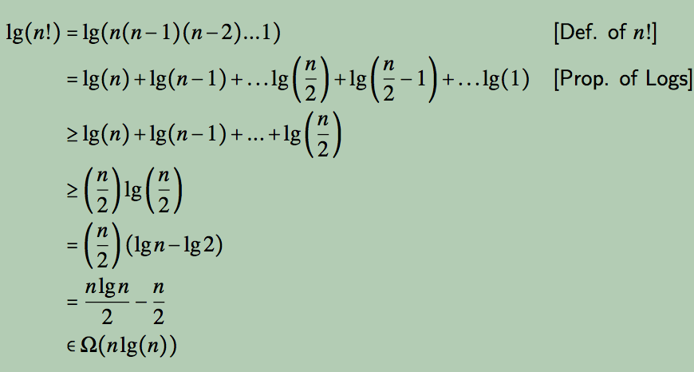
runtime
That proves runtime is at least Ω(log (n!)). Can we write that more clearly?
Nice! Any sorting algorithm must do at best (1/2)*(nlog n – n) comparisons: Ω(nlog n)

Slide 15
Sorting
“Slow” sorts

Slide 16
Sorting
“Slow” sorts
Insertion
Selection

Slide 17
Sorting
“Slow” sorts
Insertion
Selection
“Fast” sorts

Slide 18
Sorting
“Slow” sorts
Insertion
Selection
“Fast” sorts
Quick
Merge
Heap

Slide 19
Sorting
“Slow” sorts
Insertion
Selection
“Fast” sorts
Quick
Merge
Heap
These are all comparison sorts, can’t do better than O(n log n)

Slide 20
Sorting
Non-comparison sorts

Slide 21
Sorting
Non-comparison sorts
If we know something about the data, we don’t strictly need to compare objects to each other

Slide 22
Sorting
Non-comparison sorts
If we know something about the data, we don’t strictly need to compare objects to each other
If there are only a few possible values and we know what they are, we can just sort by identifying the value

Slide 23
Sorting
Non-comparison sorts
If we know something about the data, we don’t strictly need to compare objects to each other
If there are only a few possible values and we know what they are, we can just sort by identifying the value
If the data are strings and ints of finite length, then we can take advantage of their sorted order.

Slide 24
Sorting
Two sorting techniques we use to this end

Slide 25
Sorting
Two sorting techniques we use to this end
Bucket sort

Slide 26
Sorting
Two sorting techniques we use to this end
Bucket sort
Radix sort

Slide 27
Sorting
Two sorting techniques we use to this end
Bucket sort
Radix sort
If the data is sufficiently structured, we can get O(n) runtimes

Slide 28
BucketSort
If all values to be sorted are known to be integers between 1 and K (or any small range):
Create an array of size K
Put each element in its proper bucket (a.k.a. bin)
If data is only integers, no need to store more than a count of how times that bucket has been used
Output result via linear pass through array of buckets
count array
1 | 3
2 | 1
3 | 2
4 | 2
5 | 3
Example:
K=5
input (5,1,3,4,3,2,1,1,5,4,5)
output: 1,1,1,2,3,3,4,4,5,5,5

Slide 29
Analyzing Bucket Sort
Overall: O(n+K)
Linear in n, but also linear in K
Good when K is smaller (or not much larger) than n
We don’t spend time doing comparisons of duplicates
Bad when K is much larger than n
Wasted space; wasted time during linear O(K) pass
For data in addition to integer keys, use list at each bucket

Slide 30
Bucket Sort
Most real lists aren’t just keys; we have data
Each bucket is a list (say, linked list)
To add to a bucket, insert in O(1) (at beginning, or keep pointer to last element)
Example: Movie ratings; scale 1-5
Input:
5: Casablanca
3: Harry Potter movies
5: Star Wars Original Trilogy
1: Rocky V
count array
1
2
3
4
5
Rocky V
Harry Potter
Casablanca
Star Wars
Result: 1: Rocky V, 3: Harry Potter, 5: Casablanca, 5: Star Wars
Easy to keep ‘stable’; Casablanca still before Star Wars

Slide 31
Radix sort
Radix = “the base of a number system”
Examples will use base 10 because we are used to that
In implementations use larger numbers
For example, for ASCII strings, might use 128
Idea:
Bucket sort on one digit at a time
Number of buckets = radix
Starting with least significant digit
Keeping sort stable
Do one pass per digit
Invariant: After k passes (digits), the last k digits are sorted

Slide 32
Radix Sort Example
Radix = 10
Input: 478, 537, 9, 721, 3, 38, 143, 67
3 passes (input is 3 digits at max), on each pass, stable sort the input highlighted in yellow
4 7 8
5 3 7
0 0 9
7 2 1
0 0 3
0 3 8
1 4 3
0 6 7
7 2 1
0 0 3
1 4 3
5 3 7
0 6 7
4 7 8
0 3 8
0 0 9
0 0 3
0 0 9
7 2 1
5 3 7
0 3 8
1 4 3
0 6 7
4 7 8
0 0 3
0 0 9
0 3 8
0 6 7
1 4 3
4 7 8
5 3 7
7 2 1

Slide 33
Analysis
Input size: n
Number of buckets = Radix: B
Number of passes = “Digits”: P
Work per pass is 1 bucket sort: O(B+n)
Total work is O(P(B+n))
Compared to comparison sorts, sometimes a win, but often not
Example: Strings of English letters up to length 15
Run-time proportional to: 15*(52 + n)
This is less than n log n only if n > 33,000
Of course, cross-over point depends on constant factors of the implementations

Slide 34
Sorting Takeaways
Simple O(n²) sorts can be fastest for small n
Selection sort, Insertion sort (latter linear for mostly-sorted)
Good for “below a cut-off” to help divide-and-conquer sorts

Slide 35
Sorting Takeaways
Simple O(n²) sorts can be fastest for small n
Selection sort, Insertion sort (latter linear for mostly-sorted)
Good for “below a cut-off” to help divide-and-conquer sorts
O(n log n) sorts
Heap sort, in-place but not stable nor parallelizable
Merge sort, not in place but stable and works as external sort
Quick sort, in place but not stable and O(n²) in worst-case
Often fastest, but depends on costs of comparisons/copies

Slide 36
Sorting Takeaways
Simple O(n²) sorts can be fastest for small n
Selection sort, Insertion sort (latter linear for mostly-sorted)
Good for “below a cut-off” to help divide-and-conquer sorts
O(n log n) sorts
Heap sort, in-place but not stable nor parallelizable
Merge sort, not in place but stable and works as external sort
Quick sort, in place but not stable and O(n²) in worst-case
Often fastest, but depends on costs of comparisons/copies
Ω (n log n) is worst-case and average lower-bound for sorting by comparisons

Slide 37
Sorting Takeaways
Simple O(n²) sorts can be fastest for small n
Selection sort, Insertion sort (latter linear for mostly-sorted)
Good for “below a cut-off” to help divide-and-conquer sorts
O(n log n) sorts
Heap sort, in-place but not stable nor parallelizable
Merge sort, not in place but stable and works as external sort
Quick sort, in place but not stable and O(n²) in worst-case
Often fastest, but depends on costs of comparisons/copies
Ω (n log n) is worst-case and average lower-bound for sorting by comparisons
Non-comparison sorts
Bucket sort good for small number of possible key values
Radix sort uses fewer buckets and more phases
Best way to sort? It depends!

Slide 38
Sorting Takeaways
Simple O(n²) sorts can be fastest for small n
Selection sort, Insertion sort (latter linear for mostly-sorted)
Good for “below a cut-off” to help divide-and-conquer sorts
O(n log n) sorts
Heap sort, in-place but not stable nor parallelizable
Merge sort, not in place but stable and works as external sort
Quick sort, in place but not stable and O(n²) in worst-case
Often fastest, but depends on costs of comparisons/copies
Ω (n log n) is worst-case and average lower-bound for sorting by comparisons
Non-comparison sorts
Bucket sort good for small number of possible key values
Radix sort uses fewer buckets and more phases
Best way to sort? It depends!

