Slide 1
CSE373: Data Structures & Algorithms Lecture 23: Applications
Linda Shapiro
Spring 2016

Slide 2
Announcements
HW5 due June 1
Final June 7
Practice exam questions June 1 and 3

Slide 3
Other Data Structures and Algorithms
Quadtrees: used in spatial applications like geography and image processing
Octrees: used in vision and graphics
Image pyramids: used in image processing and computer vision
Backtracking search: used in AI and vision
Graph matching: used in AI and vision
Neural nets and deep learning

Slide 4
Quadtrees
Finkel and Bentley, 1974
Lots of work by Hanan Samet, including a book
Raster structure: divides space, not objects
Form of block coding: compact storage of a large 2-dimensional array
Vector versions exist too

Slide 5
Quadtrees, the idea
NW
NE
SW
SE
NW
NE
SW
SE
1, 4, 16, 64, 256 nodes

Slide 6
Quadtrees, the idea
NW
NE
Choropleth raster map
SW
SE
NW
NE
SW
SE

Slide 7
Quadtrees
Grid with 2^{k} times 2^{k} pixels
Depth is k +1
Internal nodes always have 4 children
Internal nodes represent a non-homogeneous region
Leaves represent a homogeneous region and store the common value (or name)

Slide 8
Quadtree complexity theorem
A subdivision with boundary length r pixels in a grid of 2^{k} times 2^{k} gives a quadtree with O(k ⋅ r) nodes.
Idea: two adjacent, different pixels “cost” at most 2 paths in the quadtree.

Slide 9
Overlay with quadtrees
Water
Acid rain with
PH below 4.5

Slide 10
Result of overlay

Slide 11
Various queries
Point location: trivial
Windowing: descend into subtree(s) that intersect query window
Traversal boundary polygon: up and down in the quadtree

Slide 12
Octrees
Like quadtrees, but for 3D applications.
Breaks 3D space into octants
Useful in graphics for representing 3D objects at different resolutions

Slide 15
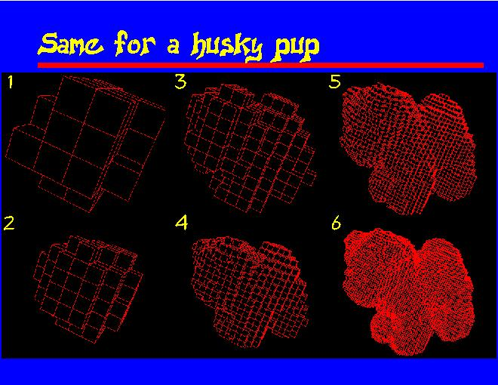

Slide 18
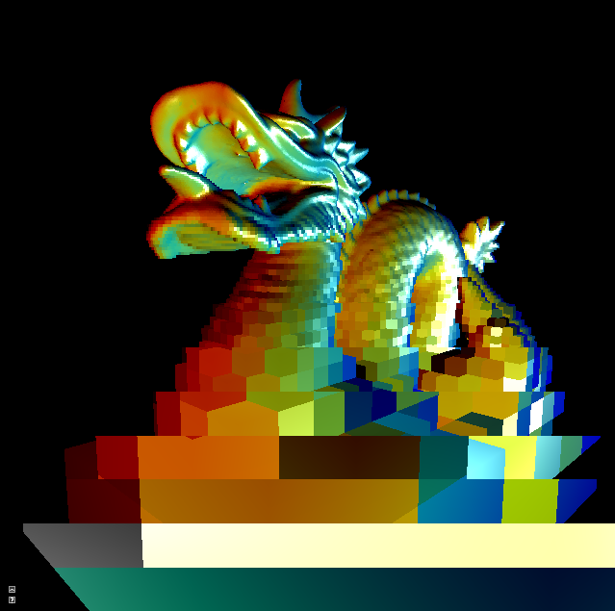
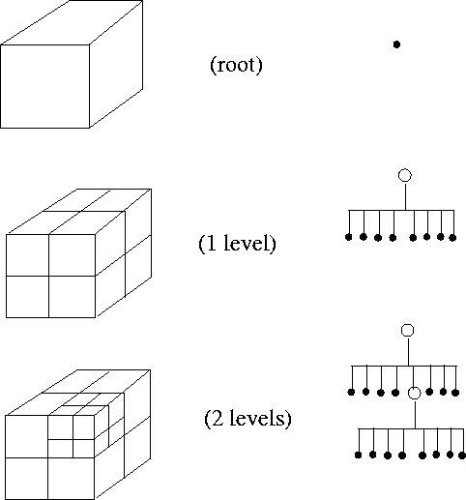

Slide 19
Image Pyramids
And so on.
3rd level is derived from the
2nd level according to the same
funtion
2nd level is derived from the
original image according to
some function
Bottom level is the original image.

Slide 20
Mean Pyramid
And so on.
At 3rd level, each pixel is the mean
of 4 pixels in the 2nd level.
At 2nd level, each pixel is the mean
of 4 pixels in the original image.
mean
Bottom level is the original image.

Slide 21
Gaussian Pyramid At each level, image is smoothed and reduced in size.
And so on.
At 2nd level, each pixel is the result
of applying a Gaussian mask to
the first level and then subsampling
to reduce the size.
Apply Gaussian filter
Bottom level is the original image.

Slide 22
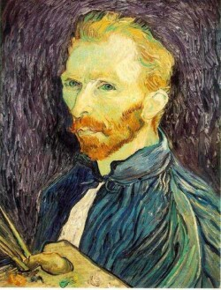
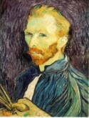
Example: Subsampling with Gaussian pre-filtering
G 1/8
G 1/4
Gaussian 1/2

Slide 23
Backtracking Search in AI/Vision
Start at the root of a search tree at a “state”
Generate children of that state
For each child
If the child is the goal, done
If the child does not satisfy the constraints of the problem, ignore it and keep going in this loop
Else call the search recursively for this child
Return
This is called backtracking, because if it goes through all children of
a node and finds no solution, it returns to the parent and continues
with the children of that parent.

Slide 24
Formal State-Space Model
Problem = (S, s, A, f, g, c)
S = state space
s = initial state
A = set of actions
f = state change function
g = goal test function
c = cost function
a
c(a)
x
y

Slide 25
3 Coins Problem A Very Small State Space Problem
There are 3 (distinct) coins: coin1, coin2, coin3.
The initial state is H H T
The legal operations are to turn over exactly one coin.
1 (flip coin1), 2 (flip coin2), 3 (flip coin3)
There are two goal states: H H H
T T T

Slide 26
State-Space Graph
1
HHT
THT
3
2
3
THH
HTT
2
1
1
3
2
HHH
TTT
3
2
TTH
HTH
1
What are some solutions?

Slide 27
Partial Search Tree
HHT
1
3
2
THT
HTT
HHH
1
3
3
2
1
2
HHT
TTT
THH
TTT
HHT
HTH
X
X

Slide 28
The 8-Puzzle Problem
one
initial
state
1 2 3
8 B 4
7 6 5
B 1 2
3 4 5
6 7 8
goal
state
B=blank
What data structure easily represents a state?
How many possible states are there?
3. What is the complexity of the search?

Slide 29
Search Tree Example: Fragment of 8-Puzzle Problem Space

Slide 30
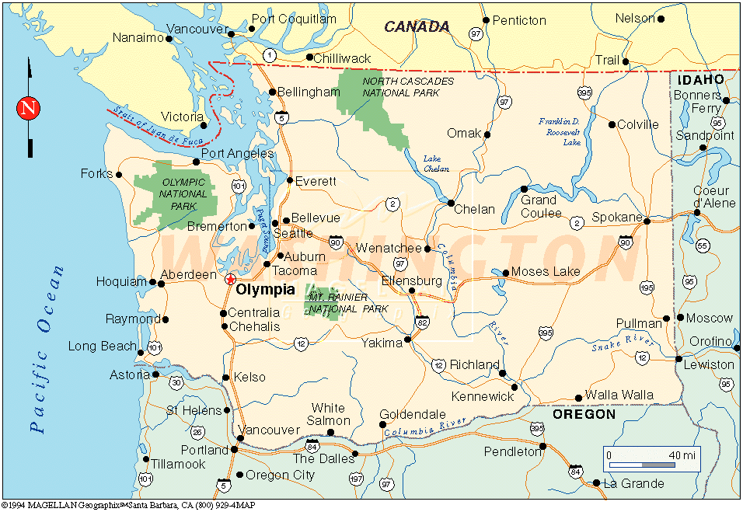
Example: Route Planning Find the shortest route from the starting city to the goal city given roads and distances.
Input:
Set of states
Operators [and costs]
Start state
Goal state (test)
Output:
The travelling salesman problem (TSP)
asks the following question:
Given a list of cities and the distances
between each pair of cities, what is the
shortest possible route that visits each
city exactly once and returns to the
origin city?
Notes:
States = cities
Start state = starting city
Goal state test = is state the destination city?
Operators = move to an adjacent city; cost = distance
Output: a shortest path from start state to goal state
SUPPOSE WE REVERSE START AND GOAL STATES?

Slide 31
Search in AI
Search in Data Structures
You’re given an existent tree.
You search it in different orders.
It resides in memory.
Search in Artificial Intelligence
The tree does not exist.
You have to generate it as you go.
For realistic problems, it does not fit in memory.

Slide 32
Search Strategies (Ch 3)
Uninformed Search
The search is blind, only the order of search is important.
Informed Search
The search uses a heuristic function to estimate the goodness of each state.

Slide 33
Depth-First Search by Recursion*
Search is a recursive procedure that is called with the start node and has arg s.
It checks first if s is the goal.
It also checks if s is illegal or too deep.
If neither, it generates the list L of successors of its argument s.
It iterates through list L, calling itself recursively for each state in L.

Slide 34
Depth-First Search by Recursion
start state (root)
successor
list of root
successor
list of
first successor
of root

Slide 35
Missionaries and Cannibals Problem
Left Bank Right Bank
River

Slide 36
Missionary and Cannibals Notes
Define your state as (M,C,S)
M: number of missionaries on left bank
C: number of cannibals on left bank
S: side of the river that the boat is on
When the boat is moving, we are in between states. When it arrives, everyone gets out.
(3,3,L) → (3,1,R)
What action did I apply?

Slide 37
What are all the actions?
Left to right
MCR
MMR
?
?
?
Right to left
MCL
MML
?
?
?

Slide 38
When is a state considered “DEAD”?
There are more cannibals than missionaries on the left bank. (Bunga-Bunga)
There are more cannibals than missionaries on the right bank. (Bunga-Bunga)
There is an ancestor state of this state that is exactly the same as this state. (Why?)

Slide 39
Same Ancestor State
Stack
(3,3,L)
(3,1,R)
(3,3,L)
(3,1,R)
(3,3,L)
X

Slide 40
Graph Matching
Input: 2 digraphs G1 = (V1,E1), G2 = (V2,E2)
Questions to ask:
Are G1 and G2 isomorphic?
Is G1 isomorphic to a subgraph of G2?
How similar is G1 to G2?
How similar is G1 to the most similar
subgraph of G2?

Slide 41
Isomorphism for Digraphs
G1 is isomorphic to G2 if there is a 1-1, onto
mapping h: V1 → V2 such that ( vi,vj ) ∈ E1 iff ( h(vi), h(vj) ) ∈ E2.
G1 G2
1
2
a
b
3
c
4
5
d
e
Find an isomorphism h: {1,2,3,4,5} → {a,b,c,d,e}.
Check that the condition holds for every edge.
Answer: h(1)=b, h(2)=e, h(3)=c, h(4)=a, h(5)=d

Slide 42
Isomorphism for Digraphs
G1 is isomorphic to G2 if there is a 1-1, onto
mapping h: V1 → V2 such that ( vi,vj ) ∈ E1 iff ( h(vi), h(vj) ) ∈ E2
G1 G2
1
2
a
b
3
c
4
5
d
e
Answer: h(1)=b, h(2)=e, h(3)=c, h(4)=a, h(5)=d
(1,2) ∈ E1 and (h(1),h(2))=(b,e) ∈ E2.
(2,1) ∈ E1 and (e,b) ∈ E2.
(2,5) ∈ E1 and (e,d) ∈ E2.
(3,1) ∈ E1 and (c,b) ∈ E2.
(3,2) ∈ E1 and (c,e) ∈ E2.
...

Slide 43
Isomorphism for Digraphs
G1 is isomorphic to G2 if there is a 1-1, onto
mapping h: V1 → V2 such that ( vi,vj ) ∈ E1 iff ( h(vi), h(vj) ) ∈ E2
G1 G2
1
2
a
b
3
c
4
5
d
e
Answer: h(1)=b, h(2)=e, h(3)=c, h(4)=a, h(5)=d
(1,2) ∈ E1 and (h(1),h(2))=(b,e) ∈ E2.
(2,1) ∈ E1 and (e,b) ∈ E2.
(2,5) ∈ E1 and (e,d) ∈ E2.
(3,1) ∈ E1 and (c,b) ∈ E2.
(3,2) ∈ E1 and (c,e) ∈ E2.
...

Slide 44
Subgraph Isomorphism for Digraphs
G1 is isomorphic to a subgraph of G2 if there
is a 1-1 mapping h: V1 → V2 such that ( vi,vj ) ∈ E1 ⇒ ( h(vi), h(vj) ) ∈ E2.
G1 G2
1
2
a
b
3
c
d
Isomorphism and subgraph isomorphism
are defined similarly for undirected graphs.
In this case, when (vi,vj) ∈ E1, either
(vi,vj) or (vj,vi) can be listed in E2, since
they are equivalent and both mean {vi,vj}.

Slide 45
Subgraph Isomorphism for Digraphs
G1 is isomorphic to a subgraph of G2 if there
is a 1-1 mapping h: V1 → V2 such that ( vi,vj ) ∈ E1 ⇒ ( h(vi), h(vj) ) ∈ E2.
G1 G2
1
2
a
b
3
c
d
Isomorphism and subgraph isomorphism
are defined similarly for undirected graphs.
In this case, when (vi,vj) ∈ E1, either
(vi,vj) or (vj,vi) can be listed in E2, since
they are equivalent and both mean {vi,vj}.
(1.2) (c,d)
(1,3) (c,b)
(2,3) (d,b)

Slide 46
Subgraph Isomorphism for Graphs
G1 is isomorphic to a subgraph of G2 if there
is a 1-1 mapping h: V1 → V2 such that {vi,vj } ∈ E1 ⇒ { h(vi), h(vj) } ∈ E2.
G1 G2
1
2
a
b
3
c
d
Because there are no directed edges, there are more possible mappings.
2 3
c b d
c d b (shown on graph)
b c d
b d c
d b c
d c b

Slide 47
Graph Matching Algorithms:
Subgraph Isomorphism for Digraph
Given model graph M = (VM,EM)
data graph D = (VD,ED)
Find 1-1 mapping h:VM → VD
satisfying (vi,vj) ∈ EM ⇒ ((h(vi),h(vj)) ∈ ED.

Slide 48
Method: Recursive Backtracking Tree Search
(Order is depth first, leftmost child first.)
M
D
1
2
a
b
c
3
e
d
(1,2) ∈ M, but (a,b) ∈ D
root
1,a
1,b
1,c
1,d
1,e
. . .
. . .
. . .
2,b
2,c
. . .
2,a
2,c
X
X
3,c
3,d
3,e
3,a
3,d
X
X
X
X
YES!

Slide 49
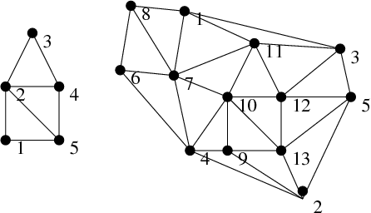
Application to Computer Vision
Find the house model in the image graph.

Slide 50
More Examples

Slide 51
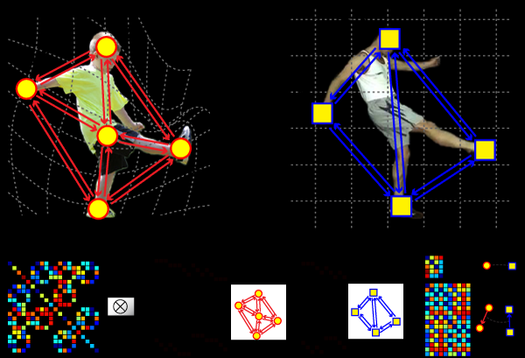

Slide 52
RIO: Relational Indexing for Object Recognition
RIO worked with industrial parts that could have
- planar surfaces
- cylindrical surfaces
- threads

Slide 53
Object Representation in RIO
3D objects are represented by a 3D mesh and set of
2D view classes.
Each view class is represented by an attributed graph
whose nodes are features and whose attributed
edges are relationships.
Graph matching is done through an indexing method.

Slide 54
RIO Features
ellipses coaxials coaxials-multi
parallel lines junctions triples
close and far L V Y Z U

Slide 55
RIO Relationships
share one arc
share one line
share two lines
coaxial
close at extremal points
bounding box encloses / enclosed by

Slide 56
Graph Representation
1 coaxials-
multi
encloses
This is just a piece of
the whole graph.
encloses
2 ellipse
encloses
3 parallel
lines
coaxial

Slide 57
Relational Indexing for Recognition
Preprocessing (off-line) Phase
for each model view M_{i} in the database
encode each 2-graph of M_{i} to produce an index
store M_{i} and associated information in the indexed
bin of a hash table H

Slide 58
Matching (on-line) phase
Construct a relational (2-graph) description D for the scene
For each 2-graph G of D
Select the M_{i}s with high votes as possible hypotheses
Verify or disprove via alignment, using the 3D meshes
encode it, producing an index to access the hash table H
cast a vote for each M_{i} in the associated bin

Slide 59
The Voting Process
hash table
two related
features
from an
image
array of
accumulators
to vote for
models

Slide 60
Verification
The matched features of the hypothesized object are
used to determine its pose. Pose is computed from
correspondences between 2D and 3D points, lines,
and circles.
2. The 3D mesh of the object is used to project all its
features onto the image using perspective projection
and hidden feature removal.
3. A verification procedure checks how well the object
features line up with edges on the image.

Slide 61
Feature Extraction

Slide 62
Some Test Scenes

Slide 63
Sample Alignments 3D to 2D Perspective Projection

Slide 64
RIO Verifications
incorrect
hypothesis

Slide 65
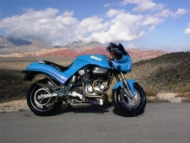
Fergus Object Recognition by Parts:
Enable Computers to Recognize Different Categories of Objects in Images.

Slide 66
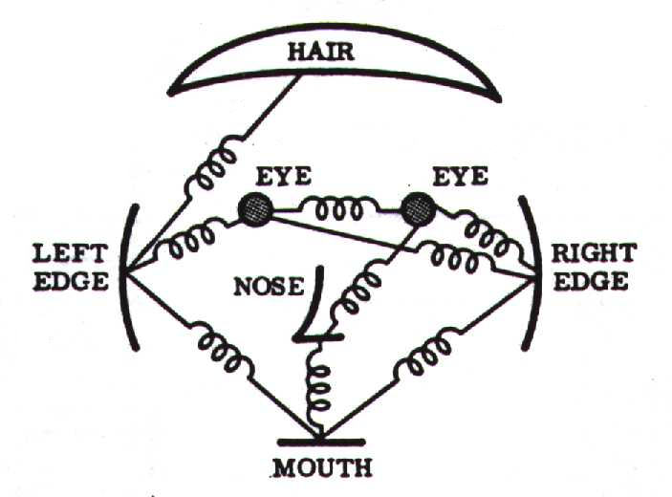
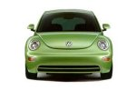
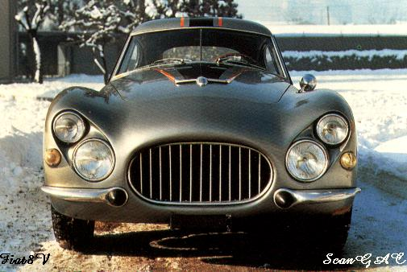
Model: Constellation Of Parts
Fischler & Elschlager, 1973

Slide 67
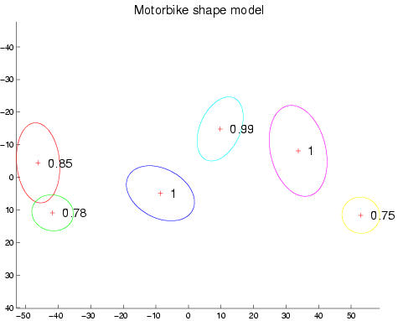
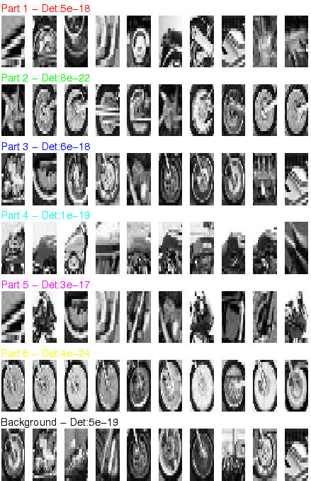
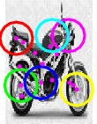
Motorbikes

Slide 68
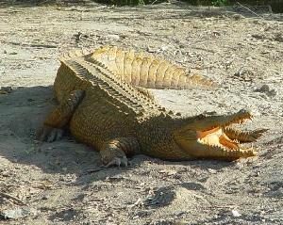
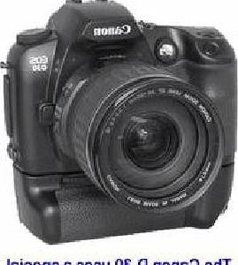
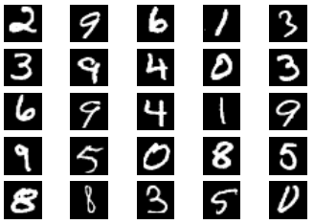
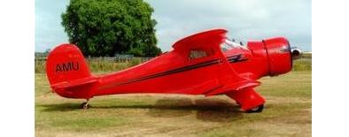
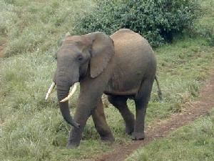
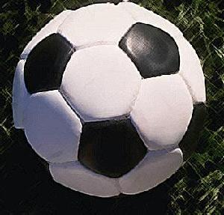
Image classification
$K$ classes
Task: assign correct class label to the whole image
Digit classification (MNIST)
Object recognition (Caltech-101)

Slide 69
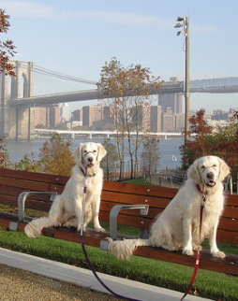
Classification vs. Detection
Dog
Dog
Dog

Slide 70
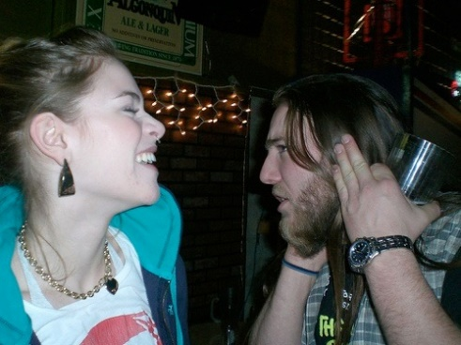
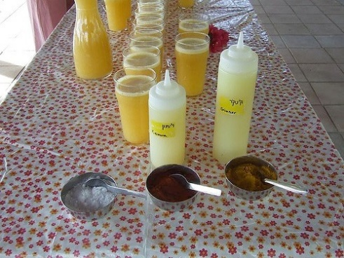
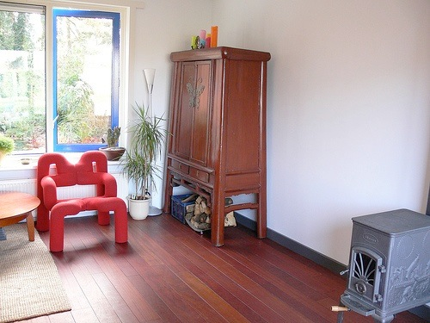
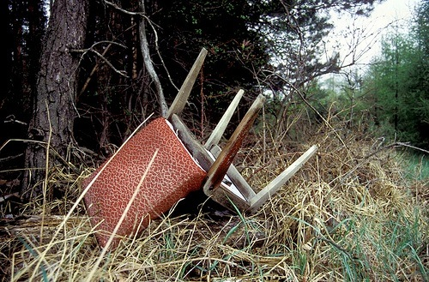
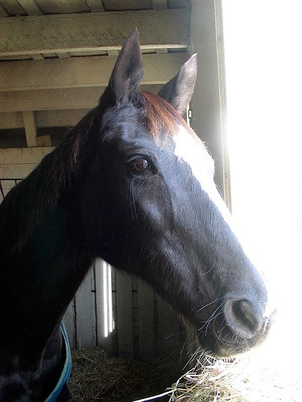
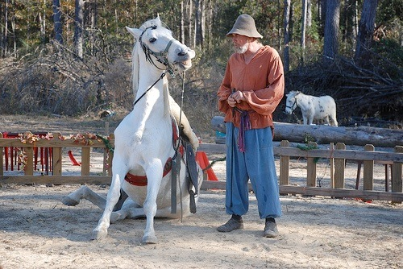
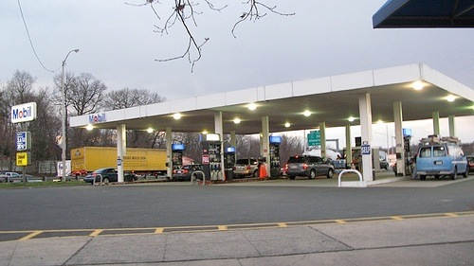
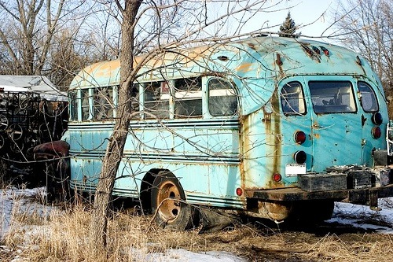
Generic categories
Can we detect people, chairs, horses, cars, dogs, buses, bottles, sheep …?
PASCAL Visual Object Categories (VOC) dataset

Slide 71
Quiz time

Slide 72
Warm up
This is an average image of which object class?

Slide 73
Warm up
pedestrian

Slide 74
A little harder
?

Slide 75
A little harder
?
Hint: airplane, bicycle, bus, car, cat, chair, cow, dog, dining table

Slide 76
A little harder
bicycle (PASCAL)

Slide 77
A little harder, yet
?

Slide 78
A little harder, yet
?
Hint: white blob on a green background

Slide 79
A little harder, yet
sheep (PASCAL)

Slide 80
Impossible?
?

Slide 81
Impossible?
dog (PASCAL)

Slide 82
Impossible?
dog (PASCAL)
Why does the mean look like this?
There’s no alignment between the examples!
How do we combat this?

Slide 83
PASCAL VOC detection history
41%
41%
37%
DPM++,
MKL,
Selective
Search
Selective
Search,
DPM++,
MKL
28%
DPM++
23%
DPM,
MKL
17%
DPM,
HOG+
BOW
DPM

Slide 84
Part-based models & multiple features (MKL)
41%
41%
37%
rapid performance improvements
DPM++,
MKL,
Selective
Search
Selective
Search,
DPM++,
MKL
28%
DPM++
23%
DPM,
MKL
17%
DPM,
HOG+
BOW
DPM

Slide 85
Kitchen-sink approaches
increasing complexity & plateau
41%
41%
37%
DPM++,
MKL,
Selective
Search
Selective
Search,
DPM++,
MKL
28%
DPM++
23%
DPM,
MKL
17%
DPM,
HOG+
BOW
DPM

Slide 86
Region-based Convolutional Networks (R-CNNs)
62%
53%
R-CNN v2
R-CNN v1
41%
41%
37%
DPM++,
MKL,
Selective
Search
Selective
Search,
DPM++,
MKL
28%
DPM++
23%
DPM,
MKL
17%
DPM,
HOG+
BOW
DPM
[R-CNN. Girshick et al. CVPR 2014]

Slide 87
Region-based Convolutional Networks (R-CNNs)
~1 year
~5 years
[R-CNN. Girshick et al. CVPR 2014]

Slide 88
Convolutional Neural Networks
Overview

Slide 89
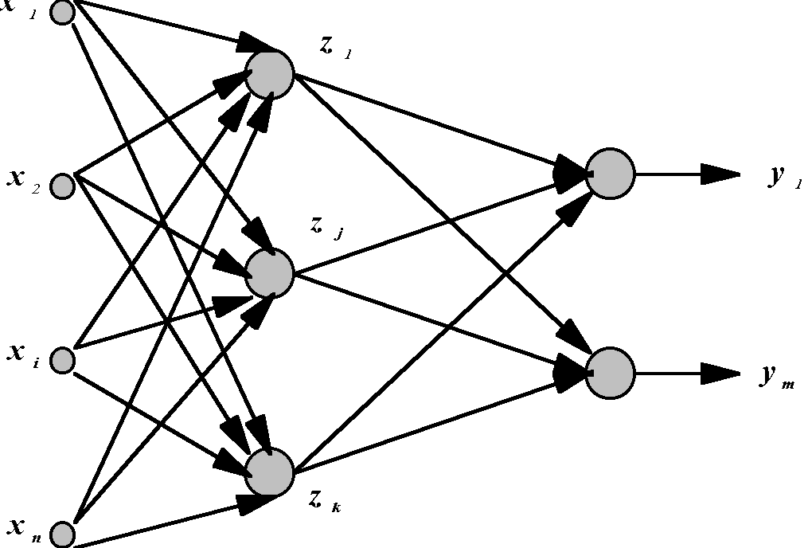
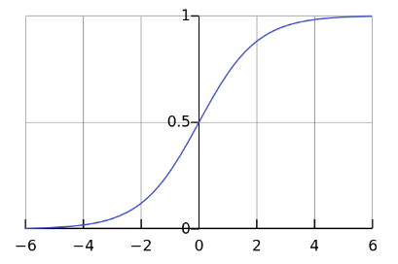
Standard Neural Networks
hidden layer
“Fully connected”
outputs
inputs
g(sum of weights w times inputs x)
$$x={\left(x_{1},…,x_{784}\right)}^{T}$$
$$z_{j}={g(w}_{j }^{T}x)$$
$$g\left(t\right)=\frac{1}{1+e^{−t}}$$

Slide 90
From NNs to Convolutional NNs
Local connectivity
Shared (“tied”) weights
Multiple feature maps
Pooling

Slide 91
Convolutional NNs
Local connectivity
compare
Each green unit is only connected to (3) neighboring blue units

Slide 92
Convolutional NNs
Shared (“tied”) weights
$$w_{1}$$
$$w_{2}$$
$$w_{3}$$
All green units share the same parameters $w$
Each green unit computes the same function, but with a different input window
$$w_{1}$$
$$w_{2}$$
$$w_{3}$$

Slide 93
Convolutional NNs
Convolution with 1-D filter: $[w_{3},w_{2},w_{1}]$
$$w_{1}$$
$$w_{2}$$
$$w_{3}$$
All green units share the same parameters $w$
Each green unit computes the same function, but with a different input window

Slide 94
Convolutional NNs
Convolution with 1-D filter: $[w_{3},w_{2},w_{1}]$
$$w_{1}$$
$$w_{2}$$
All green units share the same parameters $w$
Each green unit computes the same function, but with a different input window
$$w_{3}$$

Slide 95
Convolutional NNs
Convolution with 1-D filter: $[w_{3},w_{2},w_{1}]$
All green units share the same parameters $w$
Each green unit computes the same function, but with a different input window
$$w_{1}$$
$$w_{2}$$
$$w_{3}$$

Slide 96
Convolutional NNs
Convolution with 1-D filter: $[w_{3},w_{2},w_{1}]$
All green units share the same parameters $w$
Each green unit computes the same function, but with a different input window
$$w_{1}$$
$$w_{2}$$
$$w_{3}$$

Slide 97
Convolutional NNs
Convolution with 1-D filter: $[w_{3},w_{2},w_{1}]$
All green units share the same parameters $w$
Each green unit computes the same function, but with a different input window
$$w_{1}$$
$$w_{2}$$
$$w_{3}$$

Slide 98
Convolutional NNs
Multiple feature maps
$${w′}_{1}$$
$${w′}_{2}$$
All orange units compute the same function but with a different input windows
Orange and green units compute different functions
$${w′}_{3}$$
$$w_{1}$$
Feature map 2
(array of orange units)
$$w_{2}$$
$$w_{3}$$
Feature map 1
(array of green units)

Slide 99
Convolutional NNs
Pooling (max, average)
1
4
Pooling area: 2 units
Pooling stride: 2 units
Subsamples feature maps
4
0
3
3

Slide 100
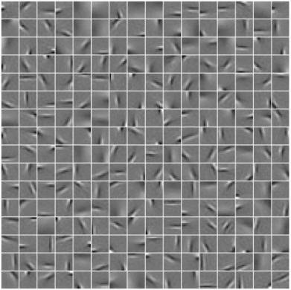
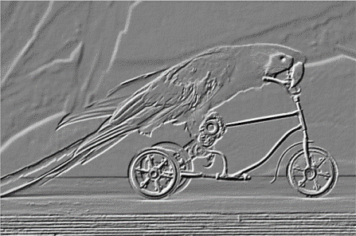
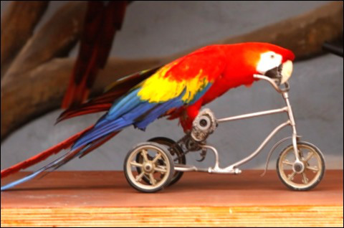
2D input
Pooling
Convolution
Image

Slide 101
Core idea of “deep learning”
Input: the “raw” signal (image, waveform, …)
Features: hierarchy of features is learned from the raw input

Slide 102
Ross’s Own System: Region CNNs

Slide 103
Competitive Results

Slide 104
Top Regions for Six Object Classes

