Slide 1
CSE373: Data Structure & Algorithms Lecture 22: More Sorting
Linda Shapiro
Spring 2016

Slide 2
Announcements
HW 5 due June 1
Final Exam June 7

Slide 3
Divide-and-Conquer Sorting
Two great sorting methods are fundamentally divide-and-conquer
Merge sort: Sort the left half of the elements (recursively)
Sort the right half of the elements (recursively)
Merge the two sorted halves into a sorted whole
Quick sort: Pick a “pivot” element
Divide elements into less-than pivot
and greater-than pivot
Sort the two divisions (recursively on each)
Answer is sorted-less-than then pivot then
sorted-greater-than

Slide 4
Quick sort
A divide-and-conquer algorithm
Recursively chop into two pieces
Instead of doing all the work as we merge together, we will do all the work as we recursively split into halves
Unlike merge sort, does not need auxiliary space
O(n log n) on average ☺, but O(n²) worst-case ☹
Faster than merge sort in practice?
Often believed so
Does fewer copies and more comparisons, so it depends on the relative cost of these two operations!

Slide 5
Quicksort Overview
Pick a pivot element
Partition all the data into:
The elements less than the pivot
The pivot
The elements greater than the pivot
Recursively sort A and C
The answer is, “as simple as A, B, C”

Slide 6
Think in Terms of Sets
Notice: S₁ and S₂
are not of equal sizes.
S
select pivot value
81
43
31
57
13
75
92
0
65
26
S₁
S₂
partition S
0
31
75
13
43
65
92
81
26
57
S₁
S₂
Quicksort(S₁) and
Quicksort(S₂)
0
13
26
31
43
57
65
75
81
92
S
0
13
26
31
43
57
65
75
81
92
Presto! S is sorted
[Weiss]

Slide 7
Example, Showing Recursion
8
2
9
4
5
3
1
6
Divide
5
2 4 3 1
8 9 6
Divide
3
2 1
4
6
8
9
Divide
1 Element
1
2
Conquer
1 2
Conquer
1 2 3 4
6 8 9
Conquer
1 2 3 4 5 6 8 9

Slide 8
Details
Have not yet explained:
How to pick the pivot element
Any choice is correct: data will end up sorted
But as analysis will show, want the two partitions to be about equal in size
How to implement partitioning
In linear time
In place

Slide 9
Pivots
Best pivot?
Median
Halve each time
Why can’t we use it?
Worst pivot?
Greatest/least element
Problem of size n - 1
O(n²)
8
2
9
4
5
3
1
6
2 4 3 1
5
8 9 6
8
2
9
4
5
3
1
6
1
8 2 9 4 5 3 6

Slide 10
Potential pivot rules
While sorting arr from lo to hi-1 …
Pick arr[lo] or arr[hi-1]
Fast, but worst-case occurs with mostly sorted input
Pick random element in the range
Does as well as any technique, but (pseudo)random number generation can be slow
Still probably the most elegant approach
Median of 3, e.g., arr[lo], arr[hi-1], arr[(hi+lo)/2]
Common heuristic that tends to work well

Slide 11
Partitioning
Conceptually simple, but hardest part to code up correctly
After picking pivot, need to partition in linear time in place
One approach (there are slightly fancier ones):
Swap pivot with arr[lo]
Use two pointers i and j, starting at lo+1 and hi-1
while (i < j)
if (arr[j] > pivot) j--
else if (arr[i] < pivot) i++
else swap arr[i] with arr[j]
Swap pivot with arr[i] *
*skip step 4 if pivot ends up being least element

Slide 12
Example
Step one: pick pivot as median of 3
lo = 0, hi = 10
0
1
2
3
4
5
6
7
8
9
8
1
4
9
0
3
5
2
7
6
Step two: move pivot to the lo position
0
1
2
3
4
5
6
7
8
9
6
1
4
9
0
3
5
2
7
8

Slide 13
Example
Often have more than
one swap during partition –
this is a short example
Now partition in place
Move pointers
Swap
Move pointers
Move pivot
6
1
4
9
0
3
5
2
7
8
6
1
4
9
0
3
5
2
7
8
6
1
4
2
0
3
5
9
7
8
6
1
4
2
0
3
5
9
7
8
5
1
4
2
0
3
6
9
7
8

Slide 14
Practice on the left half
0 1 2 3 4 5
5 | 1 | 4 | 2 | 0 | 3
Three values for pivot: 5, 3, 4; median 4

Slide 15
Practice on the left half
0 1 2 3 4 5
5 | 1 | 4 | 2 | 0 | 3
Three values for pivot: 5, 3, 4; median 4
Swap the pivot with the lo position.
4 | 1 | 5 | 2 | 0 | 3
Set up pointers at beginning and end.
4 | 1 | 5 | 2 | 0 | 3
Left pointer can move, since 1 < 4,
but right pointer can’t, since 3 not > 4.
4 | 1 | 3 | 2 | 0 | 5
SWAP and move pointers
Left pointer can move, since 2 < 4
4 | 1 | 3 | 2 | 0 | 5
SWAP with the pivot
0 | 1 | 3 | 2 | 4 | 5

Slide 16
Quick sort visualization
http://www.cs.usfca.edu/~galles/visualization/ComparisonSort.html

Slide 17
Analysis
Best-case: Pivot is always the median
T(0)=T(1)=1
T(n)=2T(n/2) + n -- linear-time partition
Same recurrence as merge sort: O(n log n)
Worst-case: Pivot is always smallest or largest element
T(0)=T(1)=1
T(n) = 1T(n-1) + n
Basically same recurrence as selection sort: O(n²)
Average-case (e.g., with random pivot)
O(n log n), not responsible for proof (in text)

Slide 18
Cutoffs
For small n, all that recursion tends to cost more than doing a quadratic sort
Remember asymptotic complexity is for large n
Common engineering technique: switch algorithm below a cutoff
Reasonable rule of thumb: use insertion sort for n < 10
Notes:
Could also use a cutoff for merge sort
Cutoffs are also the norm with parallel algorithms
Switch to sequential algorithm
None of this affects asymptotic complexity

Slide 19
How Fast Can We Sort?
Heapsort & mergesort have O(n log n) worst-case running time
Quicksort has O(n log n) average-case running time
These bounds are all tight, actually Θ(n log n)
Comparison sorting in general is Ω (n log n)
An amazing computer-science result: proves all the clever programming in the world cannot comparison-sort in linear time

Slide 20
The Big Picture
Surprising amount of juicy computer science: 2-3 lectures…
Simple
algorithms:
O(n²)
Fancier
algorithms:
O(n log n)
Comparison
lower bound:
Ω(n log n)
Specialized
algorithms:
O(n)
Handling
huge data
sets
Insertion sort
Selection sort
Shell sort
…
Heap sort
Merge sort
Quick sort (avg)
…
Bucket sort
Radix sort
External
sorting
How???
Change the model – assume
more than “compare(a,b)”

Slide 21
Bucket Sort (a.k.a. BinSort)
If all values to be sorted are known to be integers between 1 and K (or any small range):
Create an array of size K
Put each element in its proper bucket (a.k.a. bin)
If data is only integers, no need to store more than a count of how times that bucket has been used
Output result via linear pass through array of buckets
count array
1 | 3
2 | 1
3 | 2
4 | 2
5 | 3
Example:
K=5
input (5,1,3,4,3,2,1,1,5,4,5)
output: 1,1,1,2,3,3,4,4,5,5,5

Slide 22
Visualization
http://www.cs.usfca.edu/~galles/visualization/CountingSort.html

Slide 23
Analyzing Bucket Sort
Overall: O(n+K)
Linear in n, but also linear in K
Ω(n log n) lower bound does not apply because this is not a comparison sort
Good when K is smaller (or not much larger) than n
We don’t spend time doing comparisons of duplicates
Bad when K is much larger than n
Wasted space; wasted time during linear O(K) pass
For data in addition to integer keys, use list at each bucket

Slide 24
Bucket Sort with Data What does this look like?
Most real lists aren’t just keys; we have data
Each bucket is a list (say, linked list)
To add to a bucket, insert in O(1) (at beginning, or keep pointer to last element)
Example: Movie ratings; scale 1-5;1=bad, 5=excellent
Input=
5: Casablanca
3: Harry Potter movies
5: Star Wars Original Trilogy
1: Rocky V
count array
1
2
3
4
5
Rocky V
Harry Potter
Casablanca
Star Wars
Result: 1: Rocky V, 3: Harry Potter, 5: Casablanca, 5: Star Wars
Easy to keep ‘stable’; Casablanca still before Star Wars

Slide 25
Radix sort
Radix = “the base of a number system”
Examples will use 10 because we are used to that
In implementations use larger numbers
For example, for ASCII strings, might use 128
Idea:
Bucket sort on one digit at a time
Number of buckets = radix
Starting with least significant digit
Keeping sort stable
Do one pass per digit
Invariant: After k passes (digits), the last k digits are sorted
Aside: Origins go back to the 1890 U.S. census

Slide 26
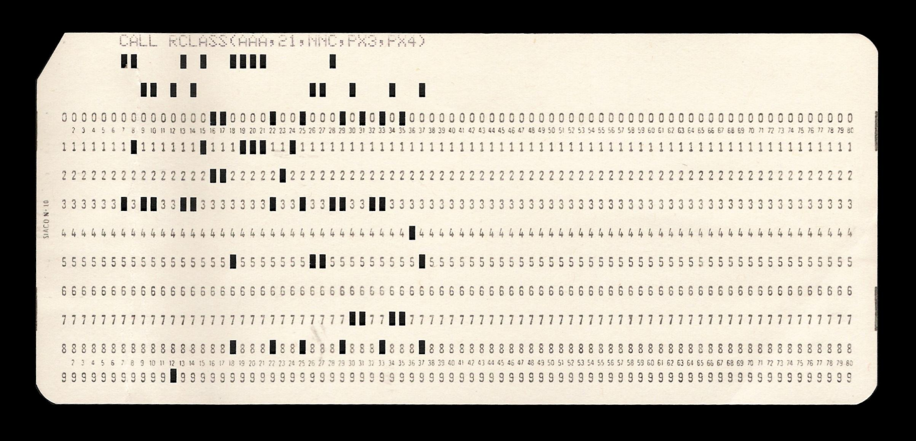
History: Punched Card

Slide 27
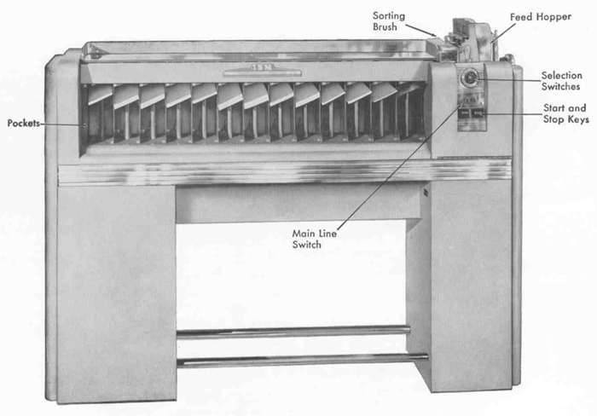
History: IBM Sorting Machine

Slide 28
Example
Radix = 10
Input: 478
537
9
721
3
38
143
67
0
1
2
3
4
5
6
7
8
9
721
3
143
537
67
478
38
9
Order now: 721
3
143
537
67
478
38
9
First pass:
bucket sort by ones digit

Slide 29
Example
0
1
2
3
4
5
6
7
8
9
721
3
143
537
67
478
38
9
Radix = 10
0
1
2
3
4
5
6
7
8
9
3
9
721
537
38
143
67
478
Order was: 721
3
143
537
67
478
38
9
Second pass:
stable bucket sort by tens digit
Order now: 3
9
721
537
38
143
67
478

Slide 30
Example
0
1
2
3
4
5
6
7
8
9
3
9
721
537
38
143
67
478
Radix = 10
0
1
2
3
4
5
6
7
8
9
3
9
38
67
143
478
537
721
Order was: 3
9
721
537
38
143
67
478
Order now: 3
9
38
67
143
478
537
721
Third pass:
stable bucket sort by 100s digit

Slide 31
Analysis
Input size: n
Number of buckets = Radix: B
Number of passes = “Digits”: P
Work per pass is 1 bucket sort: O(B+n)
Total work is O(P(B+n))
Compared to comparison sorts, sometimes a win, but often not
Example: Strings of English letters up to length 15
Run-time proportional to: 15*(52 + n)
This is less than n log n only if n > 33,000
Of course, cross-over point depends on constant factors of the implementations
And radix sort can have poor locality properties

Slide 32
Sorting massive data
Need sorting algorithms that minimize disk/tape access time:
Quicksort and Heapsort both jump all over the array, leading to expensive random disk accesses
Merge sort scans linearly through arrays, leading to (relatively) efficient sequential disk access
Merge sort is the basis of massive sorting
Merge sort can leverage multiple disks
Fall 2013
32
Notes:
Don’t have to spend a lot of time gettign into details. Point out mergesort has seq reading of a data which is good for spatial locality.

Slide 33
External Merge Sort
Sort 900 MB using 100 MB RAM
Read 100 MB of data into memory
Sort using conventional method (e.g. quicksort)
Write sorted 100MB to temp file
Repeat until all data in sorted chunks (900/100 = 9 total)
Read first 10 MB of each sorted chuck, merge into remaining 10MB
writing and reading as necessary
Single merge pass instead of log n
Additional pass helpful if data much larger than memory
Parallelism and better hardware can improve performance
Distribution sorts (similar to bucket sort) are also used

Slide 34
Last Slide on Sorting
Simple O(n²) sorts can be fastest for small n
Selection sort, Insertion sort (latter linear for mostly-sorted)
Good for “below a cut-off” to help divide-and-conquer sorts
O(n log n) sorts
Heap sort, in-place but not stable nor parallelizable
Merge sort, not in place but stable and works as external sort
Quick sort, in place but not stable and O(n²) in worst-case
Often fastest, but depends on costs of comparisons/copies
Ω (n log n) is worst-case and average lower-bound for sorting by comparisons
Non-comparison sorts
Bucket sort good for small number of possible key values
Radix sort uses fewer buckets and more phases
Best way to sort? It depends!

