Slide 1
Help Session Hash Collisions, Graphs
Ezgi, Shenqi, Bran

Slide 2
Hash Collision Resolution
Collision: Two keys map to the same location in the hash table.
Chaining
Linear Probing
Quadratic Probing
Double hashing
Rehashing

Slide 3
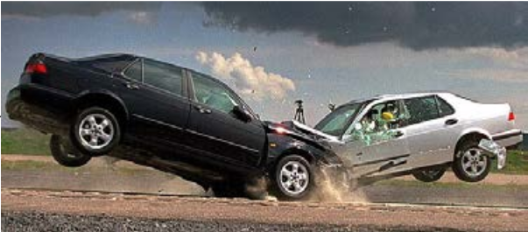
Chaining
Table size = 11, h(x) = x % 11
Insert 20, 30, 2, 13, 25, 24, 10, 9
20 % 11 = 9
30 % 11 = 8
2 % 11 = 2
13 % 11 = 2
25 % 11 = 3
24 % 11 = 2
10 % 11 = 10
9 % 11 = 9
0
1
2
3
4
5
6
7
8
9
10
2
13
24
25
30
20
9
10

Slide 4
Linear Probing: h(key) + i % TableSize
Table size = 11, h(x) = x % 11
Insert 20, 30, 2, 13, 25, 24, 10, 9
20 % 11 = 9
30 % 11 = 8
2 % 11 = 2
13 % 11 = 2
(13+1) % 11 = 3
25 % 11 = 3
(25+1) % 11 = 4
24 % 11 = 2
(24+1) % 11 = 3
(24+2) % 11 = 4
(24+3) % 11 = 5
10 % 11 = 10
9 % 11 = 9
(9+1) % 11 = 10
(9+2) % 11 = 0
0
1
2
3
4
5
6
7
8
9
10
9
2
13
25
24
30
20
10

Slide 5
Quadratic Probing: h(key) + i² % TableSize
Table size = 11, h(x) = x % 11
Insert 20, 30, 2, 13, 25, 24, 10, 9
20 % 11 = 9
30 % 11 = 8
2 % 11 = 2
13 % 11 = 2
(13+1²) % 11 = 3
25 % 11 = 3
(25+1²) % 11 = 4
24 % 11 = 2
(24+1²) % 11 = 3
(24+2²) % 11 = 6
10 % 11 = 10
9 % 11 = 9
(9+1²) % 11 = 10
(9+2²) % 11 = 2
(9+3²) % 11 = 7
0
1
2
3
4
5
6
7
8
9
10
2
13
25
24
9
30
20
10

Slide 6
Double Hashing: h(key) + i*g(key) % TableSize
Table size = 11, h(x) = x % 13, g(x) = 7 – (x % 7)
Insert 20, 30, 2, 13, 25, 24, 10, 9
(20 % 13) % 11 = 7
(30 % 13) % 11 = 4
(2 % 13) % 11 = 2
(13 % 13) % 11 = 0
(25 % 13) % 11 = 1
(24 % 13) % 11 = 9
(10 % 13) % 11 = 10
(9 % 13) % 11 = 9
(9 % 13 + 7 – 9 % 7) % 11 = (9 + 7 - 2) % 11 = 3
0
1
2
3
4
5
6
7
8
9
10
13
25
2
9
30
20
24
10

Slide 9
Graphs

Slide 10
What can we represent with graphs?

Slide 11
What can we represent with graphs?
Social networks
Friends on Facebook
Enemies in the Marvel universe
Road systems
Course prerequisites
Matrices
Anything that deals with connecting things

Slide 12
Example: Facebook friends
What would the nodes of this graph be?
What about the edges?
Is it a directed or an undirected graph?
Is it connected?
Is it dense or sparse?

Slide 13
Example: Facebook friends
Nodes: People
Edges: Friends
Directed? No, but we could use directed edges for “follows”
Connected? Nearly (99.1% connected)
2011 paper “The Anatomy of the Facebook Social Graph” Ugander, et al.
Dense or sparse? SPARSE!

Slide 14
Example: Course prerequisites
What would the nodes of this graph be?
What about the edges?
Is it a directed or an undirected graph?
Is it connected?
Is it dense or sparse?
What could we use for weights?
What would a path represent?

Slide 15
Example: Course prerequisites
Nodes: Courses
Edges: Prerequisites
Directed? Yes.
Connected? Not strongly connected
But if a program has one intro class that is a prereq for everything else, it would be weakly connected.
Dense? No
Weights: Maybe how difficult one class is given prereqs taken
Path: A possible plan of courses to take

Slide 16
Example: Course prerequisites
What would happen if this graph had cycles?

Slide 17
Example: Course prerequisites
What would happen if this graph had cycles?
Some classes would be impossible to take
This means it should be a tree (directed acyclic graph)

Slide 18
Example: Plane routes
Could think of this graph as completely connected.
But some paths might be VERY expensive.
If you want a direct flight from SeaTac to Assumption Island, you’ll need a private plane.
Simple path = flight plan with no repeats
Cycle = Round trip

