Slide 1
Help Session: ADTs: List, Stack, Queue Proof by Induction
Ezgi
Shenqi
Bran

Slide 2
ADTs so far
 | List | Stack | Queue
Adding Elements | insert (at any location) | push (only to the last location, top of the stack) | enqueue (only to the last location, back of the queue)
Removing Elements | remove (from any location) | pop (only from the last location, top of the stack) | dequeue (only from the first location, front of the queue)
Accessing Elements | retrieve (from any location) | top (only the last element, top of the stack) | front (only the first element, front of the queue)

Slide 3
ADT vs Implementation
java.util.queue class
ArrayQueue.java
...
how to change the data structure
eg: queue
implementation
ADT
Data Structure
program
(user)
printer
your first hw! (Executor.java)
enqueue
dequeue
isFull
isEmpty
front
…
array
linked list
…

Slide 4
Implementations
 | List | Stack | Queue
Adding Elements | insert (at any location) | push (only to the last location, top of the stack) | enqueue (only to the last location, back of the queue)
Array Implementation | - Move n elements if not inserting to the end - O(n) | - Update the pointer - O(1) | - Update the pointer - O(1)
Linked List Implementation | - Traverse until the location - O(n) | - Add a new node - O(1) | - Add a new node - O(1)

Slide 5
Implementations
 | List | Stack | Queue
Removing Elements | remove (from any location) | pop (only from the last location, top of the stack) | dequeue (only from the first location, front of the queue)
Array Implementation | - Move n elements if not removing from the end - O(n) | - Update the pointer - O(1) | - Update the pointer - O(1)
Linked List Implementation | - Traverse until the location - O(n) | - Remove a node - O(1) | - Remove a node - O(1)

Slide 6
Implementations
 | List | Stack | Queue
Accessing Elements | retrieve (from any location) | top (only the last element, top of the stack) | front (only the first element, front of the queue)
Array Implementation | - O(1) | - O(1) | - O(1)
Linked List Implementation | - Traverse until the location - O(n) | - O(1) | - O(1)

Slide 7
Example: Palindromes
A palindrome
A string of characters that reads the same from left to right as its does from right to left
noon, radar, level, racecar
Eve, Hannah
A man, a plan, a canal - Panama!
How would you recognize a palindrome using ADTs?
Hint: order matters – in both directions

Slide 8
Example: Palindromes
To recognize a palindrome, a queue can be used in conjunction with a stack
A stack reverses the order of occurrences
A queue preserves the order of occurrences
As you traverse the character string from left to right, insert each character into both a queue and a stack
Compare the characters at the front of the queue and the top of the stack

Slide 9
Example: Palindromes
abcd
Enqueue into a queue and push into a stack
Dequeue from the queue and pop from the stack
d
c
a
b
c
d
b
a
b
c
d
a
d
c
b
a
queue
stack

Slide 10
Example: Palindromes
hannah
Enqueue into a queue and push into a stack
Dequeue from the queue and pop from the stack
h
a
n
n
h
a
n
n
a
h
a
h
a
n
n
a
h
h
h
a
n
n
a
h
queue
stack

Slide 11
Real Life Applications
Stacks: (when you need to reverse something)
Recursion
Function call
Have you ever heard of “stack overflow”?
Redo / Undo
Queues: (when you want to preserve the order)
Routers
Printers
OS scheduling

Slide 12
Proof by Induction
A proof consists of three parts:
1. Prove it for the base case.
2. Assume it for some integer k.
3. With that assumption, show it holds for k+1.

Slide 13
Proof by Induction: Example 1
$$\sum_{p=0}^{n}{x^{p}}=x^{0}+x^{1}+x^{2}+x^{3}+…+x^{n}=\frac{x^{n+1}−1}{x−1} \\ for x≠1$$
Remember special case from lecture $x=2$:
$$2^{0}+2^{1}+2^{2}+…+2^{n}=2^{n+1}−1$$

Slide 14
$$x^{0}+x^{1}+x^{2}+x^{3}+…+x^{n}=\frac{x^{n+1}−1}{x−1}$$
Base case: $n=0$
$$x^{0}=\frac{x^{0+1}−1}{x−1} \\ 1=1$$
2. Assume that the statement is true for $n=k$.
$x^{0}+{x^{1}+x}^{2}+x^{3}+…+x^{k}=\frac{x^{k+1}−1}{x−1}$
3. Induction: Show that following statement is also true.
$$x^{0}+{x^{1}+x}^{2}+x^{3}+…+x^{k+1}=\frac{x^{k+2}−1}{x−1}$$

Slide 15

2. Assumption: $x^{0}+x^{1}+x^{2}+x^{3}+…+x^{k}=\frac{x^{k+1}−1}{x−1}$
3. Induction:
$$x^{0}+{x^{1}+x}^{2}+x^{3}+…+x^{k+1}$$
$$=x^{0}+{x^{1}+x}^{2}+x^{3}+…+x^{k}+x^{k+1}$$
$$= \frac{x^{k+1}−1}{x−1}+x^{k+1}$$
$$= \frac{x^{k+1}−1}{x−1}+ \frac{\left(x−1\right)∗x^{k+1}}{(x−1)}$$
$$=\frac{x^{k+1}−1+x∗x^{k+1}−x^{k+1}}{x−1}$$
$$=\frac{x∗x^{k+1}−1}{x−1}= \frac{x^{k+2 }−1}{x−1}$$

Slide 16

Proof by Induction: Example 2
$$\sum_{i=1}^{n}{\frac{1}{i∗(i+1)}}= \frac{n}{n+1} where n∈ℤ^{+}$$
$$\frac{1}{1∗2}+\frac{1}{2∗3}+\frac{1}{3∗4}+ …+\frac{1}{n∗\left(n+1\right)}=\frac{n}{n+1}$$

Slide 17
$$\frac{1}{1∗2}+\frac{1}{2∗3}+\frac{1}{3∗4}+ …+\frac{1}{n∗\left(n+1\right)}=\frac{n}{n+1}$$
1. Base case $n=1$(remember $n∈ℤ^{+})$
$$\frac{1}{1∗2}=\frac{1}{1+1} \frac{1}{2}=\frac{1}{2}$$
2. Assume that the statement is true for $n=k$.
$$\frac{1}{1∗2}+\frac{1}{2∗3}+\frac{1}{3∗4}+ …+\frac{1}{k∗\left(k+1\right)}=\frac{k}{k+1}$$
3. Induction: Show that the statement is also true for $n=k+1$.
$$\frac{1}{1∗2}+\frac{1}{2∗3}+\frac{1}{3∗4}+ …+\frac{1}{(k+1)∗\left(k+2\right)}=\frac{k+1}{k+2}$$

Slide 18
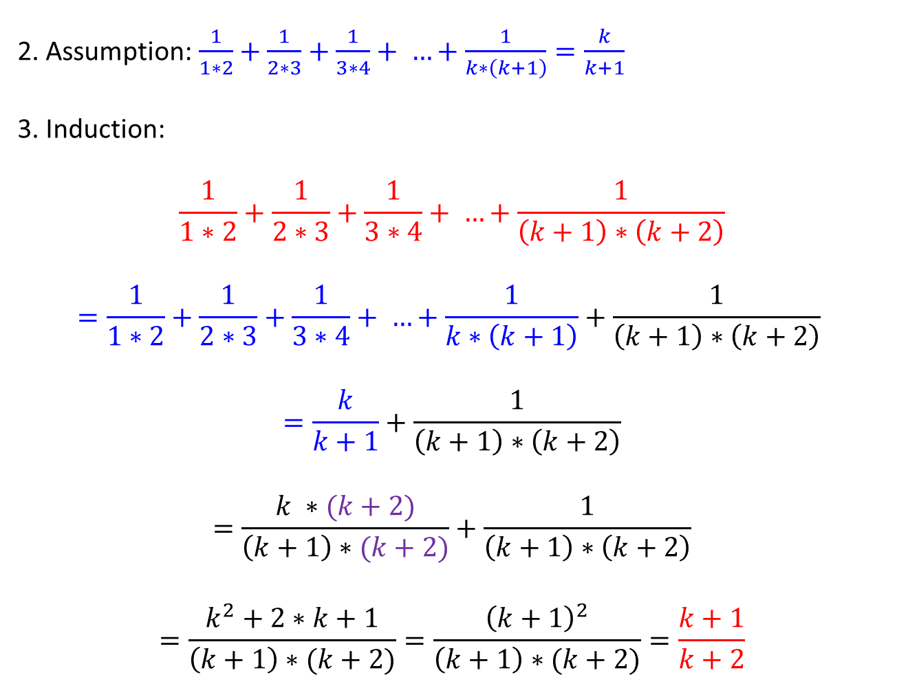
2. Assumption:$\frac{1}{1∗2}+\frac{1}{2∗3}+\frac{1}{3∗4}+ …+\frac{1}{k∗\left(k+1\right)}=\frac{k}{k+1}$
3. Induction:
$$\frac{1}{1∗2}+\frac{1}{2∗3}+\frac{1}{3∗4}+ …+\frac{1}{\left(k+1\right)∗\left(k+2\right)}$$
$$=\frac{1}{1∗2}+\frac{1}{2∗3}+\frac{1}{3∗4}+ …+\frac{1}{k∗\left(k+1\right)}+\frac{1}{\left(k+1\right)∗\left(k+2\right)}$$
$$=\frac{k}{k+1}+\frac{1}{\left(k+1\right)∗\left(k+2\right)}$$
$$=\frac{k ∗(k+2)}{\left(k+1\right)∗(k+2)}+\frac{1}{\left(k+1\right)∗\left(k+2\right)}$$
$$=\frac{k^{2}+2∗k+1}{\left(k+1\right)∗(k+2)}=\frac{{\left(k+1\right)}^{2}}{\left(k+1\right)∗(k+2)}=\frac{k+1}{k+2}$$

