Slide 1
HW05: Graphs and Shortest Paths
CSE373 Spring 16

Slide 2
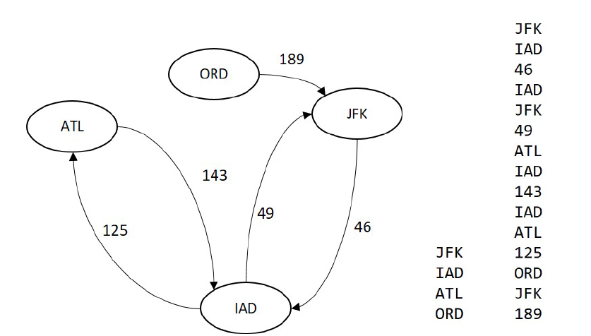
Problem Definition
Given a set of vertices and edges, construct a graph.
Given a source vertex and a destination vertex, find the shortest path using Dijkstra’s Algorithm.

Slide 3
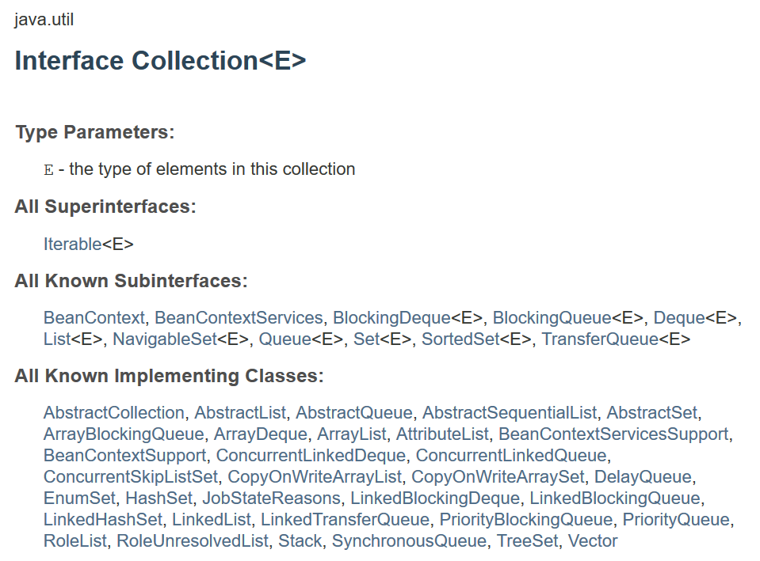
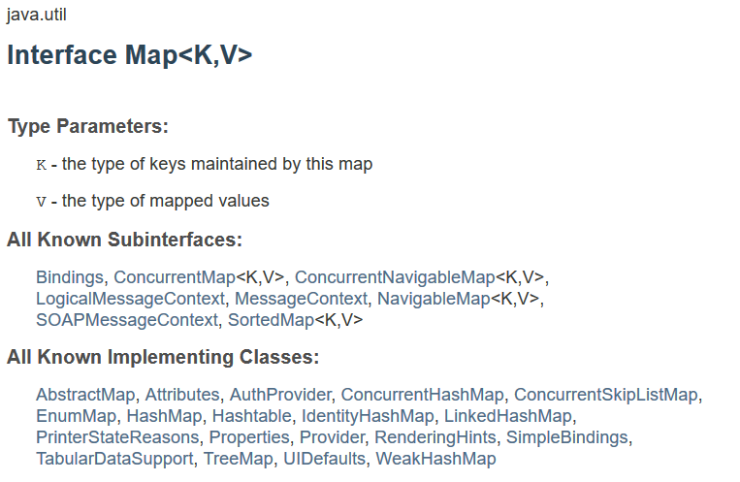
New to this assignment…
You may use any ADT implementation from Java standard collections.
Check out Collection, List, Map interfaces.
Vertices have string labels, an efficient ADT for accessing string keys is hash table. Java has a few implementations.

Slide 4
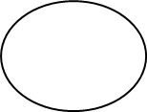
Hash table idea
Abstract Hash Table
SEA
SEA + more
ORD
ORD + more

Slide 5
What we give:
Vertex.java : Vertex class – you may add to it.
Edge.java : Edge class – you may add to it.
Path.java : Very simple class with two fields, a vertex list and an integer cost – don’t modify.
Graph.java : Graph interface – don’t modify.
MyGraph.java : An implementation of Graph interface. TODO’s.
FindPaths.java : A client of Graph interface with a main function. Driver program for the shortest path problem. TODO’s.
vertex.txt and edge txt : An example graph input.

Slide 6
What you need to do:
MyGraph.java : An implementation of the Graph interface. You need to implement the following:
MyGraph(v, e): Creates a MyGraph object with the given collection of vertices and the given collection of edges.
vertices(): Return the collection of vertices of this graph.
edges(): Return the collection of edges of this graph.
adjacentVertices(Vertex v): Return a collection of vertices adjacent to a given vertex v. Return an empty collection if there are no adjacent vertices.
int edgeCost(Vertex a, Vertex b): Return cost of edge if there is a directed edge from a to b in the graph, return -1 otherwise.
Path shortestPath(Vertex a, Vertex b): Returns the shortest path from a to b in the graph, or null if there is no such path. Uses Dijkstra's algorithm.

Slide 7
What you need to do:
FindPaths.java : A driver program that reads in a graph and prom points user for the source and the destination vertices for the shortest path algorithm.
You need to complete the code to call the shortest path algorithm.
Print out the result:
Shortest path from X to Y:
does not exist
Or
Shortest path from X to Y:
X W U T Z Y
123

Slide 8
What you need to do:
Write-Up Questions:
Worst-case asymptotic running times of your methods
adjacentVertices
edgeCost
shortestPath
in terms of |E| and |V|. Explain and justify your answers.
2. Describe how you tested your code.
3. Describe how you divided up the tasks with your partner (if
applicable).
4. Describe any extra credit problems you attempted.

Slide 9
Extra Credit:
Find an interesting real-world data set and convert it to the right format.
Improve your implementation of Dijkstra’s algorithm by using a priority queue.
Extend MyGraph with a method for computing minimum spanning trees. Also write a driver program (similar to FindPaths.java) to demonstrate.
Explain all your work in your write-up document.

Slide 10
Grading: 45 points
Correctness: 33 points
MyGraph(v,e): 3 points
vertices(): 3 points
edges(): 3 points
adjacentVertices(v): 3 points
edgeCost(a,b): 3 points
shortestPath(a,b): 13 points
FindPaths.java : 5 points
Readability: 5 points
Report: 7 points
Extra Credit: 15 points
Interesting dataset: 3 points
Dijkstra’s with priority queue: 4 points
MST: 8 points

