Slide 1
CSE373: Data Structures and Algorithms Lecture 3: Math Review; Algorithm Analysis
Lauren Milne
Summer 2015

Slide 2
Today
Homework 1 due 10:59pm next Wednesday, July 1st.
Review math essential to algorithm analysis
Exponents and logarithms
Floor and ceiling functions
Algorithm analysis

Slide 3
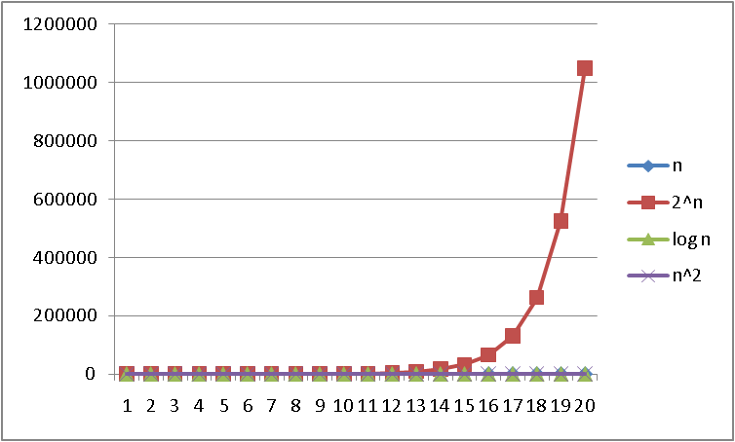
Logarithms and Exponents
See Excel file
for plot data –
play with it!
n
Notes:
what is this 2^n

Slide 4
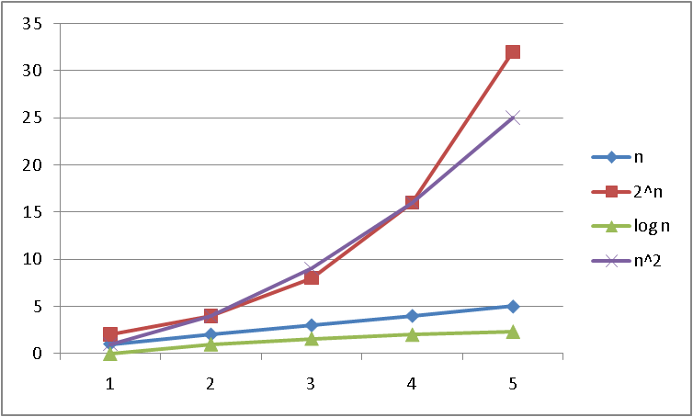
Logarithms and Exponents
See Excel file
for plot data –
play with it!
n
Notes:
which are crossing? n^2 and 2^n

Slide 5
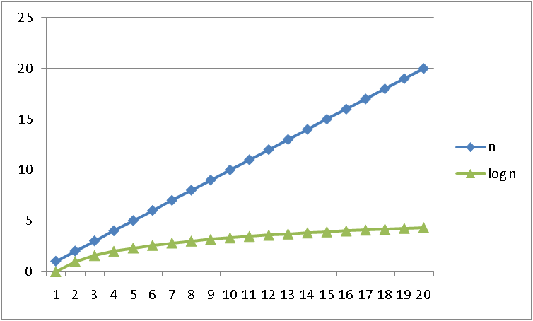
Logarithms and Exponents
See Excel file
for plot data –
play with it!
n
Notes:
n, log(n)

Slide 6
Properties of logarithms
log(A*B) = log A + log B
log(A/B) = log A – log B
log(N^{k})= k log N
log(log x) is written log log x
Grows as slowly as 2² grows quickly
(log x)(log x) is written log²x
It is greater than log x for all x > 2
It is not the same as log log x
Expand this:
log(2a²b/c)
= 1 + 2log(a) + log(b) – log(c)
x
Notes:
Difference between log^2 x and log2 x?

Slide 7
Log base doesn’t matter much!
Any base B log is equivalent to base 2 log within a constant factor
We don’t care about constant factors!
log₂ x = 3.22 log₁₀ x
To convert from base B to base A:
log_{B} x = (log_{A} x) / (log_{A} B)
Notes:
The constant 3.22 does not depend on x, constant whatever the input size is!

Slide 8
Floor and ceiling
Floor function: the largest integer < X
Ceiling function: the smallest integer > X

Slide 9
Facts about floor and ceiling

Slide 10
Algorithm Analysis
As the “size” of an algorithm’s input grows, we want to know
Time it takes to run
Space it takes to to run
Because the curves we saw are so different (2^n vs logn), only care about which curve we are like
Separate issue: Algorithm correctness – does it produce the right answer for all inputs?

Slide 11
Algorithm Analysis: A first example
Consider the following program segment:
x:= 0;
for i = 1 to n do
for j = 1 to i do
x := x + 1;
What is the value of x at the end?
1 to 1 1
1 to 2 3
1 to 3 6
1 to 4 10
…
n 1 to n ?
i j x
Number of times x gets incremented is
= 1 + 2 + 3 + … + (n-1) + n
= n*(n+1)/2
Notes:
look familiar?
Number of loop iterations

Slide 12
Analyzing the loop
Consider the following program segment:
x:= 0;
for i = 1 to n do
for j = 1 to i do
x := x + 1;
The total number of loop iterations is n*(n+1)/2
n*(n+1)/2 = (n²+ n)/2
For large enough n, the lower order and constant terms are irrelevant!
So this is O(n²)
Notes:
Assembly language
So we will call this big o of n squared. What is big o, just wait to find out!

Slide 13
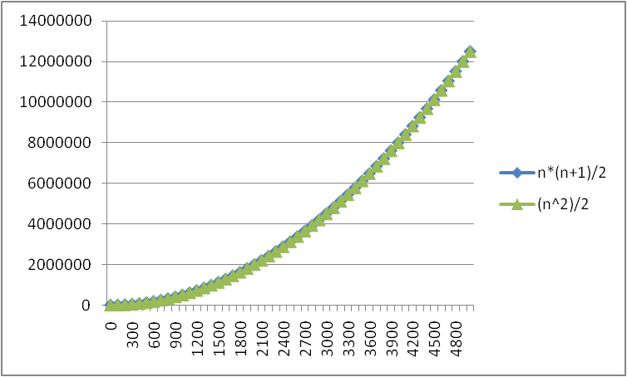
Lower-order terms don’t matter
n*(n+ 1)/2 vs. just n²/2
Notes:
To give you some intuition for why lower order terms don’t matter

Slide 14
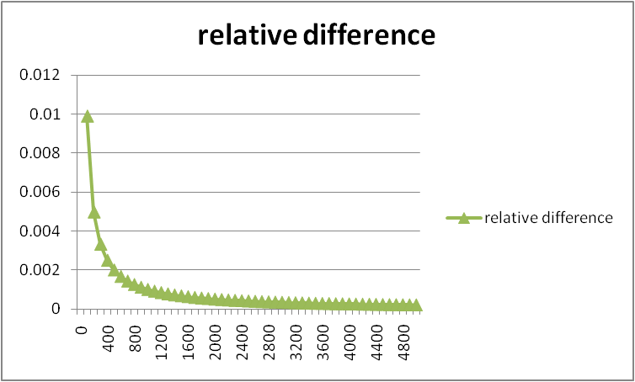
Lower-order terms don’t matter
n*(n+ 1)/2 vs. just n²/2

Slide 15
Big-O: Common Names
O(1) constant (same as O(k) for constant k)
O(log n) logarithmic
O(n) linear
O(n log n) “n log n”
O(n²) quadratic
O(n³) cubic
O(n^{k}) polynomial (where is k is any constant)
O(k^{n}) exponential (where k is any constant > 1)
O(n!) factorial
Notes:
O(n^10)*logn vs O(n^(10*logn))

Slide 16
Big-O running times
For a processor capable of one million instructions per second
Notes:
Raspberry pi 1000 MIPS
Intel core i7 100,000 MIPS

Slide 17
Analyzing code
Basic operations take “some amount of” constant time
Arithmetic
assignment
access an array index
etc…
(This is an approximation of reality: a very useful “lie”.)
Consecutive statements Sum of times
Conditionals Time to test + slower branch
Loops Sum of iterations
Calls Time of call’s body
Recursion Solve recurrence equation (next lecture)
Notes:
Constant time in terms of the program input
Why is this a lie?
For a large array, might be stored in main memory vs cache

Slide 18
Analyzing code
Add up time for all parts of the algorithm
e.g. number of iterations = (n²+ n)/2
Eliminate low-order terms i.e. eliminate n: (n²)/2
Eliminate coefficients i.e. eliminate 1/2: (n²)
Examples:
4n + 5
0.5n log n + 2n + 7
n³ + 2^{n} + 3n
n log (10n² )
n log(10)+ 2n log (n)
= O(n)
= O(n log n)
= O(2^{n}) EXPONENTIAL GROWTH!
= O(n log n)
Notes:
O(n^2)

Slide 19
Efficiency
What does it mean for an algorithm to be efficient?
We care about time (and sometimes space)
Is the following a good definition?
“An algorithm is efficient if, when implemented, it runs quickly on real input instances”
Notes:
Very vague
What does implemented mean? Can be implemented in many ways
What does run quickly mean? 1 microsecond? 1 second? 5 minutes?
What are real input instances? Will it run quickly on an array of size 1 million?

Slide 20
Gauging efficiency (performance)
Why not just time the program?
Notes:
Too much variability, not reliable or portable:
Hardware: processor(s), memory, etc.
OS, Java version,
Other programs running
Implementation dependent
Might change based on choice of input
Testing (inexhaustive) may miss worst-case input
Timing does not explain relative timing among inputs (what happens when n doubles in size)
Often want to evaluate an algorithm, not an implementation

Slide 21
Comparing algorithms
When is one algorithm (not implementation) better than another?
We will focus on large inputs, everything is fast when n is small.
Answer is independent of CPU speed, programming language, coding tricks, etc. and is general and rigorous.
Notes:
When is one algorithm (not implementation) better than another?
Various possible answers (clarity, security, …)
But a big one is performance: for sufficiently large inputs, runs in less time (our focus) or less space
Can do analysis before coding!

Slide 22
We usually care about worst-case running times
Provides a guarantee
Difficult to find a satisfactory alternative
What about average case?
Difficult to express full range of input
Could we use randomly-generated input?
May learn more about generator than algorithm
Notes:
End lecture 3

Slide 23
Example
2
3
5
16
37
50
73
75
126
Find an integer in a sorted array
// requires array is sorted
// returns whether k is in array
boolean find(int[]arr, int k){
???
}
Notes:
What are some ways we can do this?
What are some algorithms?

Slide 24
Linear search
2
3
5
16
37
50
73
75
126
Find an integer in a sorted array
Best case?
k is in arr[0]
c1 steps
= O(1)
Worst case?
k is not in arr
c2*(arr.length)
= O(arr.length)
// requires array is sorted
// returns whether k is in array
boolean find(int[]arr, int k){
for(int i=0; i < arr.length; ++i)
if(arr[i] == k)
return true;
return false;
}
Notes:
Naïve or “stupid” way of doing this– only way to do it with an unsorted array

Slide 25
Binary search
2
3
5
16
37
50
73
75
126
Find an integer in a sorted array
// requires array is sorted
// returns whether k is in array
boolean find(int[]arr, int k){
return help(arr,k,0,arr.length);
}
boolean help(int[]arr, int k, int lo, int hi) {
int mid = (hi+lo)/2; // i.e., lo+(hi-lo)/2
if(lo==hi) return false;
if(arr[mid]==k) return true;
if(arr[mid]< k) return help(arr,k,mid+1,hi);
else return help(arr,k,lo,mid);
}
Notes:
Can also be done non-recursively but “doesn’t matter” here
Walk through binary search trying to find 4
Mid = 0+8/2 = 4

Slide 26
Binary search
Best case:
c1 steps = O(1)
Worst case:
T(n) = c2 + T(n/2) where n is hi-lo and c2 is a constant
O(log n) where n is arr.length (recurrence relation)
// requires array is sorted
// returns whether k is in array
boolean find(int[]arr, int k){
return help(arr,k,0,arr.length);
}
boolean help(int[]arr, int k, int lo, int hi) {
int mid = (hi+lo)/2; // i.e., lo+(hi-lo)/2
if(lo==hi) return false;
if(arr[mid]==k) return true;
if(arr[mid]< k) return help(arr,k,mid+1,hi);
else return help(arr,k,lo,mid);
}
Notes:
Worst case much trickier
Turns out with recursion we have to solve recurrence relation
To run algorithm on array of size n, takes a constant amount of time plus the amount of time it takes to run on array of size n/2, because that is what we are doing with our recursive call

Slide 27
Solving Recurrence Relations
Determine the recurrence relation and the base case.
T(n) = c2+ T(n/2) T(1) = c1
“Expand” the original relation to find an equivalent general expression in terms of the number of expansions.
T(n) = c2 + c2 + T(n/4)
= c2 + c2 + c2 + T(n/8)
= …
= c2(k) + T(n/(2^{k}))
Find a closed-form expression by setting the number of expansions to a value which reduces the problem to a base case
Base case is T(1)
n/(2^{k}) = 1 means n = 2^{k} means k = log₂ n
So T(n) = c2 log₂ n + T(1)
So T(n) = c2 log₂ n + c1 (get to base case and do it)
So T(n) is O(log n)
Notes:
Base case: get to array of size one, either find it or do not, takes constant time to check
What is T(n/2) equal? T(n/2) = c2+T(n/4) from plugging in n/2 to recurrence relation
Then plug that into the recurrence relation for T(n)
And keep expanding
K is the number of expansions

Slide 28
Ignoring constant factors
So binary search is O(log n) and linear is O(n)
But which is faster?
Depends on constant factors
How many assignments, additions, etc. for each n?
E.g. T(n) = 5,000,000n vs. T(n) = 5n²
And could depend on overhead unrelated to n
E.g. T(n) = 5,000,000 + log n vs. T(n) = 10 + n
But there exists some n₀ such that for all n > n₀ binary search wins
Notes:
Constant we multiply n by or constant we add to n
No matter what the constant is, there exists some n
Let’s play with a couple plots to get some intuition…

Slide 29
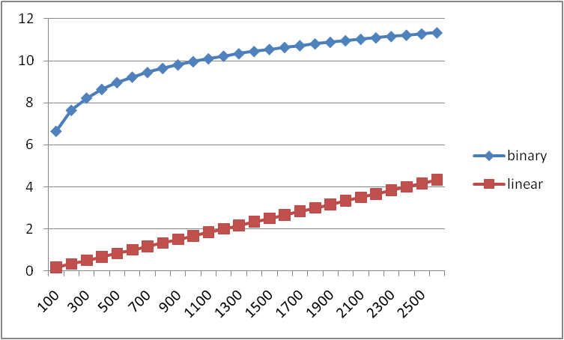
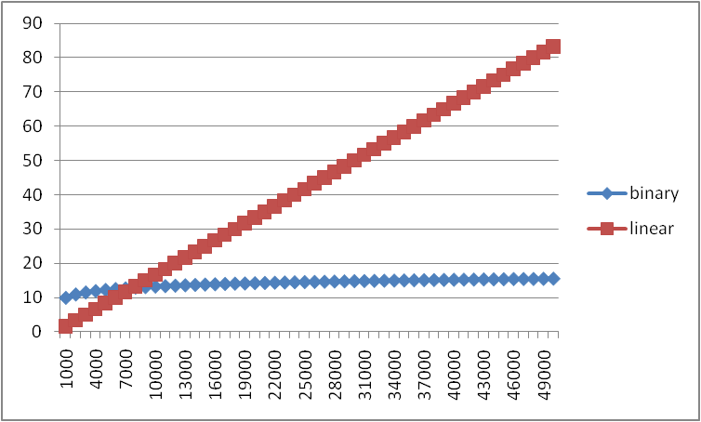
Example
Let’s try to “help” linear search
100x faster computer
3x faster compiler/language
2x smarter programmer (eliminate half the work)
Each iteration is 600x as fast as in binary search
Notes:
We really want linear search to win
So we are going to play around with those constants
X axis is size of input
Y axis is time

