Slide 1
CSE373: Data Structures and Algorithms Lecture 2: Proof by Induction & Algorithm Analysis
Lauren Milne
Summer 2015

Slide 2
Today
Did everyone get email sent on Monday about TA Sections starting on Thursday?
Homework 1 due 10:59pm next Wednesday, July 1st.
Review math essential to algorithm analysis
Proof by induction
Exponents and logarithms
Floor and ceiling functions
Begin algorithm analysis

Slide 3
Homework 1
Download Eclipse and Java
Implement Stack ADT for Java double
Array
ArrayStack: push(double n), pop(), peek(), constructor
Starts small (approx. 10 elements) and doubles in size when full, copy elements over
Throw exception if stack is empty for pop() and peek()
List
ListStack: push(double n), pop(), peek(), constructor
Inner ListStackNode class
Throw exception if stack is empty for pop() and peek()
Test
Reverse.java and Dstack.java
Using .dat sound files (created using .wav files through sox), and .dat files you create manually (edge cases)
Write up: README.txt
QueueStack – push() and pop()

Slide 4
Background on Induction
Type of mathematical proof
Typically used to establish a given statement for all natural numbers (integers > 0)
Proof is a sequence of deductive steps
Show the statement is true for the first number.
Show that if the statement is true for any one number, this implies the statement is true for the next number.
If so, we can infer that the statement is true for all numbers.

Slide 5
Think about climbing a ladder
1. Show you can get to the first rung (base case)
2. Show you can get between rungs (inductive step)
3. Now you can climb forever.
Notes:
dominos? if you can knock down the first one, and prove that each domino will knock down another domino

Slide 6
Why you should care
Induction turns out to be a useful technique
AVL trees
Heaps
Graph algorithms
Can also prove things like 3^{n} > n³ for n ≥ 4
Exposure to rigorous thinking

Slide 7
Example problem
Find the sum of the integers from 1 to n
1 + 2 + 3 + 4 + … + (n-1) + n
For any n ≥ 1
Could use brute force, but would be slow
There’s probably a clever shortcut

Slide 8
Finding the formula
Shortcut will be some formula involving n
Compare examples and look for patterns
Not something I will ask you to do!
Start with n = 10: 1 + 2 + 3 + 4 + 5 + 6 + 7 + 8 + 9 + 10
Large enough to be a pain to add up
Worthwhile to find shortcut

Slide 9
Finding the formula
1 + 2 + 3 + 4 + 5 + 6 + 7 + 8 + 9 + 10
= 5×11
Notes:
how many pairs? what’s the sum?

Slide 10
Finding the formula
1 + 2 + 3 + 4 + 5 + 6 + 7 + 8 + 9
= 4×10 + 5

Slide 11
Finding the formula
1 + 2 + 3 + 4 + 5 + 6 + 7 + 8
= 4×9

Slide 12
Finding the formula
1 + 2 + 3 + 4 + 5 + 6 + 7
= 3×8 + 4

Slide 13
Finding the formula
n=7 | 3×8 + 4
n=8 | 4×9
n=9 | 4×10 + 5
n=10 | 5×11

Slide 14
Finding the formula
n=7 | 3×8 + 4 | n is odd
n=8 | 4×9 | n is even
n=9 | 4×10 + 5 | n is odd
n=10 | 5×11 | n is even

Slide 15
Finding the formula
When n is even
1 + 2 + 3 + 4 + … + (n-3) + (n-2) + (n-1) + n
= (n/2)×(n+1)

Slide 16
Finding the formula
3×8 + 4
4×9 | n(n+1)/2
4×10 + 5
5×11 | n(n+1)/2

Slide 17
Finding the formula
When n is odd
1 + 2 + 3 + 4 + … + (n-3) + (n-2) + (n-1) + n
= ((n-1)/2)×(n+1) + (n+1)/2

Slide 18
Finding the formula
When n is odd
1 + 2 + 3 + 4 + … + (n-3) + (n-2) + (n-1) + n
= ((n-1)/2)×(n+1) + (n+1)/2

Slide 19
Finding the formula
When n is odd
1 + 2 + 3 + 4 + … + (n-3) + (n-2) + (n-1) + n
= ((n-1)×(n+1) + (n+1))/2

Slide 20
Finding the formula
When n is odd
1 + 2 + 3 + 4 + … + (n-3) + (n-2) + (n-1) + n
= ((n-1)×(n+1) + (n+1))/2

Slide 21
Finding the formula
When n is odd
1 + 2 + 3 + 4 + … + (n-3) + (n-2) + (n-1) + n
= ((n-1 + 1)×(n+1))/2

Slide 22
Finding the formula
When n is odd
1 + 2 + 3 + 4 + … + (n-3) + (n-2) + (n-1) + n
= ((n-1 + 1)×(n+1))/2

Slide 23
Finding the formula
When n is odd
1 + 2 + 3 + 4 + … + (n-3) + (n-2) + (n-1) + n
= (n (n+1))/2

Slide 24
Finding the formula
3×8 + 4 | n(n+1)/2
4×9 | n(n+1)/2
4×10 + 5 | n(n+1)/2
5×11 | n(n+1)/2

Slide 25
Are we done?
The pattern seems pretty clear
Is there any reason to think it changes?
But we want something for any n ≥ 1
A mathematical approach is skeptical

Slide 26
Are we done?
The pattern seems pretty clear
Is there any reason to think it changes?
But we want something for any n ≥ 1
A mathematical approach is skeptical
All we know is n(n+1)/2 works for 7 to 10
We must prove the formula works in all cases

Slide 27
Proof by induction
Prove the formula works for all cases.
Induction proofs have four components:
Relationship that you want to prove, e.g., sum of integers from 1 to n = n(n+1)/2
The base case (usually "let n = 1"),
The assumption step (“assume true for n = k")
The induction step (“now let n = k + 1").
n and k are just variables!
Notes:
In our ladder metaphor, steps 3 and 4 mean, assume that we can get to step k on the ladder, can you show we can get to step k+1?

Slide 28
Proof by induction
P(n) = sum of integers from 1 to n
We need to do
Base case
Assumption
Induction step
n and k are just variables!
prove for P(1)
assume for P(k)
show for P(k+1)

Slide 29
Proof by induction
P(n) = sum of integers from 1 to n
We need to do
Base case
Assumption
Induction step
prove for P(1)
assume for P(k)
show for P(k+1)
1 2 3 4 5 6…

Slide 30
Proof by induction
✓
What we are trying to prove: P(n) = n(n+1)/2
Base case
P(1) = 1
1(1+1)/2 = 1(2)/2 = 1(1) = 1

Slide 31
Proof by induction
What we are trying to prove: P(n) = n(n+1)/2
Assume true for k: P(k) = k(k+1)/2
Induction step:
Now consider P(k+1)
= 1 + 2 + … + k + (k+1)

Slide 32
Proof by induction
What we are trying to prove: P(n) = n(n+1)/2
Assume true for k: P(k) = k(k+1)/2
Induction step:
Now consider P(k+1)
= 1 + 2 + … + k + (k+1)
= k(k+1)/2 + (k+1)

Slide 33
Proof by induction
What we are trying to prove: P(n) = n(n+1)/2
Assume true for k: P(k) = k(k+1)/2
Induction step:
Now consider P(k+1)
= 1 + 2 + … + k + (k+1)
= k(k+1)/2 + (k+1)
= k(k+1)/2 + 2(k+1)/2

Slide 34
Proof by induction
What we are trying to prove: P(n) = n(n+1)/2
Assume true for k: P(k) = k(k+1)/2
Induction step:
Now consider P(k+1)
= 1 + 2 + … + k + (k+1)
= k(k+1)/2 + (k+1)
= k(k+1)/2 + 2(k+1)/2
= (k(k+1) + 2(k+1))/2

Slide 35
Proof by induction
What we are trying to prove: P(n) = n(n+1)/2
Assume true for k: P(k) = k(k+1)/2
Induction step:
Now consider P(k+1)
= 1 + 2 + … + k + (k+1)
= k(k+1)/2 + (k+1)
= k(k+1)/2 + 2(k+1)/2
= (k+1)(k+2)/2
= (k(k+1) + 2(k+1))/2

Slide 36
Proof by induction
What we are trying to prove: P(n) = n(n+1)/2
Assume true for k: P(k) = k(k+1)/2
Induction step:
Now consider P(k+1)
= 1 + 2 + … + k + (k+1)
= k(k+1)/2 + (k+1)
= k(k+1)/2 + 2(k+1)/2
= (k+1)(k+2)/2
= (k(k+1) + 2(k+1))/2

Slide 37
Proof by induction
What we are trying to prove: P(n) = n(n+1)/2
Assume true for k: P(k) = k(k+1)/2
Induction step:
Now consider P(k+1)
= 1 + 2 + … + k + (k+1)
= k(k+1)/2 + (k+1)
= k(k+1)/2 + 2(k+1)/2
= (k+1)(k+2)/2
✓
= (k(k+1) + 2(k+1))/2
= (k+1)((k+1)+1)/2

Slide 38
Proof by induction
What we are trying to prove: P(n) = n(n+1)/2
Assume true for k: P(k) = k(k+1)/2
Induction step:
Now consider P(k+1)
= 1 + 2 + … + k + (k+1)
= k(k+1)/2 + (k+1)
= k(k+1)/2 + 2(k+1)/2
= (k+1)(k+2)/2
✓
= (k(k+1) + 2(k+1))/2
= (k+1)((k+1)+1)/2

Slide 39
We’re done!
P(n) = sum of integers from 1 to n
We have shown
Base case
Assumption
Induction step
Success: we have proved that P(n) is true for any n ≥ 1 ☺
proved for P(1)
assumed for P(k)
proved for P(k+1)

Slide 40
Another one to try
What is the sum of the first n powers of 2?
2⁰ + 2¹ + 2² + ... + 2^{n}
n = 0: 2⁰ = 1
n = 1: 2⁰ + 2¹ = 1 + 2 = 3
n = 2: 2⁰ + 2¹ + 2² = 1 + 2 + 4 = 7
n = 3: 2⁰ + 2¹ + 2² + 2³ = 1 + 2 + 4 + 8 = 15
For general n, the sum is 2^{n+1} - 1
Notes:
have them work on this on their own: identify pattern first, then figure out induction

Slide 41
How to prove it
P(n) = “the sum of the first n powers of 2 is 2^{n+1}-1”
Theorem: P(n) holds for all n ≥ 0
Proof: By induction on n
Base case: n=0. Sum of first power of 2 is 2⁰ , which equals 1 = 2¹ - 1.
Inductive case:
Assume the sum of the first k powers of 2 is 2^{k+1}-1
Show the sum of the first (k+1) powers of 2 is 2^{k+2}-1

Slide 42
How to prove it
The sum of the first k+1 powers of 2 is
2⁰ + 2¹ + 2² + ... + 2^{(k-1)} + 2^{k} + 2^{k+1}
= 2^{k+1} -1 + 2^{k+1}
= 2(2^{k+1}) -1
= 2^{k+2} - 1

Slide 43
Conclusion
Mathematical induction is a technique for proving something is true for all integers starting from a small one, usually 0 or 1.
A proof consists of three parts:
1. Prove it for the base case.
2. Assume it for some integer k.
3. With that assumption, show it holds for k+1
It can be used for complexity and correctness analyses.

Slide 44
End of Inductive Proofs!

Slide 45
Powers of 2
A bit is 0 or 1 (just two different “letters” or “symbols”)
A sequence of n bits can represent 2^{n} distinct things
For example, the numbers 0 through 2^{n}-1
2¹⁰ is 1024 (“about a thousand”, kilo in CSE speak)
2²⁰ is “about a million”, mega in CSE speak
2³⁰ is “about a billion”, giga in CSE speak
Java: an int is 32 bits and signed, so what is “max int”?
Notes:
2^32 / 2 = 2^31 = 2 *2^30 = 2 billion

Slide 46
Powers of 2
A bit is 0 or 1 (just two different “letters” or “symbols”)
A sequence of n bits can represent 2^{n} distinct things
For example, the numbers 0 through 2^{n}-1
2¹⁰ is 1024 (“about a thousand”, kilo in CSE speak)
2²⁰ is “about a million”, mega in CSE speak
2³⁰ is “about a billion”, giga in CSE speak
Java: a long is 64 bits and signed, so what is max long?
2⁶³-1

Slide 47
Therefore…
Could give a unique id to…
Every person in the U.S. with 29 bits
Every person in the world with 33 bits
Every person to have ever lived with 38 bits (estimate)
Every atom in the universe with 250-300 bits
So if a password is 128 bits long and randomly generated,
do you think you could guess it?
Notes:
US population = 320 million
World pop = 7.2 billion

Slide 48
Logarithms and Exponents
Definition: x = 2^{y} if log₂ x = y
8 = 2³, so log₂ 8 = 3
65536= 2¹⁶, so log₂ 65536 = 16
The exponent of a number says how many times to use the number in a multiplication. e.g. 2³ = 2 × 2 × 2 = 8
(2 is used 3 times in a multiplication to get 8)
A logarithm says how many of one number to multiply to get another number. It asks "what exponent produced this?”
e.g. log₂8 = 3 (2 makes 8 when used 3 times in a multiplication)

Slide 49
Logarithms and Exponents
Definition: x = 2^{y} if log₂ x = y
8 = 2³, so log₂ 8 = 3
65536= 2¹⁶, so log₂ 65536 = 16
Since so much is binary in CS, log almost always means log₂
log₂ n tells you how many bits needed to represent n combinations.
So, log₂ 1,000,000 = “a little under 20”
Logarithms and exponents are inverse functions. Just as exponents grow very quickly, logarithms grow very slowly.

Slide 50
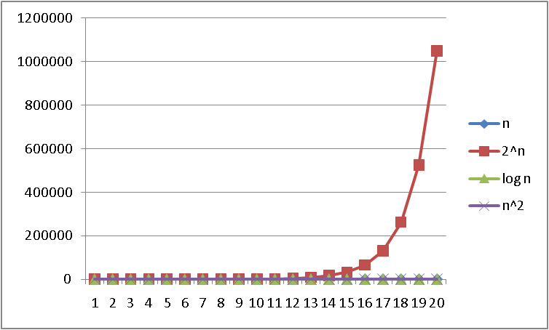
Logarithms and Exponents
See Excel file
for plot data –
play with it!
n
Notes:
what is this 2^n

Slide 51
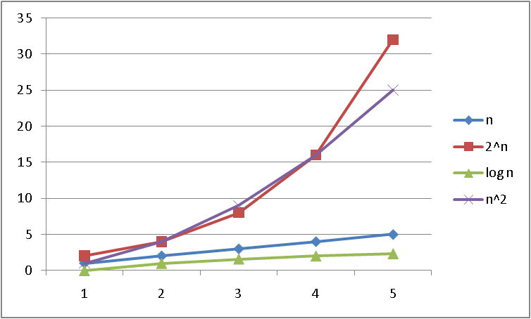
Logarithms and Exponents
See Excel file
for plot data –
play with it!
n
Notes:
which are crossing? n^2 and 2^n

Slide 52
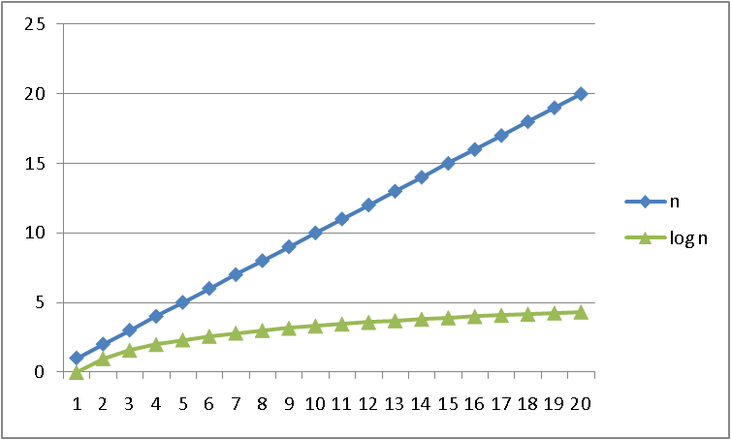
Logarithms and Exponents
See Excel file
for plot data –
play with it!
n
Notes:
n, log(n)

