Slide 1
CSE373: Data Structures & Algorithms Lecture 18: Minimum Spanning Trees
Lauren Milne
Summer 2015

Slide 2
Announcements
Homework 3 graded and comments out
Homework 5 is out
Due next Wednesday
Can be done with partners
List partner on files

Slide 3
So far
We’ve figured out how to
Find the shortest paths between a vertex and all other vertices
Breadth First Search (unweighted graph)
Dijsktra (weighted graph)
Find a spanning tree on an unweighted graph
Graph Traversal (we did DFS)
Pick random edges and see if it connects the graph (use Union Find)
Next up
Find a minimum spanning tree on a weighted graph
Prim’s algorithm
Kruskal’s algorithm

Slide 4
Minimum Spanning Trees
The minimum-spanning-tree problem
Given a weighted undirected graph, compute a spanning tree of minimum weight

Slide 5
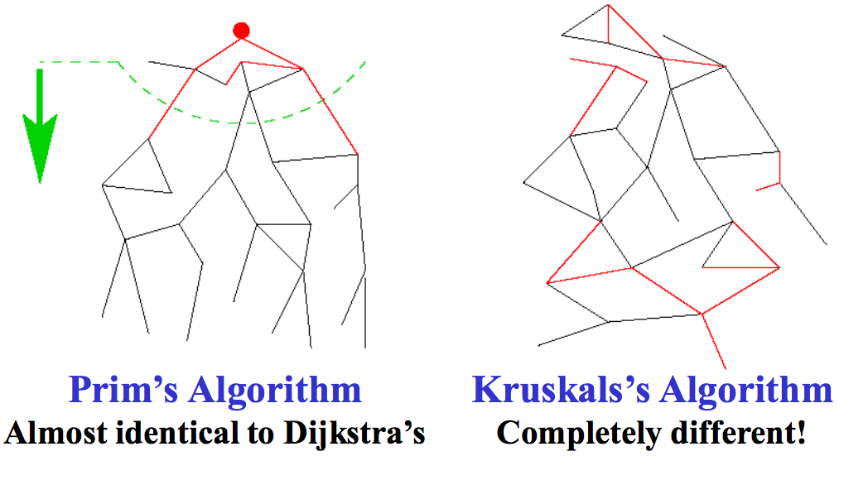
Two different approaches

Slide 6
Prim’s Algorithm Idea

Slide 7
Prim’s vs. Dijkstra’s
Recall:
Dijkstra picked the unknown vertex with smallest cost where
cost = distance to the source.
Prim’s pick the unknown vertex with smallest cost where
cost = distance from this vertex to the known set
(in other words, the cost of the smallest edge connecting this vertex to the known set)
Otherwise identical ☺

Slide 8
Prim’s Algorithm
For each node v, set v.cost = ∞ and v.known = false
Choose any node v
Mark v as known
For each edge (v,u) with weight w, set u.cost=w and u.prev=v
While there are unknown nodes in the graph
Select the unknown node v with lowest cost
Mark v as known and add (v, v.prev) to output
For each edge (v,u) with weight w,
if(w < u.cost) {
u.cost = w;
u.prev = v;
}

Slide 9
Prim’s Example
∞
∞
2
A
B
1
1
∞
2
5
E
∞
1
1
D
3
C
5
∞
∞
2
6
G
vertex | known? | cost | prev
A |  | ??
B |  | ??
C |  | ??
D |  | ??
E |  | ??
F |  | ??
G |  | ??
∞
10
F

Slide 10
Prim’s Example
0
2
2
A
B
1
1
∞
2
5
E
1
1
1
D
3
C
5
2
∞
2
6
G
vertex | known? | cost | prev
A | Y | 0
B |  | 2 | A
C |  | 2 | A
D |  | 1 | A
E |  | ??
F |  | ??
G |  | ??
∞
10
F

Slide 11
Prim’s Example
0
2
2
A
B
1
1
1
2
5
E
1
1
1
D
3
C
5
2
5
2
6
G
vertex | known? | cost | prev
A | Y | 0
B |  | 2 | A
C |  | 1 | D
D | Y | 1 | A
E |  | 1 | D
F |  | 6 | D
G |  | 5 | D
6
10
F

Slide 12
Prim’s Example
0
2
2
A
B
1
1
1
2
5
E
1
1
1
D
3
C
5
2
5
2
6
G
vertex | known? | cost | prev
A | Y | 0
B |  | 2 | A
C | Y | 1 | D
D | Y | 1 | A
E |  | 1 | D
F |  | 2 | C
G |  | 5 | D
2
10
F

Slide 13
Prim’s Example
0
1
2
A
B
1
1
1
2
5
E
1
1
1
D
3
C
5
2
3
2
6
G
vertex | known? | cost | prev
A | Y | 0
B |  | 1 | E
C | Y | 1 | D
D | Y | 1 | A
E | Y | 1 | D
F |  | 2 | C
G |  | 3 | E
2
10
F

Slide 14
Prim’s Example
0
1
2
A
B
1
1
1
2
5
E
1
1
1
D
3
C
5
2
3
2
6
G
vertex | known? | cost | prev
A | Y | 0
B | Y | 1 | E
C | Y | 1 | D
D | Y | 1 | A
E | Y | 1 | D
F |  | 2 | C
G |  | 3 | E
2
10
F

Slide 15
Prim’s Example
0
1
2
A
B
1
1
1
2
5
E
1
1
1
D
3
C
5
2
3
2
6
G
vertex | known? | cost | prev
A | Y | 0
B | Y | 1 | E
C | Y | 1 | D
D | Y | 1 | A
E | Y | 1 | D
F | Y | 2 | C
G |  | 3 | E
2
10
F

Slide 16
Prim’s Example
0
1
2
A
B
1
1
1
2
5
E
1
1
1
D
3
C
5
2
3
2
6
G
vertex | known? | cost | prev
A | Y | 0
B | Y | 1 | E
C | Y | 1 | D
D | Y | 1 | A
E | Y | 1 | D
F | Y | 2 | C
G | Y | 3 | E
2
10
F

Slide 17
Analysis
Correctness
A bit tricky
Intuitively similar to Dijkstra
Run-time
Same as Dijkstra
O(|E|log|V|) using a priority queue
Costs/priorities are just edge-costs, not path-costs

Slide 18
A cable company wants to connect five villages to their network which currently extends to the town of Avonford. What is the minimum length of cable needed?
Another Example
Brinleigh
5
Cornwell
3
4
8
6
8
Avonford
Fingley
Donster
7
5
4
2
Edan

Slide 19
Prim’s Algorithm
Model the situation as a graph and find the MST that connects all the villages (nodes).
B
5
C
3
4
8
6
8
A
D
7
F
5
4
2
E

Slide 20
Prim’s Algorithm
Select any vertex
A
Select the shortest edge connected to that vertex
AB 3
B
5
C
3
4
8
6
8
A
D
7
F
5
4
2
E

Slide 21
Prim’s Algorithm
Select the shortest
edge that connects
an unknown vertex to
any known vertex.
AE 4
B
5
C
3
4
8
6
8
A
D
7
F
5
4
2
E

Slide 22
Prim’s Algorithm
Select the shortest
edge that connects
an unknown vertex to
any known vertex.
ED 2
B
5
C
3
4
8
6
8
A
D
7
F
5
4
2
E

Slide 23
Prim’s Algorithm
Select the shortest
edge that connects
an unknown vertex to
any known vertex.
DC 4
B
5
C
3
4
8
6
8
A
D
7
F
5
4
2
E

Slide 24
Prim’s Algorithm
Select the shortest
edge that connects
an unknown vertex to
any known vertex.
EF 5
B
5
C
3
4
8
6
8
A
D
7
F
5
4
2
E

Slide 25
Prim’s Algorithm
All vertices have been
connected.
The solution is
AB 3
AE 4
ED 2
DC 4
EF 5
Total weight of tree: 18
B
5
C
3
4
8
6
8
A
D
7
F
5
4
2
E

Slide 26
Minimum Spanning Tree Algorithms
Prim’s Algorithm for Minimum Spanning Tree
Similar idea to Dijkstra’s Algorithm but for MSTs.
Both based on expanding cloud of known vertices
Kruskal’s Algorithm for Minimum Spanning Tree
Another, but different, greedy MST algorithm.
Uses the Union-Find data structure.

Slide 27
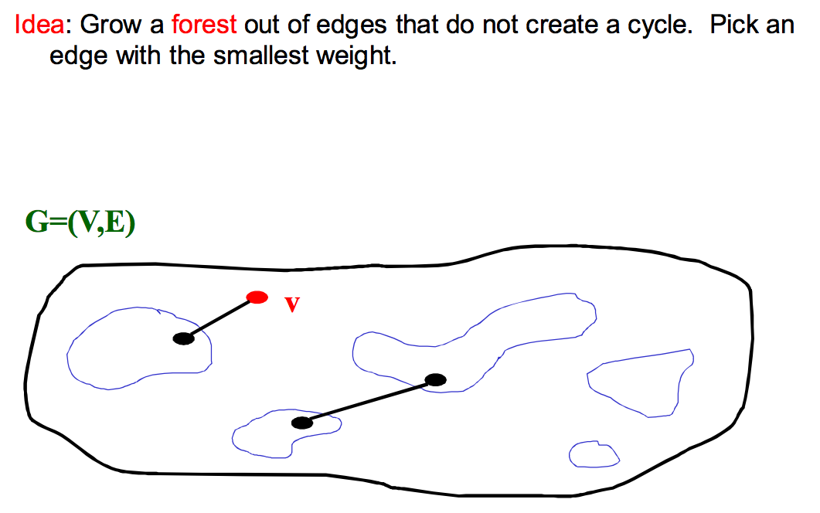
Kruskal’s Algorithm

Slide 28
Kruskal’s Algorithm Pseudocode
Sort edges by weight (better: put in min-heap)
Each node in its own set
While output size < |V|-1
Consider next smallest edge (u,v)
if find(u) and find(v) indicate u and v are in different sets
output (u,v)
union(find(u),find(v))
invariant:
u and v in same set if and only if connected in output-so-far

Slide 29
Kruskal’s Example
2
Edges in sorted order:
1: (A,D), (C,D), (B,E), (D,E)
2: (A,B), (C,F), (A,C)
3: (E,G)
5: (D,G), (B,D)
6: (D,F)
10: (F,G)
A
B
1
1
5
2
E
1
1
D
3
C
5
2
6
G
10
F
Output:
Note: At each step, the union/find sets are the trees in the forest

Slide 30
Kruskal’s Example
2
Edges in sorted order:
1: (A,D), (C,D), (B,E), (D,E)
2: (A,B), (C,F), (A,C)
3: (E,G)
5: (D,G), (B,D)
6: (D,F)
10: (F,G)
A
B
1
1
5
2
E
1
1
D
3
C
5
2
6
G
10
F
Output: (A,D)
Note: At each step, the union/find sets are the trees in the forest

Slide 31
Kruskal’s Example
2
Edges in sorted order:
1: (A,D), (C,D), (B,E), (D,E)
2: (A,B), (C,F), (A,C)
3: (E,G)
5: (D,G), (B,D)
6: (D,F)
10: (F,G)
A
B
1
1
5
2
E
1
1
D
3
C
5
2
6
G
10
F
Output: (A,D), (C,D)
Note: At each step, the union/find sets are the trees in the forest

Slide 32
Kruskal’s Example
2
Edges in sorted order:
1: (A,D), (C,D), (B,E), (D,E)
2: (A,B), (C,F), (A,C)
3: (E,G)
5: (D,G), (B,D)
6: (D,F)
10: (F,G)
A
B
1
1
5
2
E
1
1
D
3
C
5
2
6
G
10
F
Output: (A,D), (C,D), (B,E)
Note: At each step, the union/find sets are the trees in the forest

Slide 33
Kruskal’s Example
2
Edges in sorted order:
1: (A,D), (C,D), (B,E), (D,E)
2: (A,B), (C,F), (A,C)
3: (E,G)
5: (D,G), (B,D)
6: (D,F)
10: (F,G)
A
B
1
1
5
2
E
1
1
D
3
C
5
2
6
G
10
F
Output: (A,D), (C,D), (B,E), (D,E)
Note: At each step, the union/find sets are the trees in the forest

Slide 34
Kruskal’s Example
2
Edges in sorted order:
1: (A,D), (C,D), (B,E), (D,E)
2: (A,B), (C,F), (A,C)
3: (E,G)
5: (D,G), (B,D)
6: (D,F)
10: (F,G)
A
B
1
1
5
2
E
1
1
D
3
C
5
2
6
G
10
F
Output: (A,D), (C,D), (B,E), (D,E)
Note: At each step, the union/find sets are the trees in the forest

Slide 35
Kruskal’s Example
2
Edges in sorted order:
1: (A,D), (C,D), (B,E), (D,E)
2: (A,B), (C,F), (A,C)
3: (E,G)
5: (D,G), (B,D)
6: (D,F)
10: (F,G)
A
B
1
1
5
2
E
1
1
D
3
C
5
2
6
G
10
F
Output: (A,D), (C,D), (B,E), (D,E), (C,F)
Note: At each step, the union/find sets are the trees in the forest

Slide 36
Kruskal’s Example
2
Edges in sorted order:
1: (A,D), (C,D), (B,E), (D,E)
2: (A,B), (C,F), (A,C)
3: (E,G)
5: (D,G), (B,D)
6: (D,F)
10: (F,G)
A
B
1
1
5
2
E
1
1
D
3
C
5
2
6
G
10
F
Output: (A,D), (C,D), (B,E), (D,E), (C,F)
Note: At each step, the union/find sets are the trees in the forest

Slide 37
Kruskal’s Example
2
Edges in sorted order:
1: (A,D), (C,D), (B,E), (D,E)
2: (A,B), (C,F), (A,C)
3: (E,G)
5: (D,G), (B,D)
6: (D,F)
10: (F,G)
A
B
1
1
5
2
E
1
1
D
3
C
5
2
6
G
10
F
Output: (A,D), (C,D), (B,E), (D,E), (C,F), (E,G)
Note: At each step, the union/find sets are the trees in the forest
Notes:
6 edges, 7 vertices

Slide 38
Kruskal’s Algorithm Analysis
Idea: Grow a forest out of edges that do not grow a cycle
But now consider the edges in order by weight
So:
Sort edges: O(|E|log |E|) (next lecture)
Iterate through edges using union-find for cycle detection almost O(|E|)
Somewhat better:
Build min-heap with edges O(|E|) (Floyd’s algorithm)
Iterate through edges using union-find for cycle detection and deleteMin to get next edge O(|E| log |E|)
Not better worst-case asymptotically, but often stop long before considering all edges.
Notes:
as long as we have path compression and union by size, doing find and union takes almost constant time (log*n)

Slide 39
Kruskal’s Algorithm
List the edges in order of size:
ED 2
AB 3
AE 4
CD 4
BC 5
EF 5
CF 6
AF 7
BF 8
CF 8
B
5
C
3
4
8
6
8
A
D
7
F
5
4
2
E

Slide 40
Kruskal’s Algorithm
Select the edge
with min cost
ED 2
B
5
C
3
4
8
6
8
A
D
7
F
5
4
2
E

Slide 41
Kruskal’s Algorithm
Select the next
minimum cost
edge that does not
create a cycle
ED 2
AB 3
B
5
C
3
4
8
6
8
A
D
7
F
5
4
2
E

Slide 42
Kruskal’s Algorithm
Select the next
minimum cost
edge that does not
create a cycle
ED 2
AB 3
CD 4 (or AE 4)
B
5
C
3
4
8
6
8
A
D
7
F
5
4
2
E

Slide 43
Kruskal’s Algorithm
Select the next
minimum cost
edge that does not
create a cycle
ED 2
AB 3
CD 4
AE 4
B
5
C
3
4
8
6
8
A
D
7
F
5
4
2
E

Slide 44
Kruskal’s Algorithm
Select the next
minimum cost
edge that does not
create a cycle
ED 2
AB 3
CD 4
AE 4
BC 5 – forms a cycle
EF 5
B
5
C
3
4
8
6
8
A
D
7
F
5
4
2
E

Slide 45
Kruskal’s Algorithm
All vertices have been
connected.
The solution is
ED 2
AB 3
CD 4
AE 4
EF 5
Total weight of tree: 18
B
5
C
3
4
8
6
8
A
D
7
F
5
4
2
E

Slide 46
Done with graph algorithms!
Next lecture…
Sorting
More sorting
Even more sorting
☺

Slide 47
Homework 5
Due 11pm next Wednesday
You may work with a partner
Create graph representation in MyGraph.java
adjacency list or adjacency matrix
don’t change constructor!
deal with edge cases/exceptions as outlined in html
probably want to use map to look up info about some vertex
Compute shortestPath() using Dijkstra’s
not required to use priority queue to store un-explored vertices
use equals, not == to determine if same vertex, FindPaths() create copies of vertices
finish FindPaths.java so it prints correct output
Test and Readme

