Slide 1
CSE373: Data Structures & Algorithms Lecture 12: Amortized Analysis and Memory Locality
Lauren Milne
Summer 2015

Slide 2
Announcements
Midterms graded, pick them up at the end of class.
Homework 3 due on Wednesday at 11pm
TA Session tomorrow starts at 11 AM (not 10:50 AM)

Slide 3
Amortized Analysis
In amortized analysis, the time required to perform a sequence of data structure operations is averaged over all the operations performed.
Typically used to show that the average cost of an operation is small for a sequence of operations, even though a single operation can cost a lot

Slide 4
Amortized Analysis
Recall our plain-old stack implemented as an array that doubles its size if it runs out of room
Can we claim push is O(1) time if resizing is O(n) time?
We can’t, but we can claim it’s an O(1) amortized operation

Slide 5
Amortized Complexity
We get an upperbound T(n) on the total time of a sequence of n operations. The average time per operation is then T(n)/n, which is also the amortized time per operation.
If a sequence of n operations takes O(n f(n)) time, we say the amortized runtime is O(f(n))
If n operations take O(n), what is amortized time per operation?
O(1) per operation
If n operations take O(n³), what is amortized time per operation?
O(n²) per operation
The worst case time for an operation can be larger than f(n), but amortized guarantee ensures the average time per operation for any sequence is O(f(n))

Slide 6
“Building Up Credit”
Can think of preceding “cheap” operations as building up “credit” that can be used to “pay for” later “expensive” operations
Because any sequence of operations must be under the bound, enough “cheap” operations must come first
Else a prefix of the sequence would violate the bound

Slide 7
Example #1: Resizing stack
A stack implemented with an array where we double the size of the array if it becomes full
Claim: Any sequence of push/pop/isEmpty is amortized O(1) per operation
Need to show any sequence of M operations takes time O(M)
Recall the non-resizing work is O(M) (i.e., M*O(1))
The resizing work is proportional to the total number of element copies we do for the resizing
So it suffices to show that:
After M operations, we have done < 2M total element copies
(So average number of copies per operation is bounded by a constant)

Slide 8
Amount of copying
Claim: after M operations, we have done < 2M total element copies
Let n be the size of the array after M operations
Then we have done a total of:
n/2 + n/4 + n/8 + … INITIAL_SIZE < n
element copies
We must have done at least enough push operations to cause resizing up to size n, so:
M ≥ n/2
Therefore
2M ≥ n > number of element copies

Slide 9
Other approaches
If array grows by a constant amount (say 1000),
operations are not amortized O(1)
After O(M) operations, you may have done Θ(M²) copies
If array shrinks when 1/2 empty, operations are not amortized O(1)
Terrible case: pop once and shrink, push once and grow, pop once and shrink, …
If array shrinks when 3/4 empty, it is amortized O(1)
Proof is more complicated, but basic idea remains: by the time an expensive operation occurs, many cheap ones occurred

Slide 10
Example #2: Queue with two stacks
A clever and simple queue implementation using only stacks
class Queue<E> {
Stack<E> in = new Stack<E>();
Stack<E> out = new Stack<E>();
void enqueue(E x){ in.push(x); }
E dequeue(){
if(out.isEmpty()) {
while(!in.isEmpty()) {
out.push(in.pop());
}
}
return out.pop();
}
}
enqueue: A, B, C
C
B
A
in
out

Slide 11
Example #2: Queue with two stacks
A clever and simple queue implementation using only stacks
class Queue<E> {
Stack<E> in = new Stack<E>();
Stack<E> out = new Stack<E>();
void enqueue(E x){ in.push(x); }
E dequeue(){
if(out.isEmpty()) {
while(!in.isEmpty()) {
out.push(in.pop());
}
}
return out.pop();
}
}
dequeue
A
B
C
in
out

Slide 12
Example #2: Queue with two stacks
A clever and simple queue implementation using only stacks
class Queue<E> {
Stack<E> in = new Stack<E>();
Stack<E> out = new Stack<E>();
void enqueue(E x){ in.push(x); }
E dequeue(){
if(out.isEmpty()) {
while(!in.isEmpty()) {
out.push(in.pop());
}
}
return out.pop();
}
}
enqueue D, E
A
E
D
B
C
in
out

Slide 13
Example #2: Queue with two stacks
A clever and simple queue implementation using only stacks
class Queue<E> {
Stack<E> in = new Stack<E>();
Stack<E> out = new Stack<E>();
void enqueue(E x){ in.push(x); }
E dequeue(){
if(out.isEmpty()) {
while(!in.isEmpty()) {
out.push(in.pop());
}
}
return out.pop();
}
}
dequeue twice
C B A
E
D
in
out

Slide 14
Example #2: Queue with two stacks
A clever and simple queue implementation using only stacks
class Queue<E> {
Stack<E> in = new Stack<E>();
Stack<E> out = new Stack<E>();
void enqueue(E x){ in.push(x); }
E dequeue(){
if(out.isEmpty()) {
while(!in.isEmpty()) {
out.push(in.pop());
}
}
return out.pop();
}
}
dequeue again
D C B A
E
in
out

Slide 15
Analysis
dequeue is not O(1) worst-case because out might be empty and in may have lots of items
But if the stack operations are (amortized) O(1), then any sequence of queue operations is amortized O(1)
The total amount of work done per element is 1 push onto in, 1 pop off of in, 1 push onto out, 1 pop off of out
When you reverse n elements, there were n earlier O(1) enqueue operations to average with

Slide 16
When is Amortized Analysis Useful?
When the average per operation is all we care about (i.e., sum over all operations), amortized is perfectly fine
If we need every operation to finish quickly (e.g., in a web server), amortized bounds may be too weak

Slide 17
Not always so simple
Proofs for amortized bounds can be much more complicated
Example: Splay trees are dictionaries with amortized O(log n) operations
See Chapter 4.5 if curious
For more complicated examples, the proofs need much more sophisticated invariants and “potential functions” to describe how earlier cheap operations build up “energy” or “money” to “pay for” later expensive operations
See Chapter 11 if curious
But complicated proofs have nothing to do with the code (which may be easy!)

Slide 18
Switching gears…
Memory hierarchy/locality

Slide 19
Why do we need to know about the memory hierarchy/locality?
One of the assumptions that Big-O makes is that all operations take the same amount of time
Is this really true?

Slide 20
Definitions
A cycle (for our purposes) is the time it takes to execute a single simple instruction (e.g. adding two registers together)
Memory latency is the time it takes to access memory

Slide 21
Time to access:
~16-64+ registers
1 ns per instruction
CPU
SRAM
8 KB - 4 MB
Cache
2-10 ns
Main Memory
DRAM
2-10 GB
40-100 ns
a few
milliseconds
(5-10 million ns)
Disk
many GB
Notes:
each register 8-32 bits of memory, simple arithmetic or logical operations: add two numbers together
static RAM
dynamic RAM- single capacitor

Slide 22
What does this mean?
It is much faster to do: Than: 5 million arithmetic ops 1 disk access 2500 L2 cache accesses 1 disk access 400 main memory accesses 1 disk access
Why are computers build this way?
Physical realities (speed of light, closeness to CPU)
Cost (price per byte of different storage technologies)
Under the right circumstances, this kind of hierarchy can simulate storage with access time of highest (fastest) level and size of lowest (largest) level

Slide 23
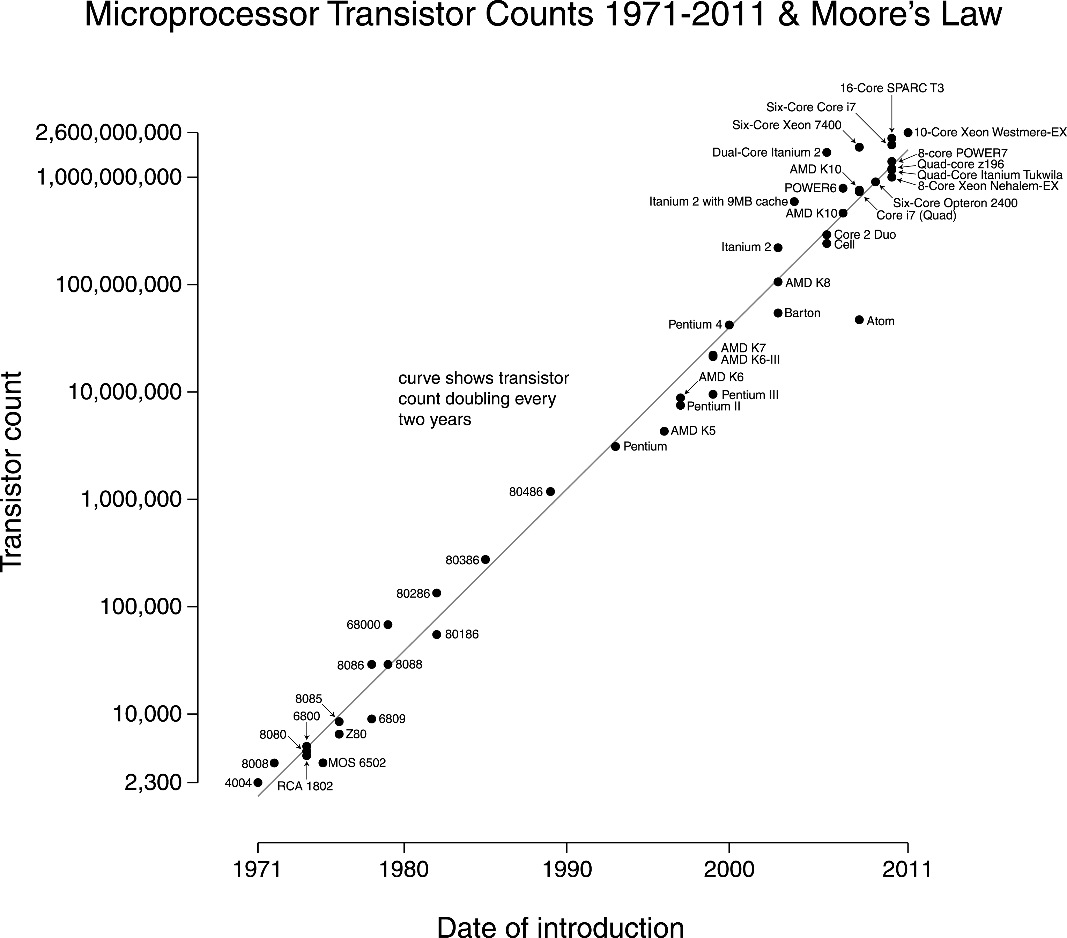
Notes:
number of transistors per chip doubled every two years

Slide 24
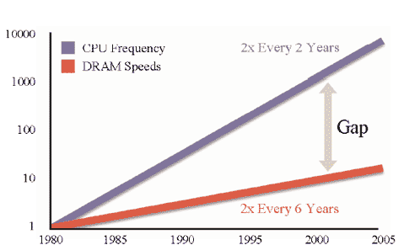
Processor-Memory Performance Gap

Slide 25
What can be done?
Goal: attempt to reduce the accesses to slower levels

Slide 26
So, what can we do?
The hardware automatically moves data from main memory into the caches for you
Replacing items already there
Algorithms are much faster if “data fits in cache” (often does)
Disk accesses are done by software (e.g. ask operating system to open a file or database to access some records)
So most code “just runs,” but sometimes it’s worth designing algorithms / data structures with knowledge of memory hierarchy
To do this, we need to understand locality

Slide 27
Locality
Temporal Locality (locality in time)
If an item (a location in memory) is referenced, that same location will tend to be referenced again soon.
Spatial Locality (locality in space)
If an item is referenced, items whose addresses are close by tend to be referenced soon.

Slide 28
How does data move up the hierarchy?
Moving data up the hierarchy is slow because of latency (think distance to travel)
Since we’re making the trip anyway, might as well carpool
Get a block of data in the same time we could get a byte
Sends nearby memory because
It’s easy
Likely to be asked for soon (think fields/arrays)
Once a value is in cache, may as well keep it around for a while; accessed once, a value is more likely to be accessed again in the near future (as opposed to some random other value)
Spatial Locality
Temporal Locality

Slide 29
Cache Facts
Definitions:
Cache hit – address requested is in the cache
Cache miss – address requested is NOT in the cache
Block or page size – the number of contiguous bytes moved from disk to memory
Cache line size – the number of contiguous bytes moved from memory to cache

Slide 30
Examples
x = a + 6
y = a + 5
z = 8 * a
miss
hit
hit
Notes:
temporal locality (red) spatial locality (blue)

Slide 31
Examples
x = a + 6
y = a + 5
z = 8 * a
x = a[0] + 6
y = a[1] + 5
z = 8 * a[2]
miss
miss
hit
hit
hit
hit

Slide 32
Examples
x = a + 6
y = a + 5
z = 8 * a
x = a[0] + 6
y = a[1] + 5
z = 8 * a[2]
miss
miss
hit
hit
hit
hit
temporal locality
spatial
locality

Slide 33
Locality and Data Structures
Which has (at least the potential) for better spatial locality, arrays or linked lists?

Slide 34
Locality and Data Structures
Which has (at least the potential) for better spatial locality, arrays or linked lists?
e.g. traversing elements
Only miss on first item in a cache line
miss
hit
hit
hit
miss
hit
hit
cache line size
cache line size
Notes:
fit 4 items in cache

Slide 35
Locality and Data Structures
Which has (at least the potential) for better spatial locality, arrays or linked lists?
e.g. traversing elements

Slide 36
Locality and Data Structures
Which has (at least the potential) for better spatial locality, arrays or linked lists?
e.g. traversing elements
Miss on every item (unless more than one randomly happen to be in the same cache line)
miss
hit
miss
hit
miss
hit
miss
hit

