Slide 1
CSE373: Data Structures & Algorithms Lecture 26: Memory Hierarchy and Locality
Kevin Quinn, Fall 2015
1

Slide 2
Why do we need to know about the memory Hierarchy?
One of the assumptions that Big-Oh makes is that all operations take the same amount of time
This is not quite correct.

Slide 3
Example
x
0
8
y
1
16
2
int x = 8;
int y = 2 * x;
int[] z = new int[1000]
int val = z[0] + z[1] + z[999];
ListNode top = new ListNode(7);
top.next = new ListNode(24);
ListNode temp = top.next;
…
z[0]
1000
0
z[1]
1001
0
…
…
z[999]
1999
0
…
…
top
3000
address 5000
3001
…
…
val
5000
7
next
5001
address 7000
…
…
val
7000
24
next
7001
null

Slide 4
Definitions
Cycle (for our purposes): the time is takes to execute a single simple instruction (for example, add 2 registers together)
Memory Latency: The time it takes to access memory

Slide 5
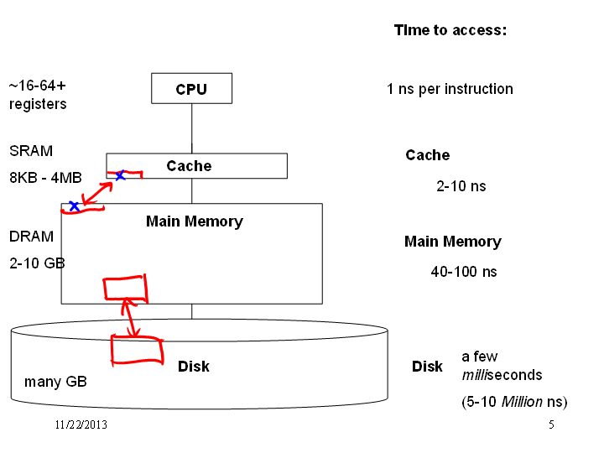

Slide 6
Moral of the story
It is much faster to do:
5 million arithmetic ops than 1 disk access
25000 L2 cache accesses than 1 disk access
400 main memory accesses then 1 disk access
Why though?
Physical realities (speed of light, closeness to CPU)
Cost (price per byte of different technologies)
Disks get much bigger but not much faster
Spinning at 7200 RPM account for much of the slowness, spinning hard disks are unlikely to get much faster.
What about SSDs?
Speedup at higher levels (i.e. a faster processor) makes lower level accesses relatively slower. Yikes.

Slide 7
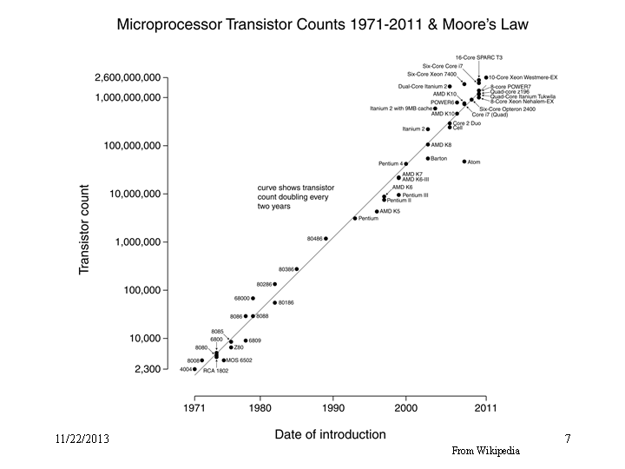

Slide 9
What can we do to optimize?
Hardware automatically moves data into caches from main memory
Replacing items already there
Algorithms are much faster if data fits in the cache
Disk accesses are abstracted away by the operating system
Code “just runs” but sometimes it’s worth designing algorithms/data structures with knowledge of the memory hierarchy

Slide 10
Locality
Temporal Locality (locality in time)
If an item (a location in memory) is referenced, that same location will tend to be referenced again soon
Spatial Locality (locality in space)
If an item is referenced, items whose addresses are close by will tend to be referenced soon as well

Slide 11
How does data move up the hierarchy?
Moving data up the hierarchy is slow because of latency (distance to travel)
Since we are making a trip anyway, might as well carpool!
Get a block of data in the same time it takes to get a byte
Send nearby memory
Because its cheap and easy
And spatial locality says it will be asked for soon!
Once we move something to the cache, keep it around for a while, no rush to get rid of it! (Temporal Locality)

Slide 12
Cache Facts
Each level is a sub-set of the level below
Definitions
Cache hit: address requested already in the cache
Cache miss: address request NOT in the cache
Block of page size: the number of contiguous bytes moved from disk to memory
Cache line size: the number of contiguous bytes moved from memory to the cache

Slide 13
Examples
x = a + 6; miss
y = a + 5; hit Temporal
z = 8 * a; hit Locality
x = a[0]; miss
y = a[1] + 5; hit Spatial
z = 8 * a[2]; hit Locality

Slide 14
Locality in Data Structure
Which has the least potential for better spatial locality, arrays or linked lists?

Slide 15
Where is the locality?
for (int i = 1; i < 100; i++) {
a = a * 7;
b = b + x[i];
c = y[5] + d;
}
= Spatial Locality on locations in array x
= Temporal Locality

