Slide 1
CSE 373: Data Structure & Algorithms Lecture 25: Programming Languages
Nicki Dell
Spring 2014

Slide 2
What is a Programming Language?
A set of symbols and associated tools that translate (if necessary) collections of symbols into instructions to a machine
Compiler, execution platform (e.g. Java Virtual Machine)
Designed by someone or some people
Can have flaws, poor decisions, mistakes
Syntax
What combinations of symbols are allowed
Semantics
What those combinations mean
These can be defined in different ways for different languages
There are a lot of languages
Wikipedia lists 675 excluding dialects of BASIC and esoteric languages

Slide 3
Before High-Level Languages
Everything done machine code or an assembly language
Arithmetic operations (add, multiply, etc.)
Memory operations (storing, loading)
Control operations (jump, branch)
Example: move 8-bit value into a register
1101 is binary code for move followed by 3-bit register id
1101000 01100001
B0 61
MOV AL, 61h ; Load AL with 97 decimal (61 hex)

Slide 4
Programming Language timeline
C: 1973
C++: 1980
MATLAB: 1984
Objective-C: 1986
Mathematic (Wolfram): 1988
Python: 1991
Ruby: 1993
Java: 1995
Javascript: 1995
PHP: 1995
C#: 2001
Scala: 2003

Slide 5
Choosing a Programming Language
Most of the time you won’t have a choice about what programming language to use
Software is already written in a particular language
Platform requires a specific language (Objective-C for iOS)
Language required by computational tool (Mathematica, etc.)
Still important to understand capabilities and limitations of language
When you do get to choose, your choice can have tremendous impact
This is despite theoretical equivalence!

Slide 6
Turing Completeness
A programming language is said to be Turing complete if it can compute every computable function
Famous non-computable function is the Halting Problem
So every Turing complete language can approximately simulate every other Turing complete language (do the same stuff)
Virtually every programming language you might encounter is Turing complete
Data or markup languages (e.g. JSON, XML, HTML) are an exception
So a choice of language is about how computation is described, not about what it’s possible to compute

Slide 7
What we might want from a Language
Readable (good syntax, intuitive semantics)
High-level of abstraction (but still possible to access low level)
Fast
Good concurrency and parallelism
Portable
Manage side effects
Expressive
Make dumb things hard
Secure
Provably correct
etc.

Slide 8
Type System
Collection of rules to assign types to elements of the language
Values, variables, functions, etc.
The goal is to reduce bugs
Logic errors, memory errors
Governed by type theory, an incredibly deep and complex topic
The type safety of a language is the extent to which its type system prevents or discourages relevant type errors
Via type checking
We’ll cover the following questions:
When does the type system check?
What does the type system check?
What do we have to tell the type system?

Slide 9
When Does It Check? – Static type checking
Static type-checking (check at compile-time)
Based on source code (program text)
If program passes, it’s guaranteed to satisfy some type-safety properties on all possible inputs
Catches bugs early (program doesn’t have to be run)
Possibly better run-time performance
Less (or no) checking to do while program runs
Compiler can optimize based on type
Not all useful features can be statically checked
Many languages use both static and dynamic checking

Slide 10
When Does it Check? – Dynamic type checking
Dynamic type-checking (check at run-time)
Performed as the program is executing
Often “tag” objects with their type information
Look up type information when performing operations
Possibly faster development time
edit-compile-test-debug cycle
Fewer guarantees about program correctness

Slide 11
What Does it Check?
Nominal type system (name-based type system)
Equivalence of types based on declared type names
Objects are only subtypes if explicitly declared so
Can be statically or dynamically checked
Structural type system (property-based type system)
Equivalence of types based on structure/definition
An element A is compatible with an element B if for each feature in B’s type, there’s an identical feature in A’s type
Not symmetric, subtyping handled similarly
Duck typing
Type-checking only based on features actually used
Only generates run-time errors

Slide 12
How Much do we Have to Tell it?
Type Inference
Automatically determining the type of an expression
Programmer can omit type annotations
Instead of (in C++) std::vector<int>::const_iterator itr = myvec.cbegin() use (in C++11) auto itr = myvec.cbegin()
Can make programming tasks easier
Only happens at compile-time
Otherwise, types must be manifest (always written out)

Slide 13
How Flexible is it?
Type conversion (typecasting)
Changing a value from one type to another, potentially changing the storage requirements
Reinterpreting the bit pattern of a value from one type to another
Can happen explicitly or implicitly
double da = 3.3
double db = 3.3;
double dc = 3.4;
int result = (int)da + (int)db + (int)dc;
int result = da + db + dc;

Slide 14
What Does it All Mean?
Most of these distinctions are not mutually exclusive
Languages that do static type-checking often have to do some dynamic type-checking as well
Some languages use a combination of nominal and duck typing
Terminology is useful for describing language characteristics
The terms “strong” or “weak” typing are often applied
These lack any formal definition
Languages aren’t necessarily limited to “official” tools

Slide 15
Memory Safety
Memory errors
Buffer overflow
Dynamic
Uninitialized variables
Out of memory
Often closely tied to type safety
Can be checked at compile-time or run-time (or not at all)
Memory can be managed manually or automatically
Garbage collection is a type of automatic management
Some languages make use of both

Slide 16
Programming Paradigms
A programming paradigm describes some fundamental way of constructing and organizing computer programs
A programming language supports one or more paradigms
Imperative
A program is a series of statements that explicitly change the program state.
Declarative
A program describes what should happen without describing how it happens
Functional (can be considered a type of declarative)
Computation done by evaluation of functions, avoiding state and mutable data
Object-oriented (as opposed to procedural)
Computation done via objects (containing data and methods)

Slide 17
Language Development
Many attempts to develop a “universal language”
have failed due to diverse needs
program size, programmer expertise, program requirements, program evolution, and personal taste
Languages often change over time
Generics were added to Java 9 years after initial release
Take extreme care not to break existing code
One “standard,” many implementations
Standard defines syntax and semantics
Whether a language will become popular is unpredictable
Some research suggests things like library availability and social factors may be more important than language features

Slide 18
Java
Age: 19 years
Developer: Oracle Corporation
Paradigms: imperative, object-oriented
Type system: static, nominative, manifest
One of the most popular languages in use today
Lots of great tools and other resources
Write Once, Run Anywhere approach (via JVM)
Used to be considered slow, improved by JIT optimization
Other languages using JVM (Scala, Jython, Clojure, Groovy)
Can be quite verbose
Sees lots of use in large-scale enterprise software
I like Java (I’ve used it a lot). Some people hate java.

Slide 19
C/C++
Age: 42/31 years
Developer: International Organization for Standardization
Paradigms: imperative, procedural, object-oriented (C++ only)
Type system: static, nominative, manifest (C++11 has inference)
Two of the most popular languages in use today
“Closer to the hardware” than Java
Used where predictable resource use is necessary
OS, graphics, games, compilers
Manual memory management, less protection from memory errors, sometimes inscrutable compiler errors
Generally easier to “do dumb things”
I’ve used C/C++ for systems programming and for building graphics/vision applications.

Slide 20
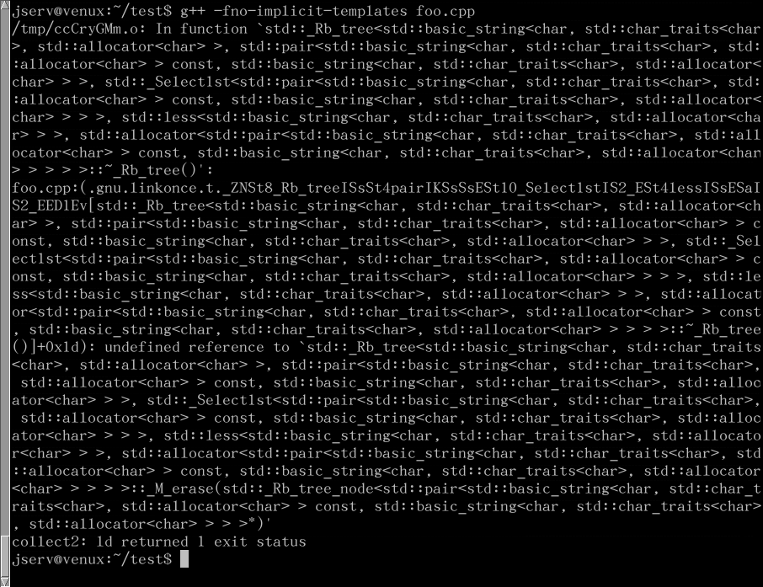

Slide 21
C#
Age: 14 years
Developer: Microsoft
Paradigms: imperative, object-oriented, functional
Type system: static, nominative, partially inferred
optionally dynamic
Runs on the .NET Framework
Provides things like garbage collection (similar to the JVM)
Allows access to system functions with unsafe keyword
Less verbose than Java, safer than C++
Primary use is writing Windows applications
I have programmed a little in C# (when at Microsoft), but Windows-only can be a big drawback

Slide 22
Haskell
Age: 24 years
Developer: many (research language)
Paradigm: pure functional, lazy evaluation
Type system: static, inferred
Pure functional programming is a different way of thinking
maybe liberating, maybe frustrating
Functional programming has seen only limited industrial use
Safer and more transparent than an imperative language
Same function with same args always returns same value
Allows for compiler optimizations
Performance suffers as hardware better suited to mutable data
I think functional programming is fascinating, and enough languages include functional elements to make it worth learning

Slide 23
SQL (Structured Query Language)
Age: 40 years
Developer: ISO
Paradigms: declarative
Type system: static
Used as a database query language
Declarative paradigm perfect for this application
Using SQL is both easy and very powerful
If you have a lot of data, definitely consider using free database software like MySQL

Slide 24
Python
Age: 23 years
Developer: Python Software Foundation
Paradigm: imperative, object-oriented, functional, procedural
Type system: dynamic, duck
Has a Read-Eval-Print-Loop (REPL)
Useful for experimenting or one-off tasks
Scripting language
Supports “scripts,” small programs run without compilation
Often used in web development or scientific/numeric computing
Variables don’t have types, only values have types
Whitespace has semantic meaning
Lack of variable types and compile-time checks mean more may be required of documentation and testing
Python is my language of choice for accomplishing small tasks

Slide 25
JavaScript
Age: 19 years
Developer: Mozilla Foundation
Paradigm: imperative, object-oriented, functional, procedural
Type system: dynamic, duck
Also a scripting language (online/browser REPLs exist)
Primary client-side language of the web
Takes a continue at any cost approach
Shared by many web-focused languages (PHP, HTML)
Things that would be errors in other languages don’t stop execution, and are allowed to fail silently
JavaScript is nice for simple things, immediately running on the web is great, but doing larger/more complex software is terrible

Slide 26
PHP
Age: 19 years
Developer: The PHP Group
Paradigm: imperative, object-oriented, functional, procedural
Type system: dynamic
Works with Apache (>50% all websites), so very common server-side language
Minimal type system, lots of strange behavior, just awful
If two strings are compared with ==, PHP will silently cast them to numbers (0e45h7 == 0w2318 evaluates to true)
I hope none of you will ever have to use (or choose to use) PHP

