Slide 1
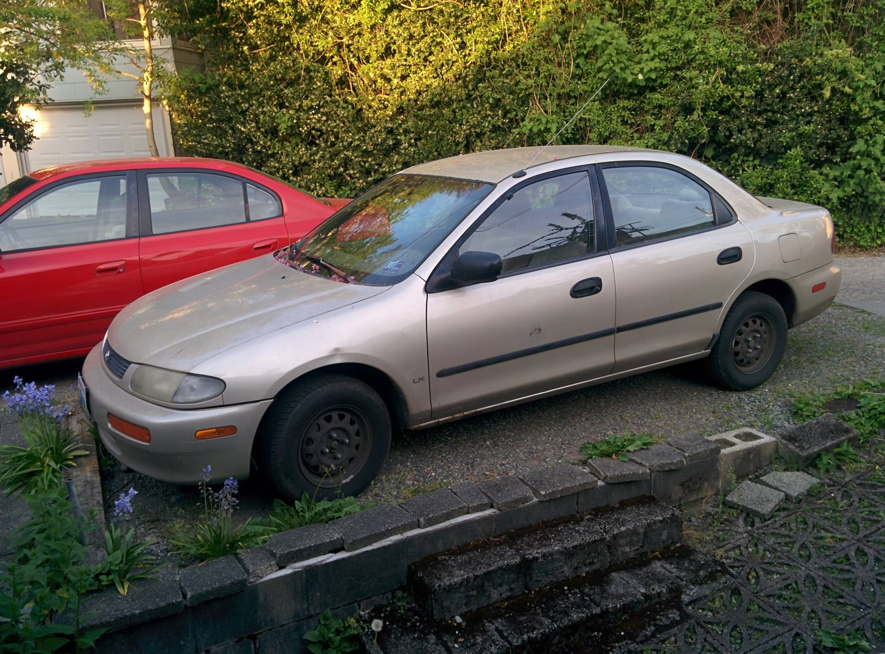
Section 4
CSE 341 – Konstantin Weitz

Slide 2
Mutual Recursion
What if we need function f to call g,
and function g to call f?

Slide 3
Mutual Recursion
Does this work?
1 fun f x = 5 fun g y =
2 ... 6 ...
3 g y 7 f x
4 ... 8 ...

Slide 4
Mutual Recursion
We can employ higher order functions
for a work around.
fun earlier (f,x) = … f y …
…
fun later x = … earlier(later,y)
Notes:
fun earlier (f, x) =
blah blah...
f x
...
fun later x =
blah blah
earlier (later, x)
blah blah

Slide 5
Mutual Recursion
But ML gives us special syntax for this
1 fun f x = 5 and g y =
2 ... 6 ...
3 g y 7 f x
4 ... 8 ...

Slide 6
Modules
Remember that signatures are good both for organization and management and for maintaining invariants

Slide 7
Modules - Invariants
Ordering of operations
e.g. insert, then query
Data kept in good state
e.g. fractions in lowest terms
Policies followed
e.g. don't allow shipping request without purchase order
Sensitive information hidden
e.g. force authentication for api use

Slide 8
Currying and Higher Order Functions
Questions?

