Slide 1
CSE 341 : Programming Languages Section 2 More Racket!
Autumn 2015

Slide 2
Reminder: TAs and Office Hours
James Barnes (jbarnes7 at cs)
Section AA: Thurs 12:30pm-1:20pm MGH 284
Office Hours: Mon 12:30-1:20, CSE 002
Dylan Swiggett (swiggd at cs)
Section AB: Thurs 1:30pm-2:20pm EEB 031
Office Hours: Tues 12:30-1:20, CSE 002
Justin Adsuara (justbads at cs)
Section AC: Thurs 2:30pm-3:20pm SAV 130
Office Hours: Thurs 3:30-4:20, CSE 002
Ben Tebbs (bentebbs at cs)
Office hours by appointment

Slide 3
Homework 1
Due yesterday! Try not to use two late days!
We’ll discuss solutions next week.

Slide 4
Lambdas and Scope

Slide 5
Structs and Side Effects
(struct point (x y) #:mutable #:transparent)
(define (do-things-with-points p1 p2)
(set-point-x! p1 0)
(set-point-y! p2 0)
(point (+ (point-x p1) (point-x p2))
(+ (point-y p1) (point-y p2))))
(define p1 (point 2 3))
(define p2 (point 4 5))
(define p3 (do-things-with-points p1 p2))
(print p1)
(print p2)
(print p3)
;; what was printed?

Slide 6
Simulating Objects
Define a make-cell function that returns a simulated instance of a cell with a single field value, which should be hidden (using lexical scoping). The cell should provide “methods” for get-value and set-value!. The value should start out as null.
Similarly but with more bells and whistles… define a make-point function that returns a simulated instance of point with x and y fields, which should be hidden (using lexical scoping). The point should provide “methods” for get-x, get-y, set-x!, set-y! and print-point. The fields should start out as 0.

Slide 7
Polynomials Project (demo)
poly-multiply
poly->code
Plus a few macro problems, just for fun!

Slide 8
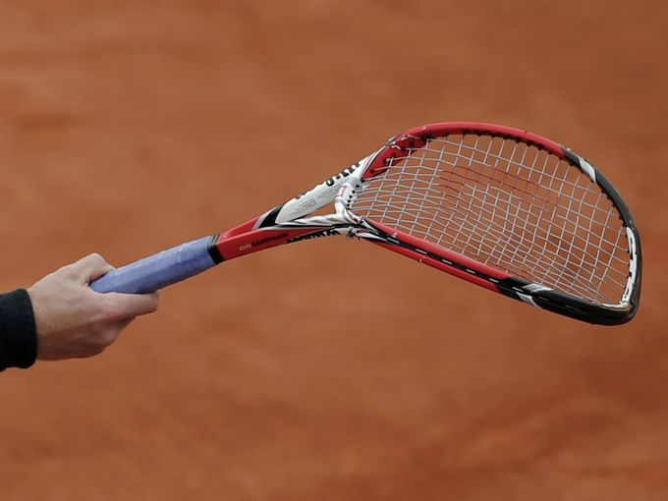
Any questions or problems?

