Slide 1
CSE 341 : Programming Languages Section 1 Hello Racket!
Autumn 2015

Slide 2
Hello! Your TAs are…
James Barnes (jbarnes7 at cs)
Section AA: Thurs 12:30pm-1:20pm MGH 284
Office Hours: Mon 12:30-1:20, CSE 002
Dylan Swiggett (swiggd at cs)
Section AB: Thurs 1:30pm-2:20pm EEB 031
Office Hours: Tues 12:30-1:20, CSE 002
Justin Adsuara (justbads at cs)
Section AC: Thurs 2:30pm-3:20pm SAV 130
Office Hours: Thurs 3:30-4:20, CSE 002
Ben Tebbs (bentebbs at cs)
Office hours by appointment

Slide 3
Racket
Setup guide on the course web, options:
@ Home: download DrRacket (6.2.1)
Labs have the software now (Linux & Windows)
Important features:
Run
Debug
Check Syntax
Questions?

Slide 4
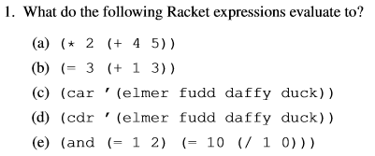
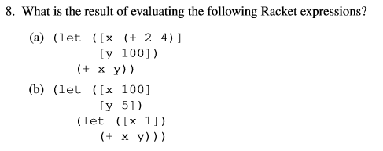
Exercises (from class)
Questions?
Questions?

Slide 5
Exercises
(/ 1 0.0)
(+ 3 (abs (- 1/2 1))
(let* ([x 0.5])
(let ([y 1]
[z x])
(let ([z y]
[y z])
(+ x y z))))

Slide 6
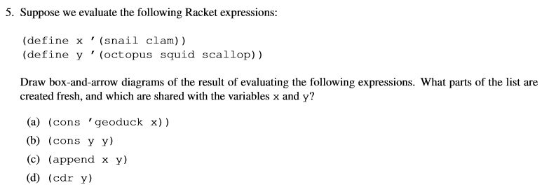
Exercises
Examples:
(equal? (x) (x)) => error! x is unknown function (equal? '(x) '(x)) => #t (cons 'x '(y z)) => '(x y z) (cons 'x '() ) => '(x) (car '(1 2 3)) => 1 (cdr (cons 1 '(2 3))) => '(2 3)
List reminders
length -- length of a list
equal? -- test if two lists are equal (recursively)
car -- first element of a list
cdr -- rest of a list
cons -- make a new list cell (a.k.a. cons cell)
list -- make a list

Slide 7
Exercises
Function reminders
Anonymous
(lambda (x1 x2) (* (- x1 x2) (- x1 x2)))
Named
(define square-diff (lambda (x1 x2) (* (- x1 x2) (- x1 x2)))) OR
(define (square-diff x1 x2) (* (- x1 x2) (- x1 x2)))) [syntactic sugar]

Slide 8
Homework questions?

