Slide 1
CSE 341 Programming Languages Dynamic Dispatch vs. Closures OOP vs. Functional Decomposition Wrapping Up
Zach Tatlock
Spring 2014

Slide 2
Dynamic dispatch
Dynamic dispatch
Also known as late binding or virtual methods
Call self.m2() in method m1 defined in class C can resolve to a method m2 defined in a subclass of C
Most unique characteristic of OOP
Need to define the semantics of method lookup as carefully as we defined variable lookup for our PLs

Slide 3
Review: variable lookup
Rules for “looking things up” is a key part of PL semantics
ML: Look up variables in the appropriate environment
Lexical scope for closures
Field names (for records) are different: not variables
Racket: Like ML plus let, letrec
Ruby:
Local variables and blocks mostly like ML and Racket
But also have instance variables, class variables, methods (all more like record fields)
Look up in terms of self, which is special

Slide 4
Using self
self maps to some “current” object
Look up instance variable @x using object bound to self
Look up class variables @@x using object bound to self.class
Look up methods…

Slide 5
Ruby method lookup
The semantics for method calls also known as message sends
e0.m(e1,…,en)
Evaluate e0, e1, …, en to objects obj0, obj1, …, objn
As usual, may involve looking up self, variables, fields, etc.
Let C be the class of obj0 (every object has a class)
If m is defined in C, pick that method, else recur with the superclass of C unless C is already Object
If no m is found, call method_missing instead
Definition of method_missing in Object raises an error
Evaluate body of method picked:
With formal arguments bound to obj1, …, objn
With self bound to obj0 -- this implements dynamic dispatch!

Slide 6
Punch-line again
e0.m(e1,…,en)
To implement dynamic dispatch, evaluate the method body with self mapping to the receiver (result of e0)
That way, any self calls in body of m use the receiver's class,
Not necessarily the class that defined m
This much is the same in Ruby, Java, C#, Smalltalk, etc.

Slide 7
Comments on dynamic dispatch
This is why distFromOrigin2 worked in PolarPoint
More complicated than the rules for closures
Have to treat self specially
May seem simpler only if you learned it first
Complicated does not necessarily mean inferior or superior

Slide 8
Static overloading
In Java/C#/C++, method-lookup rules are similar, but more complicated because > 1 methods in a class can have same name
Java/C/C++: Overriding only when number/types of arguments the same
Ruby: same-method-name always overriding
Pick the “best one” using the static (!) types of the arguments
Complicated rules for “best”
Type-checking error if there is no “best”
Relies fundamentally on type-checking rules
Ruby has none

Slide 9
A simple example, part 1
In ML (and other languages), closures are closed
So we can shadow odd, but any call to the closure bound to odd above will “do what we expect”
Does not matter if we shadow even or not
fun even x = if x=0 then true else odd (x-1)
and odd x = if x=0 then false else even (x-1)
(* does not change odd – too bad; this would improve it *)
fun even x = (x mod 2)=0
(* does not change odd – good thing; this would break it *)
fun even x = false

Slide 10
A simple example, part 2
In Ruby (and other OOP languages), subclasses can change the behavior of methods they do not override
class A
def even x
if x==0 then true else odd (x-1) end
end
def odd x
if x==0 then false else even (x-1) end
end
end
class B < A # improves odd in B objects
def even x ; x % 2 == 0 end
end
class C < A # breaks odd in C objects
def even x ; false end
end

Slide 11
The OOP trade-off
Any method that makes calls to overridable methods can have its behavior changed in subclasses even if it is not overridden
Maybe on purpose, maybe by mistake
Observable behavior includes calls-to-overridable methods
So harder to reason about “the code you're looking at”
Can avoid by disallowing overriding
“private” or “final” methods
So easier for subclasses to affect behavior without copying code
Provided method in superclass is not modified later

Slide 12
DECOMPOSITION

Slide 13
Breaking things down
In functional (and procedural) programming, break programs down into functions that perform some operation
In object-oriented programming, break programs down into classes that give behavior to some kind of data
This lecture:
These two forms of decomposition are so exactly opposite that they are two ways of looking at the same “matrix”
Which form is “better” is somewhat personal taste, but also depends on how you expect to change/extend software
For some operations over two (multiple) arguments, functions and pattern-matching are straightforward, but with OOP we can do it with double dispatch (multiple dispatch)

Slide 14
The expression example
Well-known and compelling example of a common pattern:
Expressions for a small language
Different variants of expressions: ints, additions, negations, …
Different operations to perform: eval, toString, hasZero, …
Leads to a matrix (2D-grid) of variants and operations
Implementation will involve deciding what “should happen” for each entry in the grid regardless of the PL
 | eval | toString | hasZero | …
Int
Add
Negate
…

Slide 15
Standard approach in ML
 | eval | toString | hasZero | …
Int
Add
Negate
…
Define a datatype, with one constructor for each variant
(No need to indicate datatypes if dynamically typed)
“Fill out the grid” via one function per column
Each function has one branch for each column entry
Can combine cases (e.g., with wildcard patterns) if multiple entries in column are the same
[See the ML code]

Slide 16
Standard approach in OOP
 | eval | toString | hasZero | …
Int
Add
Negate
…
Define a class, with one abstract method for each operation
(No need to indicate abstract methods if dynamically typed)
Define a subclass for each variant
So “fill out the grid” via one class per row with one method implementation for each grid position
Can use a method in the superclass if there is a default for multiple entries in a column
[See the Ruby and Java code]

Slide 17
A big course punchline
 | eval | toString | hasZero | …
Int
Add
Negate
…
FP and OOP often doing the same thing in exact opposite way
Organize the program “by rows” or “by columns”
Which is “most natural” may depend on what you are doing (e.g., an interpreter vs. a GUI) or personal taste
Code layout is important, but there is no perfect way since software has many dimensions of structure
Tools, IDEs can help with multiple “views” (e.g., rows / columns)

Slide 18
Extensibility
 | eval | toString | hasZero | noNegConstants
Int
Add
Negate
Mult
For implementing our grid so far, SML / Racket style usually by column and Ruby / Java style usually by row
But beyond just style, this decision affects what (unexpected?) software extensions need not change old code
Functions [see ML code]:
Easy to add a new operation, e.g., noNegConstants
Adding a new variant, e.g., Mult requires modifying old functions, but ML type-checker gives a to-do list if original code avoided wildcard patterns

Slide 19
Extensibility
 | eval | toString | hasZero | noNegConstants
Int
Add
Negate
Mult
For implementing our grid so far, SML / Racket style usually by column and Ruby / Java style usually by row
But beyond just style, this decision affects what (unexpected?) software extensions are easy and/or do not change old code
Objects [see Ruby code]:
Easy to add a new variant, e.g., Mult
Adding a new operation, e.g., noNegConstants requires modifying old classes, but Java type-checker gives a to-do list if original code avoided default methods

Slide 20
The other way is possible
Functions allow new operations and objects allow new variants without modifying existing code even if they didn’t plan for it
Natural result of the decomposition
Optional:
Functions can support new variants somewhat awkwardly “if they plan ahead”
Not explained here: Can use type constructors to make datatypes extensible and have operations take function arguments to give results for the extensions
Objects can support new operations somewhat awkwardly “if they plan ahead”
Not explained here: The popular Visitor Pattern uses the double-dispatch pattern to allow new operations “on the side”

Slide 21
Thoughts on Extensibility
Making software extensible is valuable and hard
If you know you want new operations, use FP
If you know you want new variants, use OOP
If both? Languages like Scala try; it’s a hard problem
Reality: The future is often hard to predict!
Extensibility is a double-edged sword
Code more reusable without being changed later
But makes original code more difficult to reason about locally or change later (could break extensions)
Often language mechanisms to make code less extensible (ML modules hide datatypes; Java’s final prevents subclassing/overriding)

Slide 22
Binary operations
 | eval | toString | hasZero | …
Int
Add
Negate
…
Situation is more complicated if an operation is defined over multiple arguments that can have different variants
Can arise in original program or after extension
Function decomposition deals with this much more simply…

Slide 23
Example
To show the issue:
Include variants String and Rational
(Re)define Add to work on any pair of Int, String, Rational
Concatenation if either argument a String, else math
Now just defining the addition operation is a different 2D grid:
 | Int | String | Rational
Int
String
Rational

Slide 24
ML Approach
Addition is different for most Int, String, Rational combinations
Run-time error for non-value expressions
Natural approach: pattern-match on the pair of values
For commutative possibilities, can re-call with (v2,v1)
fun add_values (v1,v2) =
case (v1,v2) of
(Int i, Int j) => Int (i+j)
| (Int i, String s) => String (Int.toString i ^ s)
| (Int i, Rational(j,k)) => Rational (i*k+j,k)
| (Rational _, Int _) => add_values (v2,v1)
| … (* 5 more cases (3*3 total): see the code *)
fun eval e =
case e of
…
| Add(e1,e2) => add_values (eval e1, eval e2)

Slide 25
Example
To show the issue:
Include variants String and Rational
(Re)define Add to work on any pair of Int, String, Rational
Concatenation if either argument a String, else math
Now just defining the addition operation is a different 2D grid:
Worked just fine with functional decomposition -- what about OOP…
 | Int | String | Rational
Int
String
Rational

Slide 26
What about OOP?
Starts promising:
Use OOP to call method add_values to one value with other value as result
class Add
…
def eval
e1.eval.add_values e2.eval
end
end
Classes Int, MyString, MyRational then all implement
Each handling 3 of the 9 cases: “add self to argument”
class Int
…
def add_values v
… # what goes here?
end
end

Slide 27
First try
This approach is common, but is “not as OOP”
So do not do it on your homework
A “hybrid” style where we used dynamic dispatch on 1 argument and then switched to Racket-style type tests for other argument
Definitely not “full OOP”
class Int
def add_values v
if v.is_a? Int
Int.new(v.i + i)
elsif v.is_a? MyRational
MyRational.new(v.i+v.j*i,v.j)
else
MyString.new(v.s + i.to_s)
end
end

Slide 28
Another way…
add_values method in Int needs “what kind of thing” v has
Same problem in MyRational and MyString
In OOP, “always” solve this by calling a method on v instead!
But now we need to “tell” v “what kind of thing” self is
We know that!
“Tell” v by calling different methods on v, passing self
Use a “programming trick” (?) called double-dispatch…

Slide 29
Double-dispatch “trick”
Int, MyString, and MyRational each define all of addInt, addString, and addRational
For example, String’s addInt is for adding concatenating an integer argument to the string in self
9 total methods, one for each case of addition
Add’s eval method calls e1.eval.add_values e2.eval, which dispatches to add_values in Int, String, or Rational
Int’s add_values: v.addInt self
MyString’s add_values: v.addString self
MyRational’s add_values: v.addRational self
So add_values performs “2nd dispatch” to the correct case of 9!
[Definitely see the code]

Slide 30
Why showing you this
Honestly, partly to belittle full commitment to OOP
To understand dynamic dispatch via a sophisticated idiom
Because required for the homework
To contrast with multimethods (optional)

Slide 31
Works in Java too
In a statically typed language, double-dispatch works fine
Just need all the dispatch methods in the type
[See Java code]
abstract class Value extends Exp {
abstract Value add_values(Value other);
abstract Value addInt(Int other);
abstract Value addString(Strng other);
abstract Value addRational(Rational other);
}
class Int extends Value { … }
class Strng extends Value { … }
class Rational extends Value { … }

Slide 32
Being Fair
Belittling OOP style for requiring the manual trick of double dispatch is somewhat unfair…
What would work better:
Int, MyString, and MyRational each define three methods all named add_values
One add_values takes an Int, one a MyString, one a MyRational
So 9 total methods named add_values
e1.eval.add_values e2.eval picks the right one of the 9 at run-time using the classes of the two arguments
Such a semantics is called multimethods or multiple dispatch

Slide 33
FINAL

Slide 34
Final Exam
Next Thursday, 8:30-10:20
Focus primarily on material since the midterm
Including topics on homeworks and not on homeworks
Will also have a little ML, just like the course has had
You will need to write code and English

Slide 35
Final: What to Expect
Practice finals will be slightly more predictive.
More forgiving partial credit.
Topics:
functional programming / list processing
thunks, streams, promises
references, purity, aliasing, shallow vs. deep copy
anonymous funcs, lexical scope, higher order funcs
blocks and procs
subclassing and dynamic dispatch
static typing vs. dynamic typing, soundness, completeness
implementing closures

Slide 36
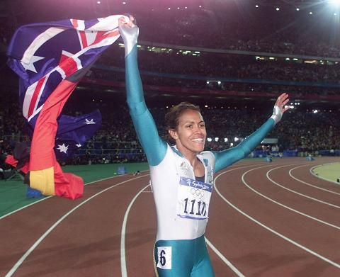

Slide 37
Victory Lap
A victory lap is an extra trip
around the track
By the exhausted victors (us) ☺
Review course goals
Slides from Introduction and Course-Motivation
Some big themes and perspectives
Stuff for five years from now more than for the final
Course evaluations: please do take some time

Slide 38
I really like studying programming languages.
Super stoked to explore PL with all of you.
Why?

Slide 39
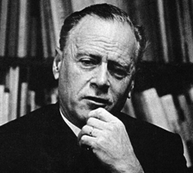
We shape our tools and thereafter
our tools shape us.
Marshall McLuhan
I discover that I think in words. The more words I know, the more things I can think about...
Reading was illegal because if you limit someone's vocab, you limit their thoughts. They can't even think of freedom because they don't have the language to.
M. K. Asante

Slide 40
I really like studying programming languages.
Super stoked to explore PL with all of you.
Why?
PL helps us break free to think thoughts, ask questions, and solve problems that would otherwise be inaccessible.

Slide 41
Looking back on the quarter…
We had 10 short weeks to learn the fundamental concepts of PL.
Curiosity and persistence will get you everywhere.
We’ll become better programmers:
Even in languages we won’t use
Learn the core ideas around which every language is built, despite countless surface-level differences and variations

Slide 42
THANK YOU Incredible Guides!!!
super ultra helpful, extraordinarily smart, stellar smiles
Armando Diaz Tolentino
Riley Klingler
Max Sherman

Slide 43
THANK YOU Our Guide in Spirit!!!
(spiritual guide?)
Dan Grossman
Creator of this flavor of 341.

Slide 44
THANK YOU. . . YOU!!1!!eleven!!one!!1!
And a huge thank you to all of you
Great attitude about a very different view of software
Good class attendance and questions
Computer science ought to be challenging and fun!

Slide 45
What this course is about
Many essential concepts relevant in any programming language
And how these pieces fit together
Use ML, Racket, and Ruby:
They let various important concepts “shine”
Using multiple languages shows how the same concept just can “look different” or actually be slightly different
In many ways simpler than Java
Big focus on functional programming
Not using mutation (assignment statements) (!)
Using first-class functions (can’t explain that yet)
But many other topics too

Slide 46
Why learn this?
To free our minds from the shackles of imperative programming.

Slide 47
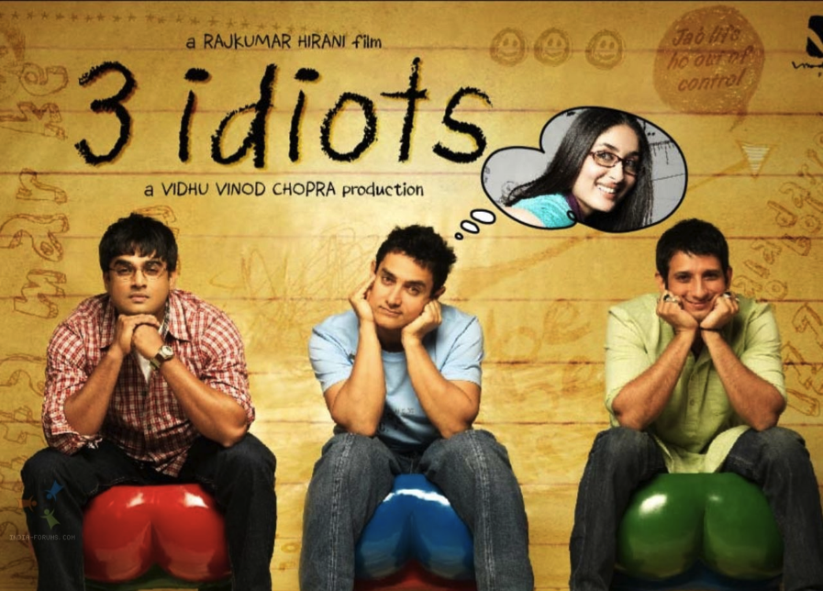

Slide 48
I really like studying programming languages.
Super stoked to explore PL with all of you.
Why?

Slide 49
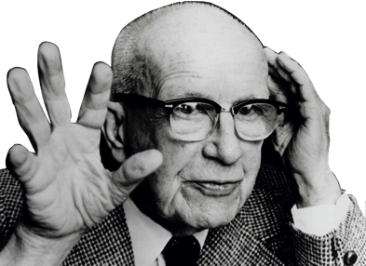
If you are in a shipwreck and all the boats are gone, a piano top buoyant enough to keep you afloat may come along and make a fortuitous life preserver.
This is not to say, though, that the best way to design a life preserver is in the form of a piano top.
I think we are clinging to a great many piano tops in accepting yesterday's fortuitous contrivings as constituting the only means for solving a given problem.
R. Buckminster Fuller

Slide 50
More Detailed Course Motivation
Why learn fundamental concepts that appear in all languages?
Why use languages quite different from C, C++, Java, Python?
Why focus on functional programming?
Why use ML, Racket, and Ruby in particular?
Not: Language X is better than Language Y
[You won’t be tested on this stuff]

Slide 51
Summary
No such thing as a “best” PL
Fundamental concepts easier to teach in some (multiple) PLs
A good PL is a relevant, elegant interface for writing software
There is no substitute for precise understanding of PL semantics
Functional languages have been on the leading edge for decades
Ideas have been absorbed by the mainstream, but very slowly
First-class functions and avoiding mutation increasingly essential
Meanwhile, use the ideas to be a better C/Java/PHP hacker
Many great alternatives to ML, Racket, and Ruby, but each was chosen for a reason and for how they complement each other

Slide 52
[From Course Motivation]
SML, Racket, and Ruby are a useful combination for us
dynamically typed statically typed
functional Racket SML
object-oriented Ruby Java
ML: polymorphic types, pattern-matching, abstract types & modules
Racket: dynamic typing, “good” macros, minimalist syntax, eval
Ruby: classes but not types, very OOP, mixins
[and much more]
Really wish we had more time:
Haskell: laziness, purity, type classes, monads
Prolog: unification and backtracking
[and much more]

Slide 53
Benefits of No Mutation
[An incomplete list]
Can freely alias or copy values/objects: Unit 1
More functions/modules are equivalent: Unit 4
No need to make local copies of data: Unit 5
Depth subtyping is sound: Unit 8
State updates are appropriate when you are modeling a phenomenon that is inherently state-based
A fold over a collection (e.g., summing a list) is not!

Slide 54
Some other highlights
Function closures are really powerful and convenient…
… and implementing them is not magic
Datatypes and pattern-matching are really convenient…
… and exactly the opposite of OOP decomposition
Sound static typing prevents certain errors…
… and is inherently approximate
Subtyping and generics allow different kinds of code reuse…
… and combine synergistically
Modularity is really important; languages can help

Slide 55
From the syllabus
Successful course participants will:
Internalize an accurate understanding of what functional and object-oriented programs mean
Develop the skills necessary to learn new programming languages quickly
Master specific language concepts such that they can recognize them in strange guises
Learn to evaluate the power and elegance of programming languages and their constructs
Attain reasonable proficiency in the ML, Racket, and Ruby languages and, as a by-product, become more proficient in languages they already know

