Slide 1
CSE 333 – Section 7
HW3 Hex View
Inheritance Constructors/Destructors
Static vs Dynamic Dispatch
Notes:
BEFORE STARTING WRITE THIS URL ON THE BOARD: cs.uw.edu/homes/jrios777/vimrc.txt
Welcome to week 7 of the best 300-level course in the department!
Today we’ll be discussing about going through HW3 using hexdump, Inheritance, and static vs Dynamic Dispatch.

Slide 2
Hex View
Find a hex editor.
Learn ‘goto offset’ command.
See HW3 pictures.
The header:
Magic word Checksum Doctable size Index size
Notes:
So in hw2 you created an in memory index that let you search through a given directory. One thing you’ll notice is that every time you started the search shell it’d take forever to start. Well, in HW3 you’re going to be writing out the index to disk in a serializable format such that we can reconstruct the hash table from the reading the file itself. Alright, so first is Hex View. What I mean by this is viewing the index file in hex as shown here.
This can be useful for inspecting to see what’s wrong in the indices you generate.
As you guys can see, each of the header makes up the first 16 bytes of the index file shown here with the magic word, checksum, doctable size and index size.
The rest of the file, as you might guess are the doctable and index themselves.
One thing you’ll notice here is that these bytes in the file are in big endian, i.e. they’re read from left to right. (e.g. 075d is actually 075d and not 5d070000)
The reason for this is that we are writing the indices out in network byte order which happens to be big endian. You can imagine that in a world with big and little endian machines we needed a common format such that files like these indices could be shared from one computer to the other without worrying about byte ordering, which is why we’re using network order (big endian).
Any questions on network order?
TODO: Show toHostFormat() and toDiskFormat() in filelayout.h. When reading from the disk remember to convert to Host Format and when writing to disk remember to convert to Disk Format!

Slide 3
Notes:
Here are the commands for emacs and vim that let you view the hexdump.
I’ve actually set up some extra stuff in my .vimrc specifically for this purpose if any of you vim users want to ask me afterwards or during office hours. My .vimrc is at the link on the board. I’ll show you guys some of my neat tricks for this
For you emacs users… I’m sorry. All I know how to do is quit emacs when I accidentally open it

Slide 4
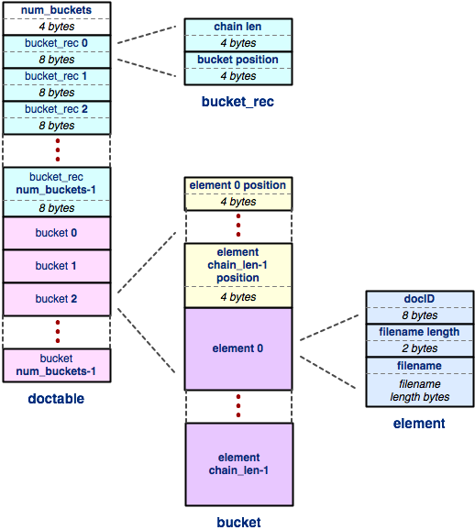
Hex View
The doctable
Notes:
So! Let’s see how the doctable is laid out
It’s a hashtable so we first write the number of buckets, and for each bucket write its length and position (within the file). (Next slides)
Any questions on that so far?
(Next slide)

Slide 5
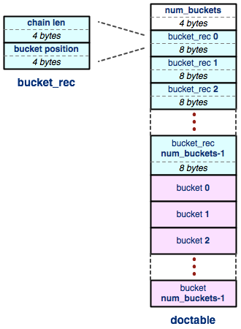
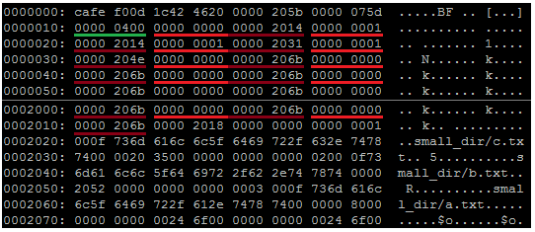
Hex View
The doctable (part 1):
Num buckets ( Chain len Bucket offset )*
Notes:
As we can see from the same example, this bucket has 1024 buckets, and the bucket records themselves follow with each bucket’s length and position, and finally the buckets themselves at 2014, which is where the first bucket is located. (Some lines were omited)
Bucket 0 as you can see has no buckets and is located at 2014. Bucket 1 has an element and starts at 2014 also. Can someone tell me why this is?? (CANDY)
The next bucket is then located at 2031 after the second bucket!
Questions?

Slide 6
Hex View
The doctable
Notes:
After providing the records for each bucket we write out the buckets themselves which begin with all the positions of each element and is shortly followed by a doctable element that consists of the doc ID, docname length and filename itself.
Any questions on this layout?

Slide 7
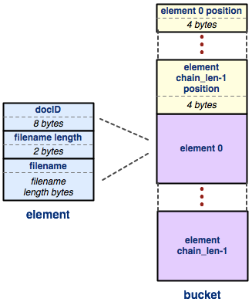
Hex View
The doctable (part 2):
( (Element offset)^{n} ( DocID Filename len Filename )^{n} )*
Notes:
Going back to the same example, we saw that both the first and second buckets started at 2014. Of course bucket 0 is empty so at 2014 is actually the bucket info for bucket 1.
This first bucket actually has 1 element as we can tell from the bucket record and inside the bucket it says element 0’s position is 2018, has docId 1, filename length of 15(0xf), and the filename itself is “small_dir/c.txt”, which indeed is 15 characters long.

Slide 8
Hex View
The doctable
Notes:
Any questions on doctable and how it’s represented in the index files?

Slide 9
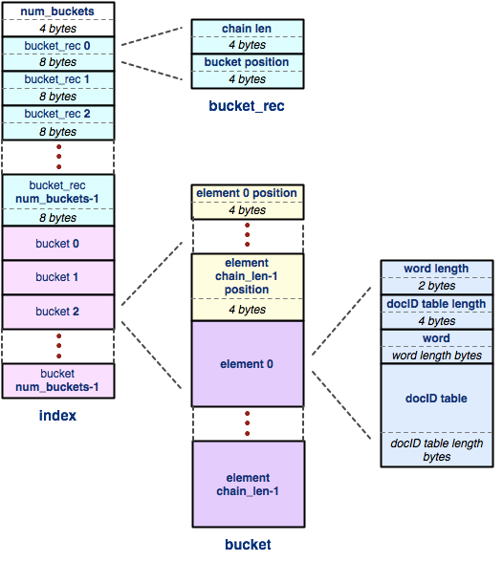
Hex View
The index
Notes:
Next we have the index.
You’ll notice that initially it looks almost identical to the doctable. Of course they’re both hash tables so it’s not really surprising to see bucket records and buckets. The key difference though is the values stored in buckets. Rather than storing a doc ID with its corresponding filename we are instead storing words with their corresponding DocID tables…. (Next slide)

Slide 10
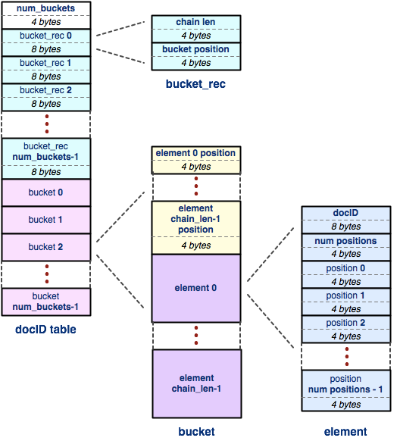
Hex View
The docID table
Notes:
… and the docID table itself is also just another hash table where the bucket elements are a list of positions of where the corresponding word appears in a given docID.
Any questions?
One of the things I like about this assignment is the amount of indirection you have to get through to get from reading the file to reading where the word “the” appears in docID 15

Slide 11
Hex View Demo
Demo:
tinytree/
tiny.idx
teeny.idx
Notes:
(10 min)

Slide 12
Inheritance Constructors/Destructors
The derived class:
Does not inherit any constructors.
MUST call their base class constructor.
Omission == calling the default constructor.
Constructors resolve from base to derived.
Destructors should be virtual !
Demo: destructex.cc and vtable.cc
Notes:
(7 min)

Slide 13
Section Exercise
class B {
public:
B(int *k) : k_(k) { out("B::cons“); }
void p() { out("B::p”); }
virtual void q() { out("B::q“); }
void operator=(B &rhs) { out("B::=“); }
~B() { out(“B::~”); }
protected:
int *k_;
};
class Der : public B {
public:
Der() : B(new int(9)) { out("Der::cons“); }
void p() { out("Der::p“); }
virtual void q() { out("Der::q“); }
void operator=(Der &rhs) { out("Der::=" ); }
~Der() { delete k_; out(“Der::~”); }
};
void out(string s) { cout << s << endl; }
void main() {
B base(nullptr), *baseptr;
Der der;
base = der;
base.p();
base.q();
baseptr = (B *) new Der;
baseptr->p();
baseptr->q();
der.p();
der.q();
delete baseptr;
}
Notes:
(8 min) Alright, now let’s do this exercise, I’ll give you guys a few minutes, pair up with somebody and figure out what this program will print out

Slide 14
Section Exercise
void main() {
B base(nullptr), *baseptr;
Der der;
base = der;
base.p();
base.q();
baseptr = (B *) new Der;
baseptr->p();
baseptr->q();
der.p();
der.q();
delete baseptr;
}
B::cons
B::cons
Der::cons
B::=
B::p
B::q
B::cons
Der::cons
B::p
Der::q
Der::p
Der::q
B::~
Der::~
B::~
B::~
Note that destructor behavior is undefined if not virtual!
Notes:
Here’s the solution!

