Slide 1
CSE 333 – SECTION 2
Memory Management
Notes:
(Before starting, write out the gdb commands list)
How to manage memory, draw diagrams, use valgrind/gdb
Today’s Spanish Lesson:
(Write on the board) “Programación de Sistemas” – What does this say? Somebody translate the Spanish! This is how you say “Systems Programming” in Spanish! Now if you ever travel to a Spanish speaking country and they ask you what your favorite class is/was, (or… they ask you which class had the best TA) you now know how to say it!

Slide 2
Questions, Comments, Concerns
Do you have any?
Exercises going ok?
Lectures make sense?
Homework 1 – If you haven’t started by now…
D:
Exercises!
Comments
Program Comments – Author, copyright, problem description at the top
Function Comments – Near the prototype/declaration in header files; local functions are a more complex story, but near the prototype works for those too.
clint or cpplint errors
Valgrind errors
Check for error codes/return values and handle them correctly!
Notes:
Aside:
- Comments should be on top of prototype/declaration NOT the definition for things in header files. (i.e. header file for public functions, in declaration for source private functions). Local functions – ok on the definition as long as you’re consistent.
**(In case) Header guard error can be ignored for this exercise, but this exercise only. You’ll learn about header guards tomorrow.
Clint/Cpplint errors: trailing spaces, too many newlines, tabs instead of spaces, etc.
Valgrind errors: mainly uninitialized values
Sizeof() clint/cpplint errors can be ignored

Slide 3
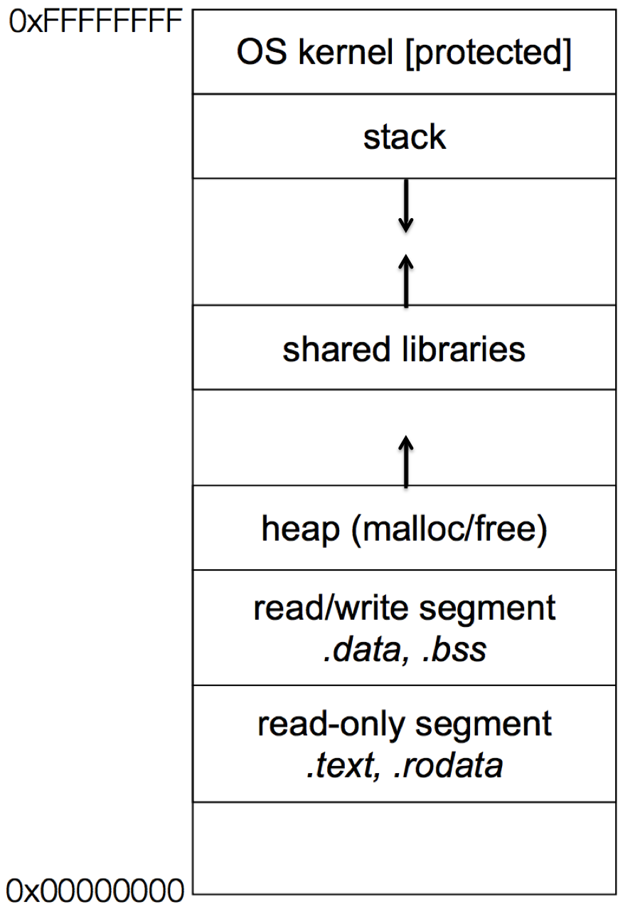
Memory Management
Heap
Large pool of unused memory
malloc() allocates chunks of this memory
free() deallocates memory and reclaims space
Stack and stack frame
Stores temporary/local variables
Each function has its own stack frame
Lifetime on heap vs. Lifetime on stack
Notes:
From 351, you’ll remember we have the stack and the heap...
(Briefly explain the diagram)
.text is code, .rodata is read only data, such as literal strings in the program, .data is read/write data such as static values
()
Shared libraries may be loaded into the executable or dynamically at runtime (the executable says to link to that library)
Dynamic would be better to avoid copying shared libraries
Questions:
What’s the lifetime of a variable that is
on the stack?
on the heap?
How about if it’s a global variable?
Other notes:
What if malloc fails? In this class always check for the return value of malloc: wrap up, close something, or return error. In general if malloc does fail then there’s probably a bigger issue going on with your program or the machine. Dependent on what you’re doing

Slide 4
Memory Diagram + GDB Example
Source Code
(Lecture Example with ll.h, ll.c and example_ll_customer.c)
What does the diagram look like as the program executes?
Is gdb consistent with your diagram?
GDB Tip: Use option –tui to get a visual debugging interface – Very useful!
Typing “help” in gdb pulls up a table of contents gdb help manual. You can then type “help sectionName” to view gdb info on different things
Some Useful GDB Commands
break, backtrace, next, step, list, finish, nfo args, info locals, display, bt, frame, watch
Notes:
Notes (From Sunjay teaching):
Big advocate
Look at the homework, we have nice diagrams. Be sure to draw these as there will be high pointer abstractions in later homeworks.
Memory Diagram notes:
Inspect ll.c and example_ll_customer.c
Comment out the free statements in example_ll_customer.c to show them what “directly lost” and “indirectly lost” bytes look like
- "definitely lost" means your program is leaking memory -- fix those leaks!
- "indirectly lost" means your program is leaking memory in a pointer-based structure. (E.g. if the root node of a binary tree is "definitely lost", all the children will be "indirectly lost".) If you fix the "definitely lost" leaks, the "indirectly lost" leaks should go away.
Show them how to use gdb in debugging this program or some other program
Now, let’s talk memory errors, based on what you guys have seen so far, what are some possible memory errors that can occur? Like, what’s something with memory you can do in C that you can’t in Java?
Dangling pointers (invalid pointers, either points to freed heap or out of scope stack)
Invalid writes
Invalid reads
Use of uninitialized memory
Old notes from Lec 5 wrap up slides in winter 16:
Slides 30-34 on Lecture 5 slides
http://courses.cs.washington.edu/courses/cse333/16wi/lectures/lec05.pdf
Ask:
- Someone explain to me where this comes from?
Preprocessor -> compiler -> linker -> executable
cpp –P
Gcc
c means compile but don’t do the linking
o means store the output in the given file
std=c11 means use the C11 standard
Wall means turn on all the compiler warnings
g to include debugging information such that you can use gdb for debugging
(show gcc11 alias)
Does anybody know why we even bother creating intermediate object files for compilation?
- In the case of the linked list files and the customer, if we change the implementation of ll.c we don’t have to recompile the customer’s object files if the function signature remains the same because the two object files will be linked appropriately during the creation of the executable
Memory management + diagrams!
(Draw stack on right, heap on left from bottom to top)
Remember, in computer science,
"We can solve any problem by introducing an extra level of indirection."

Slide 5
Memory Errors
Use of uninitialized memory
Reading/writing memory after it has been freed – Dangling pointers
Reading/writing to the end of malloc'd blocks
Reading/writing to inappropriate areas on the stack
Memory leaks where pointers to malloc'd blocks are lost
Mismatched use of malloc/new/new[] vs free/delete/delete[]
Valgrind is your friend!!
Notes:
Malloc is different than calloc!
A dangling pointer points to memory that has already been freed. The storage is no longer allocated. Trying to access it might cause a Segmentation fault (or worse!)
Double free is really bad! Undefined behavior
Reading / writing to inappropriate areas on the stack can corrupt old stack pointers, buffer overflow (351), etc
You can’t free things if you don’t have a pointer to it
(new, new[], delete, delete[] are in C++ not in C)

Slide 6
Demo: buggy code
buggy.c demo + code fix
Notes:
Write these gdb commands on the board:
Abbreviation – Name
Navigation
b – break – use to break on VerificationFailure
n – next
l - list
s – step
fin – finish
Inspecting
i lo – info locals
i ar – info args
disp – display
Stack Frame
f – frame
bt – backtrace – use on seg faults!
Tip: if ptr is a void * but you know it’s a char * you can do this:
p *(char *)ptr
Also tui mode if they like that better

Slide 7
Some buggy code
#include <stdio.h>
#include <stdlib.h>
//Returns an array containing [n, n+1, ... , m-1, m]. If n>m, then the
//array returned is []. If an error occurs, NULL is returned.
int *RangeArray(int n, int m) {
int length = m-n+1;
//Heap allocate the array needed to return
int *array = (int*) malloc(sizeof(int)*length);
//Initialize the elements
for(int i=0;i<=length; i++)
array[i] = i+n;
return array;
}
//Accepts two integers as arguments
int main(int argc, char *argv[]) {
if(argc != 3) return EXIT_FAILURE;
int n = atoi(argv[1]), m = atoi(argv[2]); //Parse cmd-line args
int *nums = RangeArray(n,m);
//Print the resulting array
for(int i=0; i<= (m-n+1); i++)
printf(“%d”, nums[i]);
puts(“”);
return EXIT_SUCCESS;
}
Notes:
Show demo
(My program compiled with no compiler warnings or errors. It must be right, right??)

Slide 8
Valgrind output
==22891== Command: ./warmup 1 10
==22891==
==22891== Invalid write of size 4
==22891== at 0x400616: RangeArray (warmup.c:14)
==22891== by 0x400683: main (warmup.c:22)
==22891== Address 0x51d2068 is 0 bytes after a block of size 40 alloc'd
==22891== at 0x4C2A93D: malloc (in /usr/lib/valgrind/vgpreload_memcheck-amd64-linux.so)
==22891== by 0x4005EC: RangeArray (warmup.c:10)
==22891== by 0x400683: main (warmup.c:22)
==22891==
==22891== Invalid read of size 4
==22891== at 0x4006A5: main (warmup.c:26)
==22891== Address 0x51d2068 is 0 bytes after a block of size 40 alloc'd
==22891== at 0x4C2A93D: malloc (in /usr/lib/valgrind/vgpreload_memcheck-amd64-linux.so)
==22891== by 0x4005EC: RangeArray (warmup.c:10)
==22891== by 0x400683: main (warmup.c:22)
==22891==
1 2 3 4 5 6 7 8 9 10 11
==22891==
==22891== HEAP SUMMARY:
==22891== in use at exit: 40 bytes in 1 blocks
==22891== total heap usage: 1 allocs, 0 frees, 40 bytes allocated
==22891==
==22891== 40 bytes in 1 blocks are definitely lost in loss record 1 of 1
==22891== at 0x4C2A93D: malloc (in /usr/lib/valgrind/vgpreload_memcheck-amd64-linux.so)
==22891== by 0x4005EC: RangeArray (warmup.c:10)
==22891== by 0x400683: main (warmup.c:22)
==22891==
==22891== LEAK SUMMARY:
==22891== definitely lost: 40 bytes in 1 blocks
==22891== indirectly lost: 0 bytes in 0 blocks
==22891== possibly lost: 0 bytes in 0 blocks
==22891== still reachable: 0 bytes in 0 blocks
==22891== suppressed: 0 bytes in 0 blocks
==22891==
==22891== For counts of detected and suppressed errors, rerun with: -v
==22891== ERROR SUMMARY: 3 errors from 3 contexts (suppressed: 3 from 3)
Notes:
Fix code in Demo
Valgrind notes:
"definitely lost" means your program is leaking memory -- fix those leaks!
"indirectly lost" means your program is leaking memory in a pointer-based structure. (E.g. if the root node of a binary tree is "definitely lost", all the children will be "indirectly lost".) If you fix the "definitely lost" leaks, the "indirectly lost" leaks should go away.
"possibly lost" means your program is leaking memory, unless you're doing unusual things with pointers that could cause them to point into the middle of an allocated block; see the user manual for some possible causes.
"still reachable" means your program is probably ok -- it didn't free some memory it could have. This is quite common and often reasonable. Don't use --show-reachable=yes if you don't want to see these reports.
"suppressed" means that a leak error has been suppressed. There are some suppressions in the default suppression files. You can ignore suppressed errors.

Slide 9
Compiling separate source files (Make preview)
Header files (*.h)
Source files (*.c)
Makefile
Notes:
(Pull up sep-compile files)
Let’s take a look at these files. I’m not going to go into detail of how the code works, but rather let’s take a look at how we’d need to compile the executable. You can go about this in many ways:
Huge command that compiles everything all together, even if you only changed one file
gcc -Wall -g -std=c11 -o adjust adjust.c grades.c
You can imagine with 100 source files this would be too long of a command and if the compile time is really long, would be wasting your time every time you make a single edit because everything is being recompiled, including what doesn’t depend on the file you changed
Compile the object files individually as needed so when one file changes you only have to recompile that file and any other files that depend on it
gcc -Wall -g -std=c11 -c -o adjust.o adjust.c (-c flag means stop after compilation and give me the object file)
gcc -Wall -g -std=c11 -c -o grades.o grades.c
gcc -Wall -g -std=c11 -o adjust grades.o adjust.o
This is better, particularly for projects that take a lot of time compiling an executable from the source code. These commands can still get lengthy and can be hard to remember though.
An even better way is to write these dependencies out in a make file so that you don’t have to memorize commands and dependencies. You’ll be using this in your homeworks and in class you’ll soon be learning how to make your own make files.
Notes (From Sunjay teaching):
Preprocessor -> compiler -> linker -> executable

Slide 10
Section exercise
Handouts.
Work with a partner, if you wish.
Look at the expandable vector code in imsobuggy.c.
First, try to find all the bugs by inspection.
Then try to use Valgrind on the same code.
Code is located at http://courses.cs.washington.edu/courses/cse333/16sp/sections/sec2-code/
Notes:
You’ll actually be working on an improved version of imsobuggy.c for exercise 5
HW TIPS:
Ctags *.c *.h to get tags for emacs/vim
Use Ctrl-[ to go to the definition
Use Ctrl-T to go back to where you were
Use Ctrl-x Ctrl-o to pull up omni completion for those tags
VIM TIP:
If you guys are using vim, I would like to advertise using this plugin called (write on Board) snipmate.vim. (Demo) Check this out, copyright statement, include statement, main function, for loop over arguments, if statement, etc. This is actually a great time saver once you’re familiar with all the shortcuts.
COMMAND LINE TIP:
Another tip, create an alias for gcc with arguments (gcc11 here) and valgrind checks (vg here) and use the !$ in bash to grab the last argument from the previous command! Like after editing in vim and compiling it
And guys, I’m serious about helping you guys out, I can share with you my vimrc/bashrc if you’d like, just come to office hours

