Slide 1
CSE 333 – Section 4
References, const and classes
Notes:
[1 min]
Welcome to week 4 edition of the best 300-level course! Wooh! Who’s excited??? Are we awake yet?? (Play wake up alias on the terminal)
Ok, before we get started each of you should have an index card, I’d like you all to fill it out and give feedback on sections
Alright, so today we’ll be reviewing C++ references, const and classes.

Slide 2
HW2
Online now.
Due on Thursday, April 28th by 11pm.
Start early!
File crawler, indexer and a command-line search engine.
Notes:
[2 min]
But first! Homework 2 is out! It’s due February 9th so make sure you get a head start on it early!
Short: This homework you’ll be crawling directories, parsing files to see what words appear in what file. Then you’ll be creating an index off these results that will be used to process queries in a command line query processor. Basically a command line mini version of Google.
This homework is trickier than the last one and there’ll definitely be more pointers to pointers to pointers. If you don’t believe me just look at the diagrams and try to make sense of them!

Slide 3
HW2
(There’s a reason we asked you to do the directory exercise…)
Part A -- finish our fileparser.c
Part B -- finish our file crawler and indexer
Part C -- finish our query processor
Demo HW2
Notes:
[5 min on HW2, 3 min on diagram]
DEMO HW2 solution binaries!!
Let’s talk about what you’ll be doing in HW2:
https://courses.cs.washington.edu/courses/cse333/16wi/hw/hw2/hw2.html
Expansive: What you’ll be doing this time is
crawling recursively through a directory of files,
parsing text data to see what words appear in which files, where they appear and how many times they appear.
As you go along your program will use the hash table you made in hw1 to create an in-memory index of all the files in the given directory
by mapping every word to a list of documents they appear in.
Finally, you’re going to make a command line query processor that uses the index to find results for the given query
(Use the whiteboard, one side for code, the other for the diagram)
Let’s talk references.
Assuming I have this code:
Int I = 0, j = 4;
Int *pi = &I;
What does the memory layout look like? (CANDY question)
(Draw the next slide’s diagram with the value 3)
Ok, let’s say that I added this line of code:
Int &ri = I;
Now how does this look like? (CANDY)
Alright, now let’s say I added this line, how does it look like now? (CANDY)
*pi = 3;
now let’s say I added this line, how does it look like now? (CANDY)
ri = j;
If we print I out what value will be printed? (CANDY)
Does everyone see how references works? They are basically aliases for already existing values
(Next Slide)

Slide 4
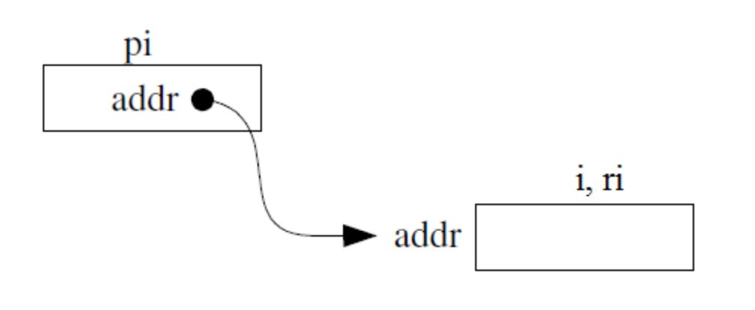
This or that?
Consider the following code:
Pointers: References:
int i; int i;
int *pi = &i; int &ri = i;
In both cases,
The difference lies in how they are used in expressions:
*pi = 4; ri = 4;
Notes:
[2 min]
When would it be a good idea to use to references instead of pointers? (CANDY) Here’s some:
When you don’t want to deal with pointer semantics (How many people love pointers after HW1??)
When you don’t want to copy stuff over

Slide 5
Pointers and References
Once a reference is created, it cannot be later made to reference another object.
Compare to pointers, which are often reassigned.
References can’t be initialized to null, whereas pointers can.
References can never be uninitialized. It is also impossible to reinitialize a reference.
Demo: experiments.cc
Notes:
[3 min, 3 min on demo]
Some key differences between pointers and references:
Refs can’t be reassigned (i.e. can’t rebind what it is an alias for), you noticed that when I wrote ri = j it didn’t reassign the reference, but rather changed the value it referred to (hence the name, reference)
Refs can’t be null, they have to be an alias for an already existing value
Refs can’t be uninitialized (unlike types like int, which can be initially not set, but holds garbage value)
DEMO: experiments.cc
Possible question
Can you have references for pointers? Yes, the syntax is int *&a = (existing pointer); but much like in the previous example there isn’t really much need for it

Slide 6
C++ const declaration
As a declaration specifier, const is a type specifier that makes objects unmodifiable.
const int m = 255;
Reference to constant integer:
int n = 100;
const int &ri = n; // ri becomes read only
Demo: const.cc
Notes:
[2 min, maybe 3 on demo]
As a declaration specifier, const is a type specifier that makes values unmodifiable.
Essentially, you make things read-only when you add const
For example, in this example we’ve made a constant reference. i.e. a read-only alias for n.
However, notice we can still manipulate n, just not ri.
So, why can’t we set ri = 3? (CANDY)
Demo const.cc
- Where will the compiler give an error?
- Want to read it from right to left

Slide 7
When to use?
Function parameter types and return types and functions that declare overloaded operators.
Pointers: may point to many different objects during its lifetime. Pointer arithmetic (++ or --) enables moving from one address to another. (Arrays, for e.g.)
References: can refer to only one object during its lifetime.
Style Guide Tip:
use const reference parameters to pass input
use pointers to pass output parameters
input parameters first, then output parameters last
Notes:
[3 min]
With things like const, reference, and pointers in C++, how do we know when to use what??
Well, we can use const and references almost everywhere! In
Function parameter types
Function return types
Overloading functions (You’ll learn about these soon)
But remember that pointers can point to many things in its lifetime, whereas references only point to one.
So, good style would be to:
Use const reference for input parameters
Use pointers for output parameters
Input params first, then output
Can anyone tell me why this might be good style? (CANDY)
This helps distinguish between what you’re reading from and what you’re changing

Slide 8
C++ Classes
/* Note: This code is unfinished! Beware! */
class Point {
public:
Point(const int x, const int y); // constructor
int get_x() const { return x_; } // inline member function
int get_y() const { return y_; } // inline member function
double distance(const Point &p) const; // member function
void setLocation(const int x, const int y); //member function
private:
int x_; // data member
int y_; // data member
}; // class Point
Notes:
[5 min, 3 min on demo]
Now on to C++ classes. Take a look at this slide for a moment and notice the differences between the Java and C++ implementations you’d write for a Point object.
What are some things you notice? (CANDY)
Private and public are separate sections rather than in the function declaration
There’s a semicolon at the end of the class
You use const parameters for values you won’t change
There’s a reference parameter for the distance function
You also use const at the end of the function!
Having the modifier here tells the client that using this function won’t modify this object, which means it is safe to use on a Const Point object.
Notice that setLocation doesn’t have the const modifier because it’s actually going to
Ok so let’s see an example of how we might use this class. File: usePoint.cc

Slide 9
Section Exercise
Define a class Rectangle whose instance variables are a pair of Point objects (upper left, lower right).
Include at least one constructor. Make sure you get const right in the right places.
Methods:
getul(), getlr() - returns upper and lower points.
intersect(Rectangle &r) – returns a Rectangle representing the overlap.
area() - returns the Rectangle's area.
contains(Point &p) - returns true or false depending on whether point p is inside the rectangle.
The C++ Primer text and cplusplus.com contain good reference material.
Notes:
Point.cc and Point.h are in the lecture code for yesterday

