Slide 1
SPAN 301 – SecCiÓn 1
Introducción
Notes:
Bienvenidos a la primera seccion de 333!
Time Constraints (Approx.)
Spanish (~1 min)
Intro to TAs/Logistics(~5 min)
SSH Key Generation (~5 min)
Git steps (~10 min)
Hw0 git tag (~3 min)
C Refresher & Pointers (~5 min)
Output Params with Ex (~5 min)
Pointers to Pointers (~5 min)
Function Pointers (~5 min)
Looking at Docs/End (~3 min)

Slide 2
Nuestros Objetivos
Introducción
Aprender a decifrar palabras desconocidas
Entender las diferencias entre diferentes dialectos del lenguaje española
Confundir los estudiantes profundamente y hacerles pensar que estamos en una clase de español
Notes:
Here’s the translation of what’s on there
Our Objectives
Introduction
Learn to decipher unknown words
Understand the differences between the different dialects of Spanish
Confuse the students profoundly and make them think that we’re in a Spanish class

Slide 3
CSE 333 – SECTION 1
Git Setup & Pointers
Notes:
Time Constraints (Approx.)
Intro (~5 min)
SSH Key Generation (~5 min)
Git steps (~10 min)
Hw0 git tag (~5 min)
JUST KIDDING. This is CSE333. I’ll speak English now.
Welcome to my favorite 300-level course!

Slide 4
Your TAs
Phillip Dang, Josh Nazarian, Sixto (Joshua) Rios, Soumya Vasisht, Qingda (Bruce) Wen, Zhitao (Reid) Zhang.
Office hours are posted
everyday 4-5 pm starting today!
CSE006
Staff Email
cse333-staff@cs.washington.edu
Please use the discussion board!
Notes:
My name is Sixto Josue Rios Jr. Rodriguez Rincon Vargas Leon Puentes Gonzalez the 4th but people call me Josh. There’s another Josh TA-ing this course this quarter so we might get mixed but if you randomly call any of us TAs “Josh” you’re twice as likely to get the name right than any of the other names. If you really want to distinguish us though, call me Josue or Josh 1.
(Introduce the TAs)
Our office hours are listed on the website, please try use the staff email and discussion board though as we are also students like you. Office hours will be in 006 every day from 4-5pm. Mine are actually today, so if you want to drop by and keep me company be my guest! I want to make you love 333 as much we TAs do!
Also, please use the discussion board! For projects, exercises, or general questions the discussion board is a great place to see what others had question on and to see if the answer you need is there and... others may be able to respond it faster than we do! Just don’t put your solution or private matters there
So that’s logistics. Before moving on though, let me remind you guys that as TAs we are here to assist you in understanding the material and know the necessary tools to succeed in this course. PLEASE, and I mean PLEASE, don’t hesitate to ask any questions! That’s what we’re here for. (After all, we did come back to TA the same course again ☺) We also love having company at office hours! So please don’t let yourself get in a rut, we’re here for you.
A note on sections:
If anything I discuss doesn’t make sense, please let me know. And, if you ever think sections are getting dry, let me know, maybe I’ll dance or bring cookies or something. (We brought candy sometimes last quarter) I want you all to be as excited about this course as I was when I took it.

Slide 5
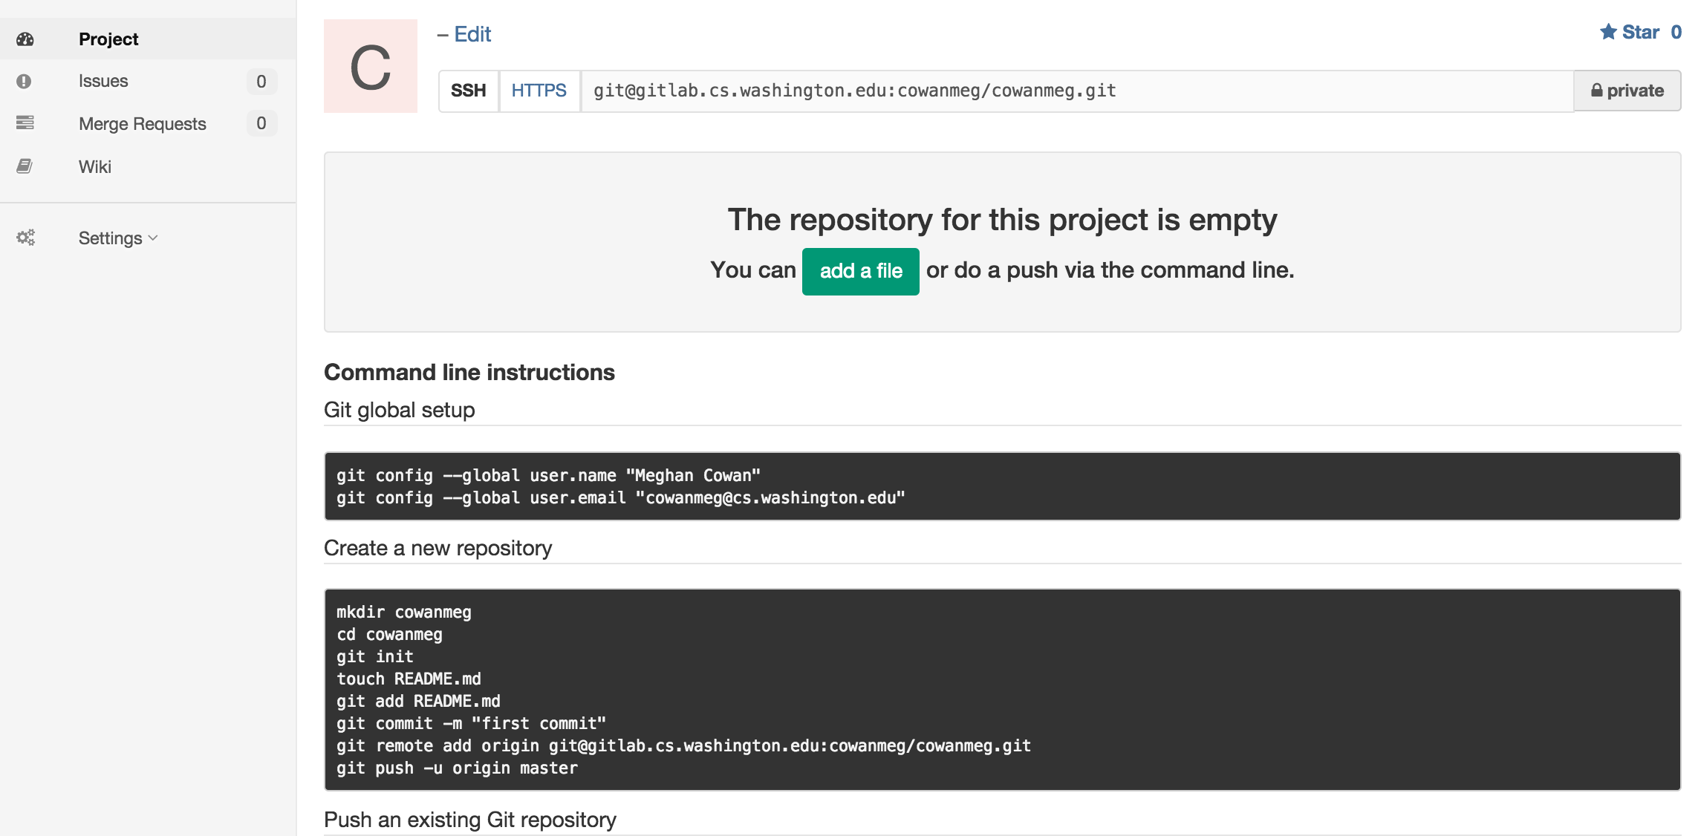
Gitlab Intro - Sign In
Sign In using your CSE netID
https://gitlab.cs.washington.edu/
Most of you should have repos created for you
Notes:
For this class we’ll be using version control for the homework projects. Each of you has a repository and we’ll be using that to pull your homework projects and grade your projects. It’s also nice because you get the benefits of version control.
Please take out your laptops, go to gitlab.cs.uw.edu, sign in with your CSE NetID and you should see under projects that we have created a repository for you. If you don’t have one, please let us know.

Slide 6
SSH Key Generation
Step 0: Check if you have a key
Run cat ~/.ssh/id_rsa.pub
If you see a long string starting with ssh-rsa or ssh-dsa go to Step 2.
Step 1: Generate a new SSH key
Run ssh-keygen -t rsa -C "$your_e-mail" to generate a new key.
Click enter to skip creating or a password
git docs suggest creating a password, but it’s overkill for 333 and complicates operations
Step 2: Copy SSH key
run cat ~/.ssh/id_rsa.pub
Copy the complete key key starting with ssh- and ending with your username and host
Step 3: Add SSH key to gitlab
Navigate to your ssh-keys page (In the top menu bar click on profile then SSH Keys in the side menu)
Click the green 'Add SSH Key' button in the right corner.
Paste into the Key text box and give a Title to identify what machine the key is for.
Notes:
cat ~/.ssh/id_rsa.pub
Do you have a public SSH Key?
ssh-keygen -t rsa -C jrios777@cs.washington.edu
-t flag specifies the type of key
-C flag specifies a comment to add to the key
You can leave the passphrase blank if you’d like and just press enter. (I leave mine blank because I have too many other passwords to remember)
cat ~/.ssh/id_rsa.pub
Copy to your clipboard the output
Go to GitLab -> Account -> Keys and add a new one, paste the key and give whatever title you’d like to
You’ll notice that I already have a couple of keys set up in GitLab. I have one for each machine I use, including attu. You’ll need to repeat these steps for each machine you use.
Btw, as a side note you can copy the key over to your ~/.ssh/authorized_keys file on attu and never have to log in to attu with a password ever again.

Slide 7
First Commit
git clone <repo url from project page> Clones your repo
touch README.md Creates a file called README.md
git status Prints out the status of the repo. Should see 1 new file README.md
git add README.md Stages a new file/updated file for commit. git status: README.md staged for commit
git commit -m "First Commit" Commits all staged files with the comment in quotes. git status: Your branch is ahead by 1 commit.
git push Publishes the changes to the central repo. You should now see these changes in the web interface.
Might need git push -u origin master on first commit (only)
Notes:
Alright now that we’re set up let’s dive into Git. How many of you are familiar with Git? A lot of you, alright. Nice! Let’s step through your first commit so that you can become familiar with the git commands. I’ll explain what each of these commands do. (Head over to Gitlab, get the url, then head over to the terminal)
Head over to GitLab and copy your repo’s url. Now on the terminal…
git clone git@gitlab.cs.washington.edu:cse333-16sp-students/cse333-16sp-jrios777.git cse333/
This command clones the repo from the given url. I specified another argument here to indicate that I want it in a folder called cse333
cd into the repo
ls –a
.gitignore has a list of files git will ignore when committing and pushing, as they’re reproducible from the source code. Please don’t modify
Create an empty README.md file
Git status
Git status prints out the status of your local repository, including what files aren’t being tracked, what changes are or aren’t staged for commit, and whether you’re up to date with the head repo (i.e. GitLab)
Notice that README.md is a new file that is not staged for commit. A commit is like a screenshot of what your repo is like at a given time. Right now this is telling us that the next time we commit/take a screenshot the README file won’t be part of it. So, let’s stage it for commit
Git add README.md
Use this command whenever you want to stage new or modified files for commit.
Type git status again. You’ll notice that under “Changes to be committed” there is the README file you created, which means the next time we commit the new/modified file will be part of it.
git commit –m “First Commit”
Use the –m flag to specify a message of what’s new in this commit, or in other words, summarize what changed since the previous screenshot
If this is your first time you may need to configure git on your machine:
git config --global user.name "Josue Rios”
git config --global user.email "jrios777@cs.washington.edu”
git commit –m “First Commit”
Now if we type git status you’ll notice it says you’re up to date and you’re one commit ahead of ‘origin/master’. This basically means you’re one commit ahead of what’s on gitlab. If we go to gitlab now you’ll notice it doesn’t have the latest commit you made. So, we’ll have to push our changes.
Git push (-u origin master for first commit to a repo)
Now all the commits you made locally are now on gitlab. Check it out.
Any questions?
Git is a distributed version control system, which means that copies of the repo can exist in multiple machines at once. (Explain how git works)
Awesome, that’s the basics of git. One more thing though, for turning in assignments you’ll creating git tags to help us determine what screenshot of your code to grade. There’s instructions online but let me show you all how it works. Do this when you’re finished with hw0 and have committed and pushed everything. (so don’t follow for now)
cd hw0/, make a change, add, commit, push
git tag hw0-final
This tells git to label this commit (screenshot of the code) as hw0-final
git push --tags
This pushes the tags to GitLab
If you ever want to retag after tagging there’s instructions in HW0
Any questions so far?
TODO: (which sections?)
More tools you’ll be using, but will go over in later sections:
Valgrind
Clint

Slide 8
References
SSH Key generation: https://gitlab.cs.washington.edu/help/ssh/README.md
Basic Git Tutorial: http://courses.cs.washington.edu/courses/cse333/16sp/hw/git.html
Notes:
If you didn’t bring your laptop I’ve provided the links for reference.

Slide 9
Quick Refresher on C
General purpose programming language
Procedural
Often used in low-level system programming
Supports use of pointer arithmetic
Provides facilities for managing memory
C passes all of its arguments by value
Pass-by-reference is simulated by passing the address of a variable
Notes:
Pass-by-reference is simulated using pointers, arrays are weird because using the bracket syntax they’re technically call by reference but what’s being passed is just a copy of a pointer value

Slide 10
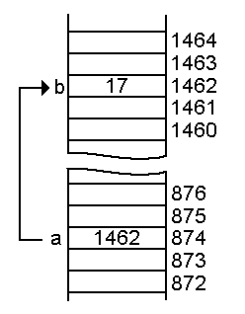
Pointers
A data type that stores an address
Used to indirectly refer to values
Can add to or subtract from the address
It’s just another number
Address
Value
Address
a
p
Notes:
JOKE TIME!
Java and C were telling jokes. It was C's turn, so he writes something on the wall, points to it and says "Do you get the reference?" But Java didn't.
- This is funny! C has pointers but Java doesn’t so it didn’t understand the reference!!! Hahaha xD

Slide 11
Example
[basic_pointer.c]
#include <stdio.h>
void f(int *j) {
(*j)++;
}
int main() {
int i = 20;
int *p = &i;
f(p);
printf("i = %d\n", i);
return 0;
}
Notes:
Take a look at this program (pause ~15 sec), now discuss with your neighbor what you think this program prints (~45 sec). What do you guys think this program prints?
Answer: i = 21
Draw the memory diagram on board, maybe with stack frames
Any questions on how we got the answer?
From next slide: draw out on board some memory with an array and ask about the values of
arr
*arr
arr + 2
arr[2]
*(arr+2)
*arr+2
*arr++
*arr++ is treated as *(arr++) where the old value of arr is dereferenced but the pointer value of arr is incremented

Slide 12
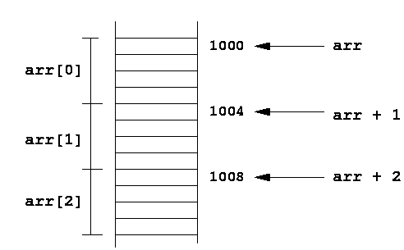
Arrays and pointers
arr[0] <==> *arr
arr[2] <==> *(arr + 2)
How about arr, arr+2,
*arr+2 or *arr++?
5
10
15
Notes:
How about the values of
arr is the address of the array,
arr + 2 is the address of the array plus 2 * sizeof(typeof(array)), hence arr[2]
*arr + 2 is the value stored at arr[0]
*arr++ is treated as *(arr++) where the old value of arr is dereferenced but the pointer value of arr is incremented

Slide 13
Output parameters
C parameters are pass-by-value
What if you want to modify a passed in parameter?
Why would this be useful in the first place?
Multiple return values
Notes:
Answer:
You would use pointers as output parameters.
Why not use a return value instead? OR Are there any cases where we might want to use a single output parameter rather than a return value?
Yes. In the case of modifying structs, instead of returning a new struct(which would have to be malloced because a stack array would go out of scope) you could instead pass in a pointer to it and modify its fields from there. This saves stack space.
You could also use output parameters to modify more than one struct/array

Slide 14
Output parameters
void make4_v1(int i) {
i = 4;
}
void make4_v2(int *i) {
int j = 4;
i = &j;
}
void make4_v3(int *i) {
*i = 4;
}
See also: [output_params.c]
Notes:
Let’s take a look at these functions, what do each of these do? When I call the function with a variable that has the argument 2 (draw on board main{ int a = 3; int *b = &a;} and stack frame) will calling any of these change the value on my end?
V1 assigns the local parameter
V2 assigns the local parameter
V3 actually changes the value the pointer points to
(output_params.c is in the staff repo)

Slide 15
Pointers to pointers
char *c = “hello”;
char **cp = &c;
char ***cpp = &cp;
Why could this be useful?
Notes:
Couple points:
You could have an array of strings, or an array of arrays of strings
You can use pointer layering for matrices

Slide 16
Function pointers
We can have pointers to functions as well
Syntax is a little awkward
Example: int (*ptr_to_int_fn)(int, int)
Makes sense if you think about it
We will be using these in the homework assignments!
Demo: [function_pointer.c]
[buggy.c]
Notes:
Listen up! This is used in HW1!
Here we’re saying the variable ptr_to_int_fn is a pointer to a function of return type int that accepts two int parameters

Slide 17
Looking up documentation
Don’t go straight to Google / Stack Overflow / etc.
Use the built-in man pages
man <program/utility/function>
man -f <name> or whatis <name>
apropos <keyword>
Much more documentation is linked on the 333 home page
Under “Resources” on the left side of the page
Notes:
Example. You can use type ls –thor to list things in the current directory in a nice format. I learned this from the man pages. Also use the documentation linked from the 333 Home Page, there’s a lot of useful stuff.

Slide 18
Questions, Comments, Concerns
Do you have any?
Exercises going ok?
Lectures make sense?
Notes:
Just a reminder there is an exercise due tomorrow, HW0 is due Monday, and HW1 is due two weeks from now.
Josh’s tips of the day:
Start homeworks early! They only get more involved over time
Get comfortable with the command line
For later…
For assignments always check that you’ve followed instructions carefully, have no memory leaks, and has no style errors!

