Slide 1
CSE333 Section 7

Slide 2
Template vs Generics
C++ templates are similar to preprocessor macros
A template will be “materialized” into multiple copies with T replaced
Accepts primitive data types and classes
Java generic can only be used on classes

Slide 3
C++ Exceptions
Provide a way to react to exceptional in programs by transferring control to special handlers
try
{
throw 20;
}
catch (int e)
{
cout << "An exception occurred. " << e << '\n';
}

Slide 4
C++ Exceptions
try {
// code here
}
catch (int param) { cout << "int exception"; }
catch (char param) { cout << "char exception"; }
catch (...) { cout << "default exception"; }

Slide 5
C++ Exceptions
std::exception is the base class specifically designed to declare objects to be thrown as exceptions
Has a virtual member function called “what” that returns a null-terminated character sequence (of type char *) containing some sort of description of the exception.
class myexception: public exception {
virtual const char* what() const throw() {
return "My exception happened";
}
} myex;

Slide 6
C++ Exceptions
C++ Standard Library also uses exceptions:
int main () {
try
{
int* myarray= new int[1000];
}
catch (exception& e)
{
cout << "Standard exception: " << e.what() << endl;
}
return 0;
}

Slide 7
C++ vs Java Exceptions
In C++, all types (including primitive and pointer) can be thrown as exception
only throwable objects in Java
In C++, there is a special catch called “catch all” that can catch all kind of exceptions
catch (...) // catch all
In Java, there is a block called finally that is always executed after the try-catch block.
no such block in C++
A few other subtle differences

Slide 8
Exception Safety
No-throw guarantee
Strong exception safety: commit or rollback
Basic exception safety: no-leak guarantee
No exception safety: no guarantees are made

Slide 9
Resource Acquisition Is Initialization
Holding a resource is tied to object lifetime:
Resource allocation (acquisition) is done during object creation (specifically initialization), by the constructor,
Resource deallocation (release) is done during object destruction, by the destructor.
If objects are destructed properly, resource leaks do not occur.

Slide 10
Example
void write_to_file (const std::string & message) {
// mutex to protect file access
static std::mutex mutex;
// lock mutex before accessing file
std::lock_guard<std::mutex> lock(mutex);
// try to open file
std::ofstream file("example.txt");
if (!file.is_open())
throw std::runtime_error("unable to open file");
// write message to file
file << message << std::endl;
}

Slide 11
Hex View
Find a hex editor.
Learn ‘goto offset’ command.
See HW3 pictures.
The header:
Magic word Checksum Doctable size Index size

Slide 12
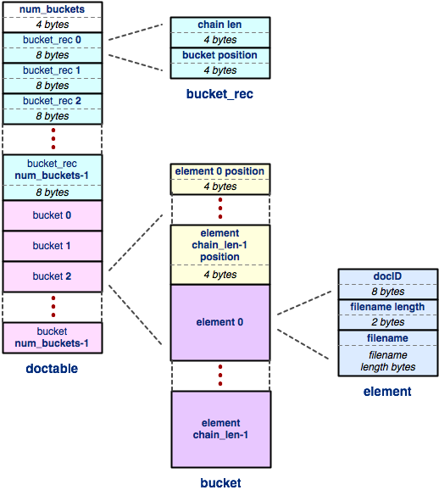
Hex View
The doctable

Slide 13
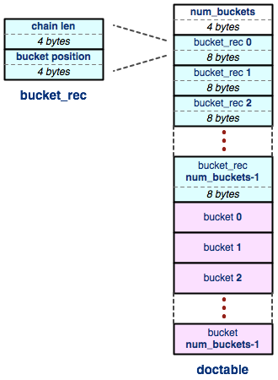
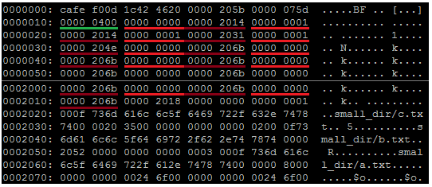
Hex View
The doctable (part 1):
Num buckets ( Chain len Bucket offset )*

Slide 14
Hex View
The doctable

Slide 15
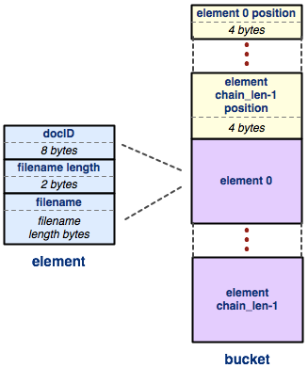
Hex View
The doctable (part 2):
( (Element offset)^{n} ( DocID Filename len Filename )^{n} )*

Slide 16
Hex View
The doctable

Slide 17
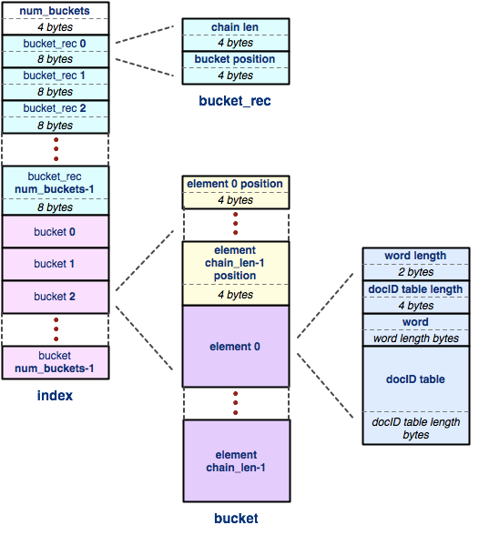
Hex View
The index

Slide 18
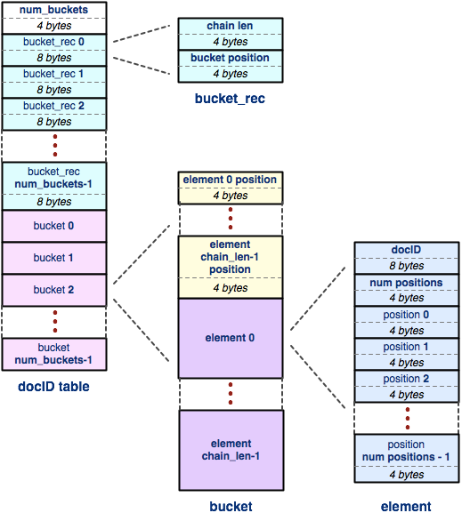
Hex View
The docID table

