Slide 1
CSE 333 – SECTION 2
Memory Management

Slide 2
Questions, Comments, Concerns
Do you have any?
Exercises going ok?
Lectures make sense?
Homework 1 – START EARLY!
Common Exercise Errors
Comments
Program Comments – Author, copyright, problem description at the top
Function Comments – Near the prototype/declaration, not near the definition
clint or cpplint errors
Valgrind errors

Slide 3
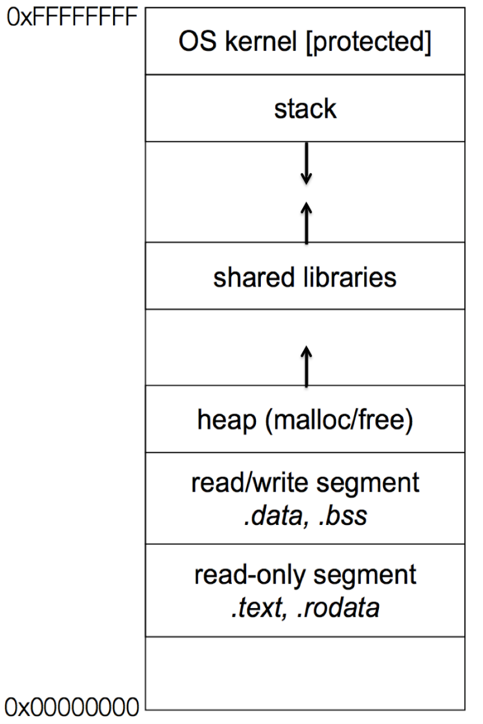
Memory Management
Heap
Large pool of unused memory
malloc() allocates chunks of this memory
free() deallocates memory and reclaims space
Stack and stack frame
Stores temporary/local variables
Each function has its own stack frame
Lifetime on heap vs. Lifetime on stack

Slide 4
Drawing memory diagrams
Lecture Example

Slide 5
Memory Errors
Use of uninitialized memory
Reading/writing memory after it has been freed – Dangling pointers
Reading/writing to the end of malloc'd blocks
Reading/writing to inappropriate areas on the stack
Memory leaks where pointers to malloc'd blocks are lost
Mismatched use of malloc/new/new[] vs free/delete/delete[]
Valgrind is your friend!!

Slide 6
Some buggy code
#include <stdio.h>
#include <stdlib.h>
//Returns an array containing [n, n+1, ... , m-1, m]. If n>m, then the
//array returned is []. If an error occurs, NULL is returned.
int *RangeArray(int n, int m) {
int length = m-n+1;
//Heap allocate the array needed to return
int *array = (int*) malloc(sizeof(int)*length);
//Initialize the elements
for(int i=0;i<=length; i++)
array[i] = i+n;
return array;
}
//Accepts two integers as arguments
int main(int argc, char *argv[]) {
if(argc != 3) return EXIT_FAILURE;
int n = atoi(argv[1]), m = atoi(argv[2]); //Parse cmd-line args
int *nums = RangeArray(n,m);
//Print the resulting array
for(int i=0; i<= (m-n+1); i++)
printf("%d", nums[i]);
puts("");
return EXIT_SUCCESS;
}
Notes:
Show demo

Slide 7
Valgrind output
==22891== Command: ./warmup 1 10
==22891==
==22891== Invalid write of size 4
==22891== at 0x400616: RangeArray (warmup.c:14)
==22891== by 0x400683: main (warmup.c:22)
==22891== Address 0x51d2068 is 0 bytes after a block of size 40 alloc'd
==22891== at 0x4C2A93D: malloc (in /usr/lib/valgrind/vgpreload_memcheck-amd64-linux.so)
==22891== by 0x4005EC: RangeArray (warmup.c:10)
==22891== by 0x400683: main (warmup.c:22)
==22891==
==22891== Invalid read of size 4
==22891== at 0x4006A5: main (warmup.c:26)
==22891== Address 0x51d2068 is 0 bytes after a block of size 40 alloc'd
==22891== at 0x4C2A93D: malloc (in /usr/lib/valgrind/vgpreload_memcheck-amd64-linux.so)
==22891== by 0x4005EC: RangeArray (warmup.c:10)
==22891== by 0x400683: main (warmup.c:22)
==22891==
1 2 3 4 5 6 7 8 9 10 11
==22891==
==22891== HEAP SUMMARY:
==22891== in use at exit: 40 bytes in 1 blocks
==22891== total heap usage: 1 allocs, 0 frees, 40 bytes allocated
==22891==
==22891== 40 bytes in 1 blocks are definitely lost in loss record 1 of 1
==22891== at 0x4C2A93D: malloc (in /usr/lib/valgrind/vgpreload_memcheck-amd64-linux.so)
==22891== by 0x4005EC: RangeArray (warmup.c:10)
==22891== by 0x400683: main (warmup.c:22)
==22891==
==22891== LEAK SUMMARY:
==22891== definitely lost: 40 bytes in 1 blocks
==22891== indirectly lost: 0 bytes in 0 blocks
==22891== possibly lost: 0 bytes in 0 blocks
==22891== still reachable: 0 bytes in 0 blocks
==22891== suppressed: 0 bytes in 0 blocks
==22891==
==22891== For counts of detected and suppressed errors, rerun with: -v
==22891== ERROR SUMMARY: 3 errors from 3 contexts (suppressed: 3 from 3)
Notes:
Fix code in Demo

Slide 8
Compiling separate source files
Header files (*.h)
Source files (*.c)
Makefile

Slide 9
Section exercise
Handouts.
Work with a partner, if you wish.
Look at the expandable vector code in imsobuggy.c.
First, try to find all the bugs by inspection.
Then try to use Valgrind on the same code.
Code is located at http://courses.cs.washington.edu/courses/cse333/15sp/sections/sec2-code/

