Slide 1
Project 3: Parallel Game Search for Chess
CSE 332
Spring 2016

Slide 2
Project 3, Due June 1, 2016

Slide 3
Tic-Tac-Toe

Slide 4
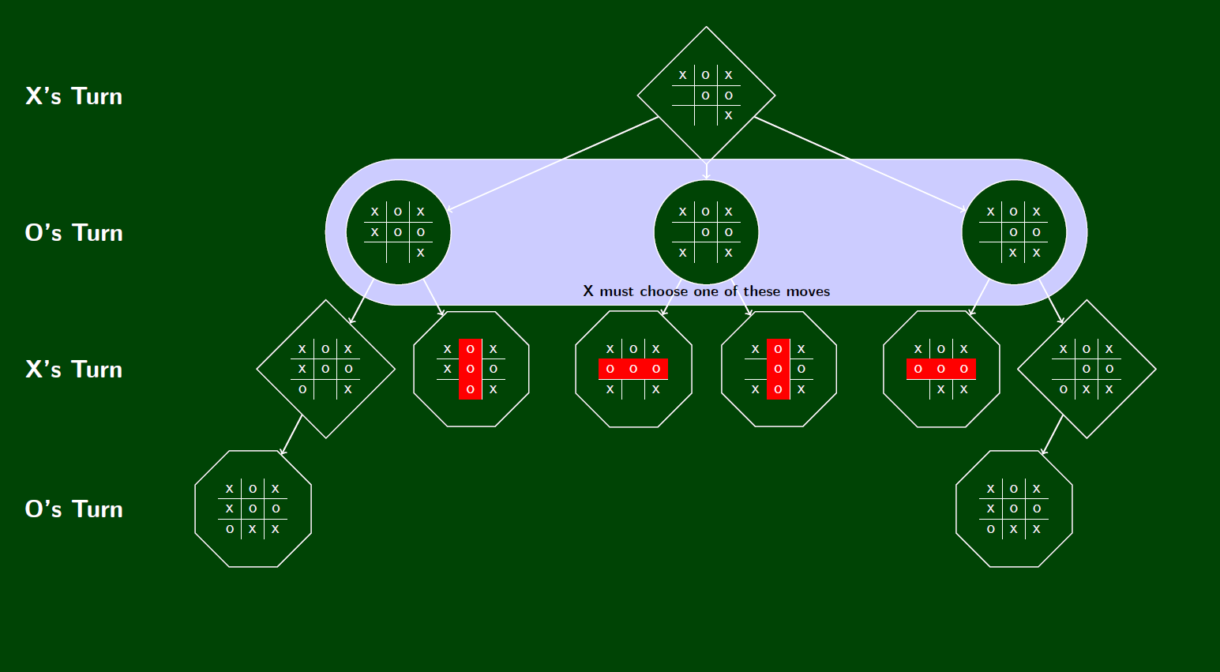
Game Tree

Slide 5
Min-Max search
Tree with numeric outcomes at leaves
Player 1 wants to maximize score
Player 2 wants to minimize score
Computing values
Leaves return values
Max levels return max of children
Min levels return min of children

Slide 6
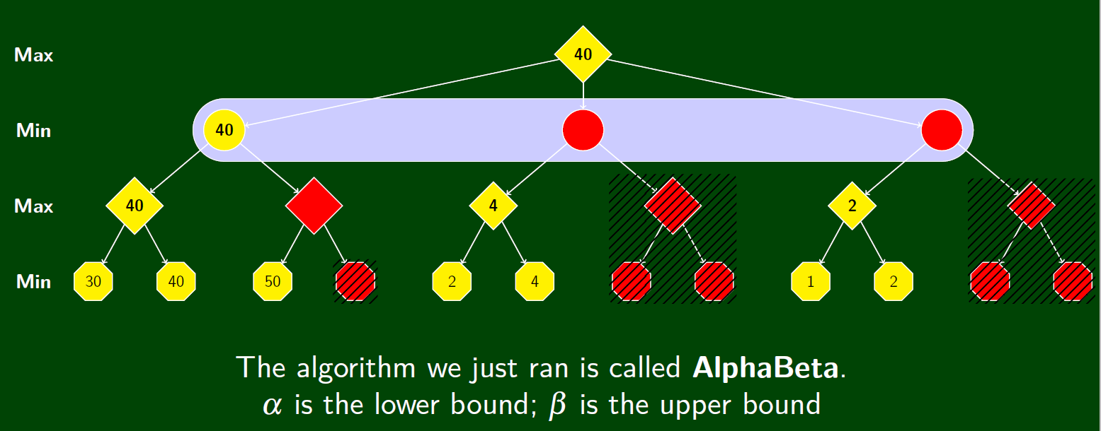
Alpha beta Pruning

