Slide 1
CSE 332 Data Abstractions:
B Trees and Hash Tables Make a Complete Breakfast
Kate Deibel
Summer 2012

Slide 2
Project 2
Big project… get started early
  This project gives you a lot of experience implementing data structures specialized to a problem
You can work with a partner
  Please contact us soon with who you will be working with
  Use the message board to find a partner
Questions related to project are good fodder for quiz sections… so ask!

Slide 3
Clarifying Splay Insert
insert(x):
Find x in splay tree
Splays it or its parent p to root
If x is in tree, stop (no duplicates)
Else, split tree based on root p
  If r < x, then r goes in left subtree
  If r > x, then r goes in right subtree
Join subtrees using x as root
x
x
L
R
L
R
p
p
OR
  < x
> x
< x
  > x
Notes:
Now, If we can split on x and produce one subtree smaller and one larger than x, insert is easy!
Just split on x.
Then, hang the left (smaller) subtree on the left of x.
Hang the right (larger) subtree on the right of x.
Pretty simple, huh?
Are we fixing up deep paths?

Slide 4
B Trees
Technically, they are called B+ trees but their name was lowered due to concerns of grade inflation

Slide 5
Reality Bites
Despite our best efforts, AVL trees and splay trees can perform poorly on very large inputs
Why? It's the fault of hardware!

Slide 6
A Typical Memory Hierarchy
CPU
instructions (e.g., addition): 2³⁰/sec
L1 Cache: 128KB = 2¹⁷
get data in L1: 2²⁹/sec = 2 insns
L2 Cache: 2MB = 2²¹
get data in L2: 2²⁵/sec = 30 insns
Main memory: 2GB = 2³¹
get data in main memory:
2²²/sec = 250 insns
Disk: 1TB = 2⁴⁰
get data from "new place" on disk:
2⁷/sec = 8,000,000 insns
"streamed":
2¹⁸/sec = 4096 insns

Slide 7
Moral of The Story
It is much faster to do:
5 million arithmetic ops
2500 L2 cache accesses
400 main memory accesses
Than:
1 disk access
1 disk access
1 disk access
Accessing the disk is EXPENSIVE!!!

Slide 8
M-ary Search Tree
Build a search tree with branching factor M:
Have an array of sorted children (Node[])
Choose M to fit snugly into a disk block (1 access for array)
Perfect tree of height h has (M^{h+1}-1)/(M-1) nodes
# hops for find: Use log_{M} n to calculate
  If M=256, that’s an 8x improvement
  If n = 2⁴⁰, only 5 levels instead of 40 (5 disk accesses)
Runtime of find if balanced: O(log₂ M log_{M} n)
Notes:
So, we’ll try to solve this problem as we did with heaps.
Here’s the general idea. We create a search tree with a branching factor of M.
Each node has M-1 keys and we search between them.
What’s the runtime?
O(log_{M}n)?
That’s a nice thought, and it’s the best case. What about the worst case?

Slide 9
Problems with M-ary Search Trees
What should the order property be?
How would you rebalance (ideally without more disk accesses)?
Any "useful" data at the internal nodes takes up disk-block space without being used by finds moving past it
Use the branching-factor idea, but for a different kind of balanced tree
  Not a binary search tree
  But still logarithmic height for any M > 2

Slide 10
B+ Trees (will just say "B Trees")
Two types of nodes:
Internal nodes and leaf nodes
Each internal node has room for
up to M-1 keys and M children
All data are at the leaves!
Order property:
Subtree between x and y
Data that is ≥ x and < y
Notice the ≥
Leaf has up to L sorted
data items
3
7
12
21
x<3
3≤x<7
7≤x<12
12≤x<21
21≤x
As usual, we will focus only on the keys in our examples

Slide 11
B Tree Find
We are used to data at internal nodes
But find is still an easy root-to-leaf algorithm
At an internal node, binary search on the M-1 keys
At the leaf do binary search on the ≤ L data items
To ensure logarithmic
running time, we need
to guarantee balance!
What should the balance condition be?
3
7
12
21
x<3
3≤x<7
7≤x<12
12≤x<21
21≤x

Slide 12
Structure Properties
Root (special case)
If tree has ≤ L items, root is a leaf (occurs when starting up, otherwise very unusual)
Otherwise, root has between 2 and M children
Internal Node
Has between ⎡M/2⎤ and M children (at least half full)
Leaf Node
All leaves at the same depth
Has between ⎡L/2⎤ and L items (at least half full)
Any M > 2 and L will work
Picked based on disk-block size

Slide 13
Example
Suppose: M=4 (max # children in internal node)
L=5 (max # data items at leaf)
All internal nodes have at least 2 children
All leaves at same depth with at least 3 data items
12
44
6
20
27
34
50
1
6
12
20
27
34
44
50
2
8
14
22
28
38
47
60
4
9
16
24
32
39
49
70
10
17
41
19

Slide 14
Example
Note on notation:
Inner nodes drawn horizontally
Leaves drawn vertically to distinguish
Includes all empty cells
12
44
6
20
27
34
50
1
6
12
20
27
34
44
50
2
8
14
22
28
38
47
60
4
9
16
24
32
39
49
70
10
17
41
19

Slide 15
Balanced enough
Not hard to show height h is logarithmic in number of data items n
Let M > 2 (if M = 2, then a list tree is legal → BAD!)
Because all nodes are at least half full (except root may have only 2 children) and all leaves are at the same level, the minimum number of data items n for a height h>0 tree is…
n ≥ 2 ⎡M/2⎤ ^{h-1} ⋅ ⎡L/2⎤
Exponential in height
because ⎡M/2⎤ > 1
minimum number
of leaves
minimum data
per leaf

Slide 16
What makes B trees so disk friendly?
Many keys stored in one internal node
All brought into memory in one disk access
But only if we pick M wisely
Makes the binary search over M-1 keys worth it (insignificant compared to disk access times)
Internal nodes contain only keys
Any find wants only one data item; wasteful to load unnecessary items with internal nodes
Only bring one leaf of data items into memory
Data-item size does not affect what M is

Slide 17
Maintaining Balance
So this seems like a great data structure
It is
But we haven’t implemented the other dictionary operations yet
insert
delete
As with AVL trees, the hard part is maintaining structure properties

Slide 18
Building a B-Tree
M = 3 L = 3
3
3
3
Insert(3)
Insert(18)
Insert(14)
18
14
18
The empty B-Tree (the root will be a leaf at the beginning)
Simply need to keep the keys sorted in a leaf

Slide 19
Building a B-Tree
M = 3 L = 3
18
3
3
3
18
Insert(30)
14
14
14
30
18
18
???
30
When we ‘overflow’ a leaf, we split it into 2 leaves
Parent gains another child
If there is no parent, we create one
How do we pick the new key?
Smallest element in right subtree
Notes:
Alright, how do we insert and delete?
Let’s start with the empty B-Tree. That’s one leaf as the root.
Now, we’ll insert 3 and 14. Fine…
What about inserting 1. Is there a problem?

Slide 20
M = 3 L = 3
18
18
18
32
3
18
3
18
3
18
32
Insert(32)
Insert(36)
14
30
14
30
14
30
36
Split leaf
again
32
18
32
Insert(15)
3
18
32
14
30
36
15

Slide 21
M = 3 L = 3
18
32
18
32
3
18
32
3
18
32
Insert(16)
14
30
36
14
30
36
15
15
16

Slide 22
M = 3 L = 3
???
15
18
32
18
3
15
18
32
14
16
30
36
15
32
Split the internal node (in this case, the root)

Slide 23
M = 3 L = 3
Insert(12,40,45,38)
18
18
15
32
15
32
40
3
15
18
32
3
15
18
32
40
14
16
30
36
12
16
30
36
45
14
38
Given the leaves and the structure of the tree, we can always fill in internal node keys using the rule:
What is the smallest value in my right branch?

Slide 24
Insertion Algorithm
Insert the data in its leaf in sorted order
If the leaf now has L+1 items, overflow!
  Split the leaf into two nodes:
    Original leaf with ⎡(L+1)/2⎤ smaller items
    New leaf with ⎣(L+1)/2⎦ = ⎡L/2⎤ larger items
  Attach the new child to the parent
    Adding new key to parent in sorted order
If Step 2 caused the parent to have M+1 children, overflow the parent!

Slide 25
Insertion Algorithm (cont)
If an internal node (parent) has M+1 kids
  Split the node into two nodes
    Original node with ⎡(M+1)/2⎤ smaller items
    New node with ⎣(M+1)/2⎦ = ⎡M/2⎤ larger items
  Attach the new child to the parent
    Adding new key to parent in sorted order
Step 4 could make the parent overflow too
Repeat up the tree until a node does not overflow
If the root overflows, make a new root with two children. This is the only the tree height inceases

Slide 26
Worst-Case Efficiency of Insert
Find correct leaf:
Insert in leaf:
Split leaf:
Split parents all the way to root:
Total
O(log₂ M log_{M} n)
O(L)
O(L)
O(M log_{M} n)
O(L + M log_{M} n)
But it’s not that bad:
Splits are rare (only if a node is FULL)
M and L are likely to be large
After a split, nodes will be half empty
Splitting the root is thus extremely rare
Reducing disk accesses is name of the game:
inserts are thus O(log_{M} n) on average

Slide 27
Adoption for Insert
We can sometimes avoid splitting via a process called adoption
Example:
Notice correction by changing parent keys
Implementation not necessary for efficiency
But introduced as it leads to how deletion works
18
30
3
18
3
30
insert(31)
14
30
14
31
32
18
32

Slide 28
Deletion
M = 3 L = 3
18
delete(32)
18
15
32
40
15
36
40
3
15
18
32
40
3
15
18
36
40
12
16
30
36
45
12
16
30
38
45
14
38
14

Slide 29
M = 3 L = 3
18
delete(15)
18
15
36
40
16
36
40
3
15
18
36
40
3
16
18
36
40
12
16
30
38
45
12
30
38
45
14
14
Are we okay?
Dang, not half full
Are you using that 14?
Can I borrow it?

Slide 30
M = 3 L = 3
18
18
16
36
40
14
36
40
3
16
18
36
40
3
14
18
36
40
12
30
38
45
12
16
30
38
45
14

Slide 31
M = 3 L = 3
18
delete(16)
18
14
36
40
14
36
40
3
14
18
36
40
3
14
18
36
40
12
16
30
38
45
12
30
38
45
Are you using that 12? Yes
Are you using that 18? Yes

Slide 32
M = 3 L = 3
18
18
14
36
40
36
40
3
14
18
36
40
3
18
36
40
12
30
38
45
12
30
38
45
14
Well, let's just consolidate our leaves since we have the room
Oops. Not enough leaves
Are you using that 18/30?

Slide 33
M = 3 L = 3
18
36
36
40
18
40
3
18
36
40
3
18
36
40
12
30
38
45
12
30
38
45
14
14

Slide 34

M = 3 L = 3
delete(14)
36
36
18
40
18
40
3
18
36
40
3
18
36
40
12
30
38
45
12
30
38
45
14

Slide 35
M = 3 L = 3
delete(18)
36
36
18
40
18
40
3
18
36
40
3
30
36
40
12
30
38
45
12
38
45
Oops. Not enough in leaf

Slide 36
M = 3 L = 3
36
36
18
40
40
3
30
36
40
3
36
40
12
38
45
12
38
45
30
We will borrow as before
Oh no. Not enough leaves and we cannot borrow!

Slide 37
M = 3 L = 3
36
3
40
36
40
3
36
40
3
36
40
12
38
45
12
38
45
30
30
We have to move up a node and collapse into a new root.

Slide 38
M = 3 L = 3
3
36
40
36
40
3
36
40
12
38
45
3
36
40
30
12
38
45
30
Huh, the root is pretty small. Let's reduce the tree's height.

Slide 39
Deletion Algorithm
Remove the data from its leaf
If the leaf now has ⎡L/2⎤ - 1, underflow!
  If a neighbor has >⎡L/2⎤ items,
  adopt and update parent
  Else merge node with neighbor
    Guaranteed to have a legal number of items
    ⎣L/2 ⎦ + ⎡L/2⎤ = L
    Parent now has one less node
If Step 2 caused parent to have
⎡M/2⎤ - 1 children, underflow!

Slide 40
Deletion Algorithm
If an internal node has ⎡M/2⎤ - 1 children
  If a neighbor has >⎡M/2⎤ items, adopt and update parent
  Else merge node with neighbor
    Guaranteed to have a legal number of items
    Parent now has one less node, may need to continue underflowing up the tree
Fine if we merge all the way up to the root
If the root went from 2 children to 1, delete the root and make child the root
This is the only case that decreases tree height

Slide 41
Worst-Case Efficiency of Delete
Find correct leaf:
Insert in leaf:
Split leaf:
Split parents all the way to root:
Total
O(log₂ M log_{M} n)
O(L)
O(L)
O(M log_{M} n)
O(L + M log_{M} n)
But it’s not that bad:
Merges are not that common
After a merge, a node will be over half full
Reducing disk accesses is name of the game:
deletions are thus O(log_{M} n) on average

Slide 42
Implementing B Trees in Java?
Assuming our goal is efficient number of disk accesses, Java was not designed for this
This is not a programming languages course
Still, it is worthwhile to know enough about "how Java works" and why this is probably a bad idea for B trees
The key issue is extra levels of indirection…

Slide 43
Naïve Approach
Even if we assume data items have int keys, you cannot get the data representation you want for "really big data"
interface Keyed<E> {
int key(E);
}
class BTreeNode<E implements Keyed<E>> {
static final int M = 128;
int[] keys = new int[M-1];
BTreeNode<E>[] children = new BTreeNode[M];
int numChildren = 0;
…
}
class BTreeLeaf<E> {
static final int L = 32;
E[] data = (E[])new Object[L];
int numItems = 0;
…
}

Slide 44
What that looks like
BTreeNode (3 objects with "header words")
M-1
12
40
… (larger array)
M-1
12
40
… (larger array)
70
BTreeLeaf (data objects not in contiguous memory)
L
… (larger array)
20

Slide 45
The moral
The point of B trees is to keep related data in contiguous memory
All the red references on the previous slide are inappropriate
As minor point, beware the extra "header words"
But that is "the best you can do" in Java
Again, the advantage is generic, reusable code
But for your performance-critical web-index,
not the way to implement your B-Tree for terabytes of data
Other languages better support "flattening objects into arrays"

Slide 46
hash tables
The national data structure of the Netherlands

Slide 47
Where We Are With Dictionaries
For dictionary with n key/value pairs
        insert find delete
Unsorted linked-list O(1) O(n) O(1)
Unsorted array O(1) O(n) O(1)
Sorted linked list O(n) O(n) O(1)
Sorted array O(n) O(log n) O(n)
Balanced tree O(log n) O(log n) O(log n)
Hash Table O(1) O(1) O(1)
"A magical array"

Slide 48
Wait…
Balanced trees give O(log n) worst-case
Hash tables give O(1) on average
Constant time is better!
So why did we learn about balanced trees?

Slide 49
Challenge of Hash Tables
Hashing is difficult to achieve
A hash function must be fast to calculate
Average O(1) requires minimal collisions
Hash tables are slow for some operations as compared to balanced trees
FindMin, FindMax, Predecessor, and Successor go from O(log n) to O(n)
printSorted goes from O(n) to O(n log n)

Slide 50
Moral
If you need to frequently use operations based on sort order,
Then you may prefer a balanced BST instead of a hash table
If the emphasis is on fast lookups,
Then a hash table is probably better

Slide 51
Hash Tables
A hash table is an array of some fixed size
Basic idea:
The goal:
Aim for constant-time find, insert, and delete "on average" under reasonable assumptions
hash table
0
 | ⁞
size -1
hash function:
index = h(key)
key space (e.g., integers, strings)

Slide 52
Hash Tables
Basic Structure
m possible keys (m typically large, even infinite)
Table is expected to have only n items
n is much less than m (often written n << m)
Many dictionaries have this property
Compiler:
All possible identifiers allowed by the language
vs. those used in some file of one program
Database:
All possible student names vs. students enrolled
Artificial Intelligence:
All possible chess-board configurations vs.
those considered by the current player

Slide 53
An Ideal Hash Functions
Is fast to compute
Rarely hashes two keys to the same index
  Known as collisions
  Zero collisions often impossible in theory but reasonably achievable in practice
0
 | ⁞
size -1
hash function:
index = h(key)
key space (e.g., integers, strings)

Slide 54
Who Hashes What
For a hash table to be generic (store elements of type E), we need E to be:
Comparable: order any two E (for all dictionaries)
Hashable: convert any E to an int
When hash tables are a reusable library, the division of responsibility involves two roles:
We will learn both roles, but most programmers "in the real world" spend more time as clients while understanding the library
client
hash table library
collision?
collision
resolution
E
int
table-index

Slide 55
More on Roles
Some ambiguity in terminology as to which parts are "hashing"
Our view is that both are important
client
hash table library
collision?
collision
resolution
E
int
table-index
"hashing"?
"hashing"?

Slide 56
More on Roles
Both roles must both contribute to minimizing collisions (heuristically)
Client should aim for different ints for the expected item keys
Do not "waste" any part of E or the int's 32 bits
Library should aim for putting "similar" ints in different indices
conversion to index is almost always "mod table-size"
using prime numbers for table-size is common

Slide 57
What to Hash?
We will focus on two most common things to hash: ints and strings
If you have objects with several fields, it is usually best to hash most of the "identifying fields" to avoid collisions:
  class Person {
  String firstName, middleName, lastName;
  Date birthDate;
  …
  }
An inherent trade-off:
hashing-time vs. collision-avoidance
use these four values

Slide 58
Hashing Integers
key space = integers
Simple hash function:
h(key) = key % TableSize
Client: f(x) = x
Library: g(x) = f(x) % TableSize
Fairly fast and natural
Example:
TableSize = 10
Insert keys 7, 18, 41, 34, 10
0
1
2
3
4
5
6
7
8
9
10
41
34
7
18
Notes:
Note that we are ignoring the data associated with the keys

Slide 59
Collision Avoidance
With (x%TableSize), number of collisions depends on
the ints inserted
TableSize
Larger table-size tends to help, but not always
Example: 70, 24, 56, 43, 10
with TableSize = 10 and TableSize = 60
Technique: Pick table size to be prime. Why?
Real-life data tends to have a pattern,
"Multiples of 61" are probably less likely than "multiples of 60"
Some collision strategies do better with prime size

Slide 60
More Arguments for a Prime Size
If TableSize is 60 and…
Lots of data items are multiples of 2, wasting 50% of table
Lots of data items are multiples of 5, wasting 80% of table
Lots of data items are multiples of 10, wasting 90% of table
If TableSize is 61…
Collisions can still happen but 2, 4, 6, 8, … will fill in table
Collisions can still happen, but 5, 10, 15, … will fill in table
Collisions can still happen but 10, 20, 30, … will fill in table
A Tidbit from Number Theory
If x and y are "co-prime" ( gcd(x,y) = 1 ),
then (a * x) % y = (b * x) % y
if and only if a % y = b % y

Slide 61
Hashing non-integer keys
If keys are not ints, the client must provide a means to convert the key to an int
Programming Trade-off:
Calculation speed
Avoiding distinct keys hashing to same ints

Slide 62

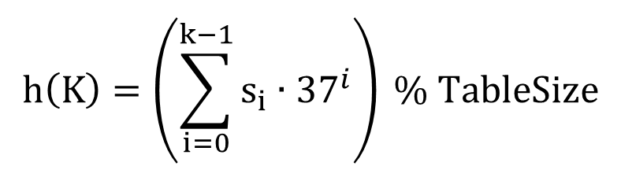
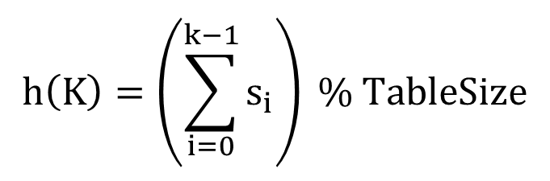
Hashing Strings
Key space K = s₀s₁s₂…s_{k-1}
where s_{i} are chars: s_{i} ∈ [0, 256]
Some choices: Which ones best avoid collisions?
$$h\left(K\right)=\left(s_{0}\right) \% TableSize$$
$$h\left(K\right)=\left(\sum_{i=0}^{k−1}{s_{i}}\right) \% TableSize$$
$$h\left(K\right)=\left(\sum_{i=0}^{k−1}{s_{i}∙{37}^{i}}\right) \% TableSize$$

Slide 63
Combining Hash Functions
A few rules of thumb / tricks:
Use all 32 bits (be careful with negative numbers)
Use different overlapping bits for different parts of the hash
  This is why a factor of 37^{i} works better than 256^{i}
  Example: "abcde" and "ebcda"
When smashing two hashes into one hash, use bitwise-xor
  bitwise-and produces too many 0 bits
  bitwise-or produces too many 1 bits
Rely on expertise of others; consult books and other resources for standard hashing functions
Advanced: If keys are known ahead of time, a perfect hash can be calcualted

Slide 64
A Final Tidbit about Hash Functions
Hash functions are typically one-way functions:
Calculating h(x) = y is easy/straightforward
Calculating h⁻¹(y) = x is difficult/impossible
This complexity of calculating the inverse of a hash function is very useful in security/encryption
Generating signatures of messages
You might recognize some names:
SHA-1, MD4, MD5, etc.

Slide 65
Collision Resolution
Calling a State Farm agent is not an option…

Slide 66
Collision Resolution
Collision:
When two keys map to the same location in the hash table
We try to avoid it, but the number of keys always exceeds the table size
Ergo, hash tables generally must support some form of collision resolution

Slide 67
Flavors of Collision Resolution
Separate Chaining
Open Addressing
Linear Probing
Quadratic Probing
Double Hashing

Slide 68

Terminology Warning
We and the book use the terms
"chaining" or "separate chaining"
"open addressing"
Very confusingly, others use the terms
"open hashing" for "chaining"
"closed hashing" for "open addressing"
We also do trees upside-down

Slide 69
Separate Chaining
All keys that map to the same
table location are kept in a linked list (a.k.a. a "chain" or "bucket")
As easy as it sounds
Example:
insert 10, 22, 86, 12, 42
with h(x) = x % 10
0 | /
1 | /
2 | /
3 | /
4 | /
5 | /
6 | /
7 | /
8 | /
9 | /

Slide 70
Separate Chaining
All keys that map to the same
table location are kept in a linked list (a.k.a. a "chain" or "bucket")
As easy as it sounds
Example:
insert 10, 22, 86, 12, 42
with h(x) = x % 10
0
1 | /
2 | /
3 | /
4 | /
5 | /
6 | /
7 | /
8 | /
9 | /
10
/

Slide 71
Separate Chaining
All keys that map to the same
table location are kept in a linked list (a.k.a. a "chain" or "bucket")
As easy as it sounds
Example:
insert 10, 22, 86, 12, 42
with h(x) = x % 10
0
1 | /
2
3 | /
4 | /
5 | /
6 | /
7 | /
8 | /
9 | /
10
/
22
/

Slide 72
Separate Chaining
All keys that map to the same
table location are kept in a linked list (a.k.a. a "chain" or "bucket")
As easy as it sounds
Example:
insert 10, 22, 86, 12, 42
with h(x) = x % 10
0
1 | /
2
3 | /
4 | /
5 | /
6
7 | /
8 | /
9 | /
10
/
22
/
86
/

Slide 73
Separate Chaining
All keys that map to the same
table location are kept in a linked list (a.k.a. a "chain" or "bucket")
As easy as it sounds
Example:
insert 10, 22, 86, 12, 42
with h(x) = x % 10
0
1 | /
2
3 | /
4 | /
5 | /
6
7 | /
8 | /
9 | /
10
/
22
12
/
86
/

Slide 74
Separate Chaining
All keys that map to the same
table location are kept in a linked list (a.k.a. a "chain" or "bucket")
As easy as it sounds
Example:
insert 10, 22, 86, 12, 42
with h(x) = x % 10
0
1 | /
2
3 | /
4 | /
5 | /
6
7 | /
8 | /
9 | /
10
/
22
12
42
/
86
/

Slide 75
Thoughts on Separate Chaining
Worst-case time for find?
Linear
But only with really bad luck or bad hash function
Not worth avoiding (e.g., with balanced trees at each bucket)
  Keep small number of items in each bucket
  Overhead of tree balancing not worthwhile for small n
Beyond asymptotic complexity, some "data-structure engineering" can improve constant factors
Linked list, array, or a hybrid
Insert at end or beginning of list
Splay-like: Always move item to front of list

Slide 76
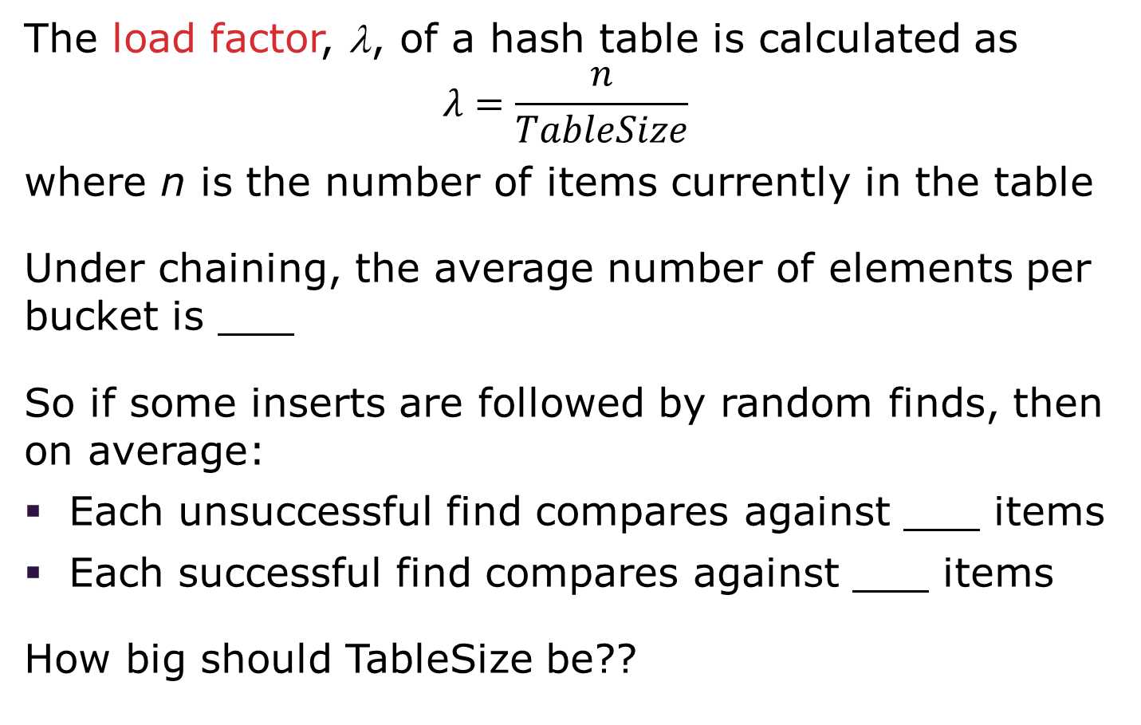
Rigorous Separate Chaining Analysis
The load factor, λ, of a hash table is calculated as
$$λ=\frac{n}{TableSize}$$
where n is the number of items currently in the table
Under chaining, the average number of elements per bucket is ___
So if some inserts are followed by random finds, then on average:
Each unsuccessful find compares against ___ items
Each successful find compares against ___ items
How big should TableSize be??

Slide 77
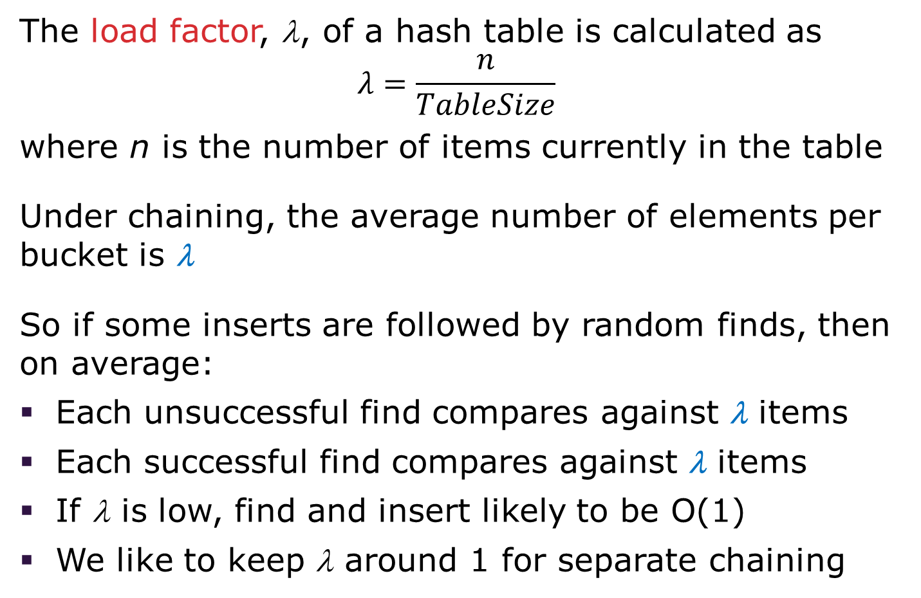
Rigorous Separate Chaining Analysis
The load factor, λ, of a hash table is calculated as
$$λ=\frac{n}{TableSize}$$
where n is the number of items currently in the table
Under chaining, the average number of elements per bucket is λ
So if some inserts are followed by random finds, then on average:
Each unsuccessful find compares against λ items
Each successful find compares against λ items
If λ is low, find and insert likely to be O(1)
We like to keep λ around 1 for separate chaining
Notes:
λ is the Greek lowercase lambda

Slide 78
Separate Chaining Deletion
Not too bad and quite easy
Find in table
Delete from bucket
Similar run-time as insert
Sensitive to underlying bucket structure
0
1 | /
2
3 | /
4 | /
5 | /
6
7 | /
8 | /
9 | /
10
/
22
12
42
/
86
/

Slide 79
Open Addressing: Linear Probing
Separate chaining does not use all the space in the table. Why not use it?
Store directly in the array cell (no linked list or buckets)
How to deal with collisions?
If h(key) is already full,
try (h(key) + 1) % TableSize. If full,
try (h(key) + 2) % TableSize. If full,
try (h(key) + 3) % TableSize. If full…
Example: insert 38, 19, 8, 79, 10
0
1
2
3
4
5
6
7
8
9

Slide 80
Open Addressing: Linear Probing
Separate chaining does not use all the space in the table. Why not use it?
Store directly in the array cell (no linked list or buckets)
How to deal with collisions?
If h(key) is already full,
try (h(key) + 1) % TableSize. If full,
try (h(key) + 2) % TableSize. If full,
try (h(key) + 3) % TableSize. If full…
Example: insert 38, 19, 8, 79, 10
0
1
2
3
4
5
6
7
8 | 38
9

Slide 81
Open Addressing: Linear Probing
Separate chaining does not use all the space in the table. Why not use it?
Store directly in the array cell
(no linked list or buckets)
How to deal with collisions?
If h(key) is already full,
try (h(key) + 1) % TableSize. If full,
try (h(key) + 2) % TableSize. If full,
try (h(key) + 3) % TableSize. If full…
Example: insert 38, 19, 8, 79, 10
0
1
2
3
4
5
6
7
8 | 38
9 | 19

Slide 82
Open Addressing: Linear Probing
Separate chaining does not use all the space in the table. Why not use it?
Store directly in the array cell
(no linked list or buckets)
How to deal with collisions?
If h(key) is already full,
try (h(key) + 1) % TableSize. If full,
try (h(key) + 2) % TableSize. If full,
try (h(key) + 3) % TableSize. If full…
Example: insert 38, 19, 8, 79, 10
0 | 8
1
2
3
4
5
6
7
8 | 38
9 | 19

Slide 83
Open Addressing: Linear Probing
Separate chaining does not use all the space in the table. Why not use it?
Store directly in the array cell
(no linked list or buckets)
How to deal with collisions?
If h(key) is already full,
try (h(key) + 1) % TableSize. If full,
try (h(key) + 2) % TableSize. If full,
try (h(key) + 3) % TableSize. If full…
Example: insert 38, 19, 8, 79, 10
0 | 8
1 | 79
2
3
4
5
6
7
8 | 38
9 | 19

Slide 84
Open Addressing: Linear Probing
Separate chaining does not use all the space in the table. Why not use it?
Store directly in the array cell
(no linked list or buckets)
How to deal with collisions?
If h(key) is already full,
try (h(key) + 1) % TableSize. If full,
try (h(key) + 2) % TableSize. If full,
try (h(key) + 3) % TableSize. If full…
Example: insert 38, 19, 8, 79, 10
0 | 8
1 | 79
2 | 10
3
4
5
6
7
8 | 38
9 | 19

Slide 85
Open Addressing
This is one example of open addressing
Open addressing means resolving collisions by trying a sequence of other positions in the table
Trying the next spot is called probing
We just did linear probing
h(key) + i) % TableSize
In general have some probe function f and use h(key) + f(i) % TableSize
Open addressing does poorly with high load factor λ
So we want larger tables
Too many probes means we lose our O(1)

Slide 86
Open Addressing: Other Operations
insert finds an open table position using a probe function
What about find?
  Must use same probe function to "retrace the trail" for the data
  Unsuccessful search when reach empty position
What about delete?
Must use "lazy" deletion. Why?
Marker indicates "data was here, keep on probing"
10 | ✗ | / | 23 | / | / | 16 | ✗ | 26

Slide 87
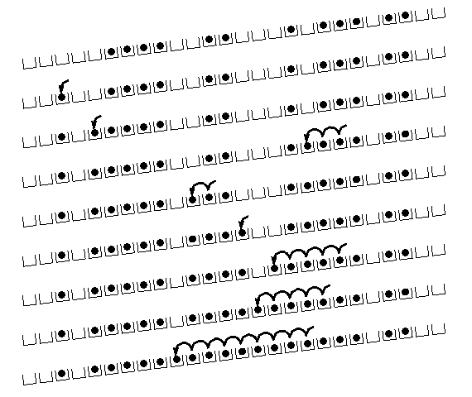
Primary Clustering
It turns out linear probing is a bad idea, even
though the probe function is quick to compute
(which is a good thing)
This tends to produce
clusters, which lead to
long probe sequences
This is called primary
clustering
We saw the start of a
cluster in our linear
probing example
[R. Sedgewick]

Slide 88
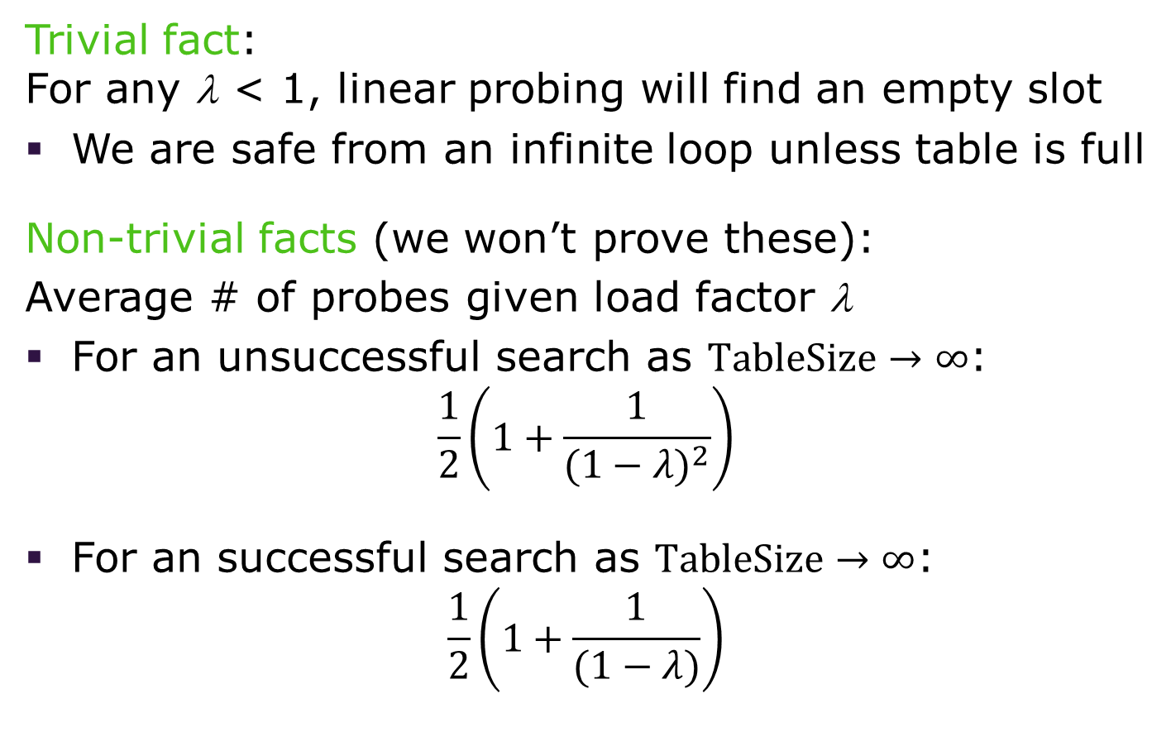
Analysis of Linear Probing
Trivial fact:
For any λ < 1, linear probing will find an empty slot
We are safe from an infinite loop unless table is full
Non-trivial facts (we won’t prove these):
Average # of probes given load factor λ
For an unsuccessful search as $TableSize→∞$:
$\frac{1}{2}\left(1+\frac{1}{{(1−λ)}^{2}}\right)$
For an successful search as $TableSize→∞$:
$\frac{1}{2}\left(1+\frac{1}{(1−λ)}\right)$

Slide 89
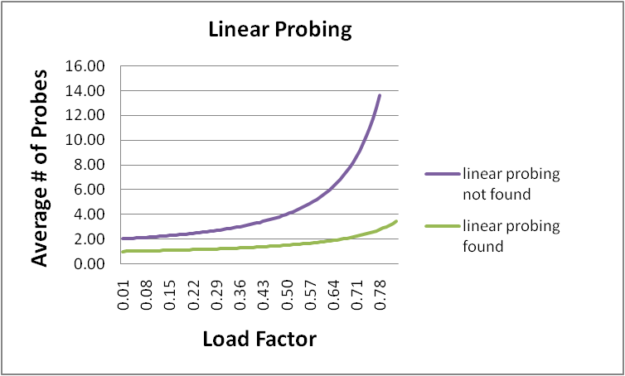
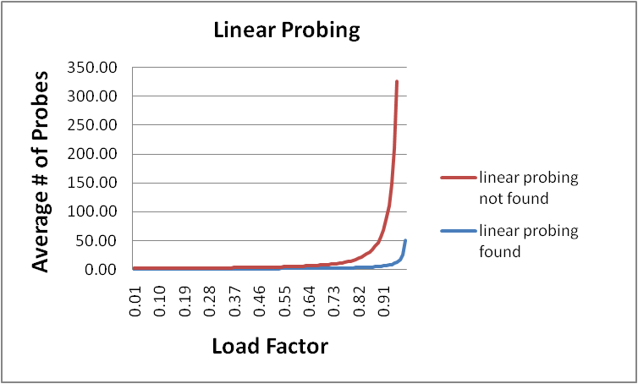
Analysis in Chart Form
Linear-probing performance degrades rapidly as the table gets full
The Formula does assumes a "large table" but the point remains
Note that separate chaining performance is linear in λ and has no trouble with λ > 1

Slide 90
Open Addressing: Quadratic Probing
We can avoid primary clustering by changing the probe function from just i to f(i)
(h(key) + f(i)) % TableSize
For quadratic probing, f(i) = i²:
0th probe: (h(key) + 0) % TableSize
1st probe: (h(key) + 1) % TableSize
2nd probe: (h(key) + 4) % TableSize
3rd probe: (h(key) + 9) % TableSize
…
i^{th} probe: (h(key) + i²) % TableSize
Intuition: Probes quickly "leave the neighborhood"

Slide 91
Quadratic Probing Example
TableSize = 10
insert(89)
0
1
2
3
4
5
6
7
8
9

Slide 92
Quadratic Probing Example
TableSize = 10
insert(89)
insert(18)
0
1
2
3
4
5
6
7
8
9 | 89

Slide 93
Quadratic Probing Example
TableSize = 10
insert(89)
insert(18)
insert(49)
0
1
2
3
4
5
6
7
8 | 18
9 | 89

Slide 94
Quadratic Probing Example
TableSize = 10
insert(89)
insert(18)
insert(49)
49 % 10 = 9 collision!
(49 + 1) % 10 = 0
insert(58)
0 | 49
1
2
3
4
5
6
7
8 | 18
9 | 89

Slide 95
Quadratic Probing Example
TableSize = 10
insert(89)
insert(18)
insert(49)
insert(58)
58 % 10 = 8 collision!
(58 + 1) % 10 = 9 collision!
(58 + 4) % 10 = 2
insert(79)
0 | 49
1
2 | 58
3
4
5
6
7
8 | 18
9 | 89

Slide 96
Quadratic Probing Example
TableSize = 10
insert(89)
insert(18)
insert(49)
insert(58)
insert(79)
79 % 10 = 9 collision!
(79 + 1) % 10 = 0 collision!
(79 + 4) % 10 = 3
0 | 49
1
2 | 58
3 | 79
4
5
6
7
8 | 18
9 | 89

Slide 97
Another Quadratic Probing Example
TableSize = 7
Insert:
76 (76 % 7 = 6)
40 (40 % 7 = 5)
48 (48 % 7 = 6)
5 (5 % 7 = 5)
55 (55 % 7 = 6)
47 (47 % 7 = 5)
0
1
2
3
4
5
6

Slide 98
Another Quadratic Probing Example
TableSize = 7
Insert:
76 (76 % 7 = 6)
40 (40 % 7 = 5)
48 (48 % 7 = 6)
5 (5 % 7 = 5)
55 (55 % 7 = 6)
47 (47 % 7 = 5)
0
1
2
3
4
5
6 | 76

Slide 99
Another Quadratic Probing Example
TableSize = 7
Insert:
76 (76 % 7 = 6)
40 (40 % 7 = 5)
48 (48 % 7 = 6)
5 (5 % 7 = 5)
55 (55 % 7 = 6)
47 (47 % 7 = 5)
0
1
2
3
4
5 | 40
6 | 76

Slide 100
Another Quadratic Probing Example
TableSize = 7
Insert:
76 (76 % 7 = 6)
40 (40 % 7 = 5)
48 (48 % 7 = 6)
5 (5 % 7 = 5)
55 (55 % 7 = 6)
47 (47 % 7 = 5)
0 | 48
1
2
3
4
5 | 40
6 | 76

Slide 101
Another Quadratic Probing Example
TableSize = 7
Insert:
(76 % 7 = 6)
(40 % 7 = 5)
48 (48 % 7 = 6)
5 (5 % 7 = 5)
55 (55 % 7 = 6)
47 (47 % 7 = 5)
0 | 48
1
2 | 5
3
4
5 | 40
6 | 76

Slide 102
Another Quadratic Probing Example
TableSize = 7
Insert:
76 (76 % 7 = 6)
40 (40 % 7 = 5)
48 (48 % 7 = 6)
5 (5 % 7 = 5)
55 (55 % 7 = 6)
47 (47 % 7 = 5)
0 | 48
1
2 | 5
3 | 55
4
5 | 40
6 | 76

Slide 103
Another Quadratic Probing Example
TableSize = 7
Insert:
76 (76 % 7 = 6)
40 (40 % 7 = 5)
48 (48 % 7 = 6)
5 (5 % 7 = 5)
55 (55 % 7 = 6)
47 (47 % 7 = 5)
(47 + 1) % 7 = 6 collision!
(47 + 4) % 7 = 2 collision!
(47 + 9) % 7 = 0 collision!
(47 + 16) % 7 = 0 collision!
(47 + 25) % 7 = 2 collision!
0 | 48
1
2 | 5
3 | 55
4
5 | 40
6 | 76
Will we ever get a 1 or 4?!?

Slide 104
Another Quadratic Probing Example
insert(47) will always fail here. Why?
For all n, (5 + n²) % 7 is 0, 2, 5, or 6
Proof uses induction and
(5 + n²) % 7 = (5 + (n - 7)²) % 7
In fact, for all c and k,
(c + n²) % k = (c + (n - k)²) % k
0 | 48
1
2 | 5
3 | 55
4
5 | 40
6 | 76

Slide 105
From Bad News to Good News
After TableSize quadratic probes, we cycle through the same indices
The good news:
For prime T and 0 ≤ i, j ≤ T/2 where i ≠ j,
(h(key) + i²) % T ≠ (h(key) + j²) % T
If TableSize is prime and λ < ½, quadratic probing will find an empty slot in at most TableSize/2 probes
If you keep λ < ½, no need to detect cycles as we just saw

Slide 106
Clustering Reconsidered
Quadratic probing does not suffer from primary clustering as the quadratic nature quickly escapes the neighborhood
But it is no help if keys initially hash the same index
Any 2 keys that hash to the same value will have the same series of moves after that
Called secondary clustering
We can avoid secondary clustering with a probe function that depends on the key: double hashing

Slide 107
Open Addressing: Double Hashing
Idea:
Given two good hash functions h and g, it is very unlikely that for some key, h(key) == g(key)
Ergo, why not probe using g(key)?
For double hashing, f(i) = i ⋅ g(key):
0th probe: (h(key) + 0 ⋅ g(key)) % TableSize
1st probe: (h(key) + 1 ⋅ g(key)) % TableSize
2nd probe: (h(key) + 2 ⋅ g(key)) % TableSize
…
i^{th} probe: (h(key) + i ⋅ g(key)) % TableSize
Crucial Detail:
We must make sure that g(key) cannot be 0

Slide 108
Double Hashing
T = 10 (TableSize)
Hash Functions:
h(key) = key mod T
g(key) = 1 + ((key/T) mod (T-1))
0
1
2
3
4
5
6
7
8
9
Insert these values into the hash table in this order. Resolve any collisions with double hashing:
13
28
33
147
43

Slide 109
Double Hashing
T = 10 (TableSize)
Hash Functions:
h(key) = key mod T
g(key) = 1 + ((key/T) mod (T-1))
0
1
2
3 | 13
4
5
6
7
8
9
Insert these values into the hash table in this order. Resolve any collisions with double hashing:
13
28
33
147
43

Slide 110
Double Hashing
T = 10 (TableSize)
Hash Functions:
h(key) = key mod T
g(key) = 1 + ((key/T) mod (T-1))
0
1
2
3 | 13
4
5
6
7
8 | 28
9
Insert these values into the hash table in this order. Resolve any collisions with double hashing:
13
28
33
147
43

Slide 111
Double Hashing
T = 10 (TableSize)
Hash Functions:
h(key) = key mod T
g(key) = 1 + ((key/T) mod (T-1))
0
1
2
3 | 13
4
5
6
7 | 33
8 | 28
9
Insert these values into the hash table in this order. Resolve any collisions with double hashing:
13
28
33 → g(33) = 1 + 3 mod 9 = 4
147
43

Slide 112
Double Hashing
T = 10 (TableSize)
Hash Functions:
h(key) = key mod T
g(key) = 1 + ((key/T) mod (T-1))
0
1
2
3 | 13
4
5
6
7 | 33
8 | 28
9 | 147
Insert these values into the hash table in this order. Resolve any collisions with double hashing:
13
28
33
147 → g(147) = 1 + 14 mod 9 = 6
43

Slide 113
Double Hashing
T = 10 (TableSize)
Hash Functions:
h(key) = key mod T
g(key) = 1 + ((key/T) mod (T-1))
0
1
2
3 | 13
4
5
6
7 | 33
8 | 28
9 | 147
Insert these values into the hash table in this order. Resolve any collisions with double hashing:
13
28
33
147 → g(147) = 1 + 14 mod 9 = 6
43 → g(43) = 1 + 4 mod 9 = 5
We have a problem:
3 + 0 = 3 3 + 5 = 8 3 + 10 = 13
3 + 15 = 18 3 + 20 = 23

Slide 114
Double Hashing Analysis
Because each probe is "jumping" by g(key) each time, we should ideally "leave the neighborhood" and "go different places from the same initial collision"
But, as in quadratic probing, we could still have a problem where we are not "safe" due to an infinite loop despite room in table
This cannot happen in at least one case:
For primes p and q such that 2 < q < p
  h(key) = key % p
  g(key) = q – (key % q)

Slide 115
Summarizing Collision Resolution
Separate Chaining is easy
find, delete proportional to load factor on average
insert can be constant if just push on front of list
Open addressing uses probing, has clustering issues as it gets full but still has reasons for its use:
Easier data representation
Less memory allocation
Run-time overhead for list nodes (but an array implementation could be faster)

Slide 116
Rehashing
When you make hash from hash leftovers…

Slide 117
Rehashing
As with array-based stacks/queues/lists
If table gets too full, create a bigger table and copy everything
Less helpful to shrink a table that is underfull
With chaining, we get to decide what "too full" means
Keep load factor reasonable (e.g., < 1)?
Consider average or max size of non-empty chains
For open addressing, half-full is a good rule of thumb

Slide 118
Rehashing
What size should we choose?
Twice-as-big?
Except that won’t be prime!
We go twice-as-big but guarantee prime
Implement by hard coding a list of prime numbers
You probably will not grow more than 20-30 times and can then calculate after that if necessary

Slide 119
Rehashing
Can we copy all data to the same indices in the new table?
Will not work; we calculated the index based on TableSize
Rehash Algorithm:
Go through old table
Do standard insert for each item into new table
Resize is an O(n) operation,
Iterate over old table: O(n)
n inserts / calls to the hash function: n ⋅ O(1) = O(n)
Is there some way to avoid all those hash function calls?
Space/time tradeoff: Could store h(key) with each data item
Growing the table is still O(n); only helps by a constant factor

Slide 120
Implementing Hashing
Reality is never as clean-cut as theory

Slide 121
Hashing and Comparing
Our use of int key can lead to us overlooking a critical detail
We do perform the initial hash on E
While chaining/probing, we compare to E which requires equality testing (compare == 0)
A hash table needs a hash function and a comparator
In Project 2, you will use two function objects
The Java library uses a more object-oriented approach:
each object has an equals method and a hashCode method:
    class Object {
    boolean equals(Object o) {…}
    int hashCode() {…}
    …
    }

Slide 122
Equal Objects Must Hash the Same
The Java library (and your project hash table) make a very important assumption that clients must satisfy
Object-oriented way of saying it:
If a.equals(b), then we must require
  a.hashCode()==b.hashCode()
Function object way of saying it:
If c.compare(a,b) == 0, then we must require
h.hash(a) == h.hash(b)
If you ever override equals
You need to override hashCode also in a consistent way
See CoreJava book, Chapter 5 for other "gotchas" with equals

Slide 123
Comparable/Comparator Rules
We have not emphasized important "rules" about comparison for:
all our dictionaries
sorting (next major topic)
Comparison must impose a consistent, total ordering:
For all a, b, and c:
  If compare(a,b) < 0, then compare(b,a) > 0
  If compare(a,b) == 0, then compare(b,a) == 0
  If compare(a,b) < 0 and compare(b,c) < 0,
  then compare(a,c) < 0

Slide 124

A Generally Good hashCode()
int result = 17; // start at a prime
foreach field f
int fieldHashcode =
boolean: (f ? 1: 0)
byte, char, short, int: (int) f
long: (int) (f ^ (f >>> 32))
float: Float.floatToIntBits(f)
double: Double.doubleToLongBits(f), then above
Object: object.hashCode( )
result = 31 * result + fieldHashcode;
return result;

Slide 125
Final Word on Hashing
The hash table is one of the most important data structures
Efficient find, insert, and delete
Operations based on sorted order are not so efficient
Useful in many, many real-world applications
Popular topic for job interview questions
Important to use a good hash function
  Good distribution of key hashs
  Not overly expensive to calculate (bit shifts good!)
Important to keep hash table at a good size
Keep TableSize a prime number
Set a preferable λ depending on type of hashtable

