Slide 1
CSE332: Data Abstractions Lecture 28: Course Wrap-up
Tyler Robison
Summer 2010

Slide 2
Merging
So, we’ve spent the quarter exploring many different data structures; time to merge back together:

Slide 3
Some unexplored nodes
Alternative data structures for balanced trees, priority queues
Disjoint-set data structure (union-find)
AVL deletion
Max-flow / min-cut graph algorithms
Huffman coding (compression)

Slide 4
What we’ve covered
Really just a beginning
Many other priority queues: skew heap, leftist heap, binomial queue, …
Many other dictionaries: red/black tree, splay tree, …
Many variations on hash tables
Many variations on B-Trees
Many other sorts, graph algorithms, etc.
Just scratched the surface of concurrency
Run-time/recurrence-relation analysis go much deeper

Slide 5
What we’ve covered
But we’ve covered the foundation
Many priority queues, but binary heaps are among the most common
Many dictionary data structures; among which balanced trees and hash tables are most important
Graph theory is an enormous area, but the basics will get you a long ways
Parallelism/concurrency issues covered are all that’s needed for many situations

Slide 6
And now
You should now be equipped to
Learn new data structures & ADTs
‘Once you learn one programming language, others come much easier’
Understand/analyze run-times
Understand uses & trade-offs
In general make more informed use of them in programming
Have had experience writing/debugging/testing data structures & parallel/concurrent software
More experience with proofs
Maybe not up to proving P!=NP, but still
Know a bunch of tools, and know how to pick the right tool for the job

Slide 7
Applications
Hash tables: Everywhere
Seriously, everywhere
If you’re interviewing for a programming job/internship, hash table questions are likely candidates
Data Bases: B-Trees under the hood
Graphs show up in CS again and again
Just very useful for modeling stuff:
Computer networks
Power grids
Road systems
Social networks
Knowledge/concept maps

Slide 8
Applications
Parallelism & Concurrency
Increasingly important
Many more cores is likely the future of computing hardware
Programming for many cores is going to be important
Speed, and thus parallelism, hugely important in many areas
Games (Xbox 360: 3 cores)
Servers
Scientific/mathematical simulations
Many others; anything concerned with speed
Concurrency problems pop up even in some simple Java applications
Ex: Handling GUI events
Big Oh analysis: ubiquitous in CS
Now some specific examples in AI; trees & graphs

Slide 9
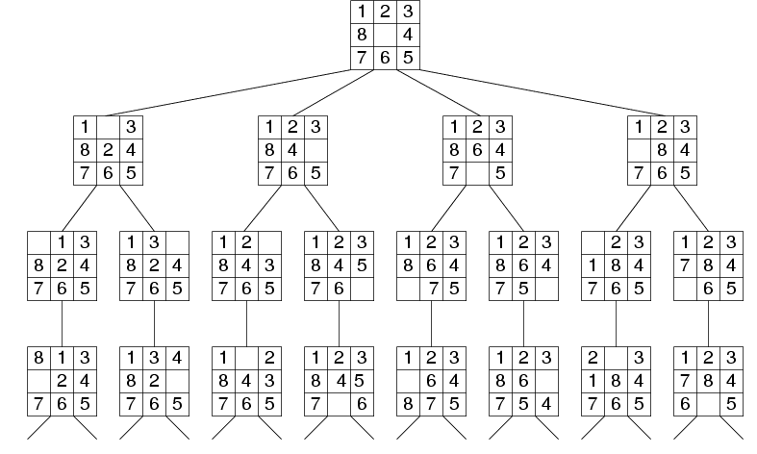
Trees & Traversals
Problem space as tree
Want to find optimal solution
BFS & iterative deepening search both work well
Better technique called A* search:
Instead of ‘closest’ or ‘furthest’, choose lowest cost=g( )+h( )
g( ) is cost so far
h( ) is expected distance to goal

Slide 10
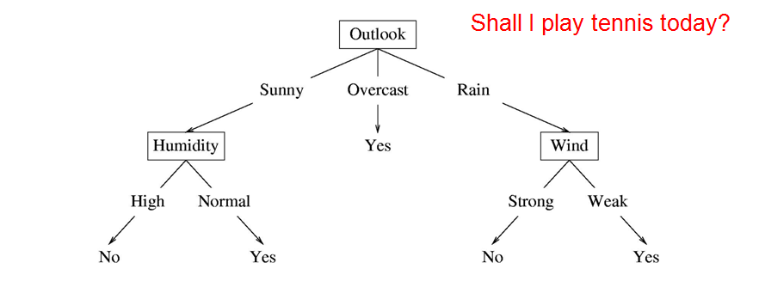
Decision Trees
Basis for simple decision-making agents
Algorithms to create optimal decision tree:
Take set of labeled data (‘Sunny,Normal Humidity,Strong Wind: Yes’)
Uses ‘information gain’ to decide what attribute to ask about next
Of course, real decision trees likely to be much larger
Ex: Face detection features

Slide 11
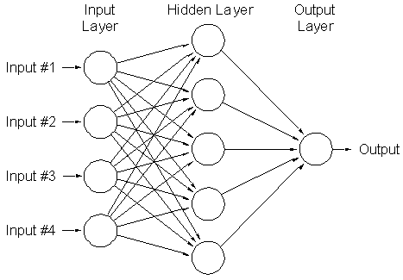
Neural Networks
Usually DAG of ‘neurons’
Edges represent how information propagates from input nodes (observations) to output nodes (decision)
Uses include OCR:
Conceptually have each pixel as a binary input
Each output represents a character: ‘Is this image a 9?’

Slide 12
Thanks!
Extra office hours

