Slide 1
CSE332: Data Abstractions Lecture 25: Deadlocks and Additional Concurrency Issues
Tyler Robison
Summer 2010

Slide 2
Where we are
We’ve covered basic concurrency, then some odds and ends:
Readers/writer locks
Condition variables
There are a couple more common issues we need to hit:
Deadlocks: Very common and very bad
Additional problems that pop up due to concurrency

Slide 3
A New Concurrency Issue: Deadlocks
So far our bank account operations have been limited to one account
Now consider a transfer method between accounts
As always, we’d like to synchronize access (one lock per account for a fine-grained locking scheme)
class BankAccount {
…
synchronized void withdraw(int amt) {…}
synchronized void deposit(int amt) {…}
synchronized void transferTo(int amt,BankAccount a){
this.withdraw(amt);
a.deposit(amt);
}
}
Notice during call to a.deposit, thread holds 2 locks; first it’s own then the destination account’s (both due to synchronized)

Slide 4
The Deadlock
For simplicity, suppose x and y are static fields holding accounts
What happens if symmetric transfers occur simultaneously between accounts x & y?
Thread 1: x.transferTo(1,y)
Thread 2: y.transferTo(1,x)
acquire lock for x
do withdraw from y
block on lock for y
acquire lock for y
do withdraw from x
block on lock for x
Time
Deadlock: Each thread is waiting for the other’s lock

Slide 5
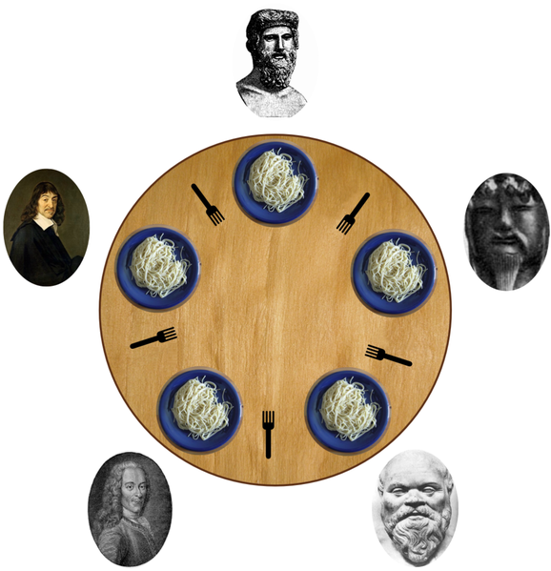
Ex: The Dining Philosophers
5 philosophers go out to dinner together at an Italian restaurant
Sit at a round table; one fork per setting
When the spaghetti comes, each philosopher proceeds to grab their right fork, then their left fork, then eats
‘Locking’ for each fork results in a deadlock

Slide 6
Deadlock, in general
A deadlock occurs when there are threads T1, …, Tn such that:
For i=1,..,n-1, Ti is waiting for a resource held by T(i+1)
Tn is waiting for a resource held by T1
In other words, there is a cycle of waiting
Can formalize as a graph of dependencies with cycles
Deadlock avoidance in programming amounts to techniques to ensure a cycle can never arise

Slide 7
Back to our example
Options for deadlock-proof transfer:
Make a smaller critical section: transferTo not synchronized
Exposes intermediate state after withdraw before deposit
May work out okay here, but would break other functionality
If we were to get the total $ in all accounts at this point, it would be wrong
Coarsen lock granularity: one lock for all accounts allowing transfers between them
Works, but sacrifices concurrent deposits/withdrawals
Give every bank-account a unique number and always acquire locks in the same order…
Entire program should obey this order to avoid cycles
Code acquiring only one lock is fine though

Slide 8
Ordering locks
class BankAccount {
…
private int acctNumber; // must be unique
void transferTo(int amt, BankAccount a) {
if(this.acctNumber < a.acctNumber)
synchronized(this) {
synchronized(a) {
this.withdraw(amt);
a.deposit(amt);
}}
else
synchronized(a) {
synchronized(this) {
this.withdraw(amt);
a.deposit(amt);
}}
}
}

Slide 9
Another example
From the Java standard library
class StringBuffer {
private int count;
private char[] value;
…
synchronized append(StringBuffer sb) {
int len = sb.length();
if(this.count + len > this.value.length)
this.expand(…);
sb.getChars(0,len,this.value,this.count);
}
synchronized getChars(int x, int, y,
char[] a, int z) {
“copy this.value[x..y] into a starting at z”
}
}

Slide 10
Two problems
Problem #1: Deadlock potential if two threads try to append in opposite directions, just like in the bank-account first example
Problem #2: The lock for sb is not held between calls to sb.length and sb.getChars
So sb could get longer
Would cause append to throw an ArrayBoundsException
Not easy to fix both problems without extra copying:
Do not want unique ids on every StringBuffer
Do not want one lock for all StringBuffer objects

Slide 11
Perspective
Code like account-transfer and string-buffer append are difficult to deal with for reasons of deadlock
Easier case: different types of objects
Can document a fixed order among types
Example: “When moving an item from the hashtable to the work queue, never try to acquire the queue lock while holding the hashtable lock”
Easier case: objects are in an acyclic structure
Can use the data structure to determine a fixed order
Example: “If holding a tree node’s lock, do not acquire other tree nodes’ locks unless they are children in the tree”

Slide 12
Motivating memory-model issues
Tricky and surprisingly wrong unsynchronized concurrent code; the assert below should never be capable of failing
class C {
private int x = 0;
private int y = 0;
void f() {
x = 1;
y = 1;
}
void g() {
int yy = y;
int xx = x;
assert(xx >= yy);
}
}
It seems like it could never fail, despite how it interleaves:
x and y are initialized to 0 when the object is constructed; no concurrent on the object possible there
x and y can only change when f() is called; first x changes, then y changes
g() get’s y’s value, then x’s
For the assert to fail, yy’s value needs to be greater than xx’s

Slide 13
Interleavings
There is no interleaving of f and g where the assertion fails
Proof #1: Exhaustively consider all possible orderings of access to shared memory
Proof #2: Assume !(xx>=yy); then yy==1 and xx==0
But if yy==1, then yy=y happened after y=1
Since programs execute in order, xx=x happened after yy=y and x=1 happened before y=1
So by transitivity, xx==1. Contradiction.
x = 1;
y = 1;
int yy = y;
int xx = x;
assert(xx >= yy);
Thread 1: f
Thread 2: g
For yy=1, the yy assignment must happen after the y assignment
x = 1;
y = 1;
int yy = y;
int xx = x;
assert(xx >= yy);

Slide 14
Data Race => Wrong
However, the code has a data race
Two actually; potentially simultaneous access to x & y
Recall: data race = unsynchronized read/write or write/write of same location = bad
If your code has data races, you can’t reason about it with interleavings
Even if there are no possible bad interleaving, your program can still break

Slide 15
Data Race => Wrong
How?!?
Optimizations do weird things:
Reorder instructions
Maintain thread-local copies of shared memory, and don’t update them immediately when changed
Optimizations occur both in compiler and hardware
Why?!?
In a word, ‘speed’
Can get great time savings this way; otherwise would sacrifice these to support the questionable practice of data races
Will not rearrange insturctions when sequential dependencies come into play; ex: Consider: x=17; y=x;
Regarding updating of shared-memory between threads, there are ways to force updates

Slide 16
The grand compromise
The compiler/hardware will never perform a memory reordering that affects the result of a single-threaded program
The compiler/hardware will never perform a memory reordering that affects the result of a data-race-free multi-threaded program
So: If no interleaving of your program has a data race, then you can forget about all this reordering nonsense: the result will be equivalent to some interleaving
Your job: Avoid data races
Compiler/hardware job: Give interleaving (illusion) if you do your job

Slide 17
Fixing our example
Naturally, we can use synchronization to avoid data races
Correct ordering now guaranteed because no data races
Compiler knows it’s not allowed to reorder these in strange ways
Now the assertion can’t fail
class C {
private int x = 0;
private int y = 0;
void f() {
synchronized(this) { x = 1; }
synchronized(this) { y = 1; }
}
void g() {
int yy,xx;
synchronized(this) { yy = y; }
synchronized(this) { xx = x; }
assert(xx >= yy);
}
}

Slide 18
A second fix: volatile
Java has volatile fields: accesses don’t count as data races
Accesses will be ordered correctly
Updates shared correctly between threads
Implementation: slower than regular fields, faster than locks
Really for experts: generally avoid using it; use standard libraries instead
If you do plan to use volatile, look up Java’s documentation of it first
class C {
private volatile int x = 0;
private volatile int y = 0;
void f() {
x = 1;
y = 1;
}
void g() {
int yy = y;
int xx = x;
assert(xx >= yy);
}
}

Slide 19
Code that’s wrong
Here is a more realistic example of code that’s wrong
Realistic because I wrote it, and not with the intention of it being wrong…
Data race on stop; change made to stop in one thread not guaranteed to be updated to others (for reasons of optimization)
No guarantee Thread 2 will ever stop; even after stop=true in Thread 1
Would “probably work” despite being wrong
Thread 1: f()
class C {
boolean stop = false;
void f() {
while(!stop) {
// do something…
}
}
void g() {
stop = didUserQuit();
}
}
Thread 2: g()
Fixes: synchronize access or make it volatile

Slide 20
Concurrency summary
Access to shared resources introduces new kinds of bugs:
Data races
Critical sections too small
Critical sections use wrong locks
Deadlocks
Requires synchronization
Locks for mutual exclusion (common, various flavors)
Condition variables for signaling others (less common)
New performance issues pop up as well:
Critical sections too large; covers expensive computation
Locks too coarse-grained; loses benefit of concurrent access
Guidelines for correct use help avoid common pitfalls; stick to them

