Slide 1
CSE332: Data Abstractions Lecture 2: Math Review; Algorithm Analysis
Tyler Robison
Summer 2010

Slide 2
Proof via mathematical induction
Suppose P(n) is some rule involving n
Example: n ≥ n/2 + 1, for all n ≥2
To prove P(n) for all integers n ≥ c, it suffices to prove
P(c) – called the “basis” or “base case”
If P(k) then P(k+1) – called the “induction step” or “inductive case”
Why we will care:
To show an algorithm is correct or has a certain running time no matter how big a data structure or input value is
(Our “n” will be the data structure or input size.)

Slide 3
Example
P(n) = “the sum of the first n powers of 2 (starting at ) is the next power of 2 minus 1”
Theorem: P(n) holds for all n ≥ 1
1=2-1
1+2=4-1
1+2+4=8-1
So far so good…

Slide 4
Example
Theorem: P(n) holds for all n ≥ 1
Proof: By induction on n
Base case, n=1:
Inductive case:
Inductive hypothesis: Assume the sum of the first k powers of 2 is 2^{k}-1
Show, given the hypothesis, that the sum of the first (k+1) powers of 2 is 2^{k+1}-1
From our inductive hypothesis we know:
Add the next power of 2 to both sides…
We have what we want on the left; massage the right a bit

Slide 5
Note for homework
Proofs by induction will come up a fair amount on the homework
When doing them, be sure to state each part clearly:
What you’re trying to prove
The base case
The inductive case
The inductive hypothesis
In many inductive proofs, you’ll prove the inductive case by just starting with your inductive hypothesis, and playing with it a bit, as shown above

Slide 6
Powers of 2
A bit is 0 or 1
A sequence of n bits can represent 2^{n} distinct things
For example, the numbers 0 through 2^{n}-1
2¹⁰ is 1024 (“about a thousand”, kilo in CSE speak)
2²⁰ is “about a million”, mega in CSE speak
2³⁰ is “about a billion”, giga in CSE speak
Java: an int is 32 bits and signed, so “max int” is “about 2 billion”
a long is 64 bits and signed, so “max long” is 2⁶³-1

Slide 7
Therefore…
We could give a unique id to…
Every person in this room with 4 bits
Every person in the U.S. with 29 bits
Every person in the world with 33 bits
Every person to have ever lived with 38 bits (estimate)
Every atom in the universe with 250-300 bits
So if a password is 128 bits long and randomly generated,
do you think you could guess it?

Slide 8
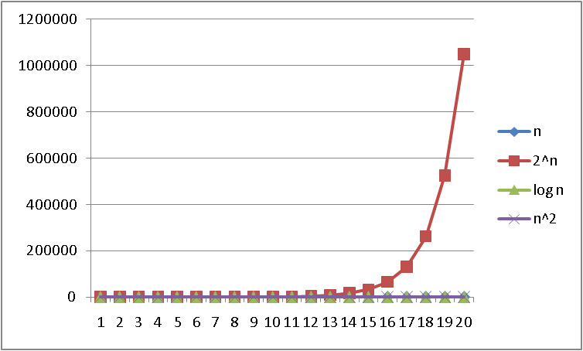
Logarithms and Exponents
Since so much is binary in CS, log almost always means log₂
Definition: log₂ x = y if x = 2^{y}
So, log₂ 1,000,000 = “a little under 20”
Just as exponents
grow very quickly,
logarithms grow
very slowly
See Excel file
for plot data –
play with it!

Slide 9
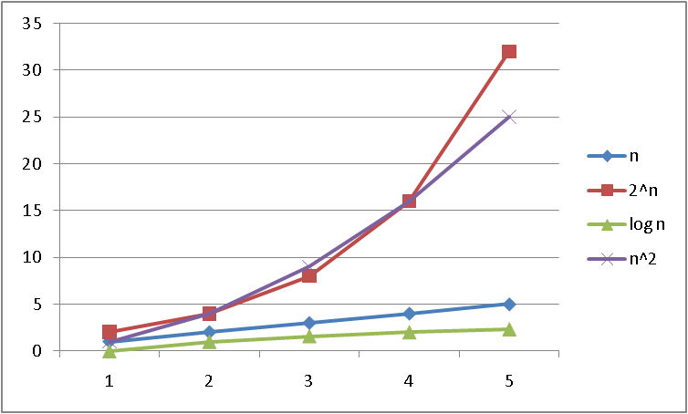
Logarithms and Exponents

Slide 10
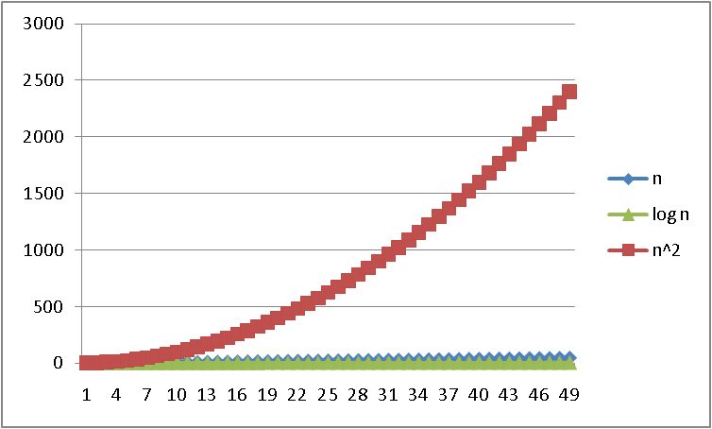
Logarithms and Exponents

Slide 11
Properties of logarithms
log(A*B) = log A + log B
So log(N^{k})= k log N
log(A/B) = log A – log B
x=
log(log x) is written log log x
Grows as slowly as 2² grows fast
Ex:
(log x)(log x) is written log²x
It is greater than log x for all x > 2
y

Slide 12
Log base doesn’t matter (much)
“Any base B log is equivalent to base 2 log within a constant factor”
And we are about to stop worrying about constant factors!
In particular, log₂ x = 3.22 log₁₀ x
In general, we can convert log bases via a constant multiplier
Say, to convert from base B to base A:
log_{B} x = (log_{A} x) / (log_{A} B)

Slide 13
Algorithm Analysis
As the “size” of an algorithm’s input grows
(length of array to sort, size of queue to search, etc.):
How much longer does the algorithm take (time)
How much more memory does the algorithm need (space)
We are generally concerned about approximate runtimes
Whether T(n)=3n+2 or T(n)=n/4+8, we say it runs in linear time
Common categories:
Constant: T(n)=1
Linear: T(n)=n
Logarithmic: T(n)=logn
Exponential: T(n)=2^{n}

Slide 14
Example
First, what does this pseudocode return?
x := 0;
for i=1 to n do
for j=1 to i do
x := x + 3;
return x;
For any n ≥ 0, it returns 3n(n+1)/2
Proof: By induction on n
P(n) = after outer for-loop executes n times, x holds 3n(n+1)/2
Base: n=0, returns 0
Inductive case:
Inductive hypothesis: x holds 3k(k+1)/2 after k iterations.
Next iteration adds 3(k+1), for total of \
3k(k+1)/2 + 3(k+1)=
(3k(k+1) + 6(k+1))/2 =
(k+1)(3k+6)/2 =
3(k+1)(k+2)/2

Slide 15
Example
How long does this pseudocode run?
x := 0;
for i=1 to n do
for j=1 to i do
x := x + 3;
return x;
Find running time in terms of n, for any n ≥ 0
Assignments, additions, returns take “1 unit time”
Constant time
Loops take the sum of the time for their iterations
So: 2 + 2*(number of times inner loop runs)
And how many times is that…

Slide 16
Example
How long does this pseudocode run?
x := 0;
for i=1 to n do
for j=1 to i do
x := x + 3;
return x;
n=1 -> 1 time; n=2 -> 3 times; n=3 -> 6 times
The total number of loop iterations is n*(n+1)/2
You’ll get to prove it in the homework
This is proportional to n² , and we say O(n²), “big-Oh of”
For large enough n, the n and constant terms are irrelevant, as are the first assignment and return
See plot… n*(n+1)/2 vs. just n²/2

Slide 17
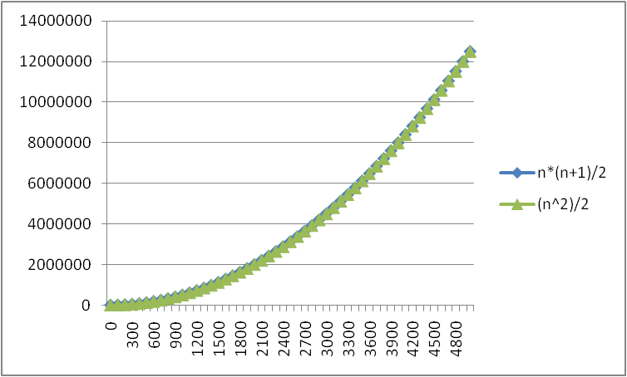
Lower-order terms don’t matter
n*(n+1)/2 vs. just n²/2

Slide 18
Big Oh (also written Big-O)
Big Oh is used for comparing asymptotic behavior of functions; which is ‘faster’?
We’ll get into the definition later, but for now:
‘f(n) is O(g(n))’ roughly means
The function f(n) is at least as small as g(n) as they go toward infinity
Think of it as ≤
BUT: Big Oh ignores constant factors
n+10 is O(n); we drop out the ‘+10’
5n is O(n); we drop out the ‘x5’
The following is NOT true though: n² is O(n)
Note that ‘f(n) is O(g(n))’ gives an upper bound for f(n)
n is O(n²)
5 is O(n)

Slide 19
Big Oh: Common Categories
From fastest to slowest
O(1) constant (same as O(k) for constant k)
O(log n) logarithmic
O(n) linear
O(n log n) “n log n”
O(n²) quadratic
O(n³) cubic
O(n^{k}) polynomial (where is k is an constant)
O(k^{n}) exponential (where k is any constant > 1)
Usage note: “exponential” does not mean “grows really fast”, it means “grows at rate proportional to k^{n} for some k>1”
A savings account accrues interest exponentially (k=1.01?)

