Slide 1
CSE332: Data Abstractions Lecture 11: Hash Tables
Tyler Robison
Summer 2010

Slide 2
Hash Table: Another dictionary
Aim for constant-time (i.e., O(1)) find, insert, and delete
“On average” under some reasonable assumptions
A hash table is an array of some fixed size
Define a mapping from each key to a location in table
Basic idea:
hash table
0
 | …
hash function:
index = h(key)
key space (e.g., integers, strings)
TableSize –1

Slide 3
Hash tables
There are m possible keys (m typically large, even infinite) but we expect our table to have only n items where n is much less than m (often written n << m)
Many dictionaries have this property
Compiler: All possible identifiers allowed by the language vs. those used in some file of one program
Database: All possible student names vs. students enrolled
AI: All possible chess-board configurations vs. those considered by the current player

Slide 4
Hash functions
Hash function: Our key to index mapping
An ideal hash function:
Is fast to compute
“Rarely” hashes two “used” keys to the same index
Often impossible in theory; easy in practice
Will handle collisions a bit later
hash table
0
 | …
hash function:
index = h(key)
key space (e.g., integers, strings)
TableSize –1

Slide 5
Who hashes what?
Hash tables can be generic
To store elements of type E, we just need E to be:
Comparable: order any two E (like with all dictionaries)
Hashable: convert any E to an int
When hash tables are a reusable library, the division of responsibility generally breaks down into two roles:
client
hash table library
collision?
collision
resolution
E
int
table-index
We will learn both roles, but most programmers “in the real world” spend more time on the client side, while still having an understanding of the library

Slide 6
More on roles
Some ambiguity in terminology on which parts are “hashing”
client
hash table library
collision?
collision
resolution
E
int
table-index
“hashing”?
“hashing”?
Two roles must both contribute to minimizing collisions
Client should aim for different ints for expected items
Avoid “wasting” any part of E or the 32 bits of the int
Library should aim for putting “similar” ints in different indices
conversion to index is almost always “mod table-size”
using prime numbers for table-size is common

Slide 7
What to hash?
In lecture we will consider the two most common things to hash: integers and strings
If you have objects with several fields, it is usually best to have most of the “identifying fields” contribute to the hash to avoid collisions
Example:
class Person { String first; String middle; String last;
int age;
}

Slide 8
Hashing integers
key space = integers
Useful for examples
Simple hash function:
h(key) = key % TableSize
Client: f(x) = x
Library g(x) = x % TableSize
Fairly fast and natural
Example:
TableSize = 10
Insert 7, 18, 41, 34, 10
(As usual, ignoring data “along for the ride”)
What could go wrong?
Now insert 20….
0
1
2
3
4
5
6
7
8
9
10
41
34
7
18

Slide 9
Collision-avoidance
Collision: Two keys map to the same index
With “x % TableSize” the number of collisions depends on
the ints inserted
TableSize
Larger table-size tends to help, but not always
Example: Insert 12, 22, 32 with TableSize = 10 vs.
TableSize = 6
Technique: Pick table size to be prime. Why?
Real-life data tends to have a pattern, and “multiples of 61” are probably less likely than “multiples of 60”
Later we’ll see that one collision-handling strategy does provably better with prime table size
Usually use something like 10 for examples though
0 | 12
1
2 | 32
3
4 | 22
5

Slide 10
More arguments for a prime table size
If TableSize is 60 and…
Lots of data items are multiples of 5, wasting 80% of table
Lots of data items are multiples of 10, wasting 90% of table
Lots of data items are multiples of 2, wasting 50% of table
If TableSize is 61…
Collisions can still happen, but 5, 10, 15, 20, … will fill table
Collisions can still happen but 10, 20, 30, 40, … will fill table
Collisions can still happen but 2, 4, 6, 8, … will fill table
In general, if x and y are “co-prime” (means gcd(x,y)==1), then
(a * x) % y == (b * x) % y if and only if a % y == b % y
So, given table size y and keys as multiples of x, we’ll get a decent distribution if x & y are co-prime
Good to have a TableSize that has not common factors with any “likely pattern” x

Slide 11
What if we don’t have ints as keys?
If keys aren’t ints, the client must convert to an int
Trade-off: speed and distinct keys hashing to distinct ints
Very important example: Strings
Key space K = s₀s₁s₂…s_{m-1}
Where s_{i} are chars: s_{i} ∈ [0,51] or s_{i} ∈ [0,255] or s_{i} ∈ [0,2¹⁶-1]
Some choices: Which avoid collisions best?
h(K) = s₀ % TableSize
h(K) = % TableSize
h(K) = % TableSize
What causes collisions for each?
Anything w/ same first letter
Any rearrangement of letters
Hmm… not so clear

Slide 12
Java-esque String Hash
Java characters in Unicode format; 2¹⁶ bits
Can compute efficiently via a trick called Horner’s Rule:
Idea: Avoid expensive computation of 31^{k}
Say n=4
h=((s[0]*31+s[1])*31+s[2])*31+s[3]

Slide 13
Specializing hash functions
How might you hash differently if all your strings were web addresses (URLs)?

Slide 14
Combining hash functions
A few rules of thumb / tricks:
Use all 32 bits (careful, that includes negative numbers)
When smashing two hashes into one hash, use bitwise-xor
Problem with Bitwise AND?
Produces too many 0 bits
Problem with Bitwise OR?
Produces too many 1 bits
Rely on expertise of others; consult books and other resources
If keys are known ahead of time, choose a perfect hash

Slide 15
Additional operations
How would we do the following in a hashtable?
findMin()
findMax()
predecessor(key)
Hashtables really not set up for these; need to search everything, O(n) time
Could try a hack:
Separately store max & min values; update on insert & delete
What about ‘2nd to max value’, predecessor, in-order traversal, etc; those are fast in an AVL tree

Slide 16
Hash Tables: A Different ADT?
In terms of a Dictionary ADT for just insert, find, delete, hash tables and balanced trees are just different data structures
Hash tables O(1) on average (assuming few collisions)
Balanced trees O(log n) worst-case
Constant-time is better, right?
Yes, but you need “hashing to behave” (collisions)
Yes, but findMin, findMax, predecessor, and successor go from O(log n) to O(n)
Why your textbook considers this to be a different ADT
Not so important to argue over the definitions

Slide 17
Collision resolution
Collision:
When two keys map to the same location in the hash table
We try to avoid it, but number-of-keys exceeds table size
So we can resolve collisions in a couple of different ways:
Separate chaining
Open addressing

Slide 18
Separate Chaining
Chaining: All keys that map to the same table location are kept in a list (a.k.a. a “chain” or “bucket”)
As easy as it sounds
Example: insert 10, 22, 107, 12, 42 with mod hashing and TableSize = 10
0 | /
1 | /
2 | /
3 | /
4 | /
5 | /
6 | /
7 | /
8 | /
9 | /

Slide 19
Separate Chaining
Chaining: All keys that map to the same table location are kept in a list (a.k.a. a “chain” or “bucket”)
As easy as it sounds
Example: insert 10, 22, 107, 12, 42 with mod hashing and TableSize = 10
0
1 | /
2 | /
3 | /
4 | /
5 | /
6 | /
7 | /
8 | /
9 | /
10
/

Slide 20
Separate Chaining
Chaining: All keys that map to the same table location are kept in a list (a.k.a. a “chain” or “bucket”)
As easy as it sounds
Example: insert 10, 22, 107, 12, 42 with mod hashing and TableSize = 10
0
1 | /
2
3 | /
4 | /
5 | /
6 | /
7 | /
8 | /
9 | /
10
/
22
/

Slide 21
Separate Chaining
Chaining: All keys that map to the same table location are kept in a list (a.k.a. a “chain” or “bucket”)
As easy as it sounds
Example: insert 10, 22, 107, 12, 42 with mod hashing and TableSize = 10
0
1 | /
2
3 | /
4 | /
5 | /
6 | /
7
8 | /
9 | /
10
/
22
/
107
/

Slide 22
Separate Chaining
Chaining: All keys that map to the same table location are kept in a list (a.k.a. a “chain” or “bucket”)
As easy as it sounds
Example: insert 10, 22, 107, 12, 42 with mod hashing and TableSize = 10
0
1 | /
2
3 | /
4 | /
5 | /
6 | /
7
8 | /
9 | /
10
/
12
22
/
107
/

Slide 23
Separate Chaining
Chaining: All keys that map to the same table location are kept in a list (a.k.a. a “chain” or “bucket”)
As easy as it sounds
Example: insert 10, 22, 107, 12, 42 with mod hashing and TableSize = 10
Why put them at the front?
Handling duplicates?
0
1 | /
2
3 | /
4 | /
5 | /
6 | /
7
8 | /
9 | /
10
/
42
12
22
/
107
/

Slide 24
Thoughts on chaining
Worst-case time for find?
Linear
But only with really bad luck or bad hash function
So not worth avoiding (e.g., with balanced trees at each bucket)
Keep # of items in each bucket small
Overhead of AVL tree, etc. not worth it for small n
Beyond asymptotic complexity, some “data-structure engineering” may be warranted
Linked list vs. array or a hybrid of the two
Move-to-front (part of Project 2)
Leave room for 1 element (or 2?) in the table itself, to optimize constant factors for the common case
A time-space trade-off…

Slide 25
Time vs. space (constant factors only here)
0
1 | /
2
3 | /
4 | /
5 | /
6 | /
7
8 | /
9 | /
0 | 10 | /
1 | / | X
2 | 42
3 | / | X
4 | / | X
5 | / | X
6 | / | X
7 | 107 | /
8 | / | X
9 | / | X
10
/
42
12
22
/
12
22
/
107
/

Slide 26
A more rigorous chaining analysis
Definition: The load factor, λ, of a hash table is
N=number of elements
Under separate chaining, the average number of elements per bucket is…?
λ
So if some inserts are followed by random finds, then on average:
Each unsuccessful find compares against ____ items
Each successful find compares against _____ items
If λ is low, find & insert likely to be O(1)
We like to keep λ around 1 for separate chaining
λ
λ/2

Slide 27
Separate Chaining Deletion
Not too bad
Find in table
Delete from bucket
Say, delete 12
Similar run-time as insert
0
1 | /
2
3 | /
4 | /
5 | /
6 | /
7
8 | /
9 | /
10
/
42
12
22
/
107
/

Slide 28
An Alternative to Separate Chaining: Open Addressing
Store directly in the array cell (no linked list)
How to deal with collisions?
If h(key) is already full,
Try (h(key) + 1) % TableSize
That’s full too?
Try (h(key) + 2) % TableSize
How about
Try (h(key) + 3) % TableSize
…
Example: insert 38, 19, 8, 109, 10
0 | /
1 | /
2 | /
3 | /
4 | /
5 | /
6 | /
7 | /
8 | 38
9 | /

Slide 29
An Alternative to Separate Chaining: Open Addressing
Store directly in the array cell (no linked list)
How to deal with collisions?
If h(key) is already full,
Try (h(key) + 1) % TableSize
That’s full too?
Try (h(key) + 2) % TableSize
How about
Try (h(key) + 3) % TableSize
…
Example: insert 38, 19, 8, 109, 10
0 | /
1 | /
2 | /
3 | /
4 | /
5 | /
6 | /
7 | /
8 | 38
9 | 19

Slide 30
An Alternative to Separate Chaining: Open Addressing
Store directly in the array cell (no linked list)
How to deal with collisions?
If h(key) is already full,
Try (h(key) + 1) % TableSize
That’s full too?
Try (h(key) + 2) % TableSize
How about
Try (h(key) + 3) % TableSize
…
Example: insert 38, 19, 8, 109, 10
0 | 8
1 | /
2 | /
3 | /
4 | /
5 | /
6 | /
7 | /
8 | 38
9 | 19

Slide 31
An Alternative to Separate Chaining: Open Addressing
Store directly in the array cell (no linked list)
How to deal with collisions?
If h(key) is already full,
Try (h(key) + 1) % TableSize
That’s full too?
Try (h(key) + 2) % TableSize
How about
Try (h(key) + 3) % TableSize
…
Example: insert 38, 19, 8, 109, 10
0 | 8
1 | 109
2 | /
3 | /
4 | /
5 | /
6 | /
7 | /
8 | 38
9 | 19

Slide 32
An Alternative to Separate Chaining: Open Addressing
Store directly in the array cell (no linked list)
How to deal with collisions?
If h(key) is already full,
Try (h(key) + 1) % TableSize
That’s full too?
Try (h(key) + 2) % TableSize
How about
Try (h(key) + 3) % TableSize
…
Example: insert 38, 19, 8, 109, 10
0 | 8
1 | 109
2 | 10
3 | /
4 | /
5 | /
6 | /
7 | /
8 | 38
9 | 19

Slide 33
Open addressing: Storing in the table
This is one example of open addressing
More generally, we just need to describe where to check next when one attempt fails (cell already in use)
Each version of open addressing involves specifying a sequence of indices to try
Trying the next spot is called probing
In the above example, our i^{th} probe was (h(key) + i) % TableSize
To get the next index to try, we just added 1 (mod the Tablesize)
This is called linear probing
More generally we have some probe function f and use
(h(key) + f(i)) % TableSize
for the i^{th} probe (start at i=0)
For linear probing, f(i)=i

Slide 34
More about Open Addressing
Find works similarly:
Keep probing until we find it
Or, if we hit null, we know it’s not in the table
How does open addressing work with high load factor (λ)
Poorly
Too many probes means no more O(1)
So want larger tables
Find with λ=1?
Deletion? How about we just remove it?
Take previous example, delete 38
Then do a find on 8
Hmm… this isn’t going to work
Stick with lazy deletion
0 | 8
1 | 109
2 | /
3 | /
4 | /
5 | /
6 | /
7 | /
8 | 38
9 | 19

Slide 35
Terminology
We and the book use the terms
“chaining” or “separate chaining”: Linked list in each bucket
vs.
“open addressing”: Store directly in table
Very confusingly,
“open hashing” is a synonym for “chaining”
vs.
“closed hashing” is a synonym for “open addressing”

Slide 36
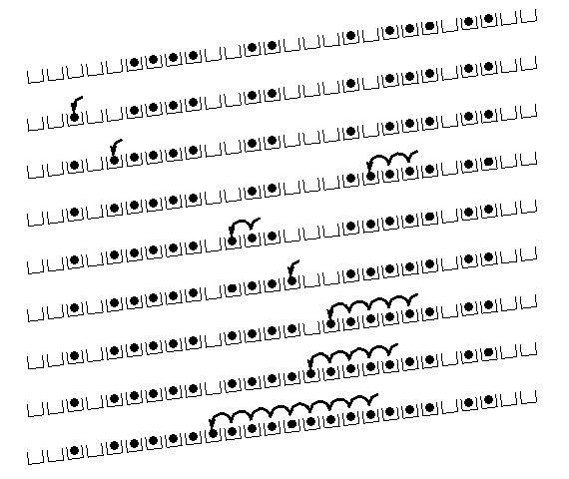
Primary Clustering
It turns out linear probing is a bad idea, even though the probe function is quick to compute (a good thing)
Tends to produce clusters, which lead to long probing sequences
Saw this happening in earlier example
Called primary clustering
[R. Sedgewick]

Slide 37
Analysis of Linear Probing
Trivial fact: For any λ < 1, linear probing will find an empty slot
It is “safe” in this sense: no infinite loop unless table is full
Non-trivial facts we won’t prove:
Average # of probes given λ (limit as TableSize →∞ )
Unsuccessful search:
Successful search:
This is pretty bad: need to leave sufficient empty space in the table to get decent performance

Slide 38
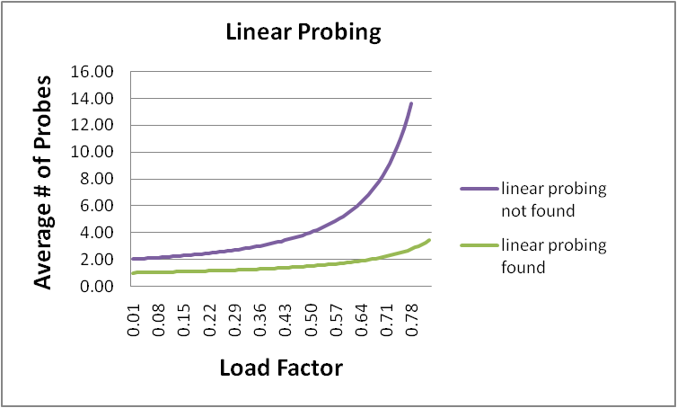
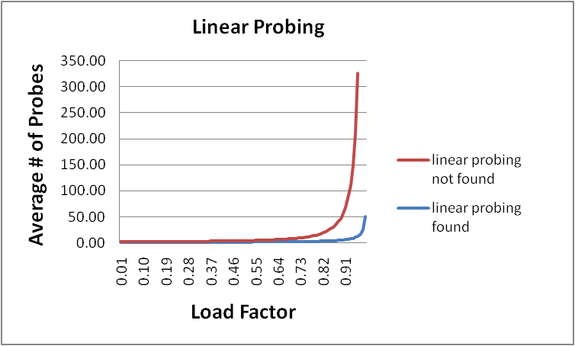
In a chart
Linear-probing performance degrades rapidly as table gets full
(Formula assumes “large table”)
By comparison, chaining performance is linear in λ and has no trouble with λ>1

Slide 39
Open Addressing: Quadratic probing
We can avoid primary clustering by changing the probe function
A common technique is quadratic probing:
f(i) = i²
So probe sequence is:
0th probe: h(key) % TableSize
1st probe: (h(key) + 1) % TableSize
2nd probe: (h(key) + 4) % TableSize
3rd probe: (h(key) + 9) % TableSize
…
i^{th} probe: (h(key) + i²) % TableSize
Intuition: Probes quickly “leave the neighborhood”

Slide 40
Quadratic Probing Example
0
1
2
3
4
5
6
7
8
9
TableSize=10
Insert:
89
18
49
58
79

Slide 41
Quadratic Probing Example
0
1
2
3
4
5
6
7
8
9 | 89
TableSize=10
Insert:
89
18
49
58
79

Slide 42
Quadratic Probing Example
0
1
2
3
4
5
6
7
8 | 18
9 | 89
TableSize=10
Insert:
89
18
49
58
79

Slide 43
Quadratic Probing Example
0 | 49
1
2
3
4
5
6
7
8 | 18
9 | 89
TableSize=10
Insert:
89
18
49
58
79

Slide 44
Quadratic Probing Example
0 | 49
1
2 | 58
3
4
5
6
7
8 | 18
9 | 89
TableSize=10
Insert:
89
18
49
58
79

Slide 45
Quadratic Probing Example
0 | 49
1
2 | 58
3 | 79
4
5
6
7
8 | 18
9 | 89
TableSize=10
Insert:
89
18
49
58
79
How about 98?

Slide 46
Another Quadratic Probing Example
TableSize = 7
Insert:
(76 % 7 = 6)
(40 % 7 = 5)
48 (48 % 7 = 6)
5 ( 5 % 7 = 5)
55 (55 % 7 = 6)
47 (47 % 7 = 5)
0
1
2
3
4
5
6

Slide 47
Another Quadratic Probing Example
TableSize = 7
Insert:
(76 % 7 = 6)
(40 % 7 = 5)
48 (48 % 7 = 6)
5 ( 5 % 7 = 5)
55 (55 % 7 = 6)
47 (47 % 7 = 5)
0
1
2
3
4
5
6 | 76

Slide 48
Another Quadratic Probing Example
TableSize = 7
Insert:
(76 % 7 = 6)
(40 % 7 = 5)
48 (48 % 7 = 6)
5 ( 5 % 7 = 5)
55 (55 % 7 = 6)
47 (47 % 7 = 5)
0
1
2
3
4
5 | 40
6 | 76

Slide 49
Another Quadratic Probing Example
TableSize = 7
Insert:
(76 % 7 = 6)
(40 % 7 = 5)
48 (48 % 7 = 6)
5 ( 5 % 7 = 5)
55 (55 % 7 = 6)
47 (47 % 7 = 5)
0 | 48
1
2
3
4
5 | 40
6 | 76

Slide 50
Another Quadratic Probing Example
TableSize = 7
Insert:
(76 % 7 = 6)
(40 % 7 = 5)
48 (48 % 7 = 6)
5 ( 5 % 7 = 5)
55 (55 % 7 = 6)
47 (47 % 7 = 5)
0 | 48
1
2 | 5
3
4
5 | 40
6 | 76

Slide 51
Another Quadratic Probing Example
TableSize = 7
Insert:
(76 % 7 = 6)
(40 % 7 = 5)
48 (48 % 7 = 6)
5 ( 5 % 7 = 5)
55 (55 % 7 = 6)
47 (47 % 7 = 5)
0 | 48
1
2 | 5
3 | 55
4
5 | 40
6 | 76

Slide 52
Another Quadratic Probing Example
TableSize = 7
Insert:
(76 % 7 = 6)
(40 % 7 = 5)
48 (48 % 7 = 6)
5 ( 5 % 7 = 5)
55 (55 % 7 = 6)
47 (47 % 7 = 5)
0 | 48
1
2 | 5
3 | 55
4
5 | 40
6 | 76
Uh-oh: For all n, ((n*n) +5) % 7 is 0, 2, 5, or 6
Proof uses induction and (n²+5) % 7 = ((n-7)²+5) % 7
In fact, for all c and k, (n²+c) % k = ((n-k)²+c) % k

Slide 53
From bad news to good news
For all c and k, (n²+c) % k = ((n-k)²+c) % k
The bad news is: After TableSize quadratic probes, we will just cycle through the same indices
The good news:
Assertion #1: If T = TableSize is prime and λ < ½, then quadratic probing will find an empty slot in at most T/2 probes
Assertion #2: For prime T and 0 ≤ i,j ≤ T/2 where i ≠ j,
(h(key) + i²) % T ≠ (h(key) + j²) % T
That is, if T is prime, the first T/2 quadratic probes map to different locations
Assertion #3: Assertion #2 is the “key fact” for proving Assertion #1
So: If you keep λ < ½, no need to detect cycles

Slide 54
Clustering reconsidered
Quadratic probing does not suffer from primary clustering: quadratic nature quickly escapes the neighborhood
But it’s no help if keys initially hash to the same index
Called secondary clustering
Any 2 keys that hash to the same value will have the same series of moves after that
Can avoid secondary clustering with a probe function that depends on the key: double hashing

Slide 55
Open Addressing: Double hashing
Idea:
Given two good hash functions h and g & 2 different keys k1 & k2, it is very unlikely that h(k1)==h(k2) & g(k1)==g(k2)
So make the probe function f(i) = i*g(key)
That is, check h(key), then h(key)+g(key), then h(key)+2*g(key), …
Even if h(key1)=h(key2), they’ll most likely go different places for the next probe
Probe sequence:
0th probe: h(key) % TableSize
1st probe: (h(key) + g(key)) % TableSize
2nd probe: (h(key) + 2*g(key)) % TableSize
3rd probe: (h(key) + 3*g(key)) % TableSize
…
i^{th} probe: (h(key) + i*g(key)) % TableSize
Detail: Make sure g(key) isn’t 0
Why?
Also, shouldn’t be a multiple of TableSize

Slide 56
Double-hashing analysis
Intuition: Since each probe is “jumping” by g(key) each time, we “leave the neighborhood” and “go different places from other initial collisions”
Say h(x)==h(y); it’s unlikely that g(x)==g(y)
But we could still have a problem like in quadratic probing where we are not “safe” (infinite loop despite room in table)
No guarantee that i*g(key) will let us try all/most indices
It is known that this infinite loop, despite space available, cannot happen in at least one case:
h(key) = key % p
g(key) = q – (key % q)
2 < q < p
p and q are prime

Slide 57
Yet another reason to use a prime Tablesize
So, for double hashing
i^{th} probe: (h(key) + i*g(key))% TableSize
Say g(key) divides Tablesize
That is, there is some integer x such that x*g(key)=Tablesize
After x probes, we’ll be back to trying the same indices as before
Ex:
Tablesize=50
g(key)=25
Probing sequence:
h(key)
h(key)+25
h(key)+50=h(key)
h(key)+75=h(key)+25
Only 1 & itself divide a prime

Slide 58
More double-hashing facts
Assume “uniform hashing”
Means probability of g(key1) % p == g(key2) % p is 1/p
Non-trivial facts we won’t prove:
Average # of probes given λ (in the limit as TableSize →∞ )
Unsuccessful search (intuitive):
Successful search (less intuitive):
Bottom line: unsuccessful bad (but not as bad as linear probing), but successful is not nearly as bad

Slide 59
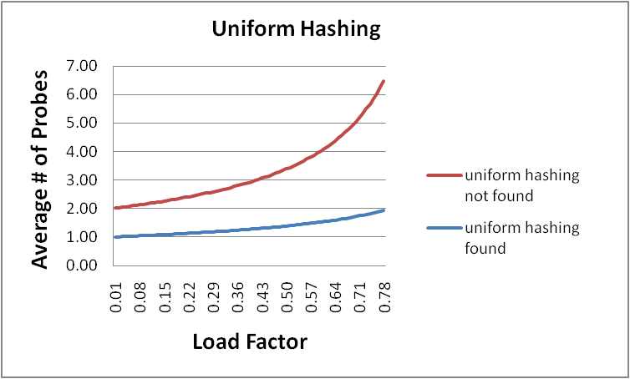
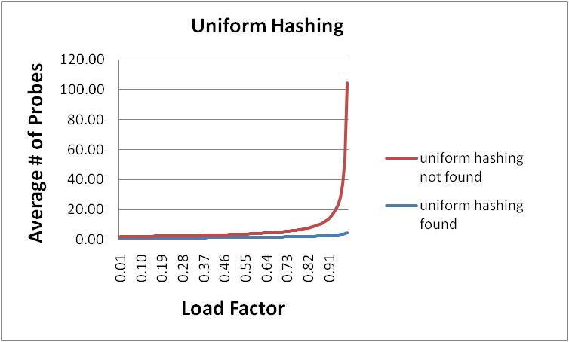
Charts: Double hashing (w/ uniform hashing) vs. Linear probing

Slide 60
We’ve explored different methods of collision detection
Chaining is easy
find, delete proportion to load factor on average; insert constant
Open addressing uses probe functions, has clustering issues as table gets full
Why use it:
Less memory allocation
Some run-time overhead for allocating linked list (or whatever) nodes; open addressing could be faster
Arguably easier data representation
Now:
Growing the table when it gets too full: Called ‘rehashing’
Relation between hashing/comparing and connection to Java

Slide 61
Rehashing
Like with array-based stacks/queues/lists, if table gets too full, create a bigger table and copy everything over
With chaining, we get to decide what “too full” means
Keep load factor reasonable (e.g., < 1)?
Consider average or max size of non-empty chains?
For open addressing, half-full is a good rule of thumb
New table size
Twice-as-big is a good idea, except…
That won’t be prime!
So go about twice-as-big
Can have a list of prime numbers in your code since you won’t grow more than 20-30 times
If you do need more primes, not too bad to calculate

Slide 62
More on rehashing
What if we copy all data to the same indices in the new table?
Not going to work; calculated index based on TableSize – we may not be able to find it later
Go through current table, do standard insert for each into new table; run-time?
O(n): Iterate through table
But resize is an O(n) operation, involving n calls to the hash function (1 for each insert in the new table)
Is there some way to avoid all those hash function calls again?
Space/time tradeoff: Could store h(key) with each data item, but since rehashing is rare, this is probably a poor use of space
And growing the table is still O(n); only helps by a constant factor

Slide 63
Hashing and comparing
For insert/find, as we go through the chain or keep probing, we have to compare each item we see to the key we’re looking for
We need to have a comparator (or key’s type needs to be comparable)
Don’t actually need < & >; just =
So a hash table needs a hash function and a comparator
In Project 2, you’ll use two function objects
The Java standard library uses a more OO approach where each object has an equals method and a hashCode method:
class Object {
boolean equals(Object o) {…}
int hashCode() {…}
…
}

Slide 64
Equal objects must hash the same
The Java library (and your project hash table) make a very important assumption that clients must satisfy…
OO way of saying it:
If a.equals(b), then we must require a.hashCode()==b.hashCode()
Function object way of saying it:
If c.compare(a,b) == 0, then we must require
h.hash(a) == h.hash(b)
What would happen if we didn’t do this?

Slide 65
Java bottom line
Lots of Java libraries use hash tables, perhaps without your knowledge
So: If you ever override equals, you need to override hashCode also in a consistent way

Slide 66
(Incorrect) Example
Think about using a hash table holding points
class PolarPoint {
double r = 0.0;
double theta = 0.0;
void addToAngle(double theta2) { theta+=theta2; }
…
boolean equals(Object otherObject) {
if(this==otherObject) return true;
if(otherObject==null) return false;
if(getClass()!=other.getClass()) return false;
PolarPoint other = (PolarPoint)otherObject;
double angleDiff =
(theta – other.theta) % (2*Math.PI);
double rDiff = r – other.r;
return Math.abs(angleDiff) < 0.0001
&& Math.abs(rDiff) < 0.0001;
}
// wrong: must override hashCode!
}

Slide 67
Aside: Comparable/Comparator have rules too
Comparison must impose a consistent, total ordering:
For all a, b, and c,
If compare(a,b) < 0, then compare(b,a) > 0
If compare(a,b) == 0, then compare(b,a) == 0
If compare(a,b) < 0 and compare(b,c) < 0, then compare(a,c) < 0
What would happen if compareTo() just randomly returned -1, 0 or 1?

Slide 68
Final word on hashing
The hash table is one of the most important data structures
Supports only find, insert, and delete efficiently
FindMin, FindMax, predecessor, etc.: not so efficiently
Most likely data-structure to be asked about in interviews; many real-world applications
Important to use a good hash function
Good distribution
Uses enough of key’s values
Important to keep hash table at a good size
Prime #
Preferable λ depends on type of table
Side-comment: hash functions have uses beyond hash tables
Examples: Cryptography, check-sums

