Slide 1
Mergesort example: Merge as we return from recursive calls
8
2
9
4
5
3
1
6
Divide
8 2 9 4
5 3 1 6
Divide
8 2
9 4
5 3
1 6
Divide
1 element
8 2
9 4
5 3
1 6
Merge
2 8
4 9
3 5
1 6
Merge
2 4 8 9
1 3 5 6
Merge
1 2 3 4 5 6 8 9
We need another array in which to do each merging step; merge results into there, then copy back to original array

Slide 2
Dijkstra’s Algorithm Overview
Given a weighted graph and a vertex in the graph (call it A), find the shortest path from A to each other vertex
Cost of path defined as sum of weights of edges
Negative edges not allowed
The algorithm:
Create a table like this:
Init A’s cost to 0, others infinity (or just ‘??’)
While there are unknown vertices:
Select unknown vertex w/ lowest cost (A initially)
Mark it as known
Update cost and path to all uknown vertices adjacent to that vertex
vertex | known? | cost | path
A |  | 0
B |  | ??
C |  | ??
D |  | ??

Slide 3
Parallelism Overview
We say it takes time T_{P} to complete a task with P processors
Adding together an array of n elements would take O(n) time, when done sequentially (that is, P=1)
Called the work; T₁
If we have ‘enough’ processors, we can do it much faster; O(logn) time
Called the span; T∞
+
+
+
+
+
+
+
+
+
+
+
+
+
+
+

Slide 4
Considering Parallel Run-time
Our fork and join frequently look like this:
divide
base cases
combine results
Each node takes O(1) time
Even the base cases, as they are at the cut-off
Sequentially, we can do this in O(n) time; O(1) for each node, ~3n nodes, if there were no cut-off (linear # on base case row, halved each row up/down)
Carrying this out in (perfect) parallel will take the time of the longest branch; ~2logn, if we halve each time

Slide 5
Some Parallelism Definitions
Speed-up on P processors: T₁ / T_{P}
We often assume perfect linear speed-up
That is, T₁ / T_{P} = P; w/ 2x processors, it’s twice as fast
‘Perfect linear speed-up ’usually our goal; hard to get in practice
Parallelism is the maximum possible speed-up: T₁ / T ∞
At some point, adding processors won’t help
What that point is depends on the span

Slide 6
The ForkJoin Framework Expected Performance
If you write your program well, you can get the following expected performance:
T_{P} ≤ (T₁ / P) + O(T ∞)
T₁/P for the overall work split between P processors
P=4? Each processor takes 1/4 of the total work
O(T ∞) for merging results
Even if P=∞, then we still need to do O(T ∞) to merge results
What does it mean??
We can get decent benefit for adding more processors; effectively linear speed-up at first (expected)
With a large # of processors, we’re still bounded by T ∞; that term becomes dominant

Slide 7
Amdahl’s Law
Let the work (time to run on 1 processor) be 1 unit time
Let S be the portion of the execution that cannot be parallelized
Then: T₁ = S + (1-S) = 1
Then: T_{P} = S + (1-S)/P
Amdahl’s Law: The overall speedup with P processors is:
T₁ / T_{P} = 1 / (S + (1-S)/P)
And the parallelism (infinite processors) is:
T₁ / T∞ = 1 / S

Slide 8
Parallel Prefix Sum
Given an array of numbers, compute an array of their running sums in O(logn) span
Requires 2 passes (each a parallel traversal)
First is to gather information
Second figures out output
input
6
4
16
10
16
14
2
8
output
6
10
26
36
52
66
68
76

Slide 9
Parallel Prefix Sum
range 0,8
sum
fromleft
76
0
2 passes:
Compute ‘sum’
Compute ‘fromtleft’
range 0,4
sum
fromleft
range 4,8
sum
fromleft
36
40
0
36
range 0,2
sum
fromleft
range 2,4
sum
fromleft
range 4,6
sum
fromleft
range 6,8
sum
fromleft
10
26
30
10
0
10
36
66
r 0,1
s
f
r 1,2
s
f
r 2,3
s
f
r 3,4
s
f
r 4,5
s
f
r 5,6
s
f
r 6,7
s
f
r 7.8
s
f
6
4
16
10
16
14
2
8
0
6
10
26
36
52
66
68
input
6
4
16
10
16
14
2
8
output
6
10
26
36
52
66
68
76

Slide 10
Parallel Quicksort
2 optimizations:
Do the two recursive calls in parallel
Now recurrence takes the form:
O(n) + 1T(n/2)
So O(n) span
Parallelize the partitioning step
Partitioning normally O(n) time
Recall that we can use Parallel Prefix Sum to ‘filter’ with O(logn) span
Partitioning can be done with 2 filters, so O(logn) span for each partitioning step
These two parallel optimizations bring parallel quicksort to a span of O(log²n)

Slide 11
Race Conditions
A race condition occurs when the computation result depends on scheduling (how threads are interleaved)
If T1 and T2 happened to get scheduled in a certain way, things go wrong
We, as programmers, cannot control scheduling of threads; result is that we need to write programs that work independent of scheduling
Race conditions are bugs that exist only due to concurrency
No interleaved scheduling with 1 thread
Typically, problem is that some intermediate state can be seen by another thread; screws up other thread
Consider a ‘partial’ insert in a linked list; say, a new node has been added to the end, but ‘back’ and ‘count’ haven’t been updated

Slide 12
Data Races
A data race is a specific type of race condition that can happen in 2 ways:
Two different threads can potentially write a variable at the same time
One thread can potentially write a variable while another reads the variable
Simultaneous reads are fine; not a data race, and nothing bad would happen
‘Potentially’ is important; we say the code itself has a data race – it is independent of an actual execution
Data races are bad, but we can still have a race condition, and bad behavior, when no data races are present

Slide 13
Readers/writer locks
0 ≤ writers ≤ 1 &&
0 ≤ readers &&
writers*readers==0
A new synchronization ADT: The readers/writer lock
Idea: Allow any number of readers OR one writer
This allows more concurrent access (multiple readers)
A lock’s states fall into three categories:
“not held”
“held for writing” by one thread
“held for reading” by one or more threads
new: make a new lock, initially “not held”
acquire_write: block if currently “held for reading” or “held for writing”, else make “held for writing”
release_write: make “not held”
acquire_read: block if currently “held for writing”, else make/keep “held for reading” and increment readers count
release_read: decrement readers count, if 0, make “not held”

Slide 14
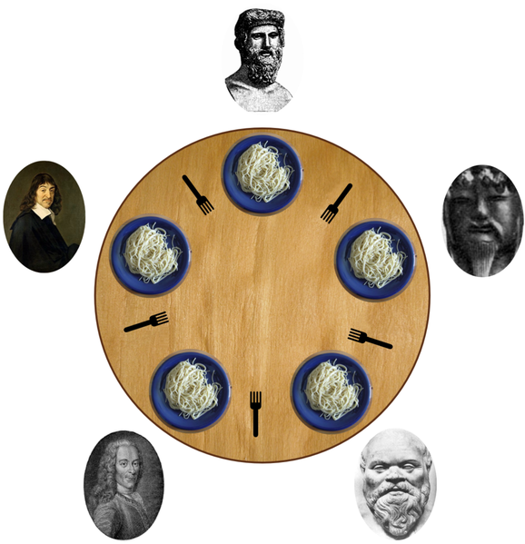
Deadlock
As illustrated by the ‘The Dining Philosophers’ problem
A deadlock occurs when there are threads T1, …, Tn such that:
Each is waiting for a lock held by the next
Tn is waiting for a resource held by T1
In other words, there is a cycle of waiting
class BankAccount {
…
synchronized void withdraw(int amt) {…}
synchronized void deposit(int amt) {…}
synchronized void transferTo(int amt,BankAccount a){
this.withdraw(amt);
a.deposit(amt);
}
}
Consider simultaneous transfers from account x to account y, and y to x

