Slide 1
CSE332: Data Abstractions Lecture 7: AVL Trees
Dan Grossman
Spring 2010

Slide 2
The AVL Tree Data Structure
Structural properties
Binary tree property
Balance property: balance of every node is between -1 and 1
Result:
Worst-case depth is O(log n)
Ordering property
Same as for BST
8
5
11
2
6
10
13
4
7
9
12
14
15
Notes:
So, AVL trees will be Binary Search Trees with one extra feature:
They balance themselves!
The result is that all AVL trees at any point will have a logarithmic asymptotic bound on their depths

Slide 3
An AVL tree?
6
3
4
1
8
2
1
0
0
11
1
7
0
10
12
0

Slide 4
An AVL tree?
4
6
3
4
8
1
2
1
5
0
0
7
11
0
3
1
0
2

Slide 5
The shallowness bound
Proving O(log n) depth bound
Let S(h) = the minimum number of nodes in an AVL tree of height h
If we can prove that S(h) grows exponentially in h, then a tree with n nodes has a logarithmic height
Step 1: Define S(h) inductively using AVL property
S(-1)=0, S(0)=1, S(1)=2
For h ≥ 2, S(h) = 1+S(h-1)+S(h-2)
Step 2: Show this recurrence grows really fast
Similar to Fibonacci numbers
Can prove for all h, S(h) > φ^{h} – 1 where
φ is the golden ratio, (1+√5)/2, about 1.62
Growing faster than 1.6^{h} is “plenty” exponential
h
h-2
h-1
= m(h-1) + m(h-2) + 1
Notes:
If h is a min-size AVL tree, it has to have this structure (diagram) (okay to switch left-right subtrees). Ask why.
Note that each subtree is an AVL tree, by definition. Since the goal is to minimize the size of the tree, might as well choose the minimum h-2 and h-1 trees.
m(h) = m(h-1) + m(h-2) + 1

Slide 6
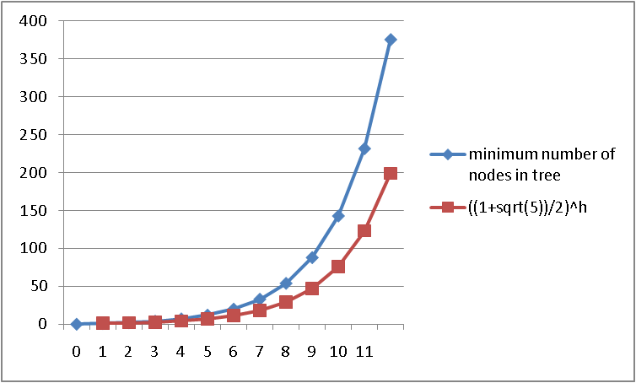
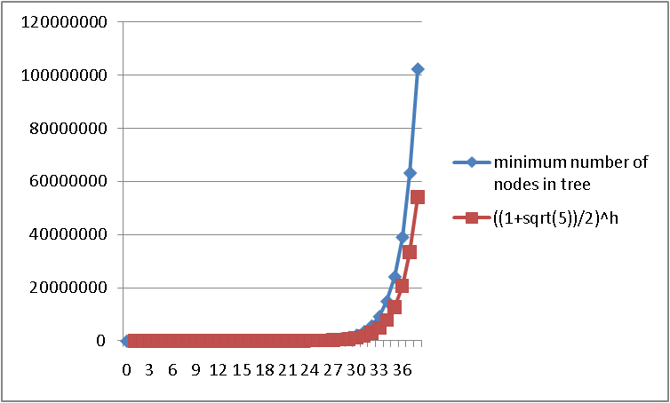
Before we prove it
Good intuition from plots comparing:
S(h) computed directly from the definition
((1+√5)/2) ^{h}
S(h) is always bigger
Graphs aren’t proofs, so let’s prove it

Slide 7
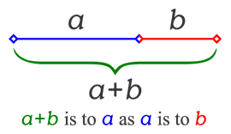
The Golden Ratio
This is a special number
Aside: Since the Renaissance, many artists and architects have proportioned their work (e.g., length:height) to approximate the golden ratio: If (a+b)/a = a/b, then a = φb
We will need one special arithmetic fact about φ :
φ²
= ((1+5^{1/2})/2)²
= (1 + 2*5^{1/2} + 5)/4
= (6 + 2*5^{1/2})/4
= (3 + 5^{1/2})/2
= 1 + (1 + 5^{1/2})/2
= 1 + φ

Slide 8
The proof
S(-1)=0, S(0)=1, S(1)=2
For h ≥ 2, S(h) = 1+S(h-1)+S(h-2)
Theorem: For all h ≥ 0, S(h) > φ^{h} – 1
Proof: By induction on h
Base cases:
S(0) = 1 > φ⁰ – 1 = 0 S(1) = 2 > φ¹ – 1 ≈ 0.62
Inductive case (k > 1):
Show S(k+1) > φ^{k+1} – 1 assuming S(k) > φ^{k} – 1 and S(k-1) > φ^{k-1} – 1
S(k+1) = 1 + S(k) + S(k-1) by definition of S
> 1 + φ^{k} – 1 + φ^{k-1} – 1 by induction
= φ^{k} + φ^{k-1} – 1 by arithmetic (1-1=0)
= φ^{k-1} (φ + 1) – 1 by arithmetic (factor φ^{k-1} )
= φ^{k-1} φ² – 1 by special property of φ
= φ^{k+1} – 1 by arithmetic (add exponents)

Slide 9
Good news
Proof means that if we have an AVL tree, then find is O(log n)
But as we insert and delete elements, we need to:
Track balance
Detect imbalance
Restore balance
10
5
15
2
9
20
Is this AVL tree balanced?
How about after insert(30)?
7

Slide 10
An AVL Tree
10
key
3
…
value
10
3
height
2
2
children
5
20
0
1
1
0
2
9
15
30
0
0
7
17
Track height at all times!
Notes:
Here’s a revision of that tree that’s balanced. (Same values, similar tree)
This one _is_ an AVL tree (and isn’t leftist).
I also have here how we might store the nodes in the AVL tree.
Notice that I’m going to keep track of height all the time. WHY?

Slide 11
AVL tree operations
AVL find:
Same as BST find
AVL insert:
First BST insert, then check balance and potentially “fix” the AVL tree
Four different imbalance cases
AVL delete:
The “easy way” is lazy deletion
Otherwise, like insert we do the deletion and then have several imbalance cases

Slide 12
Insert: detect potential imbalance
Insert the new node as in a BST (a new leaf)
For each node on the path from the root to the new leaf, the insertion may (or may not) have changed the node’s height
So after recursive insertion in a subtree, detect height imbalance and perform a rotation to restore balance at that node
All the action is in defining the correct rotations to restore balance
Fact that an implementation can ignore:
There must be a deepest element that is imbalanced after the insert (all descendants still balanced)
After rebalancing this deepest node, every node is balanced
So at most one node needs to be rebalanced

Slide 13
Case #1: Example
Insert(6)
Insert(3)
Insert(1)
Third insertion violates balance property
happens to be at the root
What is the only way to fix this?
0
6
1
2
6
6
0
1
3
3
0
1

Slide 14
Fix: Apply “Single Rotation”
Single rotation: The basic operation we’ll use to rebalance
Move child of unbalanced node into parent position
Parent becomes the “other” child (always okay in a BST!)
Other subtrees move in only way BST allows (next slide)
AVL Property violated here
2
1
6
3
1
0
3
0
1
6
0
1
Intuition: 3 must become root
new-parent-height = old-parent-height-before-insert

Slide 15
The example generalized
Node imbalanced due to insertion somewhere in
left-left grandchild increasing height
1 of 4 possible imbalance causes (other three coming)
First we did the insertion, which would make a imbalanced
a
h+2
a
h+3
h+1
h+2
b
h
h
Z
b
Z
h
h
h+1
h
X
Y
X
Y

Slide 16
The general left-left case
Node imbalanced due to insertion somewhere in
left-left grandchild increasing height
1 of 4 possible imbalance causes (other three coming)
So we rotate at a, using BST facts: X < b < Y < a < Z
a
h+3
b
h+2
h+2
h
h+1
b
a
h+1
Z
h+1
h
h
X
h
X
Y
Y
Z
A single rotation restores balance at the node
To same height as before insertion (so ancestors now balanced)

Slide 17
Another example: insert(16)
15
8
22
4
10
19
24
3
6
17
20
16

Slide 18
Another example: insert(16)
15
8
22
4
10
19
24
3
6
17
20
16
15
8
19
4
10
17
22
3
6
16
20
24

Slide 19
The general right-right case
Mirror image to left-left case, so you rotate the other way
Exact same concept, but need different code
h+3
a
h+2
b
h+2
h
h+1
X
b
a
h+1
h
h
Z
h+1
h
Y
Z
X
Y

Slide 20
Two cases to go
Unfortunately, single rotations are not enough for insertions in the left-right subtree or the right-left subtree
Simple example: insert(1), insert(6), insert(3)
First wrong idea: single rotation like we did for left-left
2
1
1
6
1
6
0
0
0
1
3
3

Slide 21
Two cases to go
Unfortunately, single rotations are not enough for insertions in the left-right subtree or the right-left subtree
Simple example: insert(1), insert(6), insert(3)
Second wrong idea: single rotation on the child of the unbalanced node
2
2
1
1
1
1
6
3
0
0
3
6

Slide 22
Sometimes two wrongs make a right ☺
First idea violated the BST property
Second idea didn’t fix balance
But if we do both single rotations, starting with the second, it works! (And not just for this example.)
Double rotation:
Rotate problematic child and grandchild
Then rotate between self and new child
2
2
Intuition: 3 must become root
1
1
1
1
3
6
3
1
0
0
0
0
3
1
6
6

Slide 23
The general right-left case
h+3
a
h+2
h
h+1
b
X
h
c
h
h-1
Z
U
V
h+2
c
h+3
a
h+1
h+1
h+2
a
b
h
c
h
X
h+1
h
h
h
X
U
h-1
U
b
V
Z
h-1
V
h
Z

Slide 24
Comments
Like in the left-left and right-right cases, the height of the subtree after rebalancing is the same as before the insert
So no ancestor in the tree will need rebalancing
Does not have to be implemented as two rotations; can just do:
h+3
h+2
a
h+2
c
h
h+1
b
h+1
X
h+1
h
a
b
c
h
h
h-1
Z
h
h
X
U
h-1
U
V
V
Z
Easier to remember than you may think:
Move c to grandparent’s position and then put a, b, X, U, V, and Z in the right places to get a legal BST

Slide 25
The last case: left-right
Mirror image of right-left
Again, no new concepts, only new code to write
h+3
a
h+2
h+2
c
b
h
h+1
h+1
Z
h+1
b
a
c
h
h
h
h
X
h
X
U
h-1
U
h-1
V
Z
V

Slide 26
Insert, summarized
Insert as in a BST
Check back up path for imbalance, which will be 1 of 4 cases:
node’s left-left grandchild is too tall
node’s left-right grandchild is too tall
node’s right-left grandchild is too tall
node’s right-right grandchild is too tall
Only one case occurs because tree was balanced before insert
After the appropriate single or double rotation, the smallest-unbalanced subtree has the same height as before the insertion
So all ancestors are now balanced

Slide 27
Now efficiency
Have argued rotations restore AVL property but do they produce an efficient data structure?
Worst-case complexity of find: O(log n)
Worst-case complexity of insert: O(log n)
A rotation is O(1) and there’s an O(log n) path to root
(Same complexity even without one-rotation-is-enough fact)
Worst-case complexity of buildTree: O(n log n)
Will take some more rotation action to handle delete…

