Slide 1
CSE332: Data Abstractions Lecture 11: Hash Tables
Dan Grossman
Spring 2010

Slide 2
Hash Tables: Review
Aim for constant-time (i.e., O(1)) find, insert, and delete
“On average” under some reasonable assumptions
A hash table is an array of some fixed size
But growable as we’ll see
hash table
0
 | …
client
hash table library
collision?
collision
resolution
E
int
table-index
TableSize –1

Slide 3
Hash Tables: A Different ADT?
In terms of a Dictionary ADT for just insert, find, delete, hash tables and balanced trees are just different data structures
Hash tables O(1) on average (assuming few collisions)
Balanced trees O(log n) worst-case
Constant-time is better, right?
Yes, but you need “hashing to behave” (collisions)
Yes, but findMin, findMax, predecessor, and successor go from O(log n) to O(n)
Why your textbook considers this to be a different ADT
Not so important to argue over the definitions

Slide 4
Collision resolution
Collision:
When two keys map to the same location in the hash table
We try to avoid it, but number-of-keys exceeds table size
So hash tables should support collision resolution
Ideas?

Slide 5
Separate Chaining
0 | /
1 | /
2 | /
3 | /
4 | /
5 | /
6 | /
7 | /
8 | /
9 | /
Chaining: All keys that map to the same table location are kept in a list (a.k.a. a “chain” or “bucket”)
As easy as it sounds
Example: insert 10, 22, 107, 12, 42 with mod hashing and TableSize = 10

Slide 6
Separate Chaining
0
1 | /
2 | /
3 | /
4 | /
5 | /
6 | /
7 | /
8 | /
9 | /
Chaining: All keys that map to the same table location are kept in a list (a.k.a. a “chain” or “bucket”)
As easy as it sounds
Example: insert 10, 22, 107, 12, 42 with mod hashing and TableSize = 10
10
/

Slide 7
Separate Chaining
0
1 | /
2
3 | /
4 | /
5 | /
6 | /
7 | /
8 | /
9 | /
Chaining: All keys that map to the same table location are kept in a list (a.k.a. a “chain” or “bucket”)
As easy as it sounds
Example: insert 10, 22, 107, 12, 42 with mod hashing and TableSize = 10
10
/
22
/

Slide 8
Separate Chaining
0
1 | /
2
3 | /
4 | /
5 | /
6 | /
7
8 | /
9 | /
Chaining: All keys that map to the same table location are kept in a list (a.k.a. a “chain” or “bucket”)
As easy as it sounds
Example: insert 10, 22, 107, 12, 42 with mod hashing and TableSize = 10
10
/
22
/
107
/

Slide 9
Separate Chaining
0
1 | /
2
3 | /
4 | /
5 | /
6 | /
7
8 | /
9 | /
Chaining: All keys that map to the same table location are kept in a list (a.k.a. a “chain” or “bucket”)
As easy as it sounds
Example: insert 10, 22, 107, 12, 42 with mod hashing and TableSize = 10
10
/
12
22
/
107
/

Slide 10
Separate Chaining
Chaining: All keys that map to the same table location are kept in a list (a.k.a. a “chain” or “bucket”)
As easy as it sounds
Example: insert 10, 22, 107, 12, 42 with mod hashing and TableSize = 10
0
1 | /
2
3 | /
4 | /
5 | /
6 | /
7
8 | /
9 | /
10
/
42
12
22
/
107
/

Slide 11
Thoughts on chaining
Worst-case time for find: linear
But only with really bad luck or bad hash function
So not worth avoiding (e.g., with balanced trees at each bucket)
Beyond asymptotic complexity, some “data-structure engineering” may be warranted
Linked list vs. array vs. chunked list (lists should be short!)
Move-to-front (cf. Project 2)
Better idea: Leave room for 1 element (or 2?) in the table itself, to optimize constant factors for the common case
A time-space trade-off…

Slide 12
Time vs. space (constant factors only here)
0
1 | /
2
3 | /
4 | /
5 | /
6 | /
7
8 | /
9 | /
0 | 10 | /
1 | / | X
2 | 42
3 | / | X
4 | / | X
5 | / | X
6 | / | X
7 | 107 | /
8 | / | X
9 | / | X
10
/
42
12
22
/
12
22
/
107
/

Slide 13
More rigorous chaining analysis
Definition: The load factor, λ, of a hash table is
← number of elements
Under chaining, the average number of elements per bucket is λ
So if some inserts are followed by random finds, then on average:
Each unsuccessful find compares against ____ items
Each successful find compares against _____ items

Slide 14
More rigorous chaining analysis
Definition: The load factor, λ, of a hash table is
← number of elements
Under chaining, the average number of elements per bucket is λ
So if some inserts are followed by random finds, then on average:
Each unsuccessful find compares against λ items
Each successful find compares against λ / 2 items

Slide 15
Alternative: Use empty space in the table
Another simple idea: If h(key) is already full,
try (h(key) + 1) % TableSize. If full,
try (h(key) + 2) % TableSize. If full,
try (h(key) + 3) % TableSize. If full…
Example: insert 38, 19, 8, 109, 10
0 | /
1 | /
2 | /
3 | /
4 | /
5 | /
6 | /
7 | /
8 | 38
9 | /

Slide 16
Alternative: Use empty space in the table
Another simple idea: If h(key) is already full,
try (h(key) + 1) % TableSize. If full,
try (h(key) + 2) % TableSize. If full,
try (h(key) + 3) % TableSize. If full…
Example: insert 38, 19, 8, 109, 10
0 | /
1 | /
2 | /
3 | /
4 | /
5 | /
6 | /
7 | /
8 | 38
9 | 19

Slide 17
Alternative: Use empty space in the table
Another simple idea: If h(key) is already full,
try (h(key) + 1) % TableSize. If full,
try (h(key) + 2) % TableSize. If full,
try (h(key) + 3) % TableSize. If full…
Example: insert 38, 19, 8, 109, 10
0 | 8
1 | /
2 | /
3 | /
4 | /
5 | /
6 | /
7 | /
8 | 38
9 | 19

Slide 18
Alternative: Use empty space in the table
Another simple idea: If h(key) is already full,
try (h(key) + 1) % TableSize. If full,
try (h(key) + 2) % TableSize. If full,
try (h(key) + 3) % TableSize. If full…
Example: insert 38, 19, 8, 109, 10
0 | 8
1 | 109
2 | /
3 | /
4 | /
5 | /
6 | /
7 | /
8 | 38
9 | 19

Slide 19
Alternative: Use empty space in the table
Another simple idea: If h(key) is already full,
try (h(key) + 1) % TableSize. If full,
try (h(key) + 2) % TableSize. If full,
try (h(key) + 3) % TableSize. If full…
Example: insert 38, 19, 8, 109, 10
0 | 8
1 | 109
2 | 10
3 | /
4 | /
5 | /
6 | /
7 | /
8 | 38
9 | 19

Slide 20
Open addressing
This is one example of open addressing
In general, open addressing means resolving collisions by trying a sequence of other positions in the table.
Trying the next spot is called probing
Our i^{th} probe was (h(key) + i) % TableSize
This is called linear probing
In general have some probe function f and use h(key) + f(i) % TableSize
Open addressing does poorly with high load factor λ
So want larger tables
Too many probes means no more O(1)

Slide 21
Terminology
We and the book use the terms
“chaining” or “separate chaining”
“open addressing”
Very confusingly,
“open hashing” is a synonym for “chaining”
“closed hashing” is a synonym for “open addressing”
(If it makes you feel any better,
most trees in CS grow upside-down ☺)

Slide 22
Other operations
Okay, so insert finds an open table position using a probe function
What about find?
Must use same probe function to “retrace the trail” and find the data
Unsuccessful search when reach empty position
What about delete?
Must use “lazy” deletion. Why?
But here just means “no data here, but don’t stop probing”
Note: delete with chaining is plain-old list-remove

Slide 23
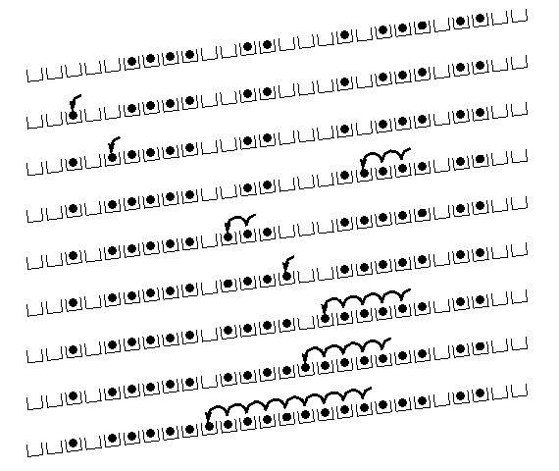
(Primary) Clustering
It turns out linear probing is a bad idea, even though the probe function is quick to compute (a good thing)
Tends to produce clusters, which lead to long probing sequences
Called primary clustering
Saw this starting in our example
[R. Sedgewick]

Slide 24
Analysis of Linear Probing
Trivial fact: For any λ < 1, linear probing will find an empty slot
It is “safe” in this sense: no infinite loop unless table is full
Non-trivial facts we won’t prove:
Average # of probes given λ (in the limit as TableSize →∞ )
Unsuccessful search:
Successful search:
This is pretty bad: need to leave sufficient empty space in the table to get decent performance (see chart)

Slide 25
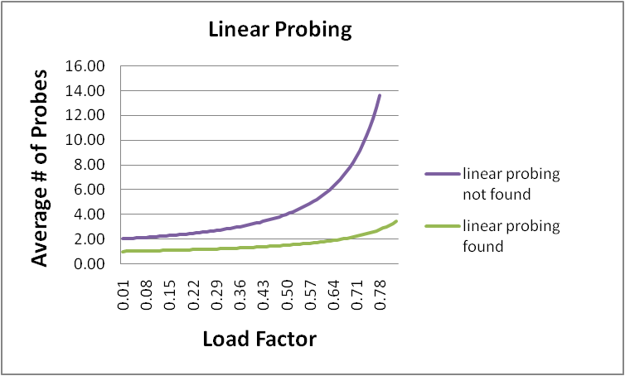
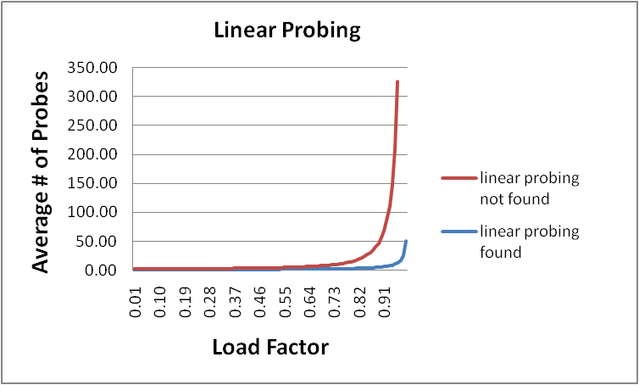
In a chart
Linear-probing performance degrades rapidly as table gets full
(Formula assumes “large table” but point remains)
By comparison, chaining performance is linear in λ and has no trouble with λ>1

Slide 26
Quadratic probing
We can avoid primary clustering by changing the probe function
A common technique is quadratic probing:
f(i) = i²
So probe sequence is:
0th probe: h(key) % TableSize
1st probe: (h(key) + 1) % TableSize
2nd probe: (h(key) + 4) % TableSize
3rd probe: (h(key) + 9) % TableSize
…
i^{th} probe: (h(key) + i²) % TableSize
Intuition: Probes quickly “leave the neighborhood”

Slide 27
Quadratic Probing Example
0
1
2
3
4
5
6
7
8
9
TableSize=10
Insert:
89
18
49
58
79

Slide 28
Quadratic Probing Example
0
1
2
3
4
5
6
7
8
9 | 89
TableSize=10
Insert:
89
18
49
58
79

Slide 29
Quadratic Probing Example
0
1
2
3
4
5
6
7
8 | 18
9 | 89
TableSize=10
Insert:
89
18
49
58
79

Slide 30
Quadratic Probing Example
0 | 49
1
2
3
4
5
6
7
8 | 18
9 | 89
TableSize=10
Insert:
89
18
49
58
79

Slide 31
Quadratic Probing Example
0 | 49
1
2 | 58
3
4
5
6
7
8 | 18
9 | 89
TableSize=10
Insert:
89
18
49
58
79

Slide 32
Quadratic Probing Example
0 | 49
1
2 | 58
3 | 79
4
5
6
7
8 | 18
9 | 89
TableSize=10
Insert:
89
18
49
58
79

Slide 33
Another Quadratic Probing Example
TableSize = 7
Insert:
(76 % 7 = 6)
(40 % 7 = 5)
48 (48 % 7 = 6)
5 ( 5 % 7 = 5)
55 (55 % 7 = 6)
47 (47 % 7 = 5)
0
1
2
3
4
5
6

Slide 34
Another Quadratic Probing Example
TableSize = 7
Insert:
(76 % 7 = 6)
(40 % 7 = 5)
48 (48 % 7 = 6)
5 ( 5 % 7 = 5)
55 (55 % 7 = 6)
47 (47 % 7 = 5)
0
1
2
3
4
5
6 | 76

Slide 35
Another Quadratic Probing Example
TableSize = 7
Insert:
(76 % 7 = 6)
(40 % 7 = 5)
48 (48 % 7 = 6)
5 ( 5 % 7 = 5)
55 (55 % 7 = 6)
47 (47 % 7 = 5)
0
1
2
3
4
5 | 40
6 | 76

Slide 36
Another Quadratic Probing Example
TableSize = 7
Insert:
(76 % 7 = 6)
(40 % 7 = 5)
48 (48 % 7 = 6)
5 ( 5 % 7 = 5)
55 (55 % 7 = 6)
47 (47 % 7 = 5)
0 | 48
1
2
3
4
5 | 40
6 | 76

Slide 37
Another Quadratic Probing Example
TableSize = 7
Insert:
(76 % 7 = 6)
(40 % 7 = 5)
48 (48 % 7 = 6)
5 ( 5 % 7 = 5)
55 (55 % 7 = 6)
47 (47 % 7 = 5)
0 | 48
1
2 | 5
3
4
5 | 40
6 | 76

Slide 38
Another Quadratic Probing Example
TableSize = 7
Insert:
(76 % 7 = 6)
(40 % 7 = 5)
48 (48 % 7 = 6)
5 ( 5 % 7 = 5)
55 (55 % 7 = 6)
47 (47 % 7 = 5)
0 | 48
1
2 | 5
3 | 55
4
5 | 40
6 | 76

Slide 39
Another Quadratic Probing Example
TableSize = 7
Insert:
(76 % 7 = 6)
(40 % 7 = 5)
48 (48 % 7 = 6)
5 ( 5 % 7 = 5)
55 (55 % 7 = 6)
47 (47 % 7 = 5)
0 | 48
1
2 | 5
3 | 55
4
5 | 40
6 | 76
Uh-oh: For all n, ((n*n) +5) % 7 is 0, 2, 5, or 6
Excel shows takes “at least” 50 probes and a pattern
Proof uses induction and (n²+5) % 7 = ((n-7)²+5) % 7
In fact, for all c and k, (n²+c) % k = ((n-k)²+c) % k

Slide 40
From bad news to good news
The bad news is: After TableSize quadratic probes, we will just cycle through the same indices
The good news:
Assertion #1: If T = TableSize is prime and λ < ½, then quadratic probing will find an empty slot in at most T/2 probes
Assertion #2: For prime T and 0 ≤ i,j ≤ T/2 where i ≠ j,
(h(key) + i²) % T ≠ (h(key) + j²) % T
Assertion #3: Assertion #2 is the “key fact” for proving Assertion #1
So: If you keep λ < ½, no need to detect cycles

Slide 41
Clustering reconsidered
Quadratic probing does not suffer from primary clustering: no problem with keys initially hashing to the same neighborhood
But it’s no help if keys initially hash to the same index
Called secondary clustering
Can avoid secondary clustering with a probe function that depends on the key: double hashing…

Slide 42
Double hashing
Idea:
Given two good hash functions h and g, it is very unlikely that for some key, h(key) == g(key)
So make the probe function f(i) = i*g(key)
Probe sequence:
0th probe: h(key) % TableSize
1st probe: (h(key) + g(key)) % TableSize
2nd probe: (h(key) + 2*g(key)) % TableSize
3rd probe: (h(key) + 3*g(key)) % TableSize
…
i^{th} probe: (h(key) + i*g(key)) % TableSize
Detail: Make sure g(key) can’t be 0

Slide 43
Double-hashing analysis
Intuition: Since each probe is “jumping” by g(key) each time, we “leave the neighborhood” and “go different places from other initial collisions”
But we could still have a problem like in quadratic probing where we are not “safe” (infinite loop despite room in table)
It is known that this cannot happen in at least one case:
h(key) = key % p
g(key) = q – (key % q)
2 < q < p
p and q are prime

Slide 44
More double-hashing facts
Assume “uniform hashing”
Means probability of g(key1) % p == g(key2) % p is 1/p
Non-trivial facts we won’t prove:
Average # of probes given λ (in the limit as TableSize →∞ )
Unsuccessful search (intuitive):
Successful search (less intuitive):
Bottom line: unsuccessful bad (but not as bad as linear probing), but successful is not nearly as bad

Slide 45
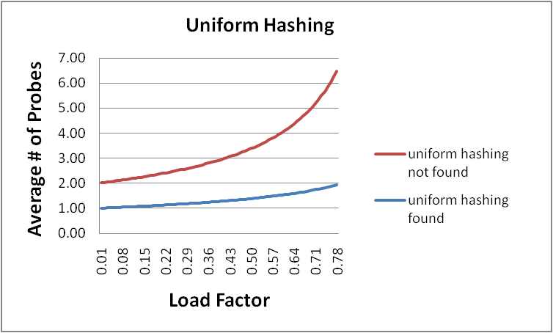
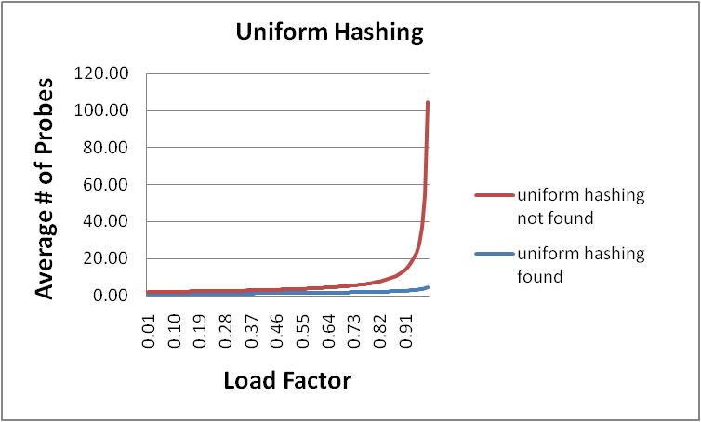
Charts

Slide 46
Where are we?
Chaining is easy
insert, find, delete proportion to load factor on average
Open addressing uses probe functions, has clustering issues as table gets full
Why use it:
Less memory allocation?
Easier data representation?
Now:
Growing the table when it gets too full
Relation between hashing/comparing and connection to Java

Slide 47
Rehashing
Like with array-based stacks/queues/lists, if table gets too full, create a bigger table and copy everything over
Especially with chaining, we get to decide what “too full” means
Keep load factor reasonable (e.g., < 1)?
Consider average or max size of non-empty chains?
For open addressing, half-full is a good rule of thumb
New table size
Twice-as-big is a good idea, except, uhm, that won’t be prime!
So go about twice-as-big
Can have a list of prime numbers in your code since you won’t grow more than 20-30 times

Slide 48
More on rehashing
We double the size (rather than “add 1000”) to get good amortized guarantees (still promising to prove that later ☺)
But one resize is an O(n) operation, involving n calls to the hash function (1 for each insert in the new table)
Space/time tradeoff: Could store h(key) with each data item, but since rehashing is rare, this is probably a poor use of space
And growing the table is still O(n)

Slide 49
Hashing and comparing
Haven’t emphasized enough for a find or a delete of an item of type E, we hash E, but then as we go through the chain or keep probing, we have to compare each item we see to E.
So a hash table needs a hash function and a comparator
In Project 2, you’ll use two function objects
The Java standard library uses a more OO approach where each object has an equals method and a hashCode method:
class Object {
boolean equals(Object o) {…}
int hashCode() {…}
…
}

Slide 50
Equal objects must hash the same
The Java library (and your project hash table) make a very important assumption that clients must satisfy…
OO way of saying it:
If a.equals(b), then we must require a.hashCode()==b.hashCode()
Function object way of saying i:
If c.compare(a,b) == 0, then we must require
h.hash(a) == h.hash(b)
Why is this essential?

Slide 51
Java bottom line
Lots of Java libraries use hash tables, perhaps without your knowledge
So: If you ever override equals, you need to override hashCode also in a consistent way
See CoreJava book, Chapter 5 for other “gotchas” with equals

Slide 52
Bad Example
Think about using a hash table holding points
class PolarPoint {
double r = 0.0;
double theta = 0.0;
void addToAngle(double theta2) { theta+=theta2; }
…
boolean equals(Object otherObject) {
if(this==otherObject) return true;
if(otherObject==null) return false;
if(getClass()!=other.getClass()) return false;
PolarPoint other = (PolarPoint)otherObject;
double angleDiff =
(theta – other.theta) % (2*Math.PI);
double rDiff = r – other.r;
return Math.abs(angleDiff) < 0.0001
&& Math.abs(rDiff) < 0.0001;
}
// wrong: must override hashCode!
}

Slide 53
By the way: comparison has rules too
We didn’t emphasize some important “rules” about comparison functions for:
all our dictionaries
sorting (next major topic)
In short, comparison must impose a consistent, total ordering:
For all a, b, and c,
If compare(a,b) < 0, then compare(b,a) > 0
If compare(a,b) == 0, then compare(b,a) == 0
If compare(a,b) < 0 and compare(b,c) < 0, then compare(a,c) < 0

Slide 54
Final word on hashing
The hash table is one of the most important data structures
Supports only find, insert, and delete efficiently
Important to use a good hash function
Important to keep hash table at a good size
Side-comment: hash functions have uses beyond hash tables
Examples: Cryptography, check-sums

