Slide 1
Section 4: Graphs and Testing
Slides by Erin Peach and Nick Carney
with material from Vinod Rathnam, Alex Mariakakis, Krysta Yousoufian, Mike Ernst, Kellen Donohue

Slide 2
AGENDA
Graphs
JUnit Testing
Test Script Language
JavaDoc
Code coverage in eclipse (OPTIONAL)

Slide 3
GRAPHS
A
B
Nodes and Edges
C
D
E

Slide 4
GRAPHS
A
B
Children of A
C
D
E

Slide 5
GRAPHS
A
B
Parents of D
C
D
E

Slide 6
GRAPHS
A
B
Paths from
A to C:
C
D
E

Slide 7
GRAPHS
A
B
Paths from
A to C:
C
D
A -> C
A -> D -> E -> C
Shortest path
from A to C?
E

Slide 8
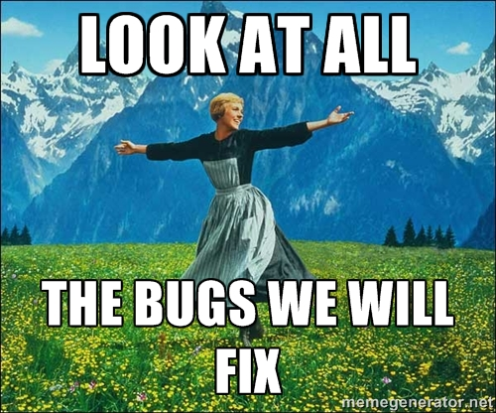
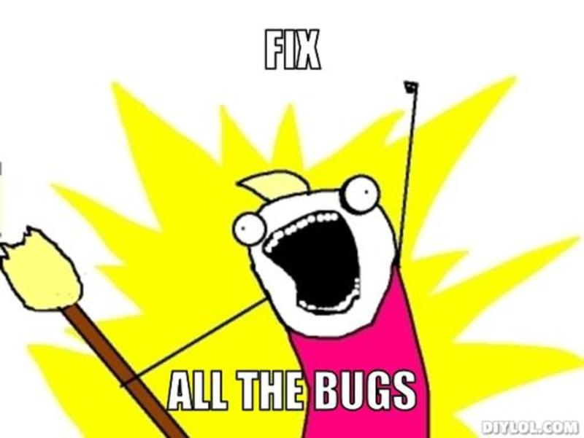
Testing

Slide 9
INTERNAL VS. EXTERNAL TESTING
Internal : JUnit
How you decide to implement the object
Checked with implementation tests
External: test script
Your API and specifications
Testing against the specification
Checked with specification tests

Slide 10
A JUNIT TEST CLASS
A method with @Test is flagged as a JUnit test
All @Test methods run when JUnit runs
import org.junit.*;
import static org.junit.Assert.*;
public class TestSuite {
...
@Test
public void TestName1() {
...
}
}

Slide 11
USING JUNIT ASSERTIONS
Verifies that a value matches expectations
assertEquals(42, meaningOfLife());
assertTrue(list.isEmpty());
If the assert fails:
Test immediately terminates
Other tests in the test class are still run as normal
Results show “details” of failed tests (We’ll get to this later)

Slide 12
USING JUNIT ASSERTIONS
Assertion | Case for failure
assertTrue(test) | the boolean test is false
assertFalse(test) | the boolean test is true
assertEquals(expected, actual) | the values are not equal
assertSame(expected, actual) | the values are not the same (by ==)
assertNotSame(expected, actual) | the values are the same (by ==)
assertNull(value) | the given value is not null
assertNotNull(value) | the given value is null
And others: http://www.junit.org/apidocs/org/junit/Assert.html
Each method can also be passed a string to display if it fails:
assertEquals("message", expected, actual)

Slide 13
CHECKING FOR EXCEPTIONS
Verify that a method throws an exception when it should:
Passes if specified exception is thrown, fails otherwise
Only time it’s OK to write a test without a form of asserts
@Test(expected=IndexOutOfBoundsException.class)
public void testGetEmptyList() {
List<String> list = new ArrayList<String>();
list.get(0);
}

Slide 14
“But don’t I need to create a list before checking if I’ve successfully added to it?”

Slide 15
SETUP AND TEARDOWN
Methods to run before/after each test case method is called:
@Before
public void name() { ... }
@After
public void name() { ... }
Methods to run once before/after the entire test class runs:
@BeforeClass
public static void name() { ... }
@AfterClass
public static void name() { ... }

Slide 16
SETUP AND TEARDOWN
public class Example {
List empty;
@Before
public void initialize() {
empty = new ArrayList();
}
@Test
public void size() {
...
}
@Test
public void remove() {
...
}
}

Slide 17
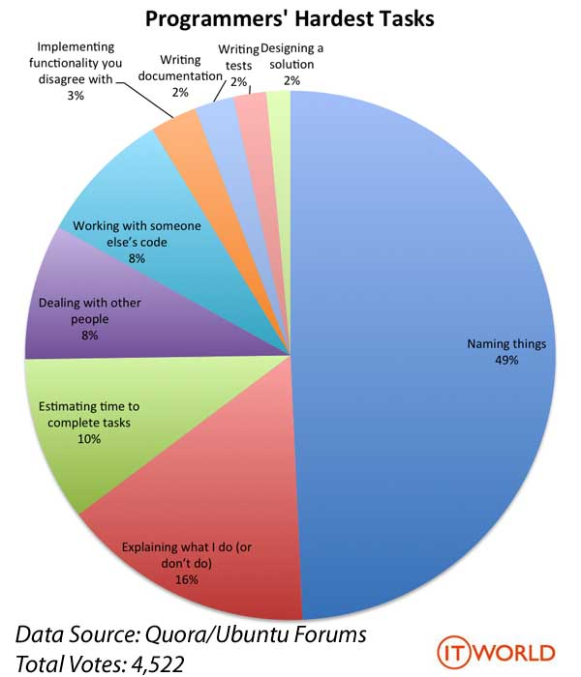
Test Writing Etiquette

Slide 18
The Rules
1. Don’t Repeat Yourself
Use constants and helper methods
2. Be Descriptive
Take advantage of message, expected, and actual values
3. Keep Tests Small
Isolate bugs one at a time – Test halts after failed assertion
4. Be Thorough
Test big, small, boundaries, exceptions, errors

Slide 19
LET’S PUT IT ALL TOGETHER!
public class DateTest {
...
// Test addDays when it causes a rollover between months
@Test
public void testAddDaysWrapToNextMonth() {
Date actual = new Date(2050, 2, 15);
actual.addDays(14);
Date expected = new Date(2050, 3, 1);
assertEquals("date after +14 days", expected, actual);
}

Slide 20
How To Create JUnit Test Classes
Right-click hw5.test -> New -> JUnit Test Case
Important: Follow naming guidelines we provide
Demo

Slide 21
JUNIT ASSERTS VS. JAVA ASSERTS
We’ve just been discussing JUnit assertions so far
Java itself has assertions
public class LitterBox {
ArrayList<Kitten> kittens;
public Kitten getKitten(int n) {
assert(n >= 0);
return kittens(n);
}
}

Slide 22
ASSERTIONS VS. EXCEPTIONS
public class LitterBox {
ArrayList<Kitten> kittens;
public Kitten getKitten(int n) {
assert(n >= 0);
return kittens(n);
}
}
public class LitterBox {
ArrayList<Kitten> kittens;
public Kitten getKitten(int n) {
try {
return kittens(n);
} catch(Exception e) {
}
}
}
Assertions should check for things that should never happen
Exceptions should check for things that might happen
“Exceptions address the robustness of your code, while assertions address its correctness”

Slide 23
REMINDER: ENABLING ASSERTS IN ECLIPSE
To enable asserts:
Go to Run -> Run Configurations… -> Arguments tab -> input -ea in VM arguments section
Do this for every test file

Slide 24
Expensive CheckReps
Ant Validate and Staff Grading will have assertions enabled
But sometimes a checkRep can be expensive
For example, looking at each node in a Graph with a large number of nodes
This could cause the grading scripts to timeout

Slide 25
Expensive CheckReps
Before your final commit, remove the checking of expensive parts of your checkRep or the checking of your checkRep entirely
Example: boolean flag and structure your checkRep as so:
private void checkRep() {
cheap-stuff
if(DEBUG_FLAG) { // or can have this for entire checkRep
expensive-stuff
}
cheap-stuff
...

Slide 26
EXTERNAL TESTS: TEST SCRIPT LANGUAGE

Slide 27
TEST SCRIPT LANGUAGE
Text file with one command listed per line
First word is always the command name
Remaining words are arguments
Commands will correspond to methods in your code

Slide 28
TEST SCRIPT LANGUAGE (ex .test file)
# Create a graph
CreateGraph graph1
# Add a pair of nodes
AddNode graph1 n1
AddNode graph1 n2
# Add an edge
AddEdge graph1 n1 n2 e1
# Print the nodes in the graph and the outgoing edges from n1
ListNodes graph1
ListChildren graph1 n1
n1
n2

Slide 29
How To Create Specification Tests
Create .test and .expected file pairs under hw5.test
Implement parts of HW5TestDriver
driver connects commands from .test file to your Graph implementation to the output which is matched with .expected file
Run all tests by running SpecificationTests.java
Note: staff will have our own .test and .expected pairs to run with your code
Do not hardcode .test/.expected pairs to pass, but instead make sure the format in hw5 instructions is correctly followed

Slide 30
DEMO: TEST SCRIPT LANGUAGE

Slide 31
JAVADOC API
Now you can generate the JavaDoc API for your code
Instructions in the Editing/Compiling Handout
Demo: Generate JavaDocs

Slide 32
CODE COVERAGE TOOL (OPTIONAL)

Slide 33
Code coverage
One measure of how well you’ve tested your code
Different kinds:
Statements
Branches
Paths
(see lecture slides on testing for more detail)

Slide 34
When is coverage knowledge useful?
What if testInductiveCase were missing from FibonacciTest.java and getFibTerm(int n) in Fibonacci.java were still returning the difference instead of the sum of previous terms?
All tests pass, but code isn’t correct!

Slide 35
Code Coverage in Eclipse
EclEmma (Ecl like Eclipse) lets you visualize statement and branch code coverage
http://www.eclemma.org/installation.html
The next couple slides will go over installation option 1

Slide 36
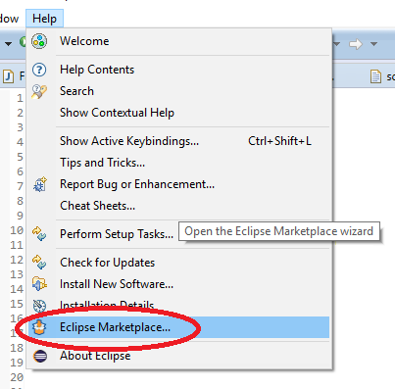
Installation Step 1
From eclipse, go to the “Help” menu, and then choose “Eclipse Marketplace…”

Slide 37
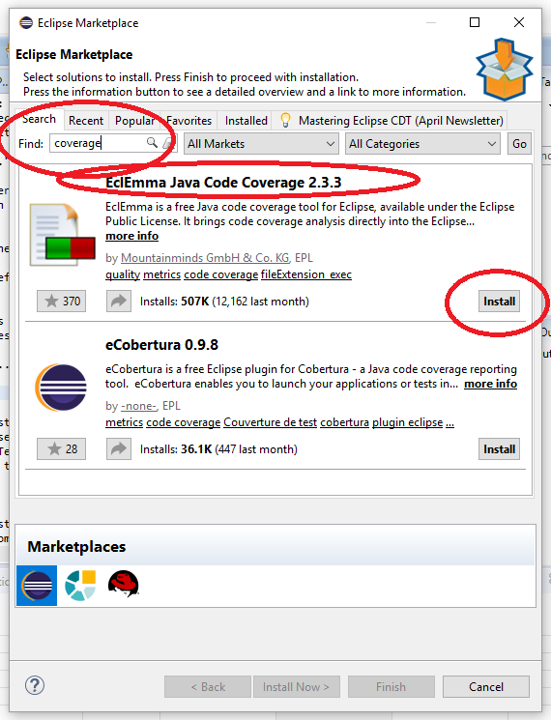
Installation Step 2
Search for “coverage,” then when “EclEmma Java Code Coverage” shows up, click “Install”
Then accept the license agreement, hit Finish, and restart Eclipse

Slide 38
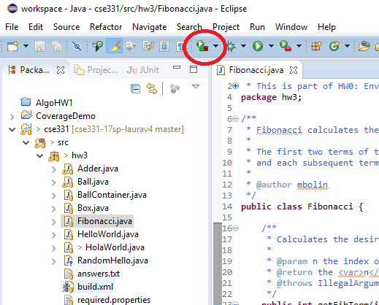
Using it
From the top bar, click the coverage arrow instead of the run arrow
Or, right-click on a .java file and chose “Coverage as” instead of “Run as”
(see next slide for screenshot)

Slide 39
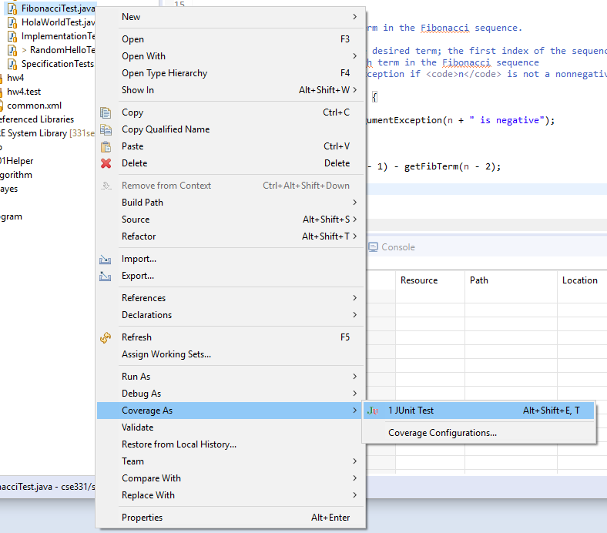

Slide 40
What it looks like
Basic idea:
Highlights lines of code green (covered), yellow (partially covered—missing some branch(es)), or red (no coverage)
Also has a view at the bottom with percent of covered code, and you can expand folders and/or packages down to the individual file level
Demo with hw3 Fibonacci.java and FibonacciTest.java

Slide 41
Questions to help explore the tool
What happens if you run the coverage view after you comment out the @Test before testInductiveCase in FibonacciTest.java?
What color(s) do the lines of that method turn?
What color(s) do the lines of the method getFibTerm(int n) in FibonacciTest.java turn?

Slide 42
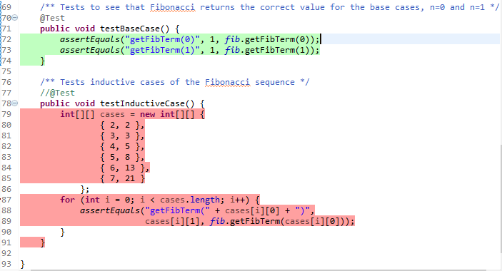
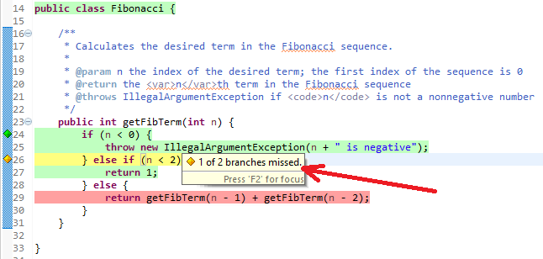
Shown by hovering the mouse pointer over the yellow line

Slide 43
So, coverage is…
Good for catching things like
Missing @Test before a test method
Finding branches/statements you’re forgetting to test
Bad for things like
Making sure you test edge cases
If original FibonacciTest had only tested n=-1, n=1, and n=3, would have caught difference instead of sum bug, but might not have caught the edge/base case issues
Making sure your tests make sense
Good style
Good choice of things to test
Etc.

Slide 44
Final note
This plugin is just a tool
It can’t test for you
It is only one way of visualizing the tests you’ve written
It can be misleading
It is optional
If it doesn’t make your life easier, don’t use it

