Slide 1
CSE 331 Software Design and Implementation
Lecture 1
Introduction
Zach Tatlock / Winter 2016

Slide 2
The Big Picture

Slide 3
Welcome!
10 week study of the craft of programming
How do we build good programs?
“Controlling complexity is the
essence of computer programming.”
-- Brian Kernighan
(UNIX, AWK, C, …)

Slide 4
Controlling Complexity

Slide 5
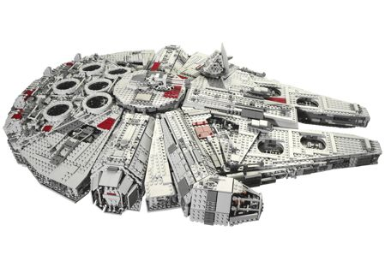
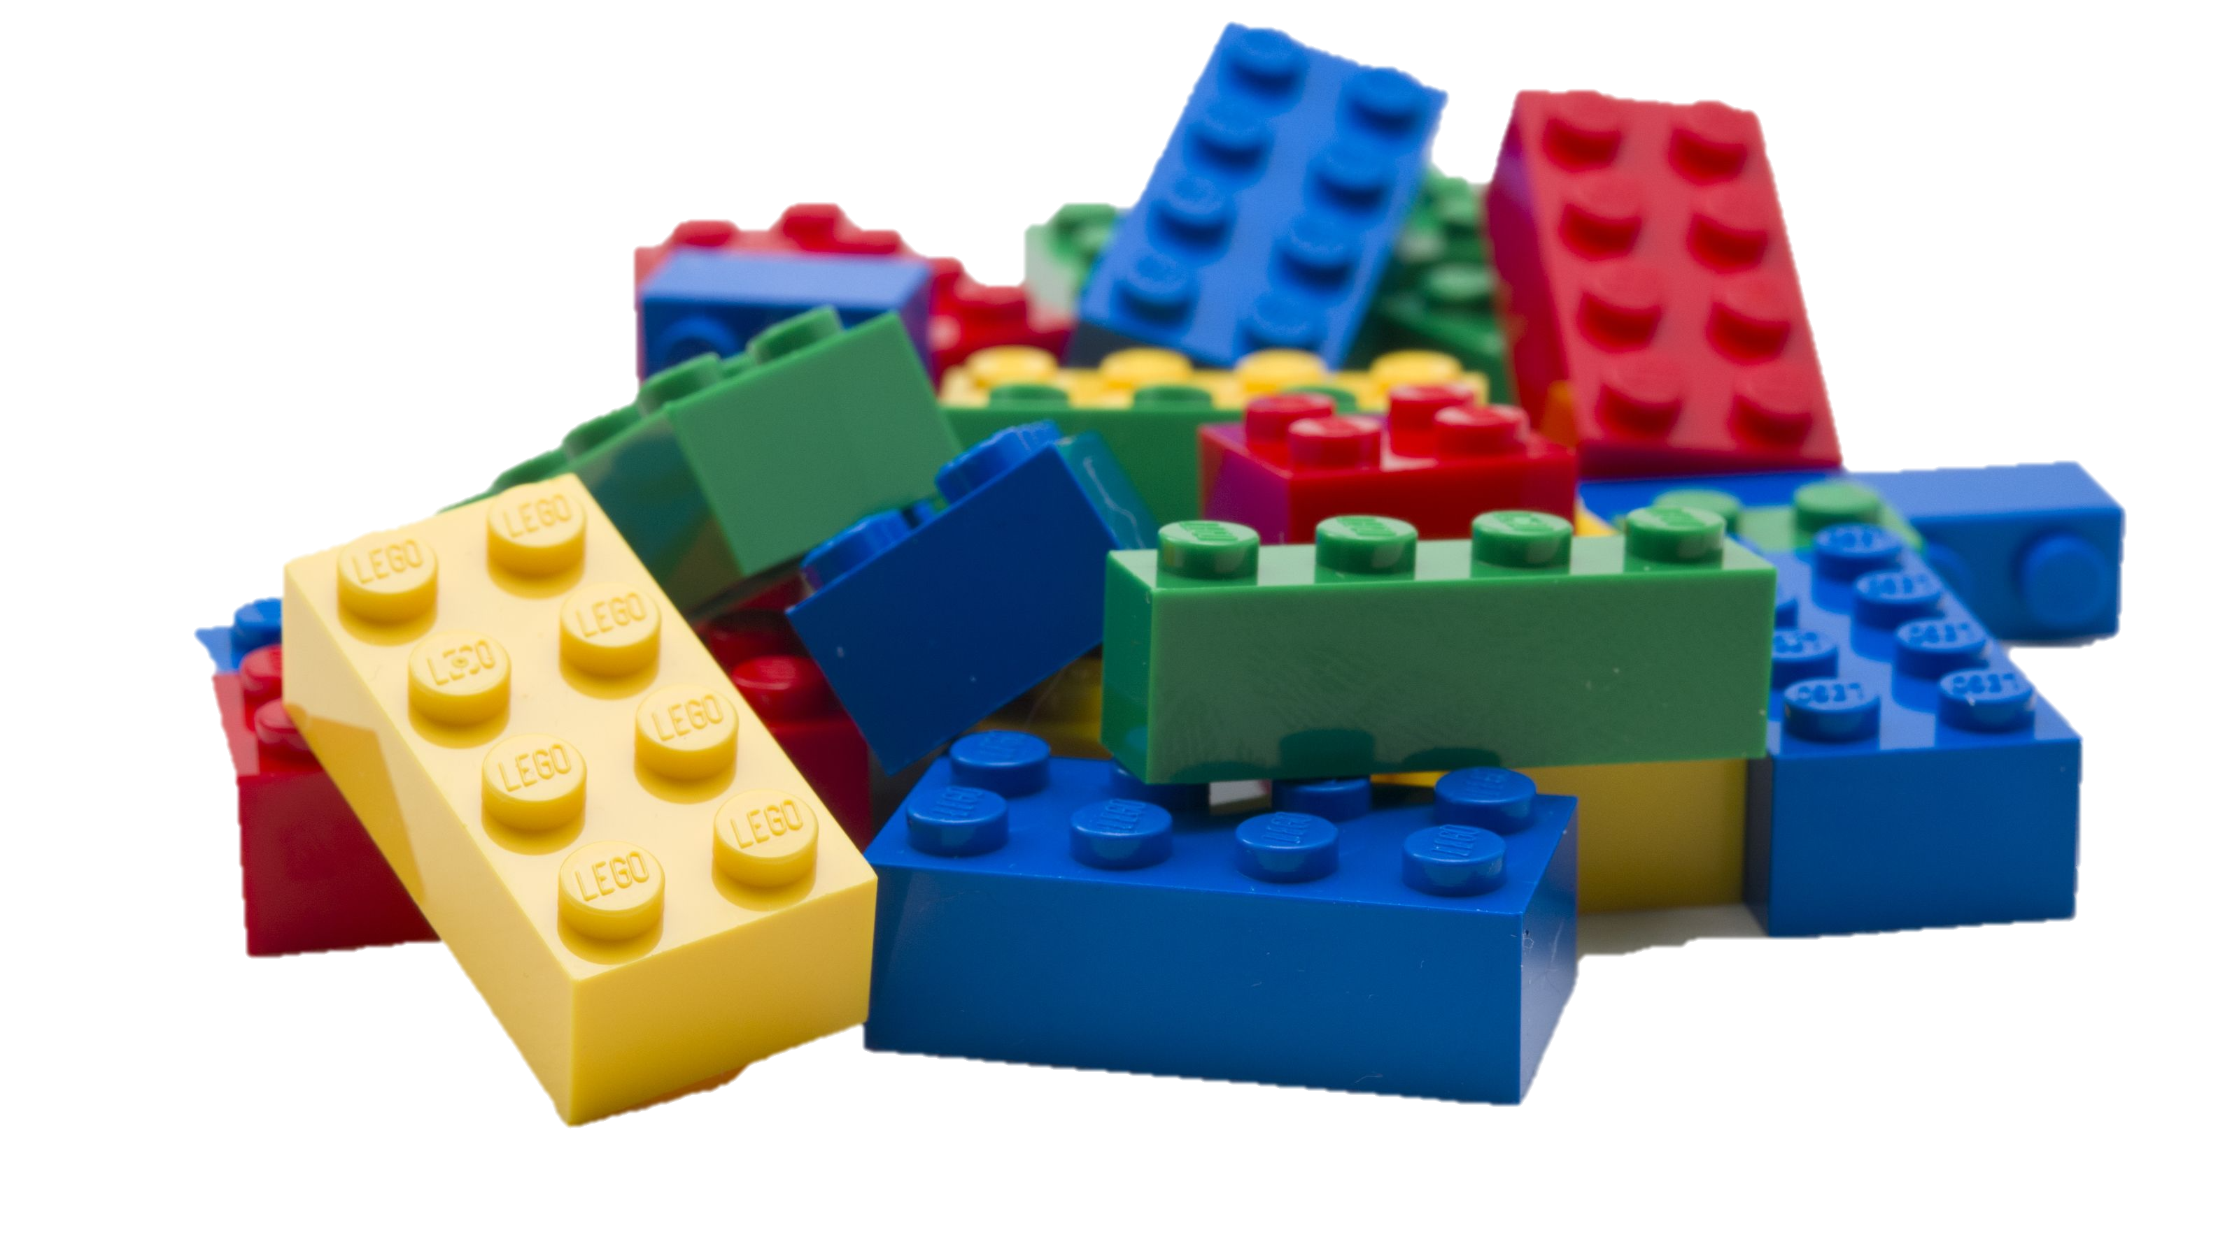
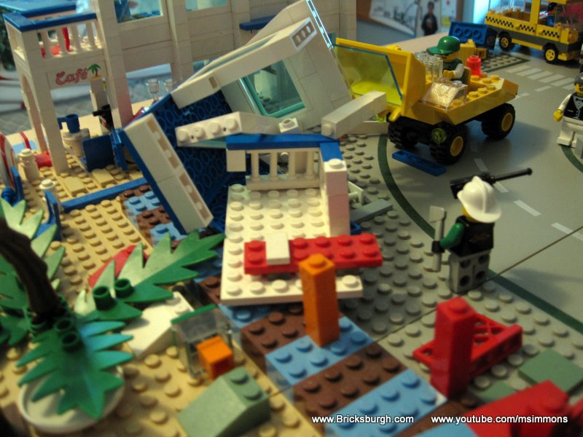
Controlling Complexity

Slide 6
Learning to Control Complexity
First, we need to refine our goals:
What quality makes a program good?
How can we tell if a program is good?
How do we build good programs?
To answer, we’ll learn principles and use tools:
Modularity, documentation, testing, verification
Tools: Java, IDEs, debuggers, JUnit, JavaDoc, git
Tools change, principles are forever.

Slide 7
Administrivia

Slide 8
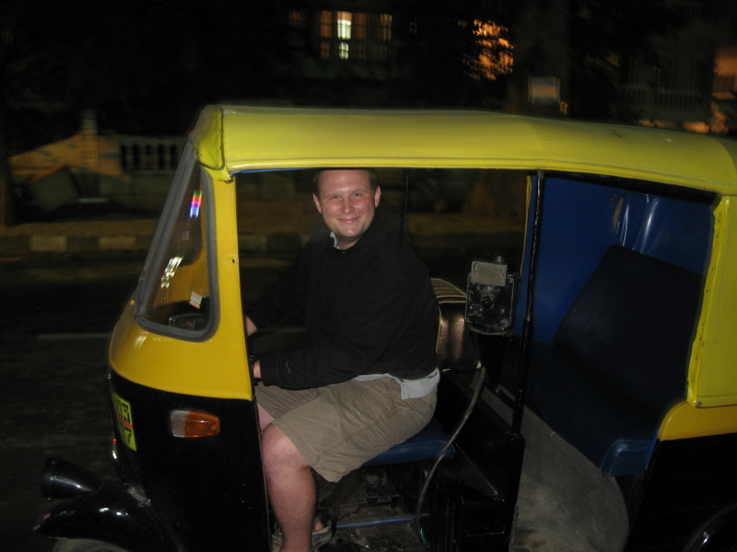
Course Staff
Instructor:
Zach Tatlock
ztatlock@cs
CSE 546
Researcher in formal verification, compilers, systems. Runner, knitter, pizza enthusiast.

Slide 9
Course Staff
TAs:
Justin Bare
Christopher Chen
Deric Pang
Marcella Cindy Prasetio
Vinod Rathnam
Office hours posted ASAP
Several 331 veterans = expert guides!

Slide 10
Credits
Great course material based on work by:
Michael Ernst
Hal Perkins
Dan Grossman
David Notkin
Dozens of amazing TAs
Hundreds of incredible students (you!)

Slide 11
Staying In Touch
We’ll use Piazza:
http://piazza.com/washington/winter2016/cse331/home
You must get announcements sent there
Discuss HW, lecture, readings
Be nice, be professional (staff will monitor)
Can post privately to instructors
Can post anonymously (to classmates)
Ask good questions, give helpful answers
http://www.catb.org/esr/faqs/smart-questions.html

Slide 12
Lecture and Section
Both required
Arrive punctually, ask questions, take notes
Your participation is crucial for everyone’s success
Materials will be posted, but just visual aids
Section often more focused on HW and tools
This week: more detail on Lecture 2 concepts
Next week: preparing for projects

Slide 13
Homework
Common 331 misconception:
“Homework seemed disconnected from lecture.”
If it feels that way, you’re making them harder!
Reconsider and seek out connections to lecture
Do think carefully before typing
Do not keep cutting with a dull blade
Early assignments are “on paper”, followed by increasingly substantial software development.
4 late days, max 2 per assignment, use wisely!

Slide 14
Text Resources
The Pragmatic Programmer
Hunt and Thomas (1999)
Collection of best practices
Effective Java
Bloch, 2nd edition (2000)
OOP design, expert tips
Java API Docs:
http://docs.oracle.com/javase/8/docs/api/

Slide 15
Readings and Quizzes
These are real programming books
Hard-won advice from top-notch hackers
Stuff all serious programmers should know
Approachable but sometimes challenging
Only partial overlap with lecture
Quizzes to ensure you keep up with reading
Reading and contemplating design is essential
Time investment that pays dividends in the long run
Material may be on exams

Slide 16
Other Reading
The Design of
Everyday Things
Zen and the Art of
Motorcycle Maintenance
Not directly used in 331, but worthwhile reads.

Slide 17
Reading Books in 21st Century
Google, Stack Overflow, Reddit, etc. good for:
Quick reference and debugging
Links to more in-depth treatment of a topic
Search often less good for:
Why did this bug arise? How could it be avoided?
Why is the system designed this way? Alternatives?
Beware copy-paste coding
Security vulns have propagated through forums
See The Full StackOverflow Developer

Slide 18
Exams
Midterm: TBD, roughly week 5
in class
Final: Monday, March 14
8:30 – 10:20 (sorry!)
Can cover any concepts from the course
Different format than homework
Will post past exams from various instructors

Slide 20
Academic Integrity
Carefully read course policy
Clearly explains how you can / cannot get help on homework and projects
Always explain any unconventional action
Honest work is the foundation of UW / academia
Your fellow students and I trust you deeply
Zero tolerance for violations, can end career

Slide 21
Organization
331 is a big, complex machine.
I’m a 331 newbie too, so I’ll need your help figuring out what works for all of us.
Patience and good faith much appreciated!

Slide 22
TODO
Log into the 331 Piazza
Check out the course website
http://cs.washington.edu/331
Read syllabus and academic integrity policy
If still trying to enroll, fill out online form
Code word provided at end of class
Go to any section on Thursday if not registered
Do Homework 0 by Friday 10AM!
Can submit to Dropbox even if not registered

Slide 23
Questions?
Anything I forgot before we discuss, you know, software?

Slide 24
331

Slide 25
Goals
One focus will be writing correct programs
What does it mean for a program to be correct?
It must match its specification
How can we determine if a program is correct?
Testing, Model Checking, Verification (proof)
What are ways to build correct programs?
Principled design and development
Abstraction, modularity, documentation

Slide 26
Controlling Complexity
Abstraction and specification
Procedural, data, and control flow abstractions
Why they are useful and how to use them
Writing, understanding, and reasoning about code
Use Java, but the principles apply broadly
Some focus on object-oriented programming
Program design and documentation
What makes a design good or bad (example: modularity)
Design processes and tools
Pragmatic considerations
Testing, debugging, and defensive programming
[more in CSE403: Managing software projects]

Slide 27
The Goal of System Building
To construct a correctly functioning artifact
All other considerations are secondary
Though many required to produce a correct system
Learning how to build correct systems is essential and very difficult, but also fun and rewarding.
Related skill: communication
Can you convince yourself and others something is correct via precise, coherent explanations?

Slide 28
Why is Good Software Hard?
Software is different from other artifacts
We build general, reusable mechanisms
Not much repetition, symmetry, or redundancy
Large systems have millions of complex parts
We understand walls in terms of bricks, bricks in terms of crystals, crystals in terms of molecules etc. As a result the number of levels that can be distinguished meaningfully in a hierarchical system is kind of proportional to the logarithm of the ratio between the largest and the smallest grain, and therefore, unless this ratio is very large, we cannot expect many levels. In computer programming our basic building block has an associated time grain of less than a microsecond, but our program may take hours of computation time. I do not know of any other technology covering a ratio of 10¹⁰ or more: the computer, by virtue of its fantastic speed, seems to be the first to provide us with an environment where highly hierarchical artefacts are both possible and necessary.
-- Dijkstra

Slide 29
Why is Good Software Hard?
Software is expected to be malleable
You can’t download a new chip into your phone
But you can update web pages, apps, and the OS
Aggressive competition for more features, platforms
Requirements, laws, and companies change
We are pioneers and explorers!
Often writing a new kind of system
No relevant experience or specific theory exists
Software engineering is about:
Managing complexity, managing change
Coping with potential defects: users, devs, environment

Slide 30
Programming is Hard
Despite decades of research, still surprisingly difficult to specify, design, implement, test, and maintain even small, simple programs.
Our assignments will be reasonable if you apply the techniques taught in class…
... but likely very difficult to do brute-force
... and almost certainly impossible unless
you start very early.
If you’re frustrated, think before you type!

Slide 31
Prerequisites
Knowing Java is essential
We assume you’ve mastered 142, 143
Examples:
Sharing:
Distinction between == and equals()
Aliasing: multiple references to the same object
Object-oriented dispatch:
Inheritance and overriding
Objects/values have a run-time type
Subtyping
Expressions have a compile-time type
Subtyping via extends (classes) and implements (interfaces)

Slide 32
You have homework!
Homework 0, due online by 10 AM Friday
Rearrange array elements by sign
O(n) time, preferably in a single pass
Only write (don’t run!) your algorithm
Clearly and concisely prove your solution correct!
Purpose:
Great practice and warm-up
Surprisingly difficult
Working up to reasoning about large designs

Slide 33
CSE 331 is a Challenge
We are going to learn a lot and have a good time
Be prepared to work hard and think hard
The staff is here to help you learn
We will be working hard too!
So, let’s get to it!
Before we create masterpieces, we first need to hone our ability to reason about code…

Slide 34
A Problem
“Complete this method so that it returns the index of the max of the first n elements of the array arr.”
int index_of_max(int[] arr, int n) {
…
}

Slide 35
A Problem
“Complete this method so that it returns the index of the max of the first n elements of the array arr.”
int index_of_max(int[] arr, int n) {
…
}
What should we ask about the specification?
Given (better) specification, how many possible implementations are there?

Slide 36
Moral
You can all write this code
More interesting for us in 331:
What if n is 0?
What if n is less than 0?
What if n is greater than the array length?
What if there are “ties”?
How should we indicate error:
exception, return value, fail-stop, …
Weaker vs. stronger specs?
Challenge writing English specs (n vs. n-1)

Slide 37
Something to Chew On
What is the relationship of “goodness” to “correctness” for programs?

Slide 38
TODO
Log into the 331 Piazza
Check out the course website
http://cs.washington.edu/331
Read syllabus and academic integrity policy
If still trying to enroll, fill out online form
Code word provided next
Go to any section on Thursday if not registered
Do Homework 0 by Friday 10AM!
Can submit to Dropbox even if not registered

