Slide 1
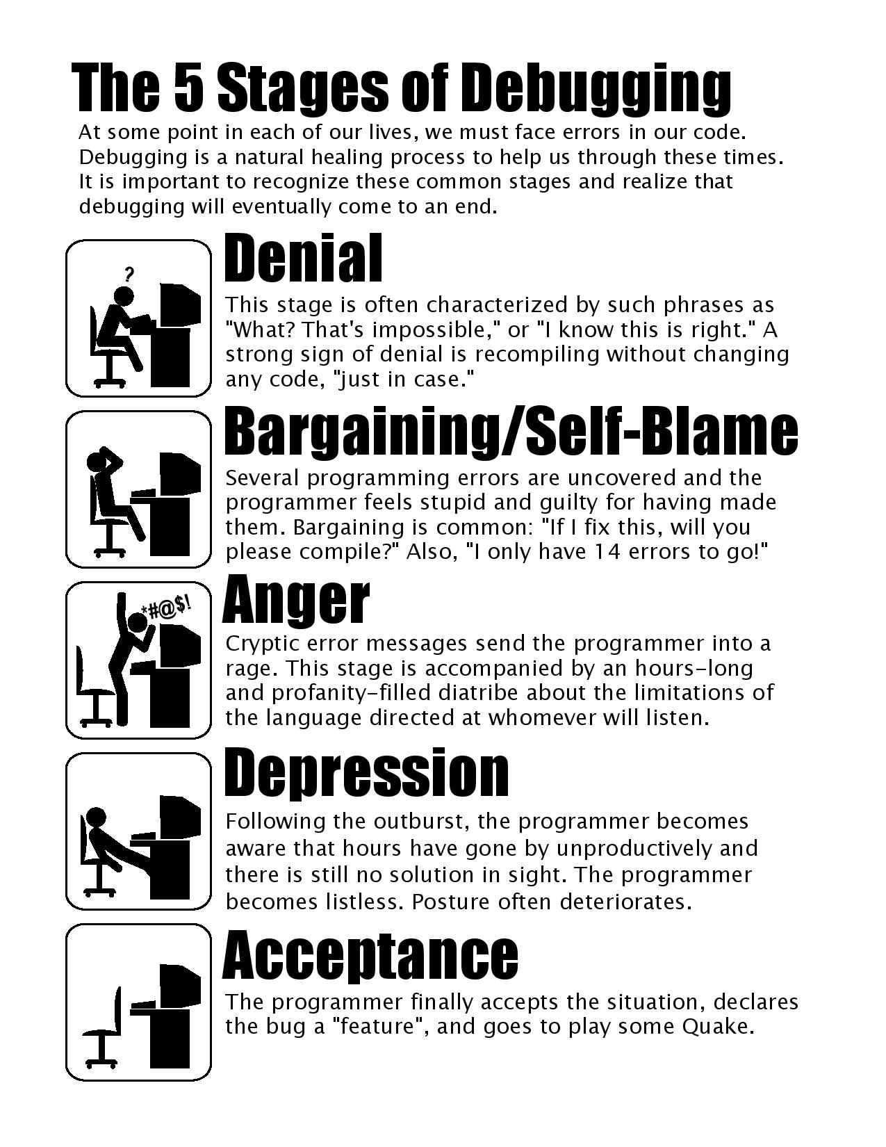

Slide 2
Section 4: HW5, Graphs, and Testing
Slides by Vinod Rathnam
with material from Alex Mariakakis, Krysta Yousoufian, Mike Ernst, Kellen Donohue

Slide 3
AGENDA
HW5
Graphs
JUnit Testing
Test Script Language (Demo)
JavaDoc (Demo)

Slide 4
DEMO: HW 5 STARTER FILES

Slide 5
GRAPHS
A
B
C
D
E

Slide 6
GRAPHS
A
B
Nodes
C
D
E

Slide 7
GRAPHS
A
B
Edges
C
D
E

Slide 8
GRAPHS
A
B
Children of A
C
D
E

Slide 9
GRAPHS
A
B
Parents of D
C
D
E

Slide 10
GRAPHS
A
B
Path from
A to C
C
D
E

Slide 11
GRAPHS
A
B
Shortest path
from A to C?
C
D
E

Slide 12
GRAPHS
A
B
Shortest path
from A to B?
C
D
E

Slide 13
INTERNAL VS. EXTERNAL TESTING
Internal : JUnit
How you decide to implement the object
Checked with implementation tests
External: test script
Your API and specifications
Testing against the specification
Checked with specification tests

Slide 14
A JUNIT TEST CLASS
A method with @Test is flagged as a JUnit test
All @Test methods run when JUnit runs
import org.junit.*;
import static org.junit.Assert.*;
public class TestSuite {
...
@Test
public void TestName1() {
...
}
}

Slide 15
USING JUNIT ASSERTIONS
Verifies that a value matches expectations
assertEquals(42, meaningOfLife());
assertTrue(list.isEmpty());
If the value isn’t what it should be, the test fails
Test immediately terminates
Other tests in the test class are still run as normal
Results show details of failed tests

Slide 16
USING JUNIT ASSERTIONS
Assertion | Case for failure
assertTrue(test) | the boolean test is false
assertFalse(test) | the boolean test is true
assertEquals(expected, actual) | the values are not equal
assertSame(expected, actual) | the values are not the same (by ==)
assertNotSame(expected, actual) | the values are the same (by ==)
assertNull(value) | the given value is not null
assertNotNull(value) | the given value is null
And others: http://www.junit.org/apidocs/org/junit/Assert.html
Each method can also be passed a string to display if it fails:
assertEquals("message", expected, actual)

Slide 17
CHECKING FOR EXCEPTIONS
Verify that a method throws an exception when it should
Test passes if specified exception is thrown, fails otherwise
Only time it’s OK to write a test without a form of asserts
@Test(expected=IndexOutOfBoundsException.class)
public void testGetEmptyList() {
List<String> list = new ArrayList<String>();
list.get(0);
}

Slide 18
SETUP AND TEARDOWN
Methods to run before/after each test case method is called:
@Before
public void name() { ... }
@After
public void name() { ... }
Methods to run once before/after the entire test class runs:
@BeforeClass
public static void name() { ... }
@AfterClass
public static void name() { ... }

Slide 19
SETUP AND TEARDOWN
public class Example {
List empty;
@Before
public void initialize() {
empty = new ArrayList();
}
@Test
public void size() {
...
}
@Test
public void remove() {
...
}
}

Slide 20
DON’T REPEAT YOURSELF
Can declare fields for frequently-used values or constants
private static final String DEFAULT_NAME = “MickeyMouse”;
private static final User DEFAULT_USER = new User(“lazowska”, “Ed”, “Lazowska”);
Can write helper methods, etc.
private void eq(RatNum ratNum, String rep) {
assertEquals(rep, ratNum.toString());
}
private BinaryTree getTree(int[] items) {
// construct BinaryTree and add each element in items
}

Slide 21
#1: BE DESCRIPTIVE
When a test fails, JUnit tells you:
Name of test method
Message passed into failed assertion
Expected and actual values of failed assertion
The more descriptive this information is, the easier it is to diagnose failures
Level of goodness | Example
Good | testAddDaysWithinMonth()
Not so good | testAddDays1(), testAddDays2()
Bad | test1(), test2()
Overkill | TestAddDaysOneDayAndThenFiveDaysStartingOnJanuaryTwentySeventhAndMakeSureItRollsBackToJanuaryAfterRollingToFebruary()

Slide 22
#1: BE DESCRIPTIVE
Take advantage of message, expected, and actual values
No need to repeat expected/actual values or info in test name
Use the right assert for the occasion:
assertEquals(expected, actual) instead of assertTrue(expected.equals(actual))

Slide 23
LET’S PUT IT ALL TOGETHER!
public class DateTest {
...
// Test addDays when it causes a rollover between months
@Test
public void testAddDaysWrapToNextMonth() {
Date actual = new Date(2050, 2, 15);
actual.addDays(14);
Date expected = new Date(2050, 3, 1);
assertEquals("date after +14 days", expected, actual);
}

Slide 24
LET’S PUT IT ALL TOGETHER!
public class DateTest {
...
// Test addDays when it causes a rollover between months
@Test
public void testAddDaysWrapToNextMonth() {
Date actual = new Date(2050, 2, 15);
actual.addDays(14);
Date expected = new Date(2050, 3, 1);
assertEquals("date after +14 days", expected, actual);
}
Tells JUnit that this method is a test to run

Slide 25
LET’S PUT IT ALL TOGETHER!
public class DateTest {
...
// Test addDays when it causes a rollover between months
@Test
public void testAddDaysWrapToNextMonth() {
Date actual = new Date(2050, 2, 15);
actual.addDays(14);
Date expected = new Date(2050, 3, 1);
assertEquals("date after +14 days", expected, actual);
}
Descriptive method name

Slide 26
LET’S PUT IT ALL TOGETHER!
public class DateTest {
...
// Test addDays when it causes a rollover between months
@Test
public void testAddDaysWrapToNextMonth() {
Date actual = new Date(2050, 2, 15);
actual.addDays(14);
Date expected = new Date(2050, 3, 1);
assertEquals("date after +14 days", expected, actual);
}
Use assertion to check expected results

Slide 27
LET’S PUT IT ALL TOGETHER!
public class DateTest {
...
// Test addDays when it causes a rollover between months
@Test
public void testAddDaysWrapToNextMonth() {
Date actual = new Date(2050, 2, 15);
actual.addDays(14);
Date expected = new Date(2050, 3, 1);
assertEquals("date after +14 days", expected, actual);
}
Message gives details about the test in case of failure

Slide 28
#2: KEEP TESTS SMALL
Ideally, test one thing at a time
“Thing” usually means one method under one input condition
Not always possible – but if you test x() using y(), try to test y() in isolation in another test
Low-granularity tests help you isolate bugs
Tell you exactly what failed and what didn’t
Only a few (likely one) assert statements per test
Test halts after first failed assertion
Don’t know whether later assertions would have failed

Slide 29
#3: BE THOROUGH
Consider each equivalence class
Items in a collection: none, one, many
Consider common input categories
Math.abs(): negative, zero, positive values
Consider boundary cases
Inputs on the boundary between equivalence classes
Person.isMinor(): age < 18, age == 18, age > 18
Consider edge cases
-1, 0, 1, empty list, arr.length, arr.length-1
Consider error cases
Empty list, null object

Slide 30
How To Create JUnit Test Classes
Right-click hw5.test -> New -> JUnit Test Case
Important: Put class name in ImplementationTests.java
Demo

Slide 31
JUNIT ASSERTS VS. JAVA ASSERTS
We’ve just been discussing JUnit assertions so far
Java itself has assertions
public class LitterBox {
ArrayList<Kitten> kittens;
public Kitten getKitten(int n) {
assert(n >= 0);
return kittens(n);
}
}

Slide 32
ASSERTIONS VS. EXCEPTIONS
public class LitterBox {
ArrayList<Kitten> kittens;
public Kitten getKitten(int n) {
assert(n >= 0);
return kittens(n);
}
}
public class LitterBox {
ArrayList<Kitten> kittens;
public Kitten getKitten(int n) {
try {
return kittens(n);
} catch(Exception e) {
}
}
}
Assertions should check for things that should never happen
Exceptions should check for things that might happen
“Exceptions address the robustness of your code, while assertions address its correctness”

Slide 33
REMINDER: ENABLING ASSERTS IN ECLIPSE
To enable asserts:
Go to Run -> Run Configurations… -> Arguments tab -> input -ea in VM arguments section
Do this for every test file
Demo!

Slide 34
Expensive CheckReps
Ant Validate and Staff Grading will have assertions enabled
But sometimes a checkRep can be expensive
For example, looking at each node in a Graph with a large number of nodes
This could cause the grading scripts to timeout

Slide 35
Expensive CheckReps
So, before your final commit, a nice thing to do is to remove the checking of expensive parts of your checkRep or the checking of your checkRep entirely
For example, one thing you can do is have a boolean flag and structure your checkRep as so:
private void checkRep() {
cheap-stuff
if(DEBUG_FLAG) { // or can have this for entire checkRep
expensive-stuff
}
cheap-stuff
...

Slide 36
EXTERNAL TESTS: TEST SCRIPT LANGUAGE

Slide 37
TEST SCRIPT LANGUAGE
Text file with one command listed per line
First word is always the command name
Remaining words are arguments
Commands will correspond to methods in your code

Slide 38
TEST SCRIPT LANGUAGE (ex .test file)
# Create a graph
CreateGraph graph1
# Add a pair of nodes
AddNode graph1 n1
AddNode graph1 n2
# Add an edge
AddEdge graph1 n1 n2 e1
# Print the nodes in the graph and the outgoing edges from n1
ListNodes graph1
ListChildren graph1 n1
n1
n2

Slide 39
TEST SCRIPT LANGUAGE
CreateGraph A
AddNode A n1
AddNode A n2
CreateGraph B
ListNodes B
AddNode A n3
AddEdge A n3 n1 e31
AddNode B n1
AddNode B n2
AddEdge B n2 n1 e21
AddEdge A n1 n3 e13
AddEdge A n1 n2 e12
ListNodes A
ListChildren A n1
ListChildren B n2
n1
n2
n3
n1
n2

Slide 40
How To Create Specification Tests
Create .test and .expected file pairs under hw5.test
Find correct format for expected output in hw5 instructions
Implement parts of HW5TestDriver
driver connects commands from .test file to your Graph implementation to the output which is matched with .expected file
Run all tests by running SpecificationTests.java
Note: staff will have our own .test and .expected pairs to run with your code
So do not hardcode .test/.expected pairs to pass, but instead make sure the format in hw5 instructions is correctly followed

Slide 41
DEMO: TEST SCRIPT LANGUAGE

Slide 42
JAVADOC API
Now you can generate the JavaDoc API for your code (Optional)
Instructions online: http://courses.cs.washington.edu/courses/cse331/15sp/tools/editing-compiling.html#javadoc
Demo: Generate JavaDocs

