Slide 1
Another Randomized Algorithm
Freivalds’ Algorithm
for
Matrix Multiplication

Slide 2
Randomized Algorithms
Quicksort makes effective use of random numbers, but is no faster than Mergesort or Heapsort.
Here we will see a problem that has a simple randomized algorithm faster than any known deterministic solution.

Slide 3
Matrix Multiplication
Multiplying n×n matrices (n = 2 in this example)
$$\left[\begin{matrix}a & b \\ c & d\end{matrix}\right]\left[\begin{matrix}w & x \\ y & z\end{matrix}\right]=\left[\begin{matrix}aw+by & ax+bz \\ cw+dy & cx+dz\end{matrix}\right]$$
Complexity of straightforward algorithm: Θ(n³) time
(There are 8 multiplications here; in general, n multiplications for each of n² entries)
Coppersmith & Winograd showed how to do it in time O(n^{2.376}) in 1989.
Williams improved this to O(n^{2.3729}) in 2011. Progress!

Slide 4
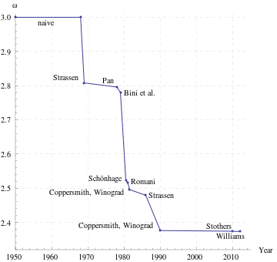
History of Matrix Multiplication Algorithms Running time: O(n^{ω})

Slide 5
Freivalds’ Algorithm (1977)
Freivalds’ variant of problem:
Determine whether n × n matrices A, B, and C satisfy the condition AB = C
Method:
Choose x ∈ {0,1}^{n} randomly and uniformly (vector of length n)
If ABx ≠ Cx then report “AB ≠ C”
else report “AB = C probably”

Slide 6
Running Time
ABx = A(Bx), so we have 3 instances of an n × n matrix times an n-vector
These are O(n²) time operations if done straightforwardly
Total running time O(n²)
Fastest deterministic solution known: O(n^{2.3729})

Slide 7
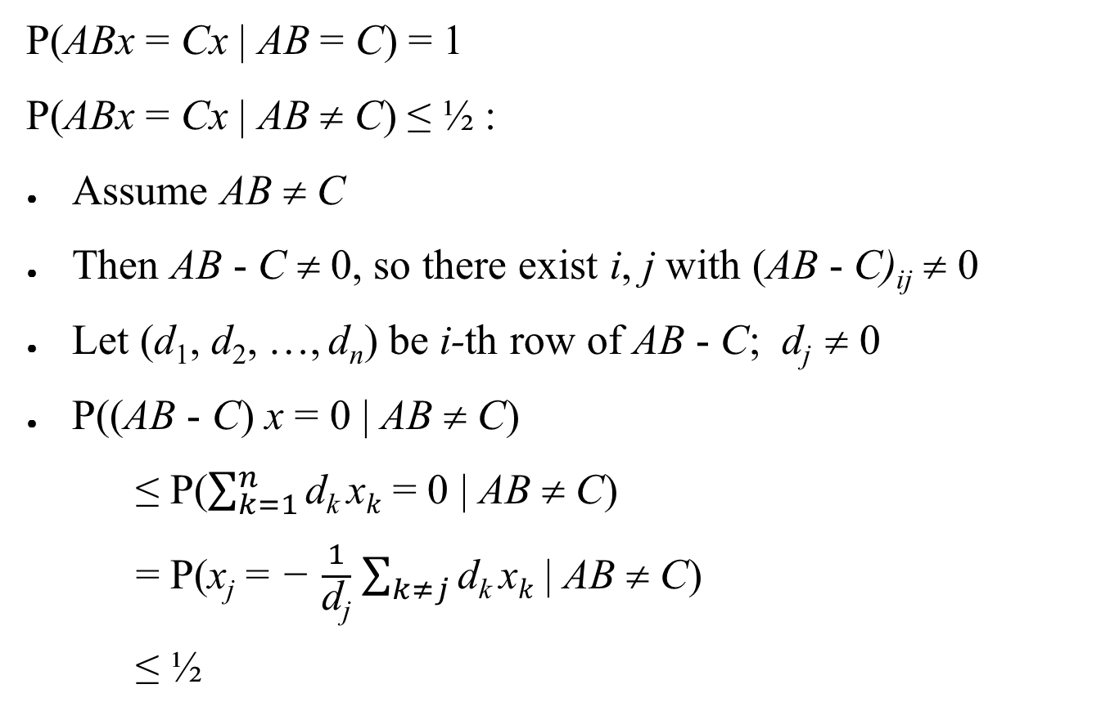
How Often Is It Wrong?
P(ABx = Cx | AB = C) = 1
P(ABx = Cx | AB ≠ C) ≤ ½ :
Assume AB ≠ C
Then AB - C ≠ 0, so there exist i, j with (AB - C)_{ij} ≠ 0
Let (d₁, d₂, …, d_{n}) be i-th row of AB - C; d_{j} ≠ 0
P((AB - C) x = 0 | AB ≠ C)
≤ P($\sum_{k=1}^{n}{\text{d}\text{k} \text{x}k}$ = 0 | AB ≠ C)
= P(x_{j} = − $\frac{1}{\text{d}\text{j}}$ $\sum_{k≠j}{\text{d}\text{k} \text{x}k}$ | AB ≠ C)
≤ ½

Slide 8
Decreasing the Probability of Error
By iterating with k random, independent choices of x, we can decrease probability of error to 1/2^{k}, using time O(kn²).
Interesting comparison
Quicksort is always correct, and runs slowly with small probability.
Frievalds’ algorithm is always fast, and incorrect with small probability.

