Slide 1
Section 5-23
Review of important distributions
Another randomized algorithm

Slide 2
Discrete Random Variables

Slide 3
Bernoulli Distribution
Definition: value 1 with probability p, 0 otherwise (prob. q = 1-p)
Example: coin toss (p = ½ for fair coin)
Parameters: p
Properties:
E[X] = p
Var[X] = p(1-p) = pq

Slide 4
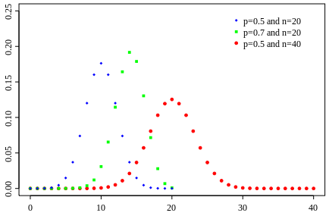
Binomial Distribution
Definition: sum of n independent Bernoulli trials, each with parameter p
Example: number of heads in 10 independent coin tosses
Parameters: n, p
Properties:
E[X] = np
Var(X) = np(1-p)
pmf:
$$Pr\left(X=k\right)=\left(\begin{matrix}n \\ k\end{matrix}\right)p^{k}{(1−p)}^{n−k}$$

Slide 5
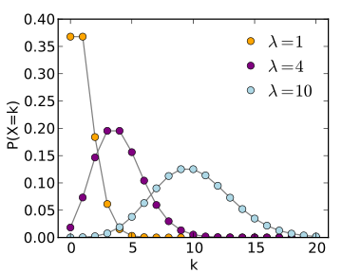
Poisson Distribution
Definition: number of events that occur in a unit of time, if those events occur independently at an average rate λ per unit time
Example: # of cars at traffic light in 1 minute, # of deaths in 1 year by horse kick in Prussian cavalry
Parameters: λ
Properties:
E[X] = λ
Var[X] = λ
pmf:
$$Pr\left(X=k\right)=\frac{λ^{k}}{k!}e^{−λ}$$

Slide 6
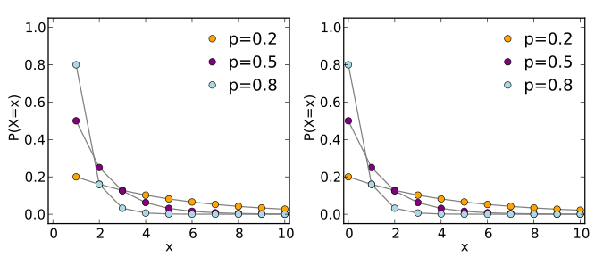

Geometric Distribution
Definition: number of independent Bernoulli trials with parameter p until and including first success (so X can take values 1, 2, 3, ...)
Example: # of coins flipped until first head
Parameters: p
Properties:
E[X] =
Var[X] =
pmf:
$$\frac{1}{p}$$
$$\frac{1−p}{p^{2}}$$
$$Pr\left(X=k\right)={\left(1−p\right)}^{k−1}p$$

Slide 7


Hypergeometric Distribution
Definition: number of successes in n draws (without replacement) from N items that contain K successes in total
Example: An urn has 10 red balls and 10 blue balls. What is the probability of drawing 2 red balls in 4 draws?
Parameters: n, N, K
Properties:
E[X] =
Var[X] =
pmf:
$$n\frac{K}{N}$$
Think about the pmf; we've been doing it for weeks now: ways-to-choose-successes times ways-to-choose-failures over ways-to-choose-n
Also, consider that the binomial dist. is the with-replacement analog of this
$$n\frac{K}{N}\frac{N−K}{N}\frac{N−n}{N−1}$$
$$Pr\left(X=k\right)=\frac{\left(\begin{matrix}K \\ k\end{matrix}\right)\left(\begin{matrix}N−K \\ n−k\end{matrix}\right)}{\left(\begin{matrix}N \\ n\end{matrix}\right)}$$

Slide 8
Continuous Random Variables

Slide 9
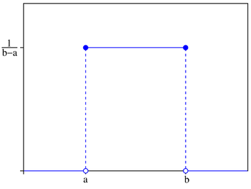


Uniform Distribution
Definition: A random variable that takes any real value in an interval with equal likelihood
Example: Choose a real number (with infinite precision) between 0 and 10
Parameters: a, b (lower and upper bound of interval)
Properties:
E[X] =
Var[X] =
pdf:
$$\frac{a+b}{2}$$
$$\frac{{\left(b−a\right)}^{2}}{12}$$
f(x) $=\frac{1}{b−a} if x∈\left[a,b\right],0 otherwise$

Slide 10
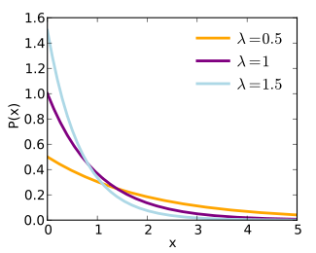
Exponential Distribution
Definition: Time until next events in Poisson process
Example: How long until the next soldier is killed by horse kick?
Parameters: λ, the rate at which Poisson events occur
Properties:
E[X] =
Var[X] =
pdf:
$$\frac{1}{λ}$$
$$\frac{1}{λ^{2}}$$
$$\text{f}\text{(}\text{x}\text{)}=λe^{−λx} for x≥0, 0 for x<0$$

Slide 11
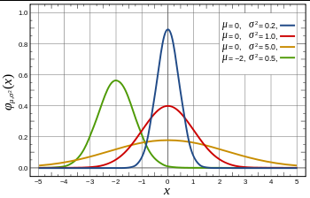
Normal Distribution
Definition: Your classic bell curve
Example: Quantum harmonic oscillator ground state (exact) Human heights, binomial random variables (approx)
Properties: μ, σ² (yes, mean and variance are given)
E[X] = μ
Var[X] = σ²
pdf:
$$\text{f}\text{(}\text{x}\text{)}=\frac{1}{\sqrt{\left(2πσ^{2}\right)}}e^{\frac{−{\left(x−μ\right)}^{2}}{2σ^{2}}}$$

Slide 12
Another Randomized Algorithm

Slide 13
Matrix Multiplication
Multiplying n×n matrices (n = 2 in this example)
$$\left[\begin{matrix}a & b \\ c & d\end{matrix}\right]∗\left[\begin{matrix}w & x \\ y & z\end{matrix}\right]=\left[\begin{matrix}aw+by & ax+bz \\ cw+dy & cx+dz\end{matrix}\right]$$
Complexity of straightforward algorithm: O(n³) time
(There are 8 multiplications here; in general, n multiplications for each of n² entries)
Coppersmith–Winograd algorithm (with help by others) can perform this operation in time O(n^{2.38})
(2.3755 in 1990, 2.3727 by 2011. Progress!)

Slide 14
Frievalds’ Algorithm
Determine whether n × n matrices A, B and C satisfy the condition AB = C
Method:
Choose x ∈ {0,1}^{n} randomly and uniformly (vector of length n)
If ABx ≠ Cx, then AB ≠ C
Else, AB = C probably

Slide 15
Results of Frievalds’ Algorithm
Runs in time O(n²)
ABx = A(Bx), so we have 3 instances of an n × n matrix times an n-vector
these are O(n²) time operations
Via some math magic,
P(the algorithm reports AB = C | AB ≠ C) ≤ ½
By iterating k random choices of x, can decrease probability of error to 1/2^{k}.
Interesting comparison
Quicksort is always correct, runs slowly with small probability
Frievalds’ alg. is always fast, incorrect with small probability

