Slide 1

Proof by Contradiction
Warm-up:
Show “if $a^{2}$ is even, then $a$ is even.
CSE 311 Spring 2022
Lecture 16

Slide 2

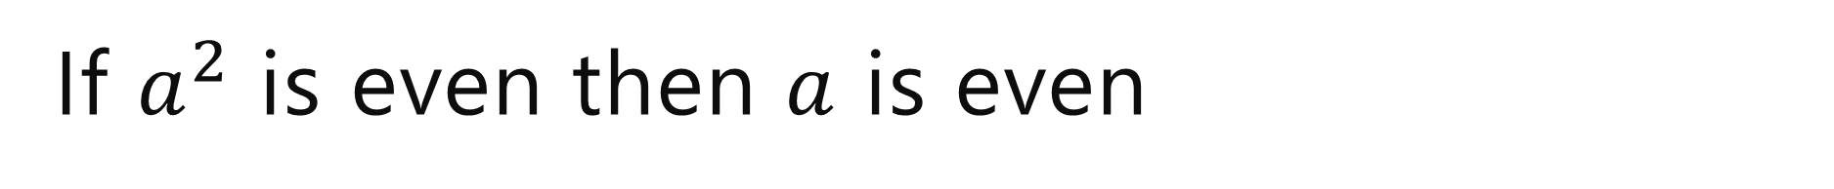
If $a^{2}$ is even then $a$ is even
Proof:
We argue by contrapositive.
Let $a$ be an arbitrary integer and suppose $a$is odd.
$a^{2}$ is odd.

Slide 3
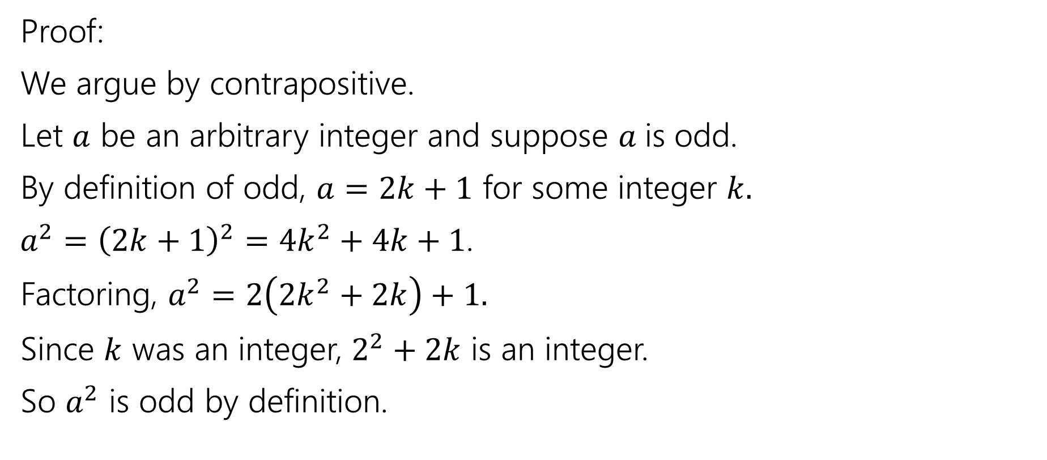
If $a^{2}$ is even then $a$ is even
Proof:
We argue by contrapositive.
Let $a$ be an arbitrary integer and suppose $a$is odd.
By definition of odd, $a=2k+1$ for some integer $k.$
$a^{2}={\left(2k+1\right)}^{2}=4k^{2}+4k+1$.
Factoring, $a^{2}=2\left(2k^{2}+2k\right)+1.$
Since $k$ was an integer, $2^{2}+2k$ is an integer.
So $a^{2}$ is odd by definition.

Slide 4
Announcements
We’re posting the handouts and solutions for this week’s section later today.
  We think you could use another example or two of properly formatted induction proofs.
  They’re primarily “study for the midterm” materials…no harm having those early.
  You should still go to section this week through, your TAs are more useful than the written solutions.
  I’ll post the slides for Friday (induction practice day) late tonight as well.
  Midterm info is here.

Slide 5

Proof By Contradiction
Suppose the negation of your claim.
Show that you can derive False (i.e. ($¬$claim) $→$ F )
If your proof is right, the implication is true.
So $¬$claim must be False.
So claim must be True!

Slide 6

Proof By Contradiction Skeleton
Suppose, for the sake of contradiction $¬p$
…
$q$
…
$¬q$
But $q$ and $¬q$ is a contradiction! So we must have $p$.

Slide 7

Proof By Contradiction
Claim: $\sqrt{2}$ is irrational (i.e. not rational).
Proof:

Slide 8

Proof By Contradiction
Claim: $\sqrt{2}$ is irrational (i.e. not rational).
Proof:
Suppose for the sake of contradiction that $\sqrt{2}$ is rational.
But [] is a contradiction!
We don’t have a fixed target.
That can make this proof harder.

Slide 9

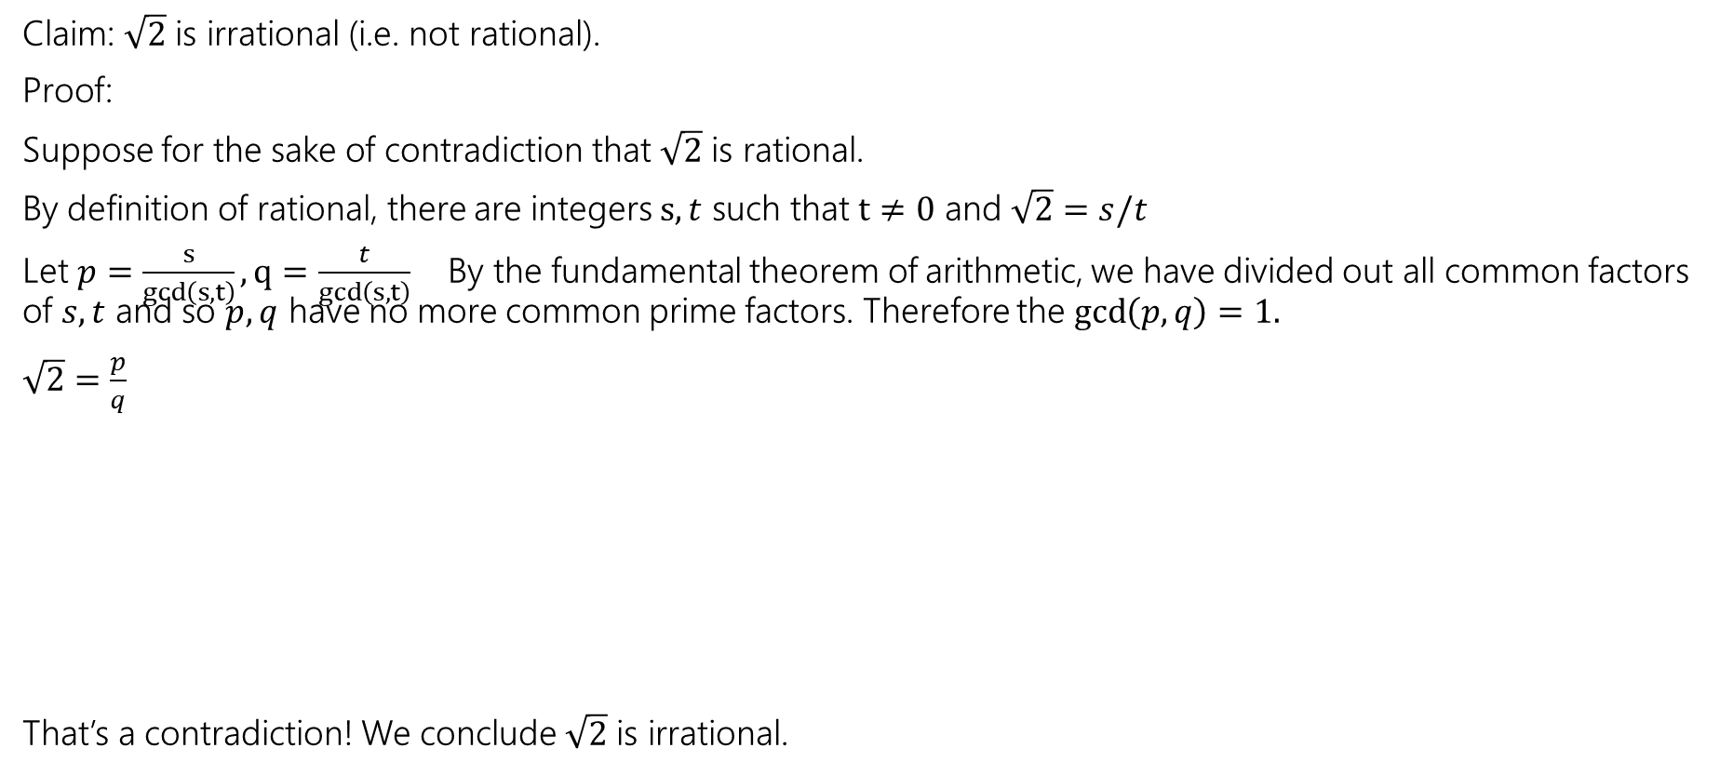
Proof By Contradiction
If $a^{2}$ is even then $a$is even.
Claim: $\sqrt{2}$ is irrational (i.e. not rational).
Proof:
Suppose for the sake of contradiction that $\sqrt{2}$ is rational.
By definition of rational, there are integers $s,t$ such that $t≠0$ and $\sqrt{2}=s/t$
Let $p=\frac{s}{gcd\left(s,t\right)}, q=\frac{t}{gcd\left(s,t\right)}$ By the fundamental theorem of arithmetic, we have divided out all common factors of $s,t$ and so $p,q$ have no more common prime factors. Therefore the $\gcd\left(p,q\right)=1.$
$\sqrt{2}=\frac{p}{q}$
That’s a contradiction! We conclude $\sqrt{2}$ is irrational.

Slide 10
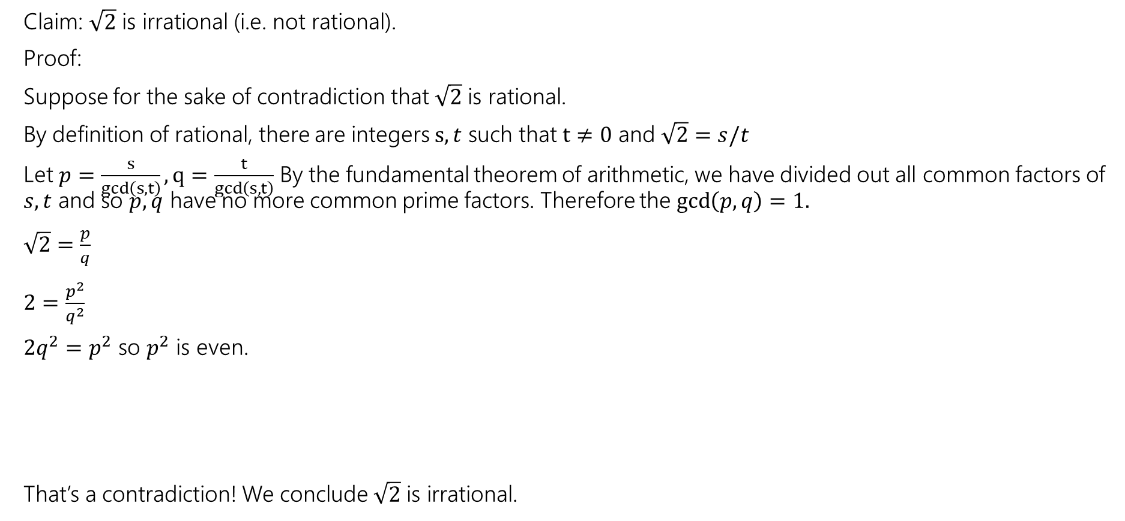
Proof By Contradiction
If $a^{2}$ is even then $a$is even.
Claim: $\sqrt{2}$ is irrational (i.e. not rational).
Proof:
Suppose for the sake of contradiction that $\sqrt{2}$ is rational.
By definition of rational, there are integers $s,t$ such that $t≠0$ and $\sqrt{2}=s/t$
Let $p=\frac{s}{gcd\left(s,t\right)}, q=\frac{t}{gcd\left(s,t\right)}$ By the fundamental theorem of arithmetic, we have divided out all common factors of $s,t$ and so $p,q$ have no more common prime factors. Therefore the $\gcd\left(p,q\right)=1.$
$\sqrt{2}=\frac{p}{q}$
$2=\frac{p^{2}}{q^{2}}$
$2q^{2}=p^{2}$ so $p^{2}$ is even.
That’s a contradiction! We conclude $\sqrt{2}$ is irrational.

Slide 11
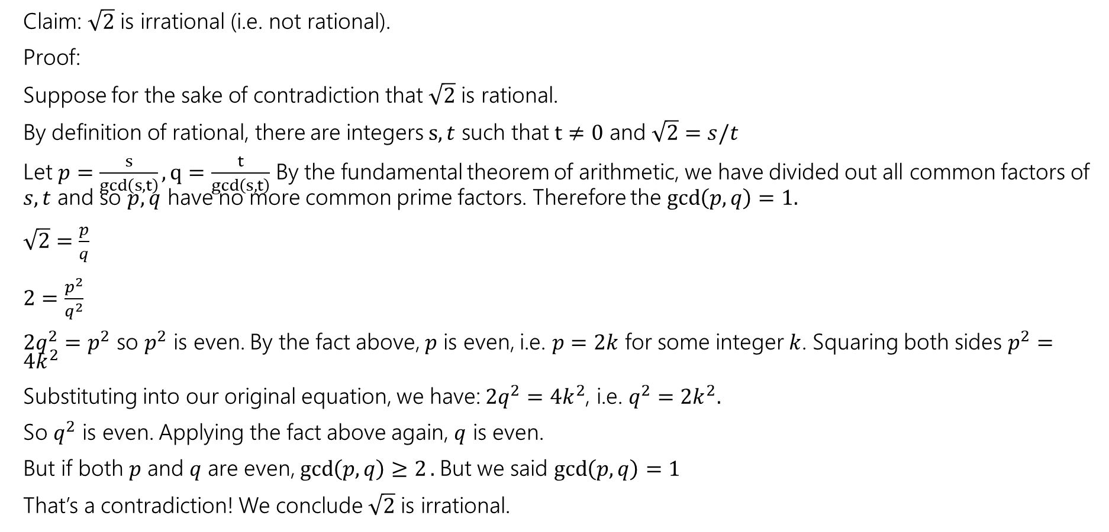
Proof By Contradiction
If $a^{2}$ is even then $a$is even.
Claim: $\sqrt{2}$ is irrational (i.e. not rational).
Proof:
Suppose for the sake of contradiction that $\sqrt{2}$ is rational.
By definition of rational, there are integers $s,t$ such that $t≠0$ and $\sqrt{2}=s/t$
Let $p=\frac{s}{gcd\left(s,t\right)}, q=\frac{t}{gcd\left(s,t\right)}$ By the fundamental theorem of arithmetic, we have divided out all common factors of $s,t$ and so $p,q$ have no more common prime factors. Therefore the $\gcd\left(p,q\right)=1.$
$\sqrt{2}=\frac{p}{q}$
$2=\frac{p^{2}}{q^{2}}$
$2q^{2}=p^{2}$ so $p^{2}$ is even. By the fact above, $p$ is even, i.e. $p=2k$ for some integer $k$. Squaring both sides $p^{2}=4k^{2}$
Substituting into our original equation, we have: $2q^{2}=4k^{2}$, i.e. $q^{2}=2k^{2}.$
So $q^{2}$ is even. Applying the fact above again, $q$ is even.
But if both $p$ and $q$ are even, $\gcd\left(p,q\right)≥2.$But we said $\gcd\left(p,q\right)=1$
That’s a contradiction! We conclude $\sqrt{2}$ is irrational.

Slide 12
Proof By Contradiction
How in the world did we know how to do that?
In real life…lots of attempts that didn’t work.
Be very careful with proof by contradiction – without a clear target, you can easily end up in a loop of trying random things and getting nowhere.

Slide 13
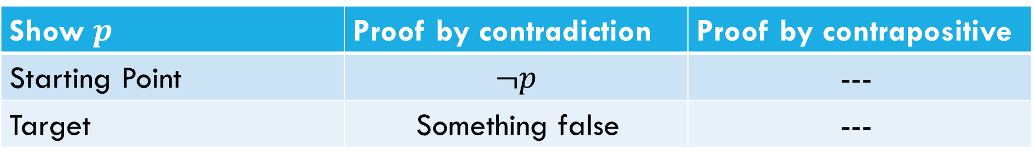
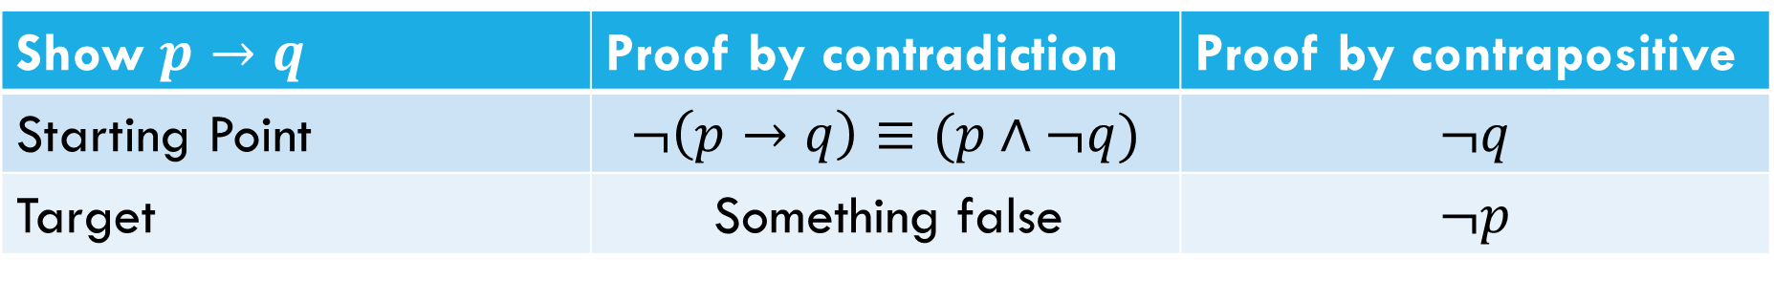
What’s the difference?
What’s the difference between proof by contrapositive and proof by contradiction?
Show $p→q$ | Proof by contradiction | Proof by contrapositive
Starting Point | $$¬\left(p→q\right)≡(p∧¬q)$$ | $$¬q$$
Target | Something false | $$¬p$$
Show $p$ | Proof by contradiction | Proof by contrapositive
Starting Point | $$¬p$$ | ---
Target | Something false | ---

Slide 14
Another Proof By Contradiction
Claim: There are infinitely many primes.
Proof:

Slide 15
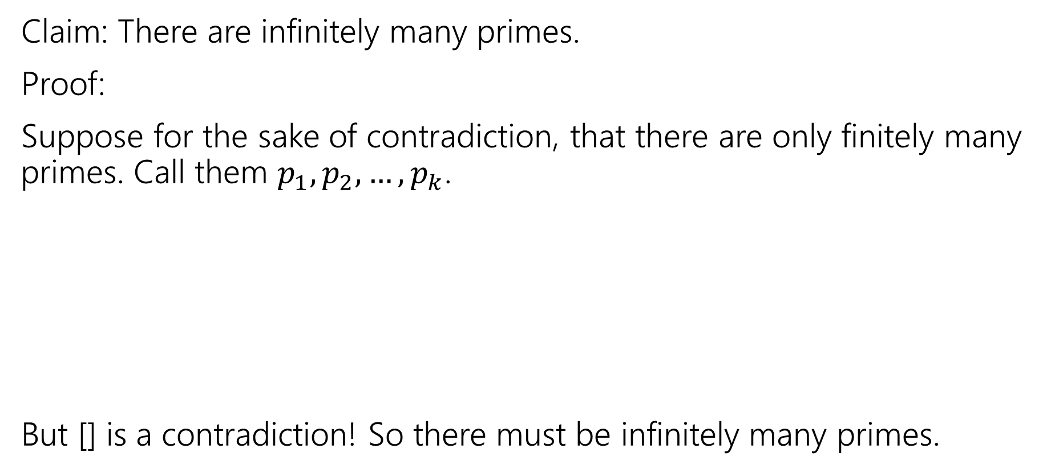
Another Proof By Contradiction
Claim: There are infinitely many primes.
Proof:
Suppose for the sake of contradiction, that there are only finitely many primes. Call them $p_{1},p_{2},…,p_{k}$.
But [] is a contradiction! So there must be infinitely many primes.

Slide 16
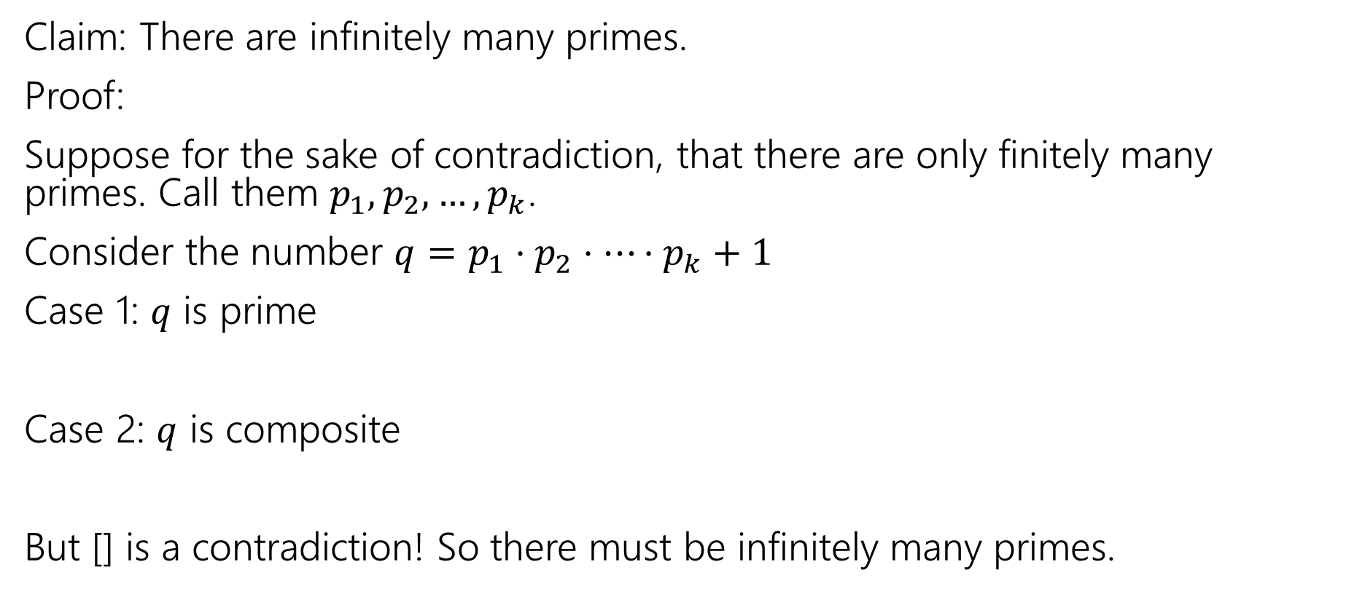
Another Proof By Contradiction
Claim: There are infinitely many primes.
Proof:
Suppose for the sake of contradiction, that there are only finitely many primes. Call them $p_{1},p_{2},…,p_{k}$.
Consider the number $q=p_{1}⋅p_{2}⋅⋯⋅p_{k}+1$
Case 1: $q$ is prime
Case 2: $q$ is composite
But [] is a contradiction! So there must be infinitely many primes.

Slide 17
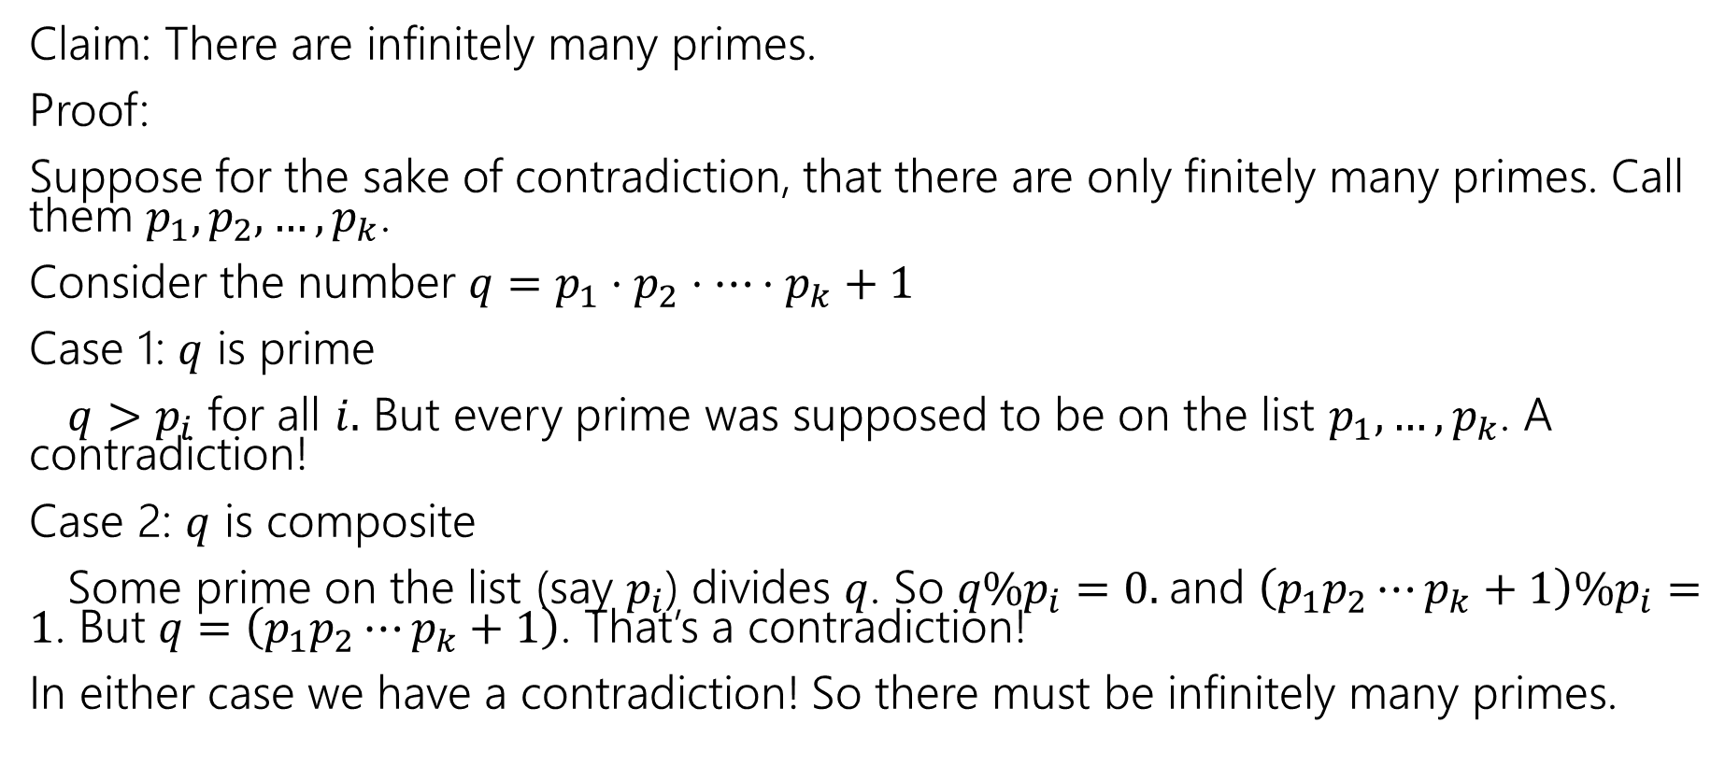
Another Proof By Contradiction
Claim: There are infinitely many primes.
Proof:
Suppose for the sake of contradiction, that there are only finitely many primes. Call them $p_{1},p_{2},…,p_{k}$.
Consider the number $q=p_{1}⋅p_{2}⋅⋯⋅p_{k}+1$
Case 1: $q$ is prime
$q>p_{i}$ for all $i.$ But every prime was supposed to be on the list $p_{1},…,p_{k}$. A contradiction!
Case 2: $q$ is composite
Some prime on the list (say $p_{i}$) divides $q$. So $q\%p_{i}=0.$and $\left(p_{1}p_{2}⋯p_{k}+1\right)\%p_{i}=1$. But $q=\left(p_{1}p_{2}⋯p_{k}+1\right)$. That’s a contradiction!
In either case we have a contradiction! So there must be infinitely many primes.

Slide 18

Just the Skeleton
“For all integers $x$, if $x^{2}$ is even, then $x$ is even.”

Slide 19
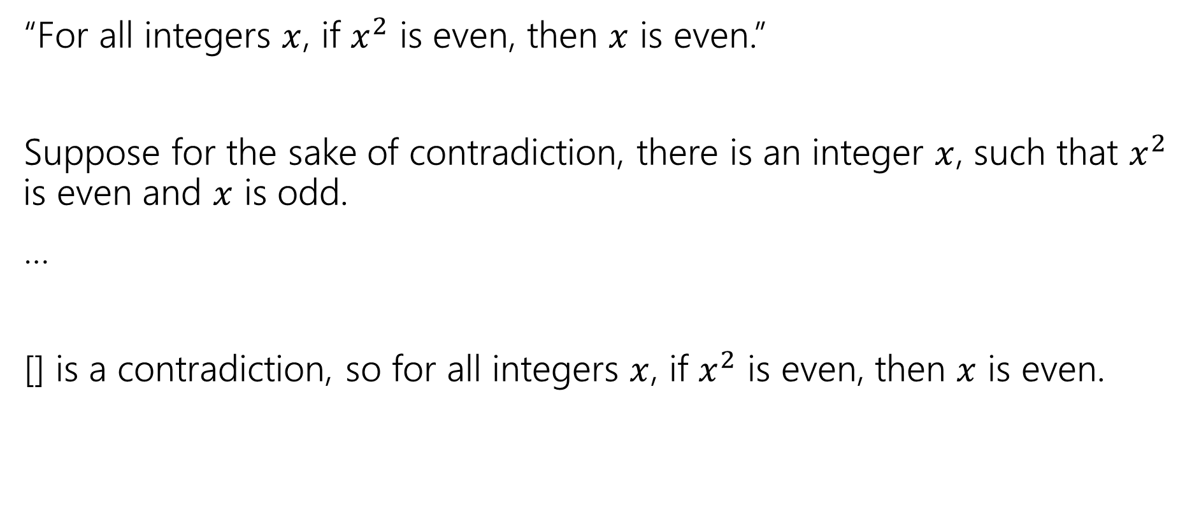
Just the Skeleton
“For all integers $x$, if $x^{2}$ is even, then $x$ is even.”
Suppose for the sake of contradiction, there is an integer $x$, such that $x^{2}$ is even and $x$ is odd.
…
[] is a contradiction, so for all integers $x$, if $x^{2}$ is even, then $x$ is even.

Slide 20

Just the Skeleton
“There is not an integer $k$ such that for all integers $n$, $k≥n$.

Slide 21
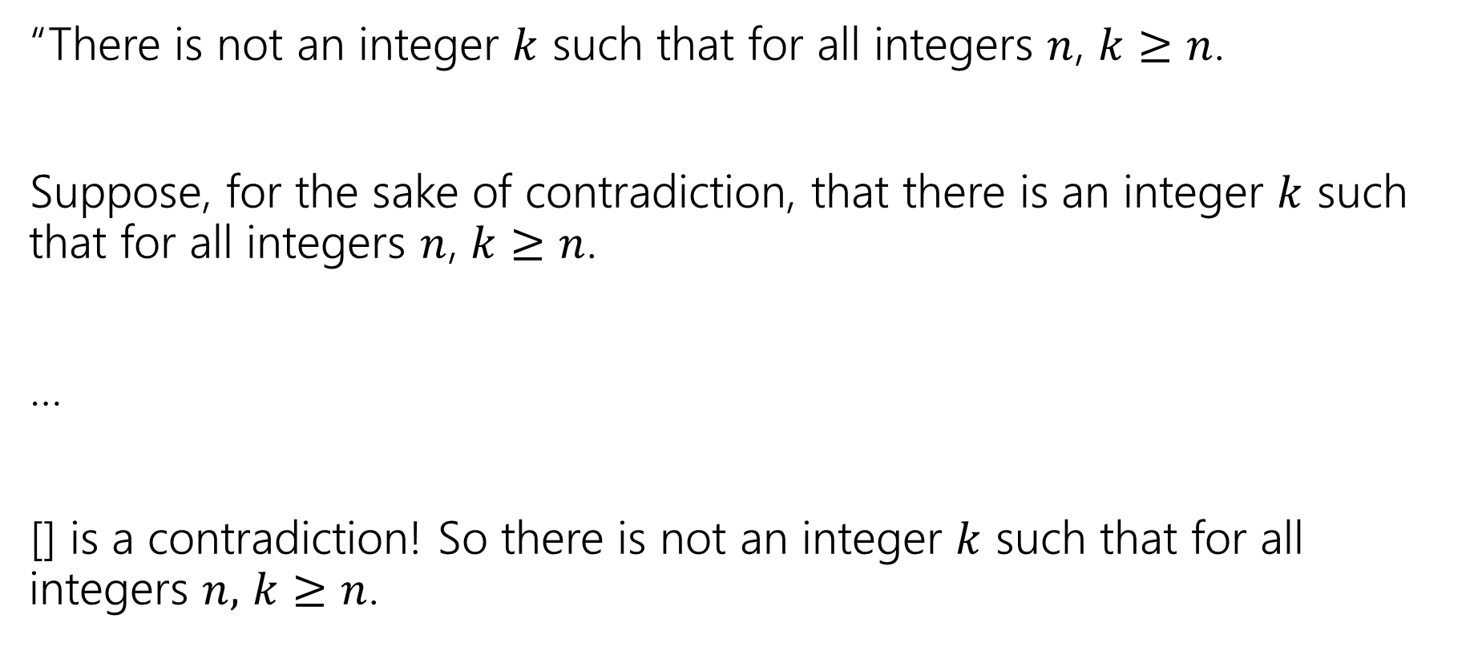
Just the Skeleton
“There is not an integer $k$ such that for all integers $n$, $k≥n$.
Suppose, for the sake of contradiction, that there is an integer $k$ such that for all integers $n$, $k≥n$.
…
[] is a contradiction! So there is not an integer $k$ such that for all integers $n,$ $k≥n$.

