Slide 1
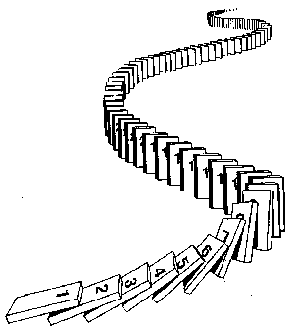
Induction
CSE 311 Winter 2022
Lecture 14

Slide 2
Announcements
HW5 (released tonight) is due Wed. May 4.
“part 2” is induction; we’ll return that to you before the midterm ends
“part 1” is number theory topics; we won’t return that to you before the midterm ends.
The midterm happens May 6-8
Taken at-home; once you open the exam, you’ll have 2 hours to submit it. You get to choose when you’re doing it (Friday night through Sunday 11:59 PM).
It will be short (intent is something you could finish in ~30 min.) more information coming to the webpage shortly.

Slide 3
Announcements
We read through comments on office hour schedules
We got approximately equal requests for more in-person and more zoom.
And requests for more OH evenly spread through the week.
We made a few small tweaks (mostly around extra people in already existing hours). But we’re in about as good shape as we can be with our current staff size.
Both lectures had covid cases in the last few weeks. General reminders:
If you need to/want to isolate, we have lectures recorded and “section recap” videos
Can’t make our zoom office hours at times you need to isolate? Try the 1:1 form/Ed.

Slide 4
Announcements
One more thing
The final is finally scheduled!
We’ll have our exam Monday of finals week at 12:30
“combined” exam (both lectures) in a big room in Kane.
More info coming over the next few weeks
Including answers to: What if I have a conflict? What if I have covid? What if I think I might have covid? What if I’m able to come in but not comfortable?

Slide 5
How do we know recursion works?
//Assume i is a nonnegative integer
//returns 2^i.
public int CalculatesTwoToTheI(int i){
if(i == 0)
return 1;
else
return 2*CaclulatesTwoToTheI(i-1);
}
Why does CalculatesTwoToTheI(4) calculate 2^4?
Convince the people around you!

Slide 6
How do we know recursion works?
Something like this:
Well, as long as CalculatesTwoToTheI(3) = 8, we get 16…
Which happens as long as CalculatesTwoToTheI(2) = 4
Which happens as long as CalculatesTwoToTheI(1) = 2
Which happens as long as CalculatesTwoToTheI(0) = 1
And it is! Because that’s what the base case says.

Slide 7
How do we know recursion works?
There’s really only two cases.
CalculatesTwoToTheI(0) = 1 (which it should!)
And that means CalculatesTwoToTheI(1) = 2, (like it should)
And that means CalculatesTwoToTheI(2) = 4, (like it should)
And that means CalculatesTwoToTheI(3) = 8, (like it should)
And that means CalculatesTwoToTheI(4) = 16, (like it should)
The Base Case is Correct
IF the recursive call we make is correct THEN our value is correct.

Slide 8
How do we know recursion works?
The code has two big cases,
So our proof had two big cases
“The base case of the code produces the correct output”
“IF the calls we rely on produce the correct output THEN the current call produces the right output”

Slide 9
A bit more formally…
“The base case of the code produces the correct output”
“IF the calls we rely on produce the correct output THEN the current call produces the right output”
Let $P(i)$ be “CalculatesTwoToTheI(i) returns $2^{i}$.”
How do we know $P(4)$?
$P(0)$ is true.
And $P\left(0\right)→P(1)$, so $P\left(1\right).$
And $P\left(1\right)→P(2)$, so $P\left(2\right).$
And $P\left(2\right)→P(3)$, so $P\left(3\right).$
And $P\left(3\right)→P(4)$, so $P\left(4\right).$

Slide 10
A bit more formally…
This works alright for $P(4)$.
What about $P\left(1000\right)?$ $P(1000000000)$?
At this point, we’d need to show that implication $P\left(k\right)→P(k+1)$ for A BUNCH of values of $k$.
But the code is the same each time.
And so was the argument!
We should instead show $∀k[P\left(k\right)→P\left(k+1\right)]$.

Slide 11
Induction
Your new favorite proof technique!
How do we show $∀n, P(n)$?
Show $P(0)$
Show $∀k(P\left(k\right)→P\left(k+1\right))$

Slide 12
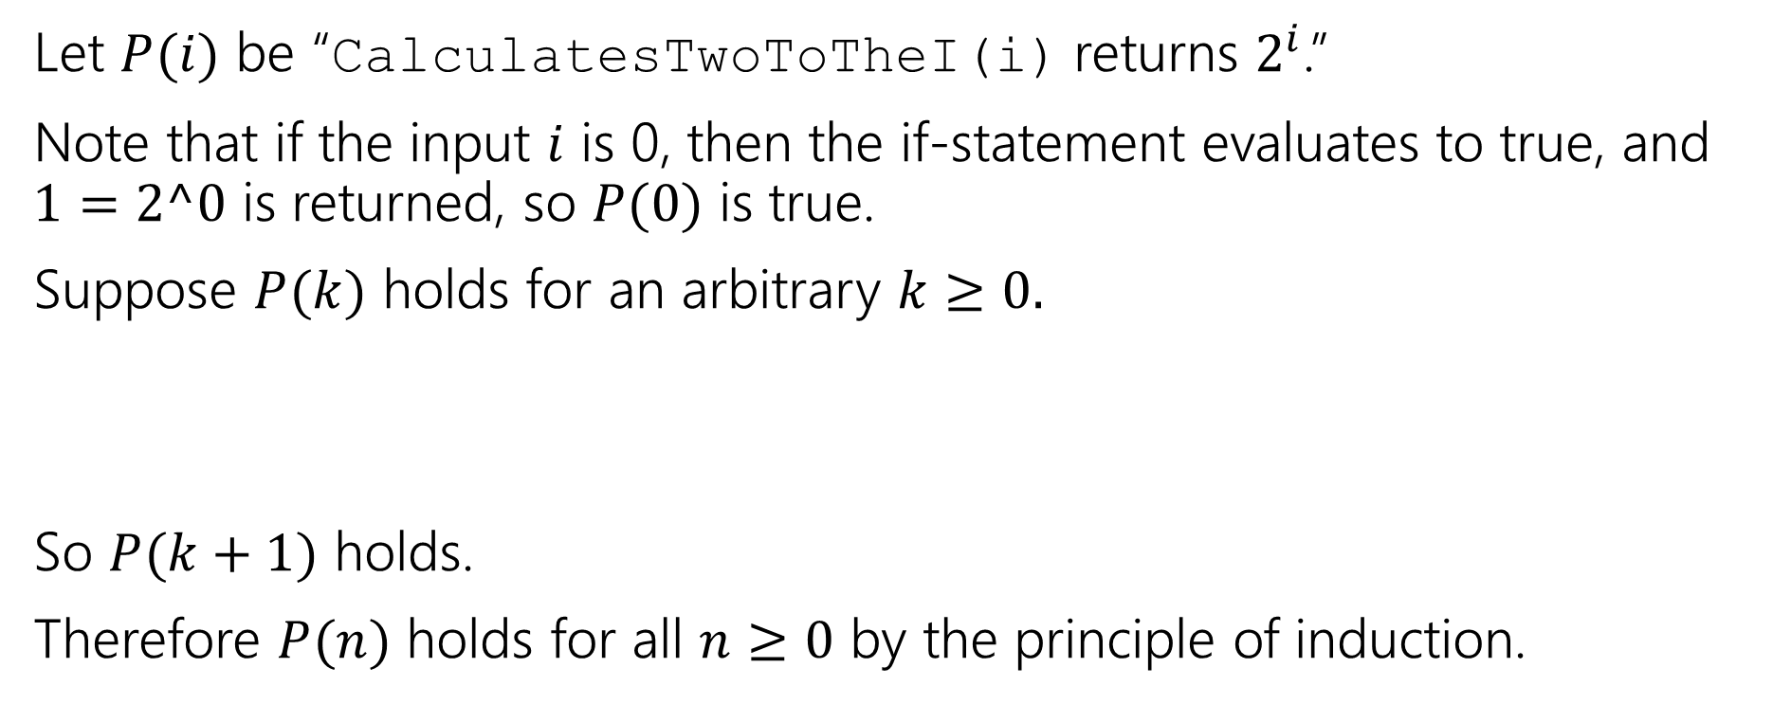
Induction
//Assume i is a nonnegative integer
public int CalculatesTwoToTheI(int i){
if(i == 0)
return 1;
else
return 2*CaclulatesTwoToTheI(i-1);
}
Let $P(i)$ be “CalculatesTwoToTheI(i) returns $2^{i}$.”
Note that if the input $i$ is 0, then the if-statement evaluates to true, and $1=2^0$ is returned, so $P(0)$ is true.
Suppose $P(k)$ holds for an arbitrary $k≥0.$
So $P(k+1)$ holds.
Therefore $P(n)$ holds for all $n≥0$ by the principle of induction.
Consider the code run on $k+1.$ Since $k≥0,$ $k+1>0$ and we are in the else branch. By inductive hypothesis, CalculatesTwoToTheI($k$) returns $2^{k}$, so the code run on $k+1$ returns $2⋅2^{k}=2^{k+1}$.

Slide 13
Making Induction Proofs Pretty
Let $P(i)$ be the predicate “CalculatesTwoToTheI(i) returns $2^{i}$.” We prove $P(n)$ holds for all $n∈ℕ$ by induction on $n$.
Base Case ($i=0)$ Note that if the input $i$ is 0, then the if-statement evaluates to true, and $1=2^0$ is returned, so $P(0)$ is true.
Inductive Hypothesis: Suppose $P(k)$ holds for an arbitrary $k≥0.$
Inductive Step: Since $k≥0, k+1≥1$, so the code goes to the recursive case. We will return $2⋅\text{CalculatesTwoToTheI}\text{(}\text{k}\text{)}$. By Inductive Hypothesis,
$\text{CalculatesTwoToTheI}\text{(}\text{k}\text{)}$= $2^{k}$. Thus we return $2⋅2^{k}=2^{k+1}$.
So $P(k+1)$ holds.
Therefore $P(n)$ holds for all $n≥0$ by the principle of induction.

Slide 14
Making Induction Proofs Pretty
All of our induction proofs will come in 5 easy(?) steps!
1. Define $P(n)$. State that your proof is by induction on $n$.
2. Show $P(0)$ i.e. show the base case
3. Suppose $P(k)$ for an arbitrary $k$.
4. Show $P\left(k+1\right)$ (i.e. get $P\left(k\right)→P(k+1)$)
5. Conclude by saying $P\left(n\right)$ is true for all $n$ by induction.

Slide 15
Some Other Notes
Always state where you use the inductive hypothesis when you’re using it in the inductive step.
It’s usually the key step, and the reader really needs to focus on it.
Be careful about what values you’re assuming the Inductive Hypothesis for – the smallest possible value of $k$ should assume the base case but nothing more.

Slide 16
The Principle of Induction (formally)
Informally: if you knock over one domino, and every domino knocks over the next one, then all your dominoes fell over.
$$P\left(0\right);∀k(P\left(k\right)→P\left(k+1\right))$$
Principle of Induction
$∴ ∀n(P\left(n\right))$

Slide 17
More induction!

Slide 18
More Induction
Induction doesn’t only work for code!
Show that $\sum_{i=0}^{n}{2^{i}}=1+2+4+…+2^{n}=2^{n+1}−1$.

Slide 19
More Induction
Induction doesn’t only work for code!
Show that $\sum_{i=0}^{n}{2^{i}}=1+2+4+…+2^{n}=2^{n+1}−1$.
Let $P\left(n\right)=$“$\sum_{i=0}^{n}{2^{i}}=$ $2^{n+1}−1$.”
We show $P(n)$ holds for all $n$ by induction on $n$.
Base Case ($)$
Inductive Hypothesis:
Inductive Step:
$P(n)$ holds for all $n≥0$ by the principle of induction.

Slide 20
More Induction
Induction doesn’t only work for code!
Show that $\sum_{i=0}^{n}{2^{i}}=1+2+4+…+2^{n}=2^{n+1}−1$.
Let $P\left(n\right)=$“$\sum_{i=0}^{n}{2^{i}}=$ $2^{n+1}−1$.”
We show $P(n)$ holds for all $n$ by induction on $n$.
Base Case ($n=0)\sum_{i=0}^{0}{2^{i}}=1=2−1=2^{0+1}−1$.
Inductive Hypothesis: Suppose $P(k)$ holds for an arbitrary $k≥0$.
Inductive Step: We show $P(k+1)$. Consider the summation$\sum_{i=0}^{k+1}{2^{i}}=2^{k+1}+\sum_{i=0}^{k}{2^{i}=2^{k+1}+2^{k+1}−1},$ where the last step is by IH.
Simplifying, we get: $\sum_{i=0}^{k+1}{2^{i}}=2^{k+1}+2^{k+1}−1=2⋅2^{k+1}−1=2^{\left(k+1\right)+1}−1.$
$P(n)$ holds for all $n≥0$ by the principle of induction.

