Slide 1
Sets
CSE 311 Spring 2022
Lecture 10

Slide 2

Now You Try
An integer $x$ is even if (and only if) there exists an integer $z$, such that $x=2z$.
Even
The sum of two even numbers is even.
Make sure you know:
1. What every word in the statement means.
2. What the statement as a whole means.
3. Where to start.
4. What your target is.
Pollev.com/uwcse311
Help me adjust my explanation!
1. Write the statement in predicate logic.
2. Write an English proof.
3. If you have lots of extra time, try writing the symbolic proof instead.

Slide 3
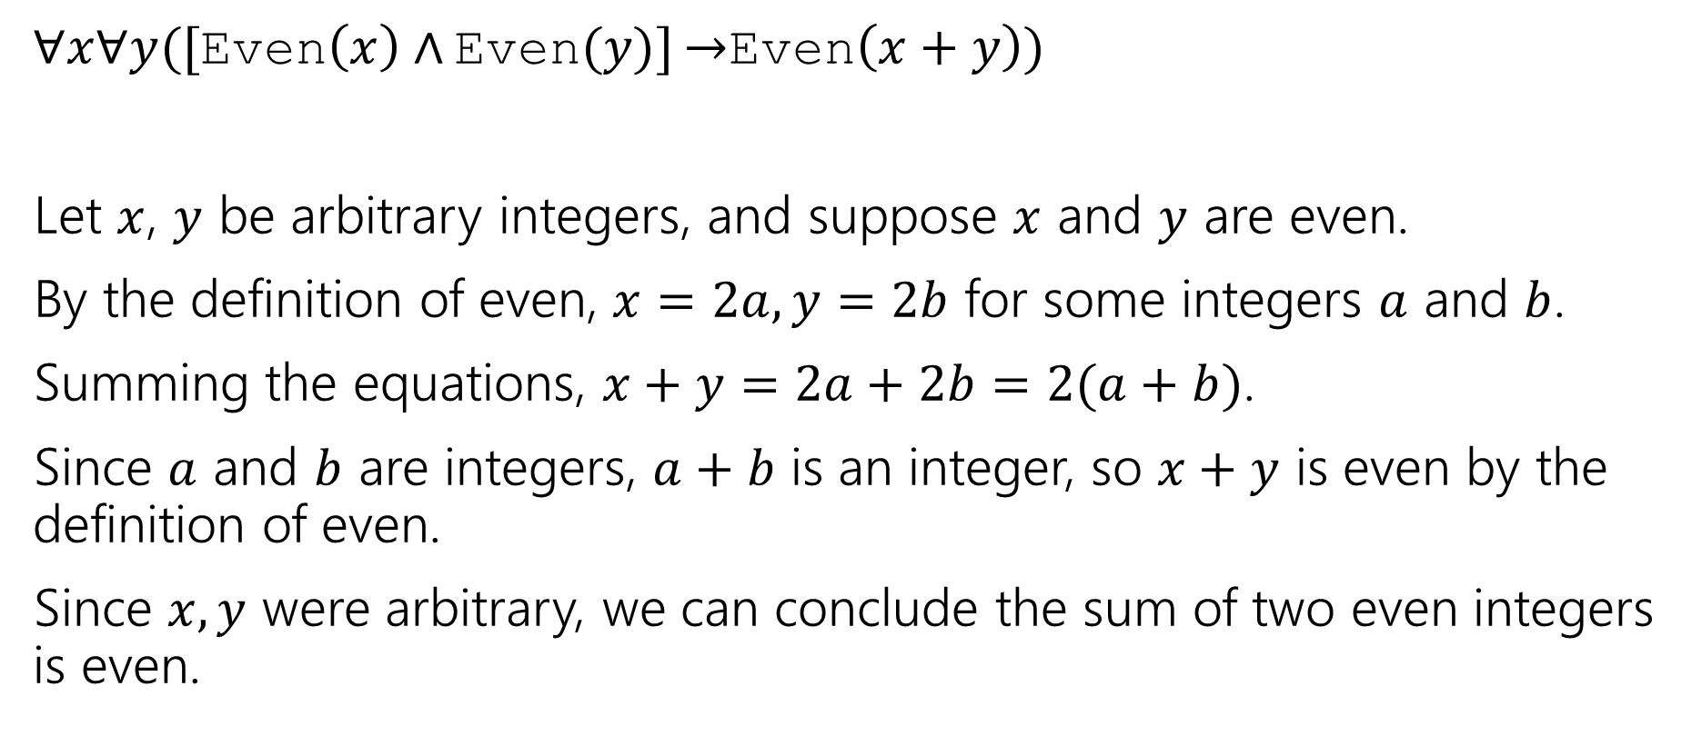
Here’s What I got.
$∀x∀y([$Even$\left(x\right)∧$ Even$(y)]$ $→$Even$\left(x+y\right))$
Let $x$, $y$ be arbitrary integers, and suppose $x$ and $y$ are even.
By the definition of even, $x=2a,y=2b$ for some integers $a$ and $b$.
Summing the equations, $x+y=2a+2b=2(a+b)$.
Since $a$ and $b$ are integers, $a+b$ is an integer, so $x+y$ is even by the definition of even.
Since $x,y$ were arbitrary, we can conclude the sum of two even integers is even.

Slide 4
Why English Proofs?
Those symbolic proofs seemed pretty nice. Computers understand them, and can check them.
So what’s up with these English proofs?
They’re far easier for people to understand.
But instead of a computer checking them, now a human is checking them.

Slide 5
Today
Is a laundry list day – everything you ever wanted to know about sets.
By the end, we’ll get to do two proofs.

Slide 6
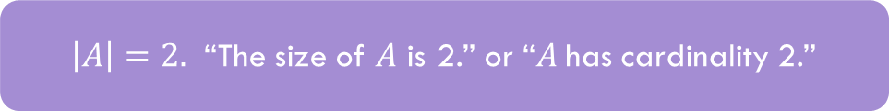
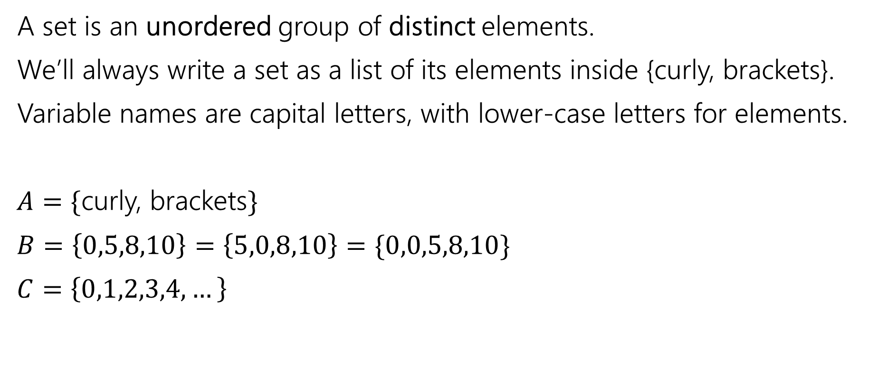
Sets
A set is an unordered group of distinct elements.
We’ll always write a set as a list of its elements inside {curly, brackets}.
Variable names are capital letters, with lower-case letters for elements.
$A=\{$curly, brackets$\}$
$B=\left\{0,5,8,10\right\}=\left\{5,0,8,10\right\}=\{0,0,5,8,10\}$
$C=\left\{0,1,2,3,4,…\right\}$
$\left|A\right|=2.$ “The size of $A$ is 2.” or “$A$has cardinality 2.”

Slide 7
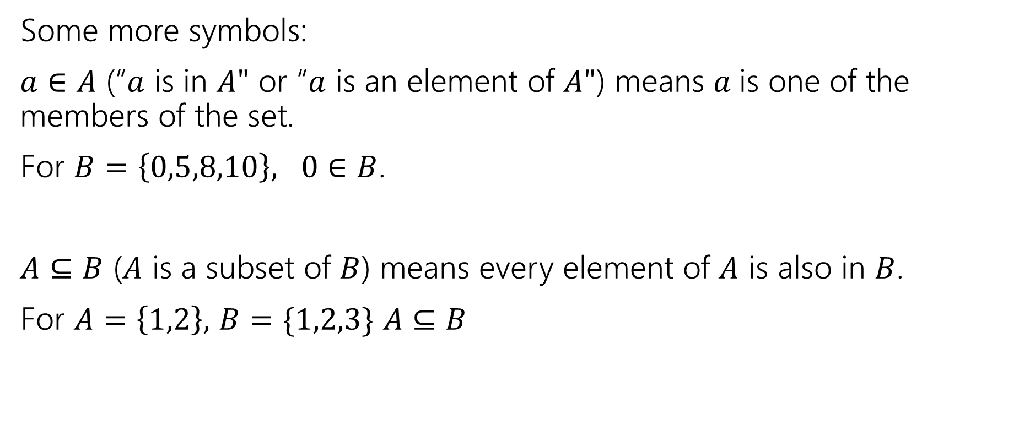
Sets
Some more symbols:
$a∈A$ (“$a$ is in $A"$ or “$a$ is an element of $A"$) means $a$is one of the members of the set.
For $B=\left\{0,5,8,10\right\}, 0∈B$.
$A⊆B$ ($A$ is a subset of $B$) means every element of $A$ is also in $B$.
For $A=\left\{1,2\right\},$ $B=\{1,2,3\}$ $A⊆B$

Slide 8

Try it!
Let $A=\left\{1,2,3,4,5\right\}$
$B=\{1,2,5\}$
Is $A⊆A?$
Is $B⊆A?$
Is $A⊆B$?
Is $\left\{1\right\}∈A$?
Is $1∈A$?

Slide 9
Try it!
Let $A=\left\{1,2,3,4,5\right\}$
$B=\{1,2,5\}$
Is $A⊆A?$
Is $B⊆A?$
Is $A⊆B$?
Is $\left\{1\right\}∈A$?
Is $1∈A$?
Yes!
Yes
No
No
Yes

Slide 10

Sets
Be careful about these two operations:
If $A=\{1,2,3,4,5\}$
$\left\{1\right\}⊆A$, but $\left\{1\right\}∉A$
$∈$ asks: is this item in that box?
$⊆$ asks: is everything in this box also in that box?

Slide 11
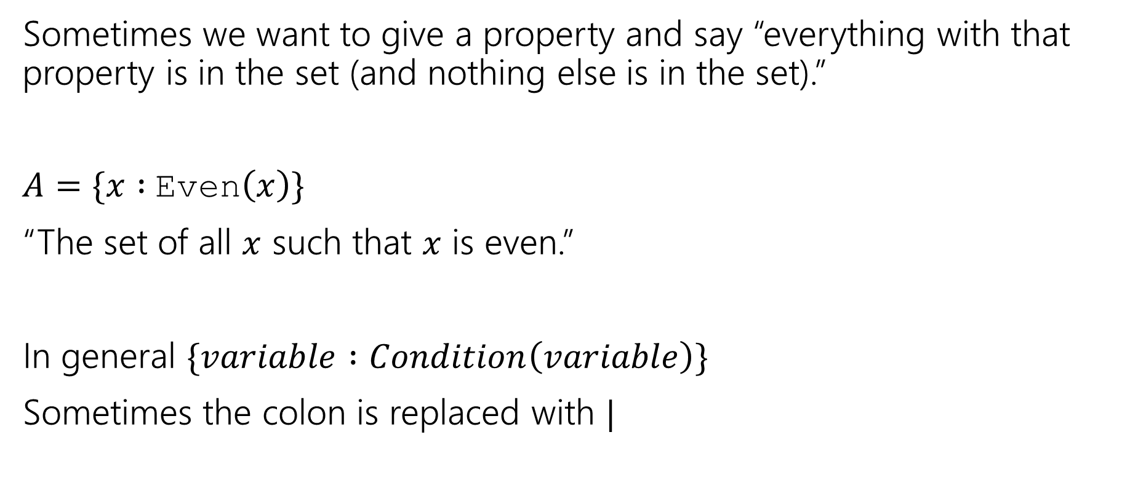
Set Builder Notation
Sometimes we want to give a property and say “everything with that property is in the set (and nothing else is in the set).”
$A=\{x :$Even$\left(x\right)\}$
“The set of all $x$ such that $x$ is even.”
In general $\{variable :Condition\left(variable\right)\}$
Sometimes the colon is replaced with $|$

Slide 12


Definitions
$A⊆B$($"A$ is a subset of $B"$) iff every element of $A$ is also in $B$.
$A=B$ ($"A$ equals $B"$) iff $A$ and $B$ have identical elements.
$A⊆B≡∀x(x∈A→x∈B)$
$A=B≡∀x\left(x∈A↔x∈B\right)≡$ $A⊆B∧B⊆A$

Slide 13


Proof Skeleton
How would we show $A⊆B?$
Let $x$ be an arbitrary element of $A$
…
So $x$ is also in $B$.
Since $x$ was an arbitrary element of $A,$ we have that $A⊆B$.
$A⊆B≡∀x(x∈A→x∈B)$

Slide 14
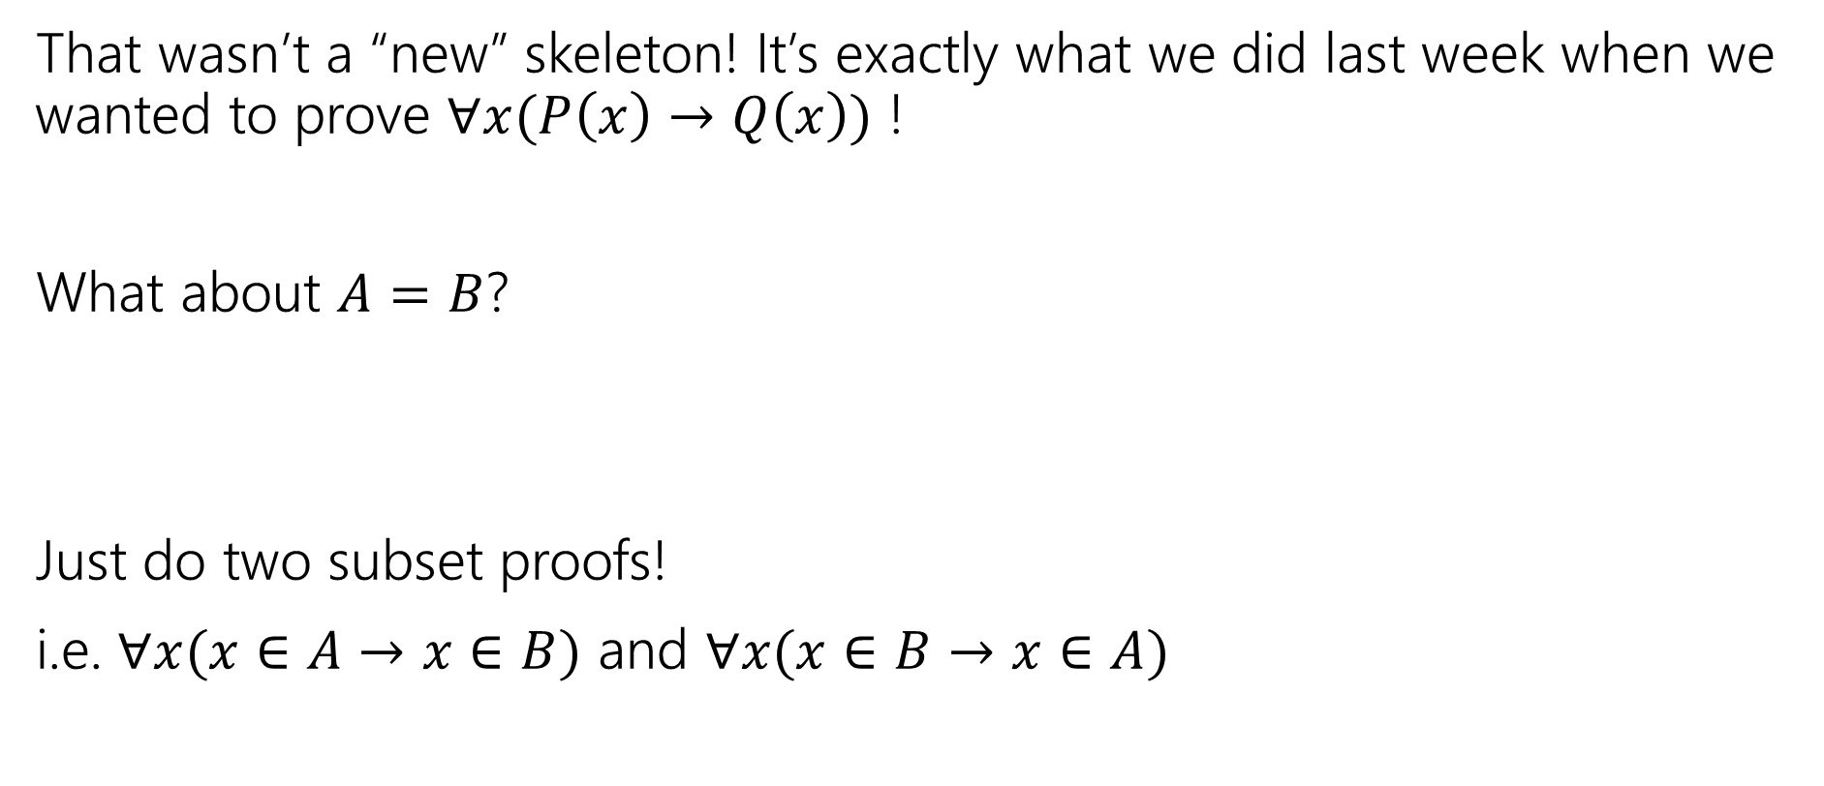
Proof Skeleton
That wasn’t a “new” skeleton! It’s exactly what we did last week when we wanted to prove $∀x(P\left(x\right)→Q\left(x\right))$ !
What about $A=B$?
Just do two subset proofs!
i.e. $∀x(x∈A→x∈B)$ and $∀x(x∈B→x∈A)$
$A=B≡∀x\left(x∈A↔x∈B\right)≡$ $A⊆B∧B⊆A$

Slide 15


What do we do with sets?
We combined propositions with $∨,∧,¬$.
We combine sets with $∩\left[intersection\right],∪,[union] ¯[complement]$
$A∪B=\{x:x∈A∨x∈B\}$
$A∩B=\{x:x∈A∧x∈B\}$
$\overline{A}=\{x:x∉A\}$
That’s a lot of elements…if we take the complement, we’ll have some “universe” $𝒰$, and $\overline{A}=\{x:x∈U∧x∉A\}$
It’s a lot like the domain of discourse.

Slide 16
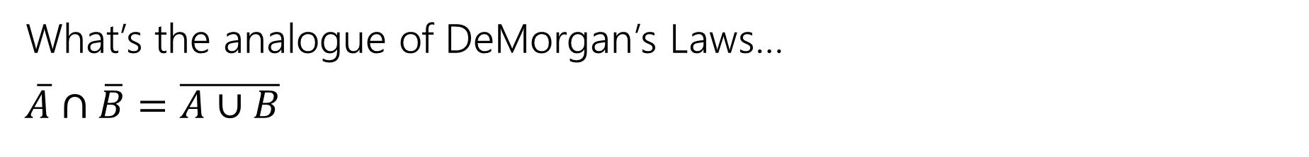
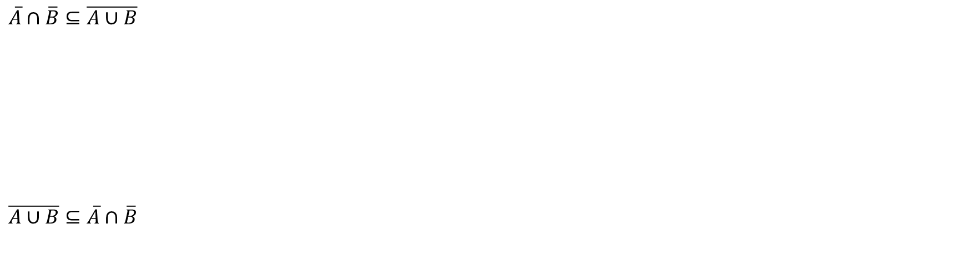
A proof!
What’s the analogue of DeMorgan’s Laws…
$\overline{A}∩\overline{B}=\overline{A∪B}$
$A=B≡∀x\left(x∈A↔x∈B\right)≡$ $A⊆B∧B⊆A$
$\overline{A}∩\overline{B}⊆\overline{A∪B}$
$\overline{A∪B}⊆\overline{A}∩\overline{B}$

Slide 17
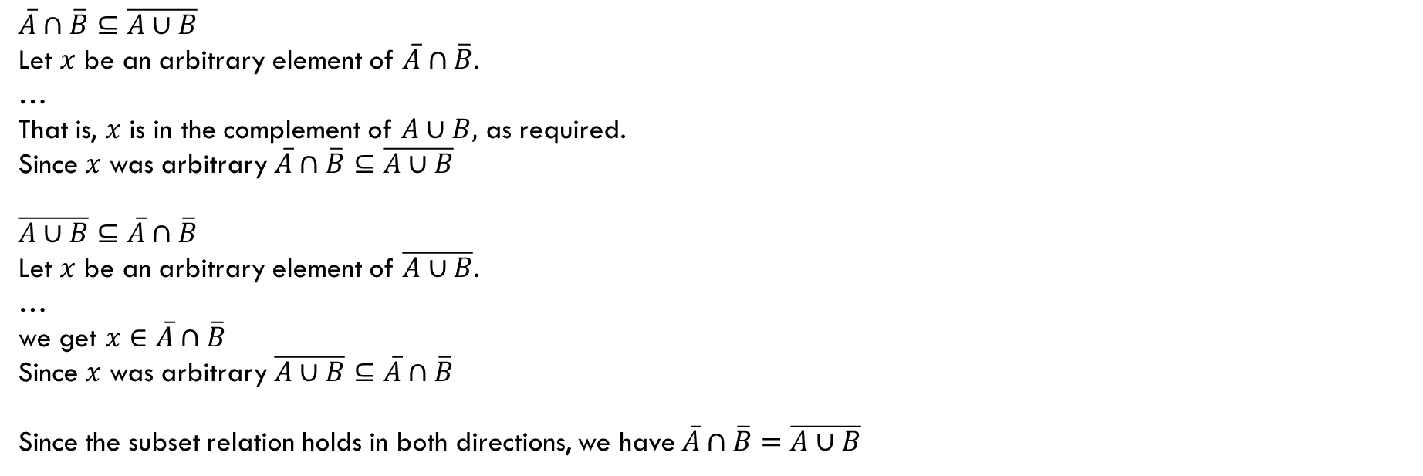
A proof!
What’s the analogue of DeMorgan’s Laws…
$\overline{A}∩\overline{B}=\overline{A∪B}$
$A=B≡∀x\left(x∈A↔x∈B\right)≡$ $A⊆B∧B⊆A$
$\overline{A}∩\overline{B}⊆\overline{A∪B}$
Let $x$ be an arbitrary element of $\overline{A}∩\overline{B}$.
…
That is, $x$ is in the complement of $A∪B,$ as required.
Since $x$ was arbitrary $\overline{A}∩\overline{B}⊆\overline{A∪B}$
$\overline{A∪B}⊆\overline{A}∩\overline{B}$
Let $x$ be an arbitrary element of $\overline{A∪B}$.
…
we get $x∈\overline{A}∩\overline{B}$
Since $x$ was arbitrary $\overline{A∪B}⊆\overline{A}∩\overline{B}$
Since the subset relation holds in both directions, we have $\overline{A}∩\overline{B}=\overline{A∪B}$

Slide 18
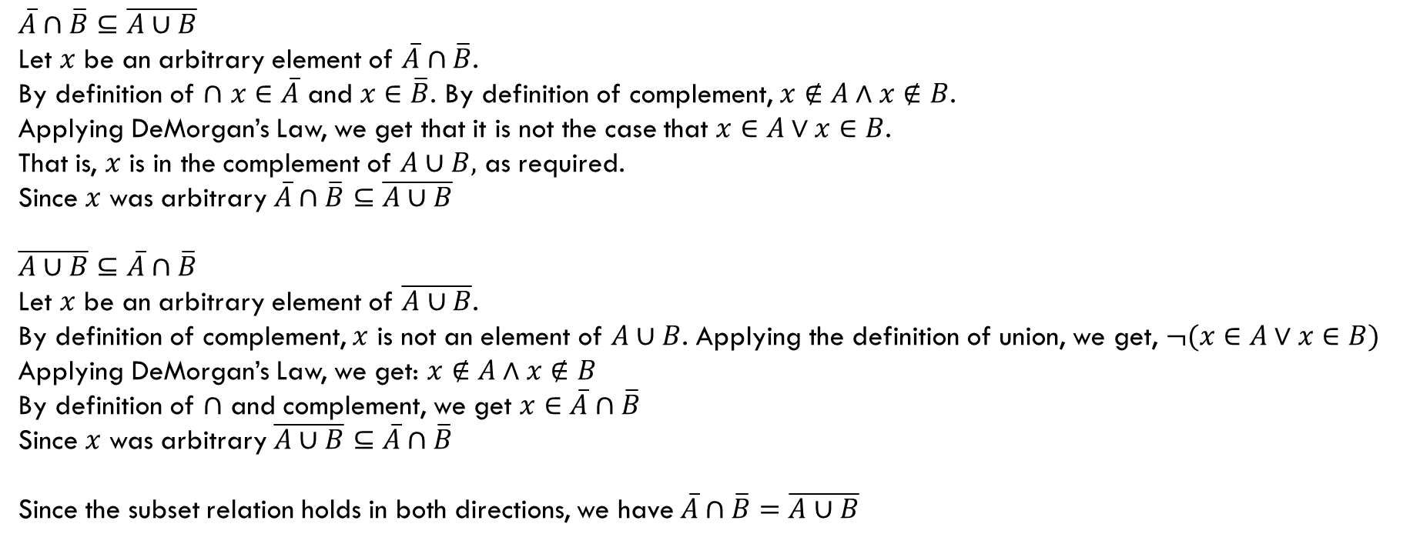
A proof!
What’s the analogue of DeMorgan’s Laws…
$\overline{A}∩\overline{B}=\overline{A∪B}$
$A=B≡∀x\left(x∈A↔x∈B\right)≡$ $A⊆B∧B⊆A$
$\overline{A}∩\overline{B}⊆\overline{A∪B}$
Let $x$ be an arbitrary element of $\overline{A}∩\overline{B}$.
By definition of $∩$ $x∈\overline{A}$ and $x∈\overline{B}$. By definition of complement, $x∉A∧x∉B$.
Applying DeMorgan’s Law, we get that it is not the case that $x∈A∨x∈B$.
That is, $x$ is in the complement of $A∪B,$ as required.
Since $x$ was arbitrary $\overline{A}∩\overline{B}⊆\overline{A∪B}$
$\overline{A∪B}⊆\overline{A}∩\overline{B}$
Let $x$ be an arbitrary element of $\overline{A∪B}$.
By definition of complement, $x$ is not an element of $A∪B$. Applying the definition of union, we get, $¬(x∈A∨x∈B)$
Applying DeMorgan’s Law, we get: $x∉A∧x∉B$
By definition of $∩$ and complement, we get $x∈\overline{A}∩\overline{B}$
Since $x$ was arbitrary $\overline{A∪B}⊆\overline{A}∩\overline{B}$
Since the subset relation holds in both directions, we have $\overline{A}∩\overline{B}=\overline{A∪B}$

Slide 19
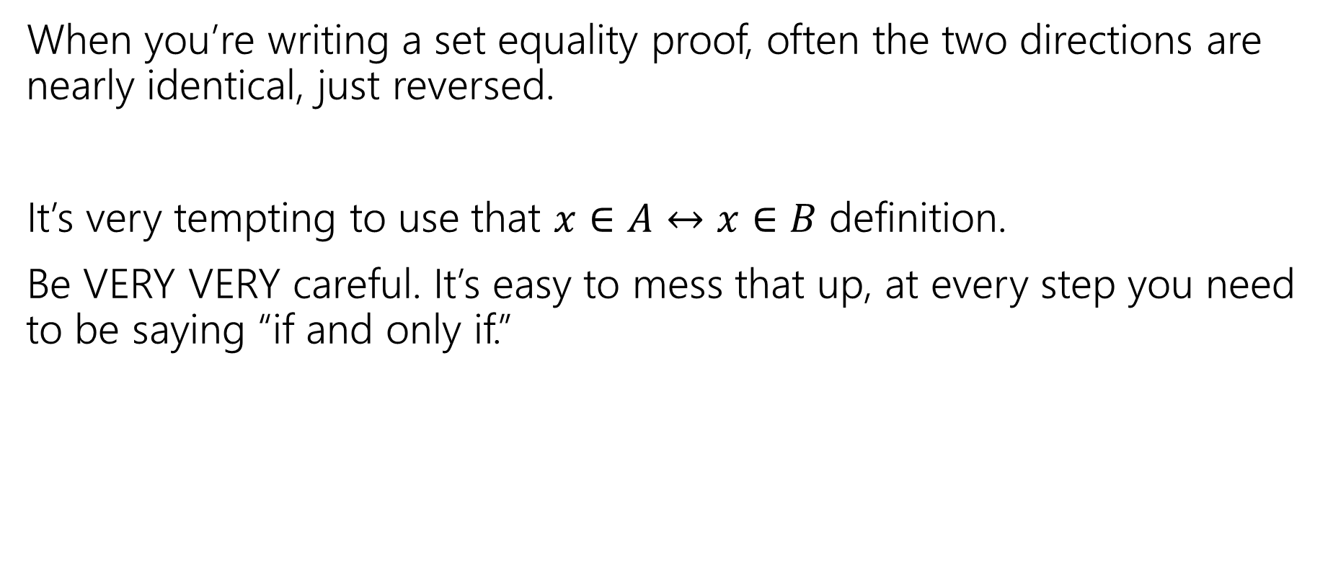
Proof-writing advice
When you’re writing a set equality proof, often the two directions are nearly identical, just reversed.
It’s very tempting to use that $x∈A↔x∈B$ definition.
Be VERY VERY careful. It’s easy to mess that up, at every step you need to be saying “if and only if.”

Slide 20

Two claims, two proof techniques
Suppose I claim that for all sets $A,B,C:$ $A∩B⊆C$
That…doesn’t look right.
How do you prove me wrong?

Slide 21
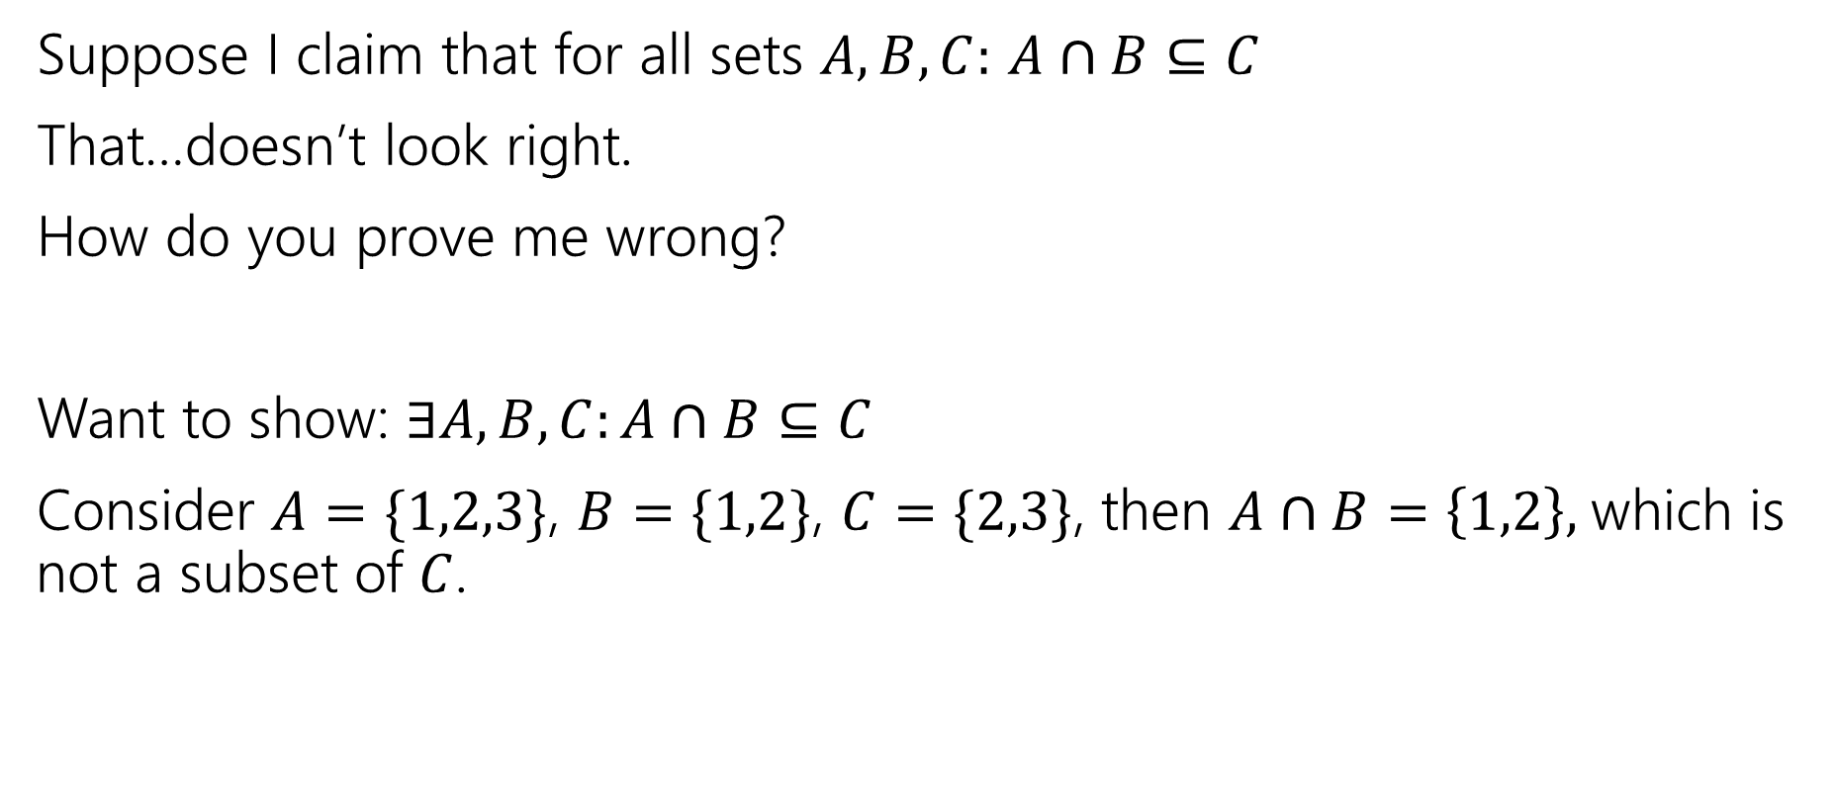
Two claims, two proof techniques
Suppose I claim that for all sets $A,B,C:$ $A∩B⊆C$
That…doesn’t look right.
How do you prove me wrong?
Want to show: $∃A,B,C:A∩B⊆C$
Consider $A=\{1,2,3\}$, $B=\{1,2\}$, $C=\{2,3\}$, then $A∩B=\left\{1,2\right\},$which is not a subset of $C$.

Slide 22
Proof By [Counter]Example
To prove an existential statement (or disprove a universal statement), provide an example, and demonstrate that it is the needed example.
You don’t have to explain where it came from! (In fact, you shouldn’t)
Computer scientists and mathematicians like to keep an air of mystery around our proofs.
  (or more charitably, we want to focus on just enough to believe the claim)

Slide 23
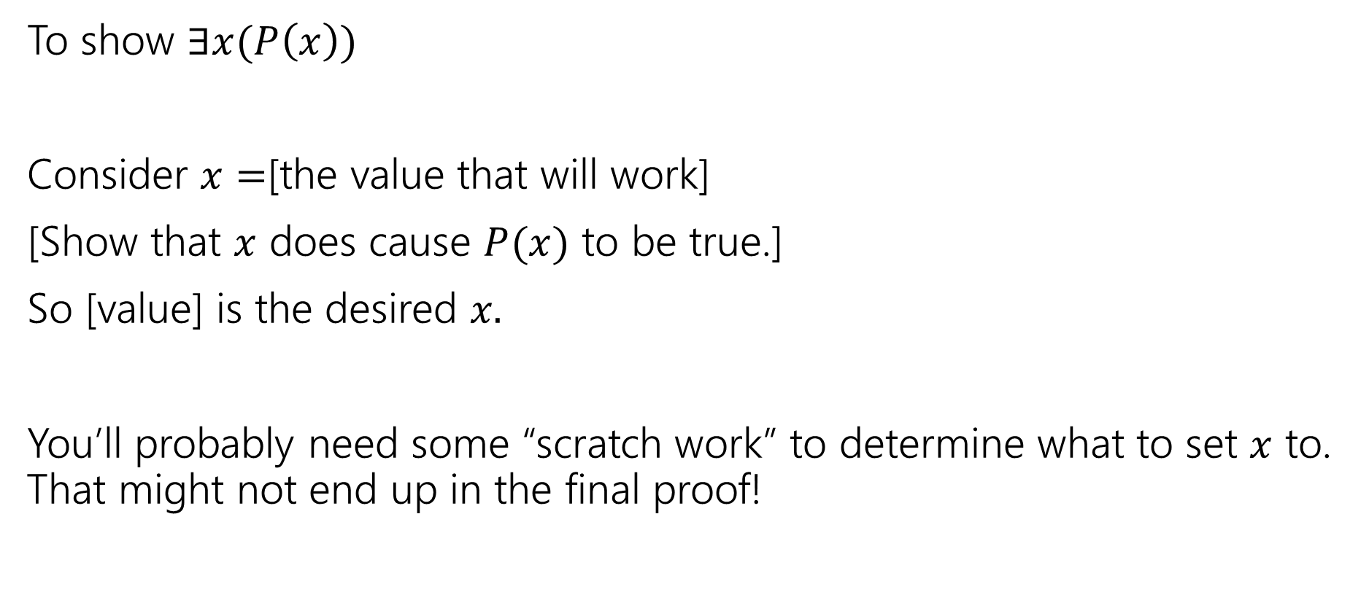
Skeleton of an Exists Proof
To show $∃x(P\left(x\right))$
Consider $x=$[the value that will work]
[Show that $x$ does cause $P(x)$ to be true.]
So [value] is the desired $x.$
You’ll probably need some “scratch work” to determine what to set $x$ to. That might not end up in the final proof!

Slide 24
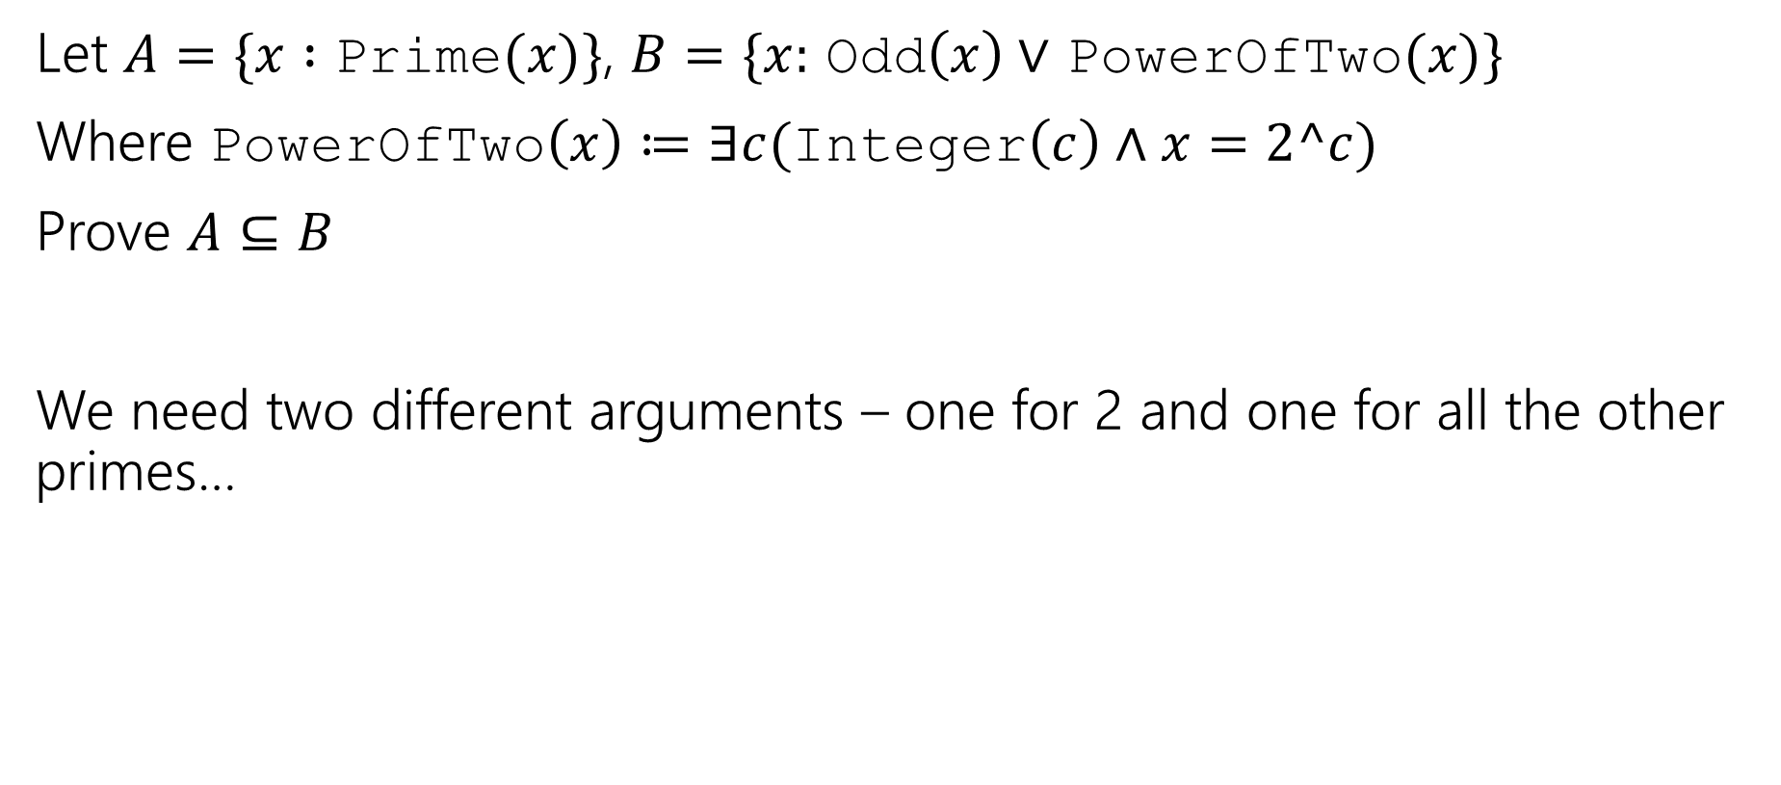
Proof By Cases
Let $A=\{x :$ Prime$(x)\}$, $B=\{x:$ Odd$\left(x\right)∨$ PowerOfTwo$(x)\}$
Where PowerOfTwo$\left(x\right)≔∃c($Integer$\left(c\right)∧x=2^c)$
Prove $A⊆B$
We need two different arguments – one for 2 and one for all the other primes…

Slide 25
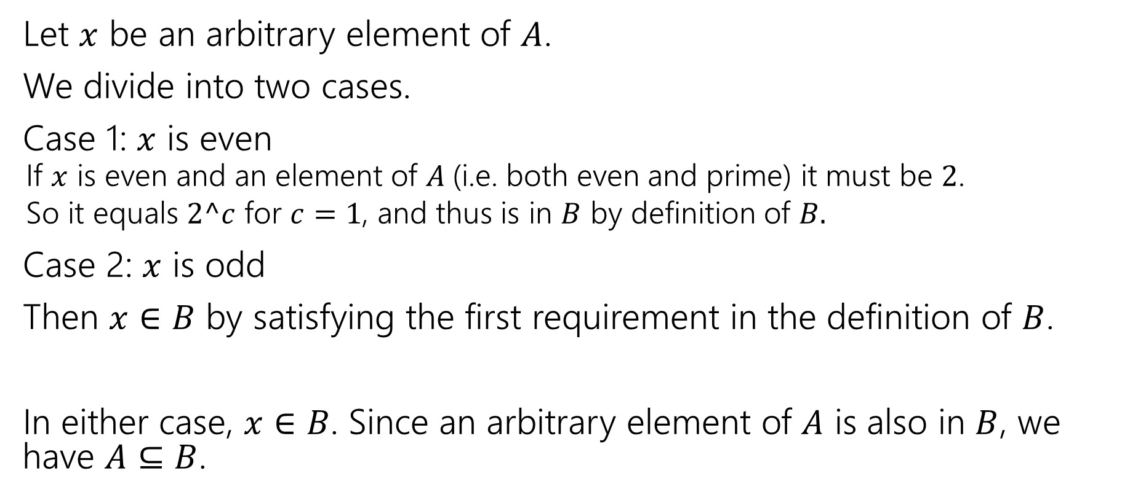
Proof By Cases
Let $x$ be an arbitrary element of $A$.
We divide into two cases.
Case 1: $x$ is even
  If $x$ is even and an element of $A$(i.e. both even and prime) it must be $2$.
  So it equals $2^c$ for $c=1$, and thus is in $B$ by definition of $B.$
Case 2: $x$ is odd
Then $x∈B$ by satisfying the first requirement in the definition of $B$.
In either case, $x∈B$. Since an arbitrary element of $A$ is also in $B$, we have $A⊆B$.

Slide 26
Proof By Cases
Make it clear how you decide which case your in.
It should be obvious your cases are “exhaustive”
Reach the same conclusion in each of the cases, and you can say you’ve got that conclusion no matter what (outside the cases).
Advanced version: sometimes you end up arguing a certain case “can’t happen”

Slide 27

Two More Set Operations
Given a set, let’s talk about it’s powerset.
$𝒫\left(A\right)=\{X:X$ is a subset of $A\}$
The powerset of $A$ is the set of all subsets of $A.$
$𝒫\left(\left\{1,2\right\}\right)=\{∅, \left\{1\right\}, \left\{2\right\}, \left\{1,2\right\}\}$

Slide 28
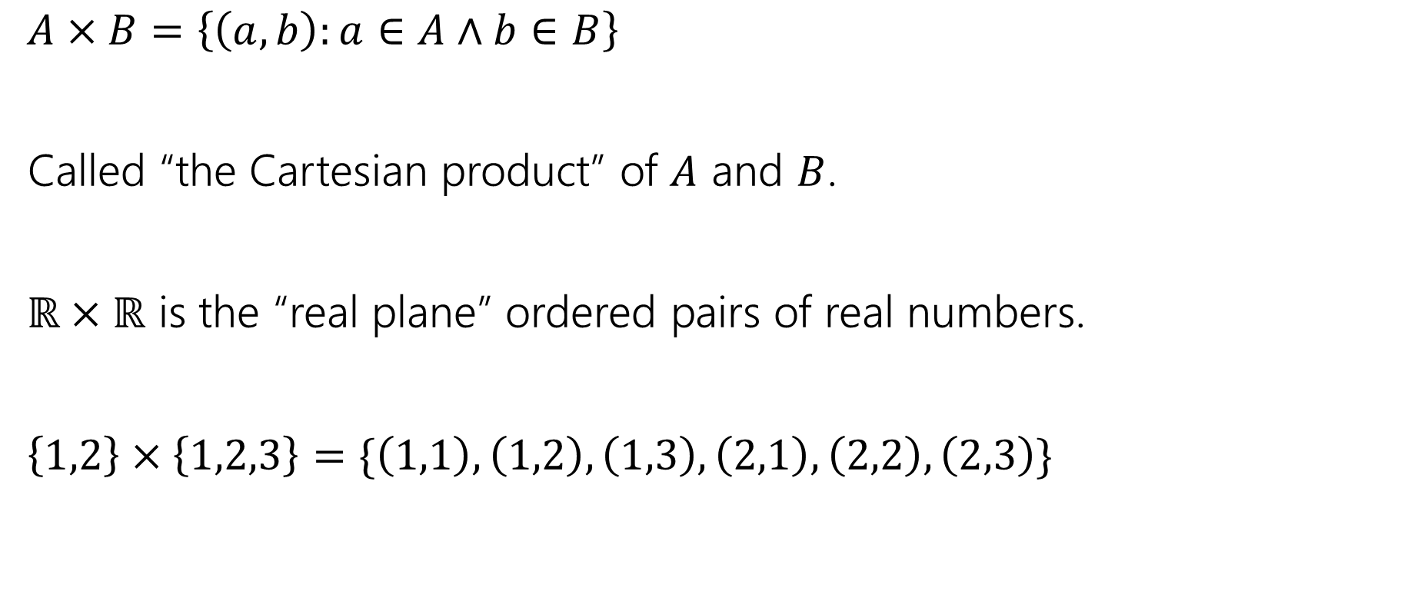
Two More Set Operations
$A×B=\left\{\left(a,b\right):a∈A∧b∈B\right\}$
Called “the Cartesian product” of $A$ and $B$.
$ℝ×ℝ$ is the “real plane” ordered pairs of real numbers.
$\left\{1,2\right\}×\left\{1,2,3\right\}=\{\left(1,1\right),\left(1,2\right),\left(1,3\right), \left(2,1\right), \left(2,2\right), \left(2,3\right)\}$

Slide 29
Read on Your Own

Slide 30
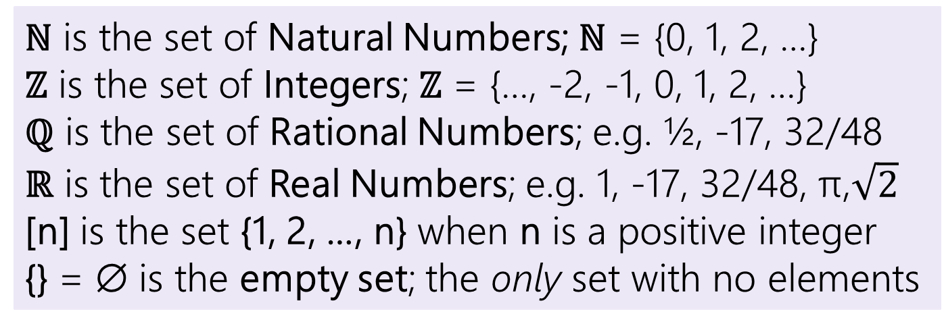
Some old friends (and some new ones)
ℕ is the set of Natural Numbers; ℕ = {0, 1, 2, …}
ℤ is the set of Integers; ℤ = {…, -2, -1, 0, 1, 2, …}
ℚ is the set of Rational Numbers; e.g. ½, -17, 32/48
ℝ is the set of Real Numbers; e.g. 1, -17, 32/48, π,$\sqrt{2}$
[n] is the set {1, 2, …, n} when n is a positive integer
{} = ∅ is the empty set; the only set with no elements

Slide 31

More connectors!
$A∖B$ “A minus B”
$A⊕B$ “XOR” (also called “symmetric difference”)
$$A∖B=\{x:x∈A∧x∉B\}$$
$$A⊕B=\{x:x∈A⊕x∈B\}$$

