Slide 1
Unalike Nested Quantifiers
Warm up
Negate the following sentence, and translate both the original and the negation into predicate logic.
Domain of Discourse: Java programs.
If a program throws an exception, then it has a bug or received invalid input. (predicates: ThrowsException, HasBug, BadInput

Slide 2
Announcements
Remember to sign up for canvas groups for your lecture breakouts.
If you don’t have a group already, you can join a not-full-one at random.
We’ll try on Friday
Proof checking tool: https://homes.cs.washington.edu/~kevinz/proof-test/
Will check your symbolic proofs, so you know if you’ve applied rules properly. – I do recommend it for rough drafts, I don’t recommend for when you’re “stuck”

Slide 3
About Grades
Grades were critical in your lives up until now.
If you were in high school, they’re critical for getting into college.
If you were at UW applying to CSE, they were key to that application
Regardless of where you’re going next, what you learn in this course matters FAR more than what your grade in this course.
If you’re planning on industry – interviews matter more than grades.
If you’re planning on grad school – letters matter most, those are based on doing work outside of class building off what you learned in class.

Slide 4
About Grades
What that means:
The TAs and I are going to prioritize your learning over debating whether -2 or -1 is “ more fair”
If you’re worried about “have I explained enough” – write more!
It’ll take you longer to write the Ed question than write the extended answer. We don’t take off for too much work.
And the extra writing is going to help you learn more anyway.

Slide 5
Regrades
TAs make mistakes!
When I was a TA, I made errors on 1 or 2% of my grading that needed to be corrected. If we made a mistake, file a regrade request on gradescope.
But those are only for mistakes, not for whether “-1 would be more fair”
If you are confused, please talk to us!
My favorite office hours questions are “can we talk about the best way to do something on the homework we just got back?”
If after you do a regrade request on gradescope, you still think a grading was incorrect, send email to Robbie.
Regrade requests will close 2 weeks after homework is returned.

Slide 6
Negation
Negate these sentences in English and translate the original and negation to predicate logic.
All cats have nine lives.
All dogs love every person.
There is a cat that loves someone.
$$∀x\left(Cat\left(x\right)→NumLives\left(x,9\right)\right)$$
$∃x(Cat\left(x\right)∧¬\left(NumLives\left(x,9\right)\right))$ “There is a cat without 9 lives.”
$$∀x∀y\left(Dog\left(x\right)∧Human(y)→Love\left(x,y\right)\right)$$
$∃x∃y(Dog\left(x\right)∧Human\left(y\right)∧¬Love\left(x,y\right))$ “There is a dog who does not love someone.” “There is a dog and a person such that the dog doesn’t love that person.”
$$∃x∃y(Cat\left(x\right)∧Human\left(y\right)∧Love(x,y)$$
$$∀x∀y([Cat\left(x\right)∧Human\left(y\right)]→¬Love\left(x,y\right))$$
“For every cat and every human, the cat does not love that human.”
“Every cat does not love any human” (“no cat loves any human”)

Slide 7
Negation with Domain Restriction
$∃x∃y(Cat\left(x\right)∧Human\left(y\right)∧Love(x,y)$
$∀x∀y([Cat\left(x\right)∧Human\left(y\right)]→¬Love\left(x,y\right))$
There are lots of equivalent expressions to the second. This one is by far the best because it reflects the domain restriction happening. How did we get there?
There’s a problem in this week’s section handout showing similar algebra.

Slide 8
Nested Quantifiers

Slide 9
Nested Quantifiers
Translate these sentences using only quantifiers and the predicate AreFriends$(x,y)$
Everyone is friends with someone.
Someone is friends with everyone.

Slide 10
Nested Quantifiers
Translate these sentences using only quantifiers and the predicate AreFriends$(x,y)$
Everyone is friends with someone.
Someone is friends with everyone.
$∀x(∃y$AreFriends$(x,y))$
$∃x(∀y$AreFriends$(x,y))$
$∀x∃y$AreFriends$(x,y)$
$∃x∀y$AreFriends$(x,y)$

Slide 11
Nested Quantifiers
$∀x∃y P(x,y)$
“For every $x$ there exists a $y$ such that $P\left(x,y\right)$ is true.”
$y$ might change depending on the $x$ (people have different friends!).
$∃x∀y P(x,y)$
“There is an $x$ such that for all $y, P(x,y)$ is true.”
There’s a special, magical $x$ value so that $P\left(x,y\right)$ is true regardless of $y.$

Slide 12
Nested Quantifiers
Let our domain of discourse be $\{A,B,C,D,E\}$
And our proposition $P(x,y)$ be given by the table.
What should we look for in the table?
$∃x∀yP\left(x,y\right)$
$∀x∃yP(x,y)$
$$y$$
$$P(x,y)$$ | A | B | C | D | E
A | T | T | T | T | T
B | T | F | F | T | F
C | F | T | F | F | F
D | F | F | F | F | T
E | F | F | F | T | F
$$x$$

Slide 13
Nested Quantifiers
Let our domain of discourse be $\{A,B,C,D,E\}$
And our proposition $P(x,y)$ be given by the table.
What should we look for in the table?
$∃x∀yP\left(x,y\right)$
A row, where every entry is T
$∀x∃yP(x,y)$
In every row there must be a T
$$y$$
$$P(x,y)$$ | A | B | C | D | E
A | T | T | T | T | T
B | T | F | F | T | F
C | F | T | F | F | F
D | F | F | F | F | T
E | F | F | F | T | F
$$x$$

Slide 14
Keep everything in order
Keep the quantifiers in the same order in English as they are in the logical notation.
“There is someone out there for everyone” is a $∀x∃y$ statement in “everyday” English.
It would never be phrased that way in “mathematical English” We’ll only every write “for every person, there is someone out there for them.”

Slide 15
Try it yourselves
Every cat loves some human.
There is a cat that loves every human.
Let your domain of discourse be mammals.
Use the predicates Cat$(x)$, Dog$(x)$, and Loves$(x,y)$ to mean $x$ loves $y$.

Slide 16
Try it yourselves
Every cat loves some human.
There is a cat that loves every human.
$∀x ($Cat$\left(x\right)→∃y[$Human$(y)∧$Loves$(x,y)])$
$∀x∃y(\text{Cat}\left(x\right)→[\text{Human}(y)∧\text{Loves}(x,y)])$
$∃x ($Cat$\left(x\right)∧∀y[$Human$\left(y\right)→$Loves$(x,y)])$
$∃x∀y(\text{Cat}\left(x\right)∧[\text{Human}(y)→\text{Loves}(x,y)])$

Slide 17
Negation
How do we negate nested quantifiers?
The old rule still applies.
To negate an expression with a quantifier
1. Switch the quantifier ($∀$ becomes $∃,$ $∃$ becomes $∀$)
2. Negate the expression inside
$¬(∀x∃y∀z \left[P\left(x,y\right)∧Q\left(y,z\right)\right])$
$∃x(¬\left(∃y∀z \left[P\left(x,y\right)∧Q\left(y,z\right)\right]\right))$
$∃x∀y(¬\left(∀z\left[P\left(x,y\right)∧Q\left(y,z\right)\right]\right))$
$∃x∀y∃z(¬\left[P\left(x,y\right)∧Q\left(y,z\right)\right])$
$∃x∀y∃z[¬P\left(x,y\right)∨¬Q\left(y,z\right)]$

Slide 18
More Translation
For each of the following, translate it, then say whether the statement is true. Let your domain of discourse be integers.
For every integer, there is a greater integer.
There is an integer $x$, such that for all integers $y$, $xy$ is equal to 1.
$∀y∃x($Equal$\left(x+y,1\right))$
$∀x∃y($Greater$(y,x))$ (This statement is true: $y$ can be $x+1$ [$y$ depends on $x]$)
$∃x∀y($Equal$(xy, 1))$ (This statement is false: no single value of $x$ can play that role for every $y$.)
For every integer, $y,$there is an integer $x$ such that $x+y=1$
(This statement is true, $y$ can depend on $x$

Slide 19
Inference Proofs and the Direct Proof Rule

Slide 20
Inference Rules
$$A∧B$$
Eliminate ∧
$$A⇒B$$
Direct Proof rule
$$∴$$
$$A, B$$
$$A→B$$
$$A∨B, ¬A$$
$$P→Q;P$$
Eliminate $∨$
Modus Ponens
$$∴$$
$$B$$
$$∴$$
$$Q$$
$$A;B$$
Intro ∧
$$∴$$
$$A∧B$$
You can still use all the propositional logic equivalences too!
$$A$$
Intro $∨$
$$∴$$
$$A∨B, B∨A$$

Slide 21
How would you argue…
Let’s say you have a piece of code.
And you think if the code gets null input then a nullPointerExecption will be thrown.
How would you convince your friend?
You’d probably trace the code, assuming you would get null input.
The code was your given
The null input is an assumption

Slide 22
In general
How do you convince someone that $p→q$ is true given some surrounding context/some surrounding givens?
You suppose $p$ is true (you assume $p$)
And then you’ll show $q$ must also be true.
Just from $p$ and the Given information.

Slide 23
The Direct Proof Rule
Write a proof “given $A$ conclude $B$”
$$A⇒B$$
Direct Proof rule
$$A→B$$
$$A→B$$
This rule is different from the others – $A⇒B$ is not a “single fact.”
It’s an observation that we’ve done a proof. (i.e. that we showed fact $B$ starting from $A$.)
We will get a lot of mileage out of this rule…starting today!

Slide 24
Given: (($p→q)∧(q→r))$ Show: $(p→r)$
Here’s an incorrect proof.
$\left(p→q\right)∧\left(q→r\right)$
$p→q$
$q→r$
$p$
$q$
$r$
$p→r$
Given
Eliminate $∧$ (1)
Eliminate $∧$ (1)
Given???
Modus Ponens 4,2
Modus Ponens 5,3
Direct Proof Rule

Slide 25
Given: (($p→q)∧(q→r))$ Show: $(p→r)$
Here’s an incorrect proof.
Proofs are supposed to be lists of facts.
Some of these “facts” aren’t really facts…
$\left(p→q\right)∧\left(q→r\right)$
$p→q$
$q→r$
$p$
$q$
$r$
$p→r$
Given
Eliminate $∧$ 1
Eliminate $∧$ (1)
Given ????
Modus Ponens 4,2
Modus Ponens 5,3
Direct Proof Rule
These facts depend on $p$.
But $p$ isn’t known generally. It was assumed for the purpose of proving $p→r.$

Slide 26
Given: (($p→q)∧(q→r))$ Show: $(p→r)$
Here’s an incorrect proof.
Proofs are supposed to be lists of facts.
Some of these “facts” aren’t really facts…
$\left(p→q\right)∧\left(q→r\right)$
$p→q$
$q→r$
$p$
$q$
$r$
$p→r$
Given
Eliminate $∧$ 1
Eliminate $∧$ (1)
Given ????
Modus Ponens 4,2
Modus Ponens 5,3
Direct Proof Rule
These facts depend on $p$.
But $p$ isn’t known generally. It was assumed for the purpose of proving $p→r.$

Slide 27
Given: (($p→q)∧(q→r))$ Show: $(p→r)$
Here’s a corrected version of the proof.
$\left(p→q\right)∧\left(q→r\right)$
$p→q$
$q→r$
4.1 $p$
4.2 $q$
4.3 $r$
$p→r$
Given
Eliminate $∧$ 1
Eliminate $∧$ 1
Assumption
Modus Ponens 4.1,2
Modus Ponens 4.2,3
Direct Proof Rule
When introducing an assumption to prove an implication:
Indent, and change numbering.
When reached your conclusion, use the Direct Proof Rule to observe the implication is a fact.
The conclusion is an unconditional fact (doesn’t depend on $p$) so it goes back up a level

Slide 28
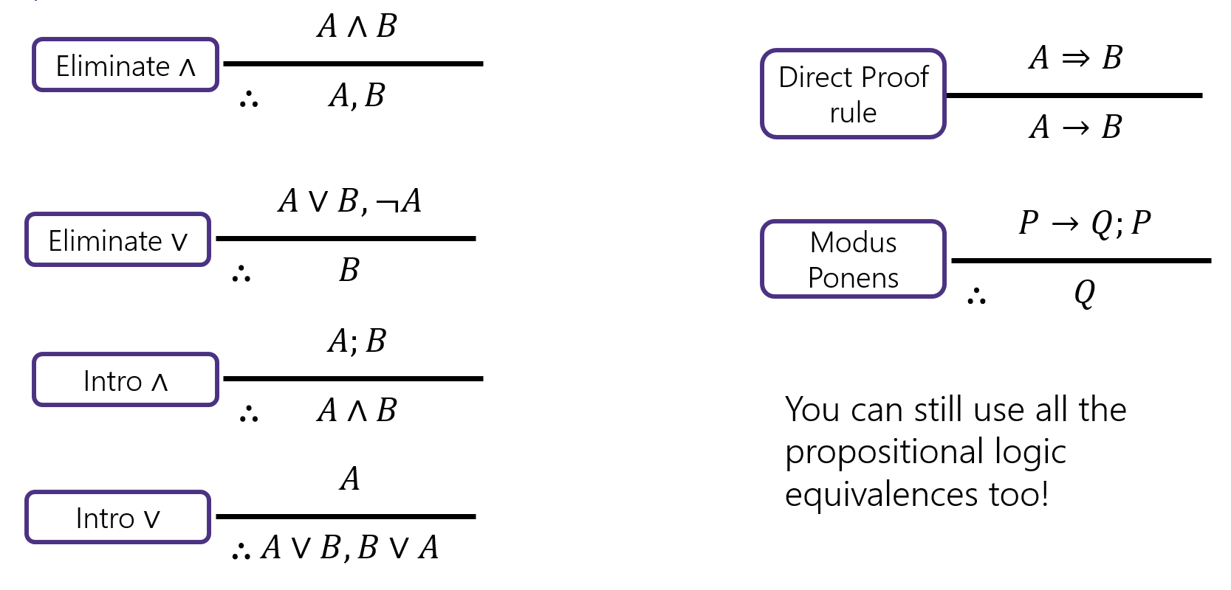
Try it!
Given: $p∨q$, $\left(r∧s\right)→¬q$, $r$. Show: $s→p$

Slide 29
Try it!
Given: $p∨q$, $\left(r∧s\right)→¬q$, $r$. Show: $s→p$
$p∨q$
$\left(r∧s\right)→¬q$
$r$
4.1 $s$
4.2 $r∧s$
4.3 $¬q$
4.4 $q∨p$
4.5 $p$
$s→p$
Given
Given
Given
Assumption
Intro $∧$(3,4.1)
Modus Ponens (2, 4.2)
Commutativity (1)
Eliminate $∨$ (4.4, 4.3)
Direct Proof Rule

