Slide 1
CSE 311: Foundations of Computing
Fall 2014
Lecture 30: Wrap up

Slide 2
announcements
Hand in Homework 9 now
Pick up all old homework and exams now
Solutions will be available on-line (username 311 password Turing) by tomorrow.
Review sessions
Saturday and Sunday, 4pm, EEB 125
List of Final Exam Topics, Practice Final and sample exam questions linked on the web
Bring your questions to the review session!
Final exam
Monday, 2:30-4:20 pm or 4:30-6:20, Kane 210
Fill in Catalyst Survey by Sunday, 3pm to choose.

Slide 3
General phenomenon: can’t tell a book by its cover
and you can’t tell what a program does just by its code...
Rice’s Theorem: In general there is no way to tell
anything about the input/output (I/O) behavior of a
program P just given it code!
Note: The statement above is not precise, and we didn’t prove it, so this
isn’t something you can use on homework or exams

Slide 4
Even harder problems
With the halting problem, by using the Universal machine (a program interpreter) we can simulate P and input x and always get the true answers correct
we can’t be sure about answering false
For other problems we can always answer false correctly but maybe not the true answers
There are natural problems where you can’t even do that!
The EQUIV problem is an example of this kind of even harder problem

Slide 5
Quick lessons
Don’t rely on the idea of improved compilers and programming languages to eliminate major programming errors
truly safe languages can’t possibly do general computation
Document your code!!!!
there is no way you can expect someone else to figure out what your program does with just your code ....since....in general it is provably impossible to do this!

Slide 6
CSE 311: Foundations of Computing
Fall 2014
The “5 minute” version

Slide 7
about the course
From the CSE catalog:
CSE 311 Foundations of Computing I (4) Examines fundamentals of logic, set theory, induction, and algebraic structures with applications to computing; finite state machines; and limits of computability. Prerequisite: CSE 143; either MATH 126 or MATH 136.
What this course is about:
Foundational structures for the practice of computer science and engineering

Slide 8
propositional logic
Statements with truth values
The Washington State flag is red
It snowed in Whistler, BC on January 4, 2011.
Rick Perry won the Iowa straw poll
Space aliens landed in Roswell, New Mexico
If n is an integer greater than two, then the equation a^{n} + b^{n} = c^{n} has no solutions in non-zero integers a, b, and c.
Propositional variables: p, q, r, s, . . .
Truth values: T for true, F for false
Compound propositions
Negation (not) ¬ p
Conjunction (and) p ∧ q
Disjunction (or) p ∨ q
Exclusive or p ⊕ q
Implication p → q
Biconditional p ↔ q

Slide 9
logical equivalence
Terminology: A compound proposition is a
Tautology if it is always true
Contradiction if it is always false
Contingency if it can be either true or false
p ∨ ¬ p
p ⊕ p
(p → q) ∧ p
(p ∧ q) ∨ (p ∧ ¬ q) ∨ (¬ p ∧ q) ∨ (¬ p ∧ ¬ q)

Slide 10
logical equivalence
p and q are logically equivalent iff p ↔ q is a tautology
The notation p ≡ q denotes p and q are logically equivalent
De Morgan’s Laws:
¬ (p ∧ q) ≡ ¬ p ∨ ¬ q
¬ (p ∨ q) ≡ ¬ p ∧ ¬ q

Slide 11
digital circuits
Computing with logic
T corresponds to 1 or “high” voltage
F corresponds to 0 or “low” voltage
Gates
Take inputs and produce outputs
Functions
Several kinds of gates
Correspond to propositional connectives
Only symmetric ones (order of inputs irrelevant)

Slide 12
combinational logic circuits
AND
OR
AND
Wires can send one value to multiple gates

Slide 13
a simple example: 1-bit binary adder
Cout
Cin
Inputs: A, B, Carry-in
Outputs: Sum, Carry-out
A A A A A
B B B B B
S S S S S
A
S
A B Cin Cout S
0 0 0 0 0 1
0 1 0
0 1 1
1 0 0 1 0 1
1 1 0
1 1 1
B
0
0
0
1
0
1
1
1
Cout
0
1
1
0
1
0
0
1
Cin
Cout = B Cin + A Cin + A B
S = A’ B’ Cin + A’ B Cin’ + A B’ Cin’ + A B Cin

Slide 14
Truth Tables to Boolean Logic
DAY | d2d1d0 | L | c0 | c1 | c2 | c3
SunS | 000 | 0 | 0 | 1 | 0 | 0
SunL | 000 | 1 | 0 | 0 | 0 | 1
MonS | 001 | 0 | 0 | 1 | 0 | 0
MonL | 001 | 1 | 0 | 0 | 0 | 1
TueS | 010 | 0 | 0 | 1 | 0 | 0
TueL | 010 | 1 | 0 | 0 | 1 | 0
WedS | 011 | 0 | 0 | 1 | 0 | 0
WedL | 011 | 1 | 0 | 0 | 1 | 0
Thu | 100 | - | 0 | 1 | 0 | 0
FriS | 101 | 0 | 1 | 0 | 0 | 0
FriL | 101 | 1 | 0 | 1 | 0 | 0
Sat | 110 | - | 1 | 0 | 0 | 0
- | 111 | - | - | - | - | -
c3 = (DAY == SUN and LEC) or (DAY == MON and LEC)
c3 = (d2 == 0 && d1 == 0 && d0 == 0 && L == 1) ||
(d2 == 0 && d1 == 0 && d0 == 1 && L == 1)
c3 = d2’•d1’•d0’•L + d2’•d1’•d0•L

Slide 15
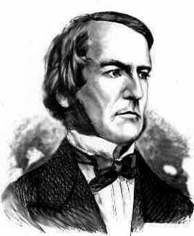
Boolean Algebra
Boolean algebra to circuit design
Boolean algebra
a set of elements B containing {0, 1}
binary operations { + , • }
and a unary operation { ’ }
such that the following axioms hold:
1. the set B contains at least two elements: 0, 1
For any a, b, c in B: 2. closure: a + b is in B a • b is in B 3. commutativity: a + b = b + a a • b = b • a 4. associativity: a + (b + c) = (a + b) + c a • (b • c) = (a • b) • c 5. identity: a + 0 = a a • 1 = a 6. distributivity: a + (b • c) = (a + b) • (a + c) a • (b + c) = (a • b) + (a • c) 7. complementarity: a + a’ = 1 a • a’ = 0

Slide 16
sum-of-products canonical forms
Also known as disjunctive normal form
Also known as minterm expansion
F = 001 011 101 110 111
+ A’BC
+ AB’C
+ ABC’
F =
A’B’C
+ ABC
A B C F F’ 0 0 0 0 1
0 0 1 1 0
0 1 0 0 1
0 1 1 1 0
1 0 0 0 1
1 0 1 1 0
1 1 0 1 0
1 1 1 1 0
F’ = A’B’C’ + A’BC’ + AB’C’

Slide 17
Predicate Logic
Predicate or Propositional Function
A function that returns a truth value, e.g.,
“x is a cat”
“x is prime”
“student x has taken course y”
“x > y”
“x + y = z” or Sum(x, y, z)
“5 < x”
Predicates will have variables or constants as arguments.
Prime(65353)

Slide 18
statements with quantifiers
Domain:
Positive Integers
∀ x (Even(x) ∨ Odd(x))
∃ x (Even(x) ∧ Prime(x))
∀ x ∃ y (Greater(y, x) ∧ Prime(y))
∀ x (Prime(x) → (Equal(x, 2) ∨ Odd(x))
∃ x ∃ y(Equal(x, y + 2) ∧ Prime(x) ∧ Prime(y))
Even(x)
Odd(x)
Prime(x)
Greater(x,y)
Equal(x,y)

Slide 19
English to Predicate Logic
Cat(x)
Red(x)
LikesTofu(x)
“Red cats like tofu”
“Some red cats don’t like tofu”

Slide 20
De Morgan’s laws for Quantifiers
¬∀x P(x) ≡ ∃x ¬P(x)
¬ ∃x P(x) ≡ ∀x ¬P(x)
“There is no largest integer”
¬ ∃ x ∀ y ( x ≥ y)
∀ x ¬ ∀y ( x ≥ y)
∀ x ∃ y ¬ ( x ≥ y)
∀ x ∃ y (y > x)
“For every integer there is a larger integer”

Slide 21
Proofs
Start with hypotheses and facts
Use rules of inference to extend set of facts
Result is proved when it is included in the set
Fact 2
Statement
Hypothesis 1
Fact 1
Hypothesis 2
Statement
Result
Hypothesis 3

Slide 22
Simple Propositional Inference Rules
Excluded middle plus two inference rules per binary connective, one to eliminate it and one to introduce it
p ∧ q
∴ p, q
p, q
∴ p ∧ q
p ∨ q , ¬p
∴ q
p x
∴ p ∨ q, q ∨ p
p, p → q
∴ q
p ⇒ q
∴ p → q
Direct Proof Rule
Not like other rules

Slide 23
Inference rules for quantifiers
P(c) for some c
∀x P(x)
∴ ∃x P(x)
∴ P(a) for any a
“Let a be anything*”...P(a)
∃x P(x)
∴ ∀x P(x)
∴ P(c) for some special** c
** By special, we mean that c is a name for a value where P(c) is true. We can’t use anything else about that value, so c has to be a NEW variable!
* in the domain of P

Slide 24
even and odd
Even(x) ≡ ∃y (x=2y)
Odd(x) ≡ ∃y (x=2y+1)
Domain: Integers
Prove: “The square of every odd number is odd”
English proof of: ∀x (Odd(x)→Odd(x²))
Let x be an odd number.
Then x=2k+1 for some integer k (depending on x)
Therefore x²=(2k+1)²= 4k²+4k+1=2(2k²+2k)+1.
Since 2k²+2k is an integer, x² is odd.

Slide 25
Definitions
A and B are equal if they have the same elements
A is a subset of B if every element of A is also in B
Note:
A = B ≡ ∀ x (x ∈ A ↔ x ∈ B)
A ⊆ B ≡ ∀ x (x ∈ A → x ∈ B)
$(A=B$) ≡ ($A⊆B) ∧(B⊆A)$
A ⊂ B

Slide 26
Set Operations
$$A∪B=\{ x :\left(x∈A\right)∨\left(x ∈B \right)\}$$
Union
$$A∩B=\{ x :\left(x∈A\right)∧\left(x∈B\right)\}$$
Intersection
$$A \backslash B=\{ x :\left(x∈A\right)∧\left(x∉B\right)\}$$
Set Difference
$$A⊕B=\{ x :\left(x∈A\right)⊕\left(x∈B\right)\}$$
Symmetric
Difference
$\overline{A }=\left\{ x :x∉A \right\}$
(with respect to universe U)
Complement

Slide 27
Empty Set, Power set, Cartesian Product
Power set of a set A = set of all subsets of A
$$𝒫\left(A\right)=\{ B :B⊆A \}$$
e.g. Days = $\{M,W,F\}$
$$𝒫\left(Days\right)=\{ ∅,$$
$\left\{M\right\}, \left\{W\right\}, \left\{F\right\},$
$\left\{M,W\right\},\left\{W,F\right\}, \left\{M,F\right\},$
$\left\{M,W,F\right\} \}$
e.g. $𝒫\left(∅\right)$ = $?$
$$A×B=\{ \left(a,b\right):a∈A, b∈B \}$$

Slide 28
Bitwise Operations
01101101 Java: z=x|y ∨ 00110111
01111111
00101010 Java: z=x&y ∧ 00001111
00001010
01101101 Java: z=x^y
⊕ 00110111
01011010

Slide 29
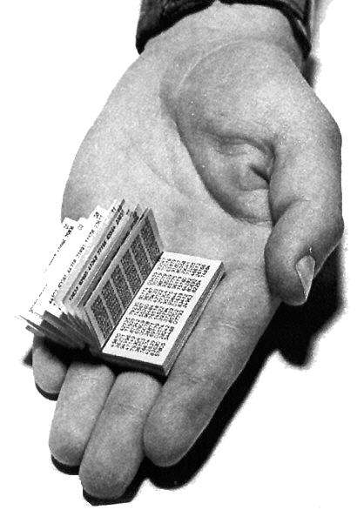
One-Time Pad
Alice and Bob privately share random n-bit vector K
Eve does not know K
Later, Alice has n-bit message m to send to Bob
Alice computes C = m ⊕ K
Alice sends C to Bob
Bob computes m = C ⊕ K which is (m ⊕ K) ⊕ K
Eve cannot figure out m from C unless she can guess K

Slide 30
division theorem
Let a be an integer and d a positive integer. Then there are unique integers q and r, with 0 ≤ r < d, such that a = dq + r.
q = a div d r = a mod d

Slide 31
Arithmetic, mod 7
a +₇ b = (a + b) mod 7
a ×₇ b = (a × b) mod 7
+ | 0 | 1 | 2 | 3 | 4 | 5 | 6
0 | 0 | 1 | 2 | 3 | 4 | 5 | 6
1 | 1 | 2 | 3 | 4 | 5 | 6 | 0
2 | 2 | 3 | 4 | 5 | 6 | 0 | 1
3 | 3 | 4 | 5 | 6 | 0 | 1 | 2
4 | 4 | 5 | 6 | 0 | 1 | 2 | 3
5 | 5 | 6 | 0 | 1 | 2 | 3 | 4
6 | 6 | 0 | 1 | 2 | 3 | 4 | 5
X | 0 | 1 | 2 | 3 | 4 | 5 | 6
0 | 0 | 0 | 0 | 0 | 0 | 0 | 0
1 | 0 | 1 | 2 | 3 | 4 | 5 | 6
2 | 0 | 2 | 4 | 6 | 1 | 3 | 5
3 | 0 | 3 | 6 | 2 | 5 | 1 | 4
4 | 0 | 4 | 1 | 5 | 2 | 6 | 3
5 | 0 | 5 | 3 | 1 | 6 | 4 | 2
6 | 0 | 6 | 5 | 4 | 3 | 2 | 1

Slide 32
modular arithmetic
Let a and b be integers, and m be a positive integer. We say a is congruent to b modulo m if m divides a – b. We use the notation a ≡ b (mod m) to indicate that a is congruent to b modulo m.
Let a and b be integers, and let m be a positive integer. Then a ≡ b (mod m) if and only if a mod m = b mod m.
Let m be a positive integer. If a ≡ b (mod m) and
c ≡ d (mod m), then
a + c ≡ b + d (mod m) and
ac ≡ bd (mod m)
Let a and b be integers, and let m be a positive integer. Then a ≡ b (mod m) if and only if
a mod m = b mod m.

Slide 33
Two’s Complement Representation
n bit signed integers, first bit will still be the sign bit
Suppose $0≤x<2^{n−1}$,
$x$ is represented by the binary representation of $x$
Suppose $0≤x≤2^{n−1}$,
$−x$ is represented by the binary representation of $2^{n}−x$
99 = 64 + 32 + 2 + 1
18 = 16 + 2
For n = 8:
99: 0110 0011
-18: 1110 1110
Key property: Twos complement representation of any number y
is equivalent to y mod 2^{n} so arithmetic works mod 2^{n}

Slide 34
hashing
Map values from a large domain, 0…M-1 in a much smaller domain, 0…n-1
Index lookup
Test for equality
Hash(x) = x mod p
(or Hash(x) = (ax + b) mod p)
Often want the hash function to depend on all of the bits of the data
Collision management

Slide 35
modular exponentiation mod 7
X | 1 | 2 | 3 | 4 | 5 | 6
1 | 1 | 2 | 3 | 4 | 5 | 6
2 | 2 | 4 | 6 | 1 | 3 | 5
3 | 3 | 6 | 2 | 5 | 1 | 4
4 | 4 | 1 | 5 | 2 | 6 | 3
5 | 5 | 3 | 1 | 6 | 4 | 2
6 | 6 | 5 | 4 | 3 | 2 | 1
a | a¹ | a² | a³ | a⁴ | a⁵ | a⁶
1 | 1 | 1 | 1 | 1 | 1 | 1
2 | 2 | 4 | 1 | 2 | 4 | 1
3 | 3 | 2 | 6 | 4 | 5 | 1
4 | 4 | 2 | 1 | 4 | 2 | 1
5 | 5 | 4 | 6 | 2 | 3 | 1
6 | 6 | 1 | 6 | 1 | 6 | 1

Slide 36
Repeated Squaring – small and fast
Since a mod m ≡ a (mod m) for any a
we have a² mod m = (a mod m)² mod m
and a⁴ mod m = (a² mod m)² mod m
and a⁸ mod m = (a⁴ mod m)² mod m
and a¹⁶ mod m = (a⁸ mod m)² mod m
and a³² mod m = (a¹⁶ mod m)² mod m
Can compute a^{k} mod m for k=2^{i} in only i steps

Slide 37
Primality
An integer p greater than 1 is called prime if the only positive factors of p are 1 and p.
A positive integer that is greater than 1 and is not prime is called composite.
Fundamental Theorem of Arithmetic
Every positive integer greater than 1 has a unique prime factorization
48 = 2 • 2 • 2 • 2 • 3
45,523 = 45,523
321,950 = 2 • 5 • 5 • 47 • 137
1,234,567,890 = 2 • 3 • 3 • 5 • 3,607 • 3,803

Slide 38
Euclid’s Theorem
There are an infinite number of primes.
Proof by contradiction:
Suppose that there are only a finite number of primes: $p_{1},p_{2},…, p_{n}$

Slide 39
GCD and Factoring
a = 2³ • 3 • 5² • 7 • 11 = 46,200
b = 2 • 3² • 5³ • 7 • 13 = 204,750
GCD(a, b) = 2^{min(3,1)} • 3^{min(1,2)} • 5^{min(2,3)} • 7^{min(1,1)} • 11^{min(1,0)} • 13^{min(0,1)}
Factoring is expensive!
Can we compute GCD(a,b) without factoring?

Slide 40
Euclid’s Algorithm
GCD(x, y) = GCD(y, x mod y)
int GCD(int a, int b){ /* a >= b, b > 0 */
int tmp;
while (b > 0) {
tmp = a % b;
a = b;
b = tmp;
}
return a;
}
Example: GCD(660, 126)

Slide 41
Extended Euclidean algorithm
Can use Euclid’s Algorithm to find $s, t$ such that
$\gcd\left(a,b\right)=sa+tb$
e.g. gcd(35,27): 35 = 1 • 27 + 8 35 - 1 • 27 = 8
27= 3 • 8 + 3 27- 3 • 8 = 3
8 = 2 • 3 + 2 8 - 2 • 3 = 2
3 = 1 • 2 + 1 3 - 1 • 2 = 1
2 = 2 • 1 + 0
Substitute back from the bottom
1= 3 - 1 • 2 = 3 – 1 (8 - 2 • 3) = (-1) • 8 + 3 • 3
= (-1) • 8 + 3 (27- 3 • 8 ) = 3 • 27 + (-10) • 8
= 3 • 27 + (-10) • (35 - 1 • 27 ) = (-10) • 35 + 13 • 27

Slide 42
Solving Modular Equations
Solving $ax≡b (mod m)$ for unknown $x$ when $\gcd\left(a,m\right)=1$.
Find $s$ such that $sa+tm=1$
Compute $a^{−1}=s mod m$, the multiplicative inverse of $a$ modulo $m$
Set $x=\left(a^{−1}⋅b\right) mod m$

Slide 43
Mathematical Induction
$P(0)$
$ k (P(k) → P(k+1))$
$$  n P(n)$$
Base Case
1. Prove P(0)
Let k be an arbitrary integer ≥ 0
3. Assume that P(k) is true
4. ...
5. Prove P(k+1) is true
P(k) → P(k+1) Direct Proof Rule
7. ∀ k (P(k) → P(k+1)) Intro ∀ from 2-6
8. ∀ n P(n) Induction Rule 1&7
Inductive
Hypothesis
Inductive
Step
Conclusion

Slide 44
strong induction
$P\left(0\right)$
$$∀k \left(\left(P\left(0\right)∧P\left(1\right)∧P\left(2\right)∧⋯∧P\left(k\right)\right)→P\left(k+1\right)\right)$$
$∴∀n P(n)$
By induction we will show that $P(n)$is true for every $n≥0$
Base Case: Prove $P(0)$
Inductive Hypothesis: Assume that for some arbitrary integer $k ≥ 0$, $P(j)$ is true for every $j$ from $0$ to $k$
Inductive Step: Prove that $P(k+1)$is true using the Inductive Hypothesis (that $P(j)$ is true for all values $ k$)
Conclusion: Result follows by induction

Slide 45
5 Steps To Inductive Proofs In English
Proof:
1. “We will show that P(n) is true for every n ≥ 0 by Induction.”
2. “Base Case:” Prove P(0)
3. “Inductive Hypothesis:”
Assume P(k) is true for some arbitrary integer k ≥ 0”
4. “Inductive Step:” Want to prove that P(k+1) is true:
Use the goal to figure out what you need.
Make sure you are using I.H. and point out where you are using it. (Don’t assume P(k+1) !!)
5. “Conclusion: Result follows by induction”

Slide 46
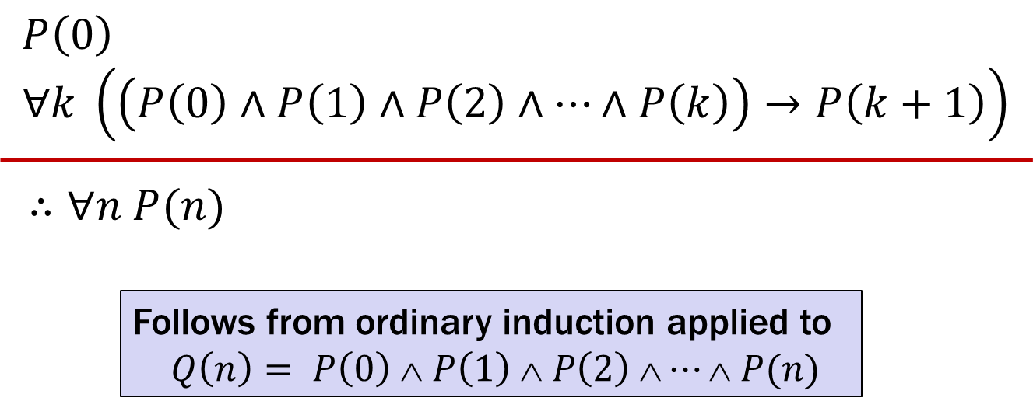
Strong Induction
$P\left(0\right)$
$$∀k \left(\left(P\left(0\right)∧P\left(1\right)∧P\left(2\right)∧⋯∧P\left(k\right)\right)→P\left(k+1\right)\right)$$
$∴∀n P(n)$
Follows from ordinary induction applied to
$$Q\left(n\right)= P\left(0\right) ∧ P\left(1\right) ∧ P\left(2\right) ∧⋯∧ P(n)$$

Slide 47
strong induction english proofs
By induction we will show that $P(n)$is true for every $n≥0$
Base Case: Prove $P(0)$
Inductive Hypothesis: Assume that for some arbitrary integer $k ≥ 0$, $P(j)$ is true for every $j$ from $0$ to $k$
Inductive Step: Prove that $P(k+1)$is true using the Inductive Hypothesis (that $P(j)$ is true for all values $ k$)
Conclusion: Result follows by induction

Slide 48
recursive definitions of functions
$F(0) = 0; F(n + 1) = F(n) + 1$for all $n≥0$
$G\left(0\right)= 1; G\left(n + 1\right)= 2×G(n)$for all$n≥0$
$0! = 1; \left(n+1\right)! = \left(n+1\right)×n!$for all$n≥0$
$H(0) = 1; H(n + 1) = 2^{H\left(n\right)}$for all $n  0$

Slide 49
Strings
An alphabet Σ is any finite set of characters
The set Σ* of strings over the alphabet Σ is defined by
Basis: ℇ ∈ Σ* (ℇ is the empty string)
Recursive: if $w$ ∈ Σ*, $a$ ∈ Σ, then $wa$ ∈ Σ*

Slide 50
Function Definitions on Recursively Defined Sets
Length:
len (ℇ) = 0;
len ($wa$) = 1 + len($w$); for $w∈Σ^{∗}, a∈Σ$
Reversal:
${\text{ℇ}}^{R}=$ ℇ
${\left(wa\right)}^{R}={aw}^{R}$ for $w$ ∈ Σ*, $a$ ∈ Σ
Concatenation:
$x •\text{ℇ}= x$for $x $ Σ*
$x • wa$= $(x • w)a$ for $x, w $Σ*, $a  $

Slide 51
Rooted Binary Trees
Basis: • is a rooted binary tree
Recursive step:
If and are rooted binary trees,
then so is:
T₁
T₂
T₂
T₁

Slide 52
Structural Induction
How to prove ∀ 𝑥 ∈ 𝑆, 𝑃(𝑥) is true:
Base Case: Show that 𝑃(𝑢) is true for all specific elements 𝑢 of 𝑆 mentioned in the Basis step
Inductive Hypothesis: Assume that 𝑃 is true for some arbitrary values of each of the existing named elements mentioned in the Recursive step
Inductive Step: Prove that 𝑃(𝑤) holds for each of the new elements 𝑤 constructed in the Recursive step using the named elements mentioned in the Inductive Hypothesis
Conclude that ∀ 𝑥 ∈ 𝑆, 𝑃(𝑥)

Slide 53
Function Definitions on Recursively Defined Sets
Length:
len(ℇ) = 0
len(wa) = 1 + len(w) for w ∈ Σ*, a ∈ Σ
Reversal:
ℇ^{R} = ℇ
(wa)^{R} = aw^{R} for w ∈ Σ*, a ∈ Σ
Concatenation:
x • ℇ = x for x ∈ Σ*
x • wa = (x • w)a for x ∈ Σ*, a ∈ Σ
Number of c’s in a string:
#_{c}(ℇ) = 0
#_{c}(wc) = #_{c}(w) + 1 for w ∈ Σ*
#_{c}(wa) = #_{c}(w) for w ∈ Σ*, a ∈ Σ, a ≠ c

Slide 54
Regular Expressions
Regular expressions over Σ
Basis:
∅, ε are regular expressions
a is a regular expression for any a ∈ Σ
Recursive step:
If A and B are regular expressions then so are:
(A ∪ B)
(AB)
A*

Slide 55
regular expressions
0*
0*1*
(0 ∪ 1)*
(0*1*)*
(0 ∪ 1)* 0110 (0 ∪ 1)*
(0 ∪ 1)* (0110 ∪ 100)(0 ∪ 1)*

Slide 56
Examples
0*
0*1*
(0 ∪ 1)0(0 ∪ 1)0
(0*1*)*
(0 ∪ 1)* 0110 (0 ∪ 1)*
(00 ∪ 11)* (01010 ∪ 10001)(0 ∪ 1)*

Slide 57
Context-Free Grammars
Example: S → 0S0 | 1S1 | 0 | 1 | ε
Example: S → 0S | S1 | ε

Slide 58
Context-Free Grammars
Grammar for $\left\{0^{n}1^{n}:n≥0\right\}$
(all strings with same # of 0’s and 1’s with all 0’s before 1’s)
Example: S → (S) | SS | ε

Slide 59
building precedence in simple arithmetic expressions
E – expression (start symbol)
T – term F – factor I – identifier N - number
E → T | E+T
T → F | F$∗$T
F → (E) | I | N
I → x | y | z
N → 0 | 1 | 2 | 3 | 4 | 5 | 6 | 7 | 8 | 9

Slide 60
definitions for relations
Let A and B be sets,
A binary relation from A to B is a subset of A × B
Let A be a set,
A binary relation on A is a subset of A × A
Let R be a relation on A
R is reflexive iff (a,a) ∈ R for every a ∈ A
R is symmetric iff (a,b) ∈ R implies (b, a)∈ R
R is antisymmetric iff (a,b) ∈ R and a ≠ b implies (b,a) ∉ R
R is transitive iff (a,b)∈ R and (b, c)∈ R implies (a, c) ∈ R

Slide 61
Combining Relations
Let R be a relation from A to B.
Let S be a relation from B to C.
The composition of R and S, S $∘$ R is the relation
from A to C defined by:
S $∘$ R = {(a, c) | ∃ b such that (a,b)∈ R and (b,c)∈ S}
Intuitively, a pair is in the composition if there is a “connection” from the first to the second.

Slide 62
Relations
(a,b)∈ Parent: b is a parent of a
(a,b)∈ Sister: b is a sister of a
Aunt = Sister ° Parent
Grandparent = Parent ° Parent
R² = R ° R = {(a, c) | ∃ b such that (a,b)∈ R and (b,c)∈ R}
R⁰ = {(a,a) | a ∈ A}
R¹ = R
R^{n+1} = R^{n} ° R
S ° R = {(a, c) | ∃ b such that (a,b)∈ R and (b,c)∈ S}

Slide 63
n-ary relations
Let A₁, A₂, …, A_{n} be sets. An n-ary relation on
these sets is a subset of A₁× A₂× . . . × A_{n}.
Student_ID | Name | GPA
328012098 | Knuth | 4.00
481080220 | Von Neuman | 3.78
238082388 | Russell | 3.85
238001920 | Einstein | 2.11
1727017 | Newton | 3.61
348882811 | Karp | 3.98
2921938 | Bernoulli | 3.21
2921939 | Bernoulli | 3.54
Student_ID | Major
328012098 | CS
481080220 | CS
481080220 | Mathematics
238082388 | Philosophy
238001920 | Physics
1727017 | Mathematics
348882811 | CS
1727017 | Physics
2921938 | Mathematics
2921939 | Mathematics

Slide 64
matrix representation for relations
Relation R on A={a₁, … a_{p}}
{(1, 1), (1, 2), (1, 4), (2,1), (2,3), (3,2), (3, 3) (4,2) (4,3)}
1 | 1 | 0 | 1
1 | 0 | 1 | 0
0 | 0 | 1 | 0
0 | 1 | 1 | 0

Slide 65
representation of relations
Directed Graph Representation (Digraph)
{(a, b), (a, a), (b, a), (c, a), (c, d), (c, e) (d, e) }
b
c
a
d
e

Slide 66
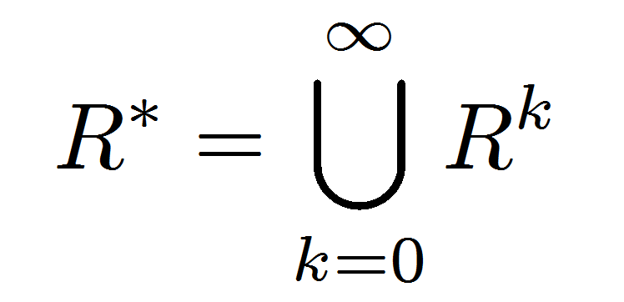
Connectivity In Graphs
Let R be a relation on a set A. There is a path of length k from a to b if and only if (a,b) ∈ R^{k}
Two vertices in a graph are connected iff there is a path between them.
Let R be a relation on a set A. The connectivity relation R* consists of the pairs (a,b) such that there is a path from a to b
in R.
Note: The Rosen text uses the wrong definition of this quantity.
What the text defines (ignoring k=0) is usually called R⁺

Slide 67
Finite State Machines
States
Transitions on inputs
Start state and final states
The language recognized by a machine is the set of strings that reach a final state
0
0
State | 0 | 1
s₀ | s₀ | s₁
s₁ | s₀ | s₂
s₂ | s₀ | s₃
s₃ | s₃ | s₃
s₀
1
s₁
1
s₂
1
s₃
0
0,1

Slide 68
accept strings with odd # of 1’s and odd # of 0’s
1
s₀
s₁
1
0
0
0
0
1
s₂
s₃
1

Slide 69
The beginning versus the end
R
0
0,1
s₀
0,1
s₁
0,1
s₂
1
A
0,1
001
1
011
1
0
1
1
1
0
000
1
010
101
0
111
1
0
0
0
1
0
100
0
110

Slide 70
product construction
Combining FSMs to check two properties at once
New states record states of both FSMs
0,1
0,1
2
s₀
s₁
0
s₁t₀
2
s₀t₁
0
2
1
0
2
1
1
t₁
s₀t₀
2
s₁t₁
2
0
0
1
2
2
1
1
t₀
1
t₂
1
2
2
0
0
s₁t₂
s₀t₂
2
0
1
0

Slide 71
State Machines with Output
“Tug-of-war”
 | Input |  | Output
State | L | R
s₁ | s₁ | s₂ | Beep
s₂ | s₁ | s₃
s₃ | s₂ | s₄
s₄ | s₃ | s₄ | Beep
R
R
R
L
S₁
_{[Beep]}
S₂
S₃
S₄
_{[Beep]}
R
L
L
L

Slide 72
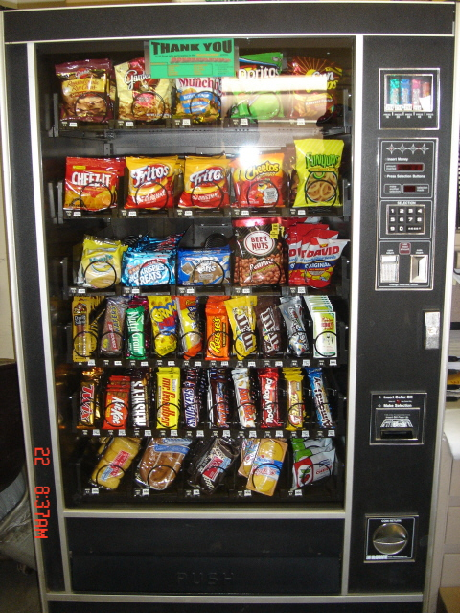
Vending Machine
Enter 15 cents in dimes or nickels
Press S or B for a candy bar

Slide 73
Vending Machine, v1.0
B,S
0
D
N
15
B,S
B,S
B,S
D
D
B
D
0’ [B]
5
10
S
N
N
N
N
D
15’ [N]
B
N
B,S
S
D
N
D
0” [S]
N
B
15” [D]
S
D
Adding additional “unexpected” transitions

Slide 74
state minimization
Finite State Machines with output at states
0
2
S0 [1]
0
S1
[0]
1
2
3
0
2
3
0
1
S0 [1]
0
S1
[0]
1
⇒
1
0
S2 [1]
S3
[0]
2
1
3
0
1,3
2
3
0
1,2
2
3
3
S2 [1]
S3
[0]
1
1
2
2
2
3
0
S4 [1]
3
S5
[0]
0
1
3

Slide 75
state minimization example
present next state output state 0 1 2 3 S0 S0 S1 S2 S3 1 S1 S0 S3 S1 S5 0 S2 S1 S3 S2 S4 1 S3 S1 S0 S4 S5 0 S4 S0 S1 S2 S5 1 S5 S1 S4 S0 S5 0
0
2
S0 [1]
0
S1
[0]
1
2
3
3
0
1
0
1
state transition table
S2 [1]
S3
[0]
1
2
Put states into groups based on their
outputs (or whether they are final states
or not)
2
3
3
1
2
2
S4 [1]
3
S5
[0]
0
0
1
3

Slide 76
minimized machine
present next state output state 0 1 2 3 S0 S0 S1 S2 S3 1 S1 S0 S3 S1 S3 0 S2 S1 S3 S2 S0 1 S3 S1 S0 S0 S3 0
0
2
S0 [1]
0
S1
[0]
1
2
3
0
1,3
3
1,2
state transition table
0
S2 [1]
S3
[0]
1
2
3

Slide 77
another way to look at DFAs
Definition: The label of a path in a DFA is the
concatenation of all the labels on its edges in order
Lemma: x is in the language recognized by a DFA iff
x labels a path from the start state to some final state
0
0
s₀
1
s₁
1
s₂
1
s₃
0
0,1

Slide 78
nondeterministic finite automaton (NFA)
Graph with start state, final states, edges labeled by symbols (like DFA) but
Not required to have exactly 1 edge out of each state labeled by each symbol--- can have 0 or >1
Also can have edges labeled by empty string ε
Definition: x is in the language recognized by an NFA if and only if x labels a path from the start state to some final state
s₀
1
s₁
1
s₂
1
s₃
0,1
0,1

Slide 79
nondeterministic finite automaton
s₀
1
s₁
0,1
s₂
0,1
s₃
0,1
Accepts strings with a 1 three positions from the end of the string

Slide 80
Building an NFA from a Regular Expression
(01 ∪1)*0
0
ɛ
1
ɛ
ɛ
ɛ
ɛ
0
ɛ
ɛ
ɛ
ɛ
1

Slide 81
NFA to DFA: subset construction
0,1
0
a,b
∅
a
0
1
1
λ
1
1
c
b
0
c
b
0
1
0
0
0,1
1
b,c
a,b,c
NFA
0
DFA

Slide 82
Languages and Machines!
All
Context-Free
???
Main Event:
Prove there is a context-free language that isn’t regular.
Regular
DFA
NFA
Regex
0*
Finite
{001, 10, 12}

Slide 83
B = {binary palindromes} can’t be recognized by any DFA
Consider the infinite set of strings
S={1, 01, 001, 0001, 00001, ...} = {0^{n}1 : n ≥ 0}
Suppose we are given an arbitrary DFA M.
Goal: Show that some x ∈ B and some y ∉ B both must end up at the same state of M
Since S is infinite we know that two different strings in S must land in the same state of M, call them 0^{i}1 and 0^{j}1 for i≠j.
That also must be true for 0 ^{i}1z and 0^{j}1z for any z ∈ {0,1}* !
In particular, with z=0^{i} we get that 0^{i}10^{i} and 0^{j}10^{i} end up at the same state of M. Since 0^{i}10^{i} ∈ B and 0^{j}10^{i} ∉ B (because i≠j) M does not recognize B. ∴ no DFA can recognize B.
0 ^{i}1
?
0 ^{j}1

Slide 84
Showing a Language L is not regular
Find an infinite set S={s₀,s₁,...,s_{n},...} of string prefixes that you think will need to be remembered separately
“Let M be an arbitrary DFA. Since S is infinite and M is finite state there must be two strings s_{i} and s_{j} in S for some i ≠j that end up at the same state of M.”
Note: You don’t get to choose which two strings s_{i} and s_{j}
Find a string t (typically depending on s_{i} and/or s_{j}) such that
s_{i}t is in L, and or s_{i}t is not in L, and
s_{j}t is not in L s_{j}t is in L
“Since s_{i} and s_{j} both end up at the same state of M, and we appended the same string t, both s_{i}t and s_{j}t end at the same state of M. Since s_{i}t ∈ L and s_{j}t ∉ L, M does not recognize L.”
“Since M was arbitrary, no DFA recognizes L.”

Slide 85
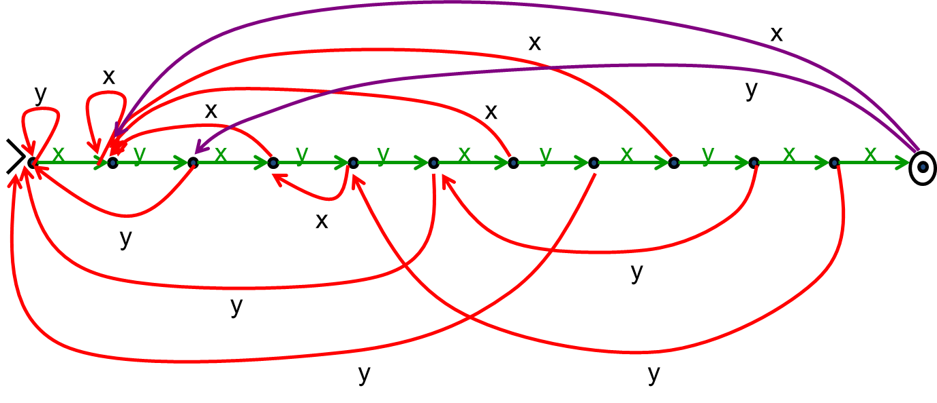
Pattern Matching DFA
pattern p=x y x y y x y x y x x

Slide 86
Languages and Machines!
All
Are there things Java can’t do?
Java
Context-Free
Binary Palindromes
Regular
DFA
NFA
Regex
0*
Finite
{001, 10, 12}

Slide 87
cardinality
A set S is countable iff we can write it as S={s₁, s₂, s₃, ...} indexed by ℕ
Set of integers is countable
{0, 1, -1, 2, -2, 3, -3, 4, . . .}
Set of rationals is countable
“dovetailing”
Σ* is countable
{0,1}* = {0,1,00,01,10,11,000,001,010,011,100,101,...}
Set of all (Java) programs is countable
1/1 | 1/2 | 1/3 | 1/4 | 1/5 | 1/6 | 1/7 | 1/8 | ...
2/1 | 2/2 | 2/3 | 2/4 | 2/5 | 2/6 | 2/7 | 2/8 | ...
3/1 | 3/2 | 3/3 | 3/4 | 3/5 | 3/6 | 3/7 | 3/8 | ...
4/1 | 4/2 | 4/3 | 4/4 | 4/5 | 4/6 | 4/7 | 4/8 | ...
5/1 | 5/2 | 5/3 | 5/4 | 5/5 | 5/6 | 5/7 | ...
6/1 | 6/2 | 6/3 | 6/4 | 6/5 | 6/6 | ...
7/1 | 7/2 | 7/3 | 7/4 | 7/5 | ....
... | ... | ... | ... | ...

Slide 88
Flipped Diagonal Number D
 |  | 1
 |  |  | 5
 |  |  |  | 5
 |  |  |  |  | 1
 |  |  |  |  |  | 5
 |  |  |  |  |  |  | 5
 |  |  |  |  |  |  |  | 5
 |  |  |  |  |  |  |  |  | 5
 |  |  |  |  |  |  |  |  |  | ...
Flipping Rule:
If digit is 5, make it 1
If digit is not 5, make it 5
 |  | 1 | 2 | 3 | 4 | 5 | 6 | 7 | 8 | 9 | ...
r₁ | 0. | 5 | 0 | 0 | 0 | 0 | 0 | 0 | 0 | ... | ...
r₂ | 0. | 3 | 3 | 3 | 3 | 3 | 3 | 3 | 3 | ... | ...
r₃ | 0. | 1 | 4 | 2 | 8 | 5 | 7 | 1 | 4 | ... | ...
r₄ | 0. | 1 | 4 | 1 | 5 | 9 | 2 | 6 | 5 | ... | ...
r₅ | 0. | 1 | 2 | 1 | 2 | 2 | 1 | 2 | 2 | ... | ...
r₆ | 0. | 2 | 5 | 0 | 0 | 0 | 0 | 0 | 0 | ... | ...
r₇ | 0. | 7 | 1 | 8 | 2 | 8 | 1 | 8 | 2 | ... | ...
r₈ | 0. | 6 | 1 | 8 | 0 | 3 | 3 | 9 | 4 | ... | ...
... | .... | ... | .... | .... | ... | ... | ... | ... | ... | ...
D= 0.

Slide 89
The Halting Problem
Given: - CODE(P) for any program P
- input x
Output: true if P halts on input x
false if P does not halt on input x
Theorem (Turing): There is no program that solves the halting problem “The halting problem is undecidable”

Slide 90
public static void D(x) {
if (H(x,x) == true) {
while (true); /* don’t halt */
}
else {
return; /* halt */
}
}
Does D(CODE(D)) halt?
H solves the halting problem implies that H(CODE(D),x) is true iff D(x) halts, H(CODE(D),x) is false iff not
Suppose D(CODE(D)) halts.
Then, we must be in the second case of the if.
So, H(CODE(D), CODE(D)) is false
Which means D(CODE(D)) doesn’t halt
Suppose D(CODE(D)) doesn’t halt.
Then, we must be in the first case of the if.
So, H(CODE(D), CODE(D)) is true.
Which means D(CODE(D)) halts.
Contradiction!

Slide 91
Some possible inputs x
D behaves like
flipped diagonal
<P₁> <P₂> <P₃> <P₄> <P₅> <P₆> ....
P₁
P₂
P₃
P₄
P₅
P₆
P₇
P₈
P₉
.
.
1
0
0
1
0
0
1
0
0 1 1 0 1 1 1 0 0 0 1 ...
1 1 0 1 0 1 1 0 1 1 1 ...
1 0 1 0 0 0 0 0 0 0 1 ...
0 1 1 0 1 0 1 1 0 1 0 ...
0 1 1 1 1 1 1 0 0 0 1 ...
1 1 0 0 0 1 1 0 1 1 1 ...
1 0 1 1 0 0 0 0 0 0 1 ...
0 1 1 1 1 0 1 1 0 1 0 ...
. . . . . . . . . . . .
. . . . . . . . . . . .
programs P
(P,x) entry is 1 if program P halts on input x
and 0 if it runs forever

Slide 92
But first another hard halting-related problem
Halting Problem:
Given: - CODE(P) for any program P
- input x
Output: true if P halts on input x
false if P does not halt on input x
HaltsNoInput Problem:
Given: - CODE(Q) for any program Q
Output: true if Q halts without reading any input
false if Q reads input or runs forever without reading any input.

Slide 93
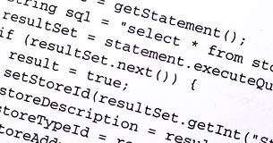
Showing there is no program solving HaltsNoInput
Suppose that hypothetical program A solves HaltsNoInput problem. Combine with Hardcoder:
H’ outputs true on inputs
CODE(P) and x
iff A outputs true
on input CODE(Q) by diagram
iff Q() reads no input
and (always) halts by property of A
iff P(x) halts by definition of Hardcoder
CODE(P)
x
Hardcoder
CODE(Q)
H’
A
true
false
If A existed then H’ would solve the
Halting Problem: Impossible

Slide 94
Showing EQUIV is Undecidable
Consider the set:
EQUIV = {(CODE(P), CODE(R)): P, R are programs, P(x) = R(x) for all inputs x}
Question: Does Q() halt?
CODE(Q)
Step 1: Construct P:
public static boolean P() {return true;}
Step 2: Construct R:
Step a: Replace return type of Q with boolean
Step b: Replace all return values with true
Step c: Add “return true;” to the end of the program
Call this program R
(CODE(P),CODE(R))
Question: Are P and R Equivalent?
Combined program outputs true
iff P and R are equivalent by diagram
iff R always returns true by defn of P
iff Q halts by construction of R from Q
EQUIV
Answering with ANS
would solve HaltsNoInput!
>>> ANS

Slide 95
Turing machines
Church-Turing Thesis
Any reasonable model of computation that includes all possible algorithms is equivalent in power to a Turing machine
Evidence
Intuitive justification
Huge numbers of equivalent models to TM’s based on radically different ideas

Slide 96
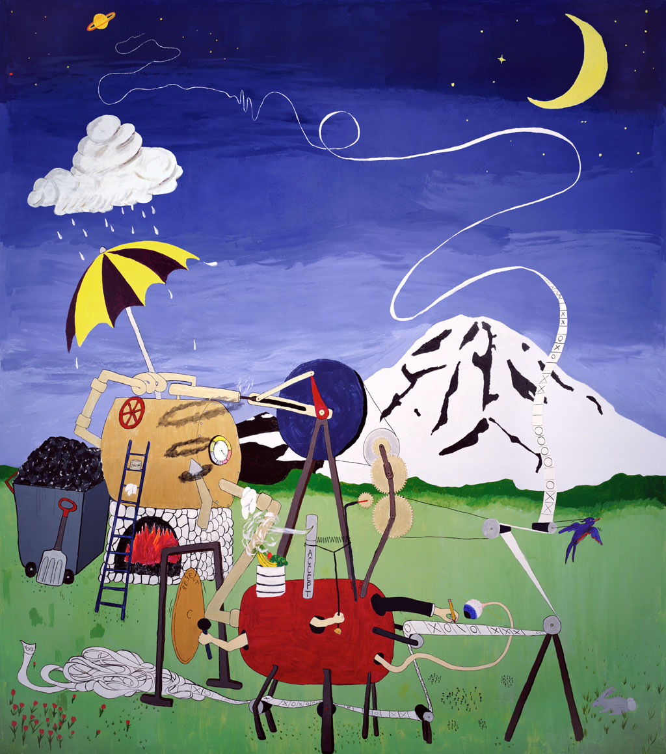
what is a Turing machine?

Slide 97
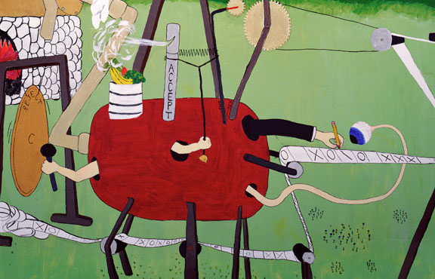
what is a turing machine?

Slide 98
sample Turing machine
 | _ | 0 | 1
s₁ | (1,s₃) | (1,s₂) | (0,s₂)
s₂ | (H,s₃) | (R,s₁) | (R,s₁)
s₃ | (H,s₃) | (R,s₃) | (R,s₃)
_ | _ | 1 | 1 | 0 | 1 | 1 | _ | _

Slide 99
Turing’s big idea: machines as data
Original Turing machine definition
A different “machine” M for each task
Each machine M is defined by a finite set of possible operations on finite set of symbols
M has a finite description as a sequence of symbols, its “code” denoted <M>
You already are used to this idea with the notion of the program code or text but this was a new idea in Turing’s time.

Slide 100
Turing’s idea: a Universal Turing Machine
A Turing machine interpreter U
On input <M> and its input x, U outputs the same thing as M does on input x
At each step it decodes which operation M would have performed and simulates it.
One Turing machine is enough
Basis for modern stored-program computer
Von Neumann studied Turing’s UTM design
input
output
x
output
x
M
U
M(x)
M(x)
<M>

Slide 101
General phenomenon: can’t tell a book by its cover
and you can’t tell what a program does just by its code...
Rice’s Theorem: In general there is no way to tell
anything about the input/output (I/O) behavior of a
program P just given it code!
Note: The statement above is not precise, and we didn’t prove it, so this
isn’t something you can use on homework or exams

Slide 102
Quick lessons
Don’t rely on the idea of improved compilers and programming languages to eliminate major programming errors
truly safe languages can’t possibly do general computation
Document your code!!!!
there is no way you can expect someone else to figure out what your program does with just your code ....since....in general it is provably impossible to do this!

Slide 103
That’s all folks!

