Slide 1
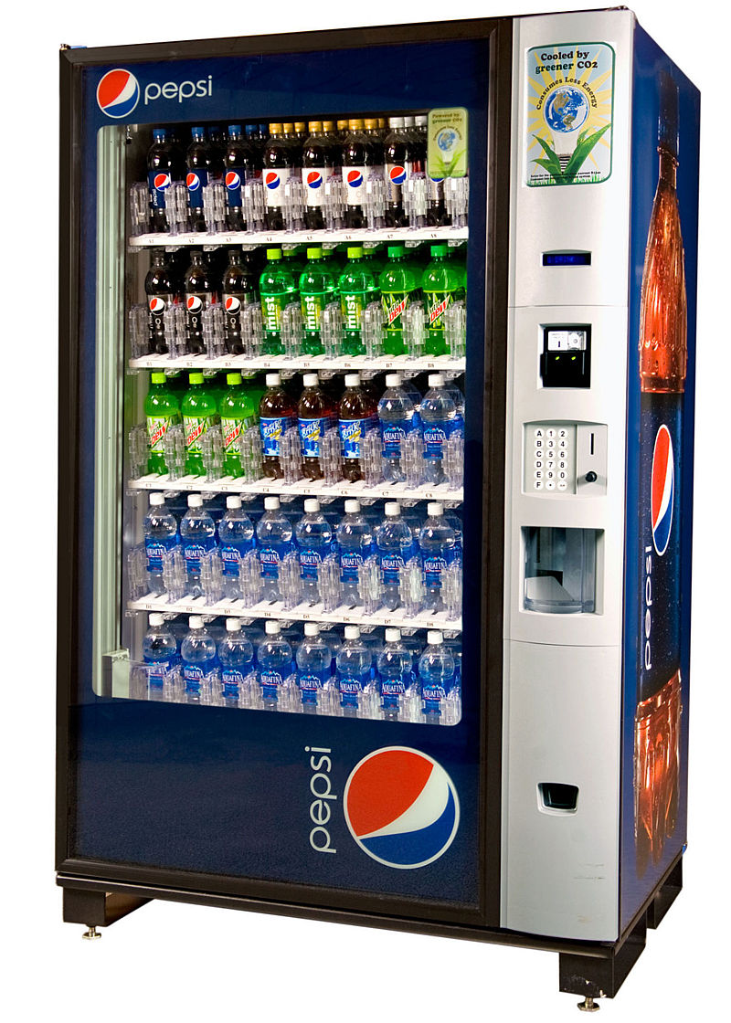
CSE 311: Foundations of Computing
Fall 2014
Lecture 23: State Minimization, NFAs

Slide 2
state minimization
Many different FSMs (DFAs) for the same problem
Take a given FSM and try to reduce its state set by combining states
Algorithm will always produce the unique minimal equivalent machine (up to renaming of states) but we won’t prove this

Slide 3
state minimization algorithm
Put states into groups based on their outputs (or whether they are final states or not)
Repeat the following until no change happens
If there is a symbol s so that not all states in a group G agree on which group s leads to, split G into smaller groups based on which group the states go to on s
s
G₂
s
G₁
s
s
G₃

Slide 4
state minimization example
present next state output state 0 1 2 3 S0 S0 S1 S2 S3 1 S1 S0 S3 S1 S5 0 S2 S1 S3 S2 S4 1 S3 S1 S0 S4 S5 0 S4 S0 S1 S2 S5 1 S5 S1 S4 S0 S5 0
0
2
S0 [1]
0
S1
[0]
1
2
3
3
0
1
0
1
S2 [1]
S3
[0]
state transition table
1
2
3
2
3
Put states into groups based on their
outputs (or whether they are final states
or not)
1
2
2
S4 [1]
3
S5
[0]
0
0
1
3

Slide 5
state minimization example
present next state output state 0 1 2 3 S0 S0 S1 S2 S3 1 S1 S0 S3 S1 S5 0 S2 S1 S3 S2 S4 1 S3 S1 S0 S4 S5 0 S4 S0 S1 S2 S5 1 S5 S1 S4 S0 S5 0
0
2
S0 [1]
0
S1
[0]
1
2
3
3
0
1
0
1
state transition table
S2 [1]
S3
[0]
1
2
Put states into groups based on their
outputs (or whether they are final states
or not)
2
3
3
1
2
2
S4 [1]
3
S5
[0]
0
0
1
3

Slide 6
state minimization example
present next state output state 0 1 2 3 S0 S0 S1 S2 S3 1 S1 S0 S3 S1 S5 0 S2 S1 S3 S2 S4 1 S3 S1 S0 S4 S5 0 S4 S0 S1 S2 S5 1 S5 S1 S4 S0 S5 0
0
2
S0 [1]
0
S1
[0]
1
2
3
3
0
1
0
1
state transition table
S2 [1]
S3
[0]
1
2
Put states into groups based on their
outputs (or whether they are final states
or not)
2
3
3
1
2
2
S4 [1]
3
S5
[0]
0
If there is a symbol s so that not all states in
a group G agree on which group s leads to,
split G based on which group the states go
to on s
0
1
3

Slide 7
state minimization example
present next state output state 0 1 2 3 S0 S0 S1 S2 S3 1 S1 S0 S3 S1 S5 0 S2 S1 S3 S2 S4 1 S3 S1 S0 S4 S5 0 S4 S0 S1 S2 S5 1 S5 S1 S4 S0 S5 0
0
2
S0 [1]
0
S1
[0]
1
2
3
3
0
1
0
1
state transition table
S2 [1]
S3
[0]
1
2
Put states into groups based on their
outputs (or whether they are final states
or not)
2
3
3
1
2
2
S4 [1]
3
S5
[0]
0
If there is a symbol s so that not all states in
a group G agree on which group s leads to,
split G based on which group the states go
to on s
0
1
3

Slide 8
state minimization example
present next state output state 0 1 2 3 S0 S0 S1 S2 S3 1 S1 S0 S3 S1 S5 0 S2 S1 S3 S2 S4 1 S3 S1 S0 S4 S5 0 S4 S0 S1 S2 S5 1 S5 S1 S4 S0 S5 0
0
2
S0 [1]
0
S1
[0]
1
2
3
3
0
1
0
1
state transition table
S2 [1]
S3
[0]
1
2
Put states into groups based on their
outputs (or whether they are final states
or not)
2
3
3
1
2
2
S4 [1]
3
S5
[0]
0
If there is a symbol s so that not all states in
a group G agree on which group s leads to,
split G based on which group the states go
to on s
0
1
3

Slide 9
state minimization example
present next state output state 0 1 2 3 S0 S0 S1 S2 S3 1 S1 S0 S3 S1 S5 0 S2 S1 S3 S2 S4 1 S3 S1 S0 S4 S5 0 S4 S0 S1 S2 S5 1 S5 S1 S4 S0 S5 0
0
2
S0 [1]
0
S1
[0]
1
2
3
3
0
1
0
1
state transition table
S2 [1]
S3
[0]
1
2
Put states into groups based on their
outputs (or whether they are final states
or not)
2
3
3
1
2
2
S4 [1]
3
S5
[0]
0
If there is a symbol s so that not all states in
a group G agree on which group s leads to,
split G based on which group the states go
to on s
0
1
3

Slide 10
state minimization example
present next state output state 0 1 2 3 S0 S0 S1 S2 S3 1 S1 S0 S3 S1 S5 0 S2 S1 S3 S2 S4 1 S3 S1 S0 S4 S5 0 S4 S0 S1 S2 S5 1 S5 S1 S4 S0 S5 0
0
2
S0 [1]
0
S1
[0]
1
2
3
3
0
1
0
1
state transition table
S2 [1]
S3
[0]
1
2
Put states into groups based on their
outputs (or whether they are final states
or not)
2
3
3
1
2
2
S4 [1]
3
S5
[0]
0
If there is a symbol s so that not all states in
a group G agree on which group s leads to,
split G based on which group the states go
to on s
0
1
3

Slide 11
state minimization example
present next state output state 0 1 2 3 S0 S0 S1 S2 S3 1 S1 S0 S3 S1 S5 0 S2 S1 S3 S2 S4 1 S3 S1 S0 S4 S5 0 S4 S0 S1 S2 S5 1 S5 S1 S4 S0 S5 0
0
2
S0 [1]
0
S1
[0]
1
2
3
3
0
1
0
1
state transition table
S2 [1]
S3
[0]
1
2
3
2
3
1
Can combine states S0-S4 and
S3-S5.
In table replace all S4 with S0
and all S5 with S3
2
2
S4 [1]
3
S5
[0]
0
0
1
3

Slide 12
minimized machine
present next state output state 0 1 2 3 S0 S0 S1 S2 S3 1 S1 S0 S3 S1 S3 0 S2 S1 S3 S2 S0 1 S3 S1 S0 S0 S3 0
0
2
S0 [1]
0
S1
[0]
1
2
3
0
1,3
3
1,2
state transition table
0
S2 [1]
S3
[0]
1
2
3

Slide 13
another way to look at DFAs
Definition: The label of a path in a DFA is the
concatenation of all the labels on its edges in order
Lemma: x is in the language recognized by a DFA iff
x labels a path from the start state to some final state
0
0
s₀
1
s₁
1
s₂
1
s₃
0
0,1

Slide 14
nondeterministic finite automaton (NFA)
Graph with start state, final states, edges labeled by symbols (like DFA) but
Not required to have exactly 1 edge out of each state labeled by each symbol--- can have 0 or >1
Also can have edges labeled by empty string ε
Definition: x is in the language recognized by an NFA if and only if x labels a path from the start state to some final state
s₀
1
s₁
1
s₂
1
s₃
0,1
0,1

Slide 15
goal: NFA to recognize...
binary strings that have even # of 1’s or contain the substring 111

