Slide 1
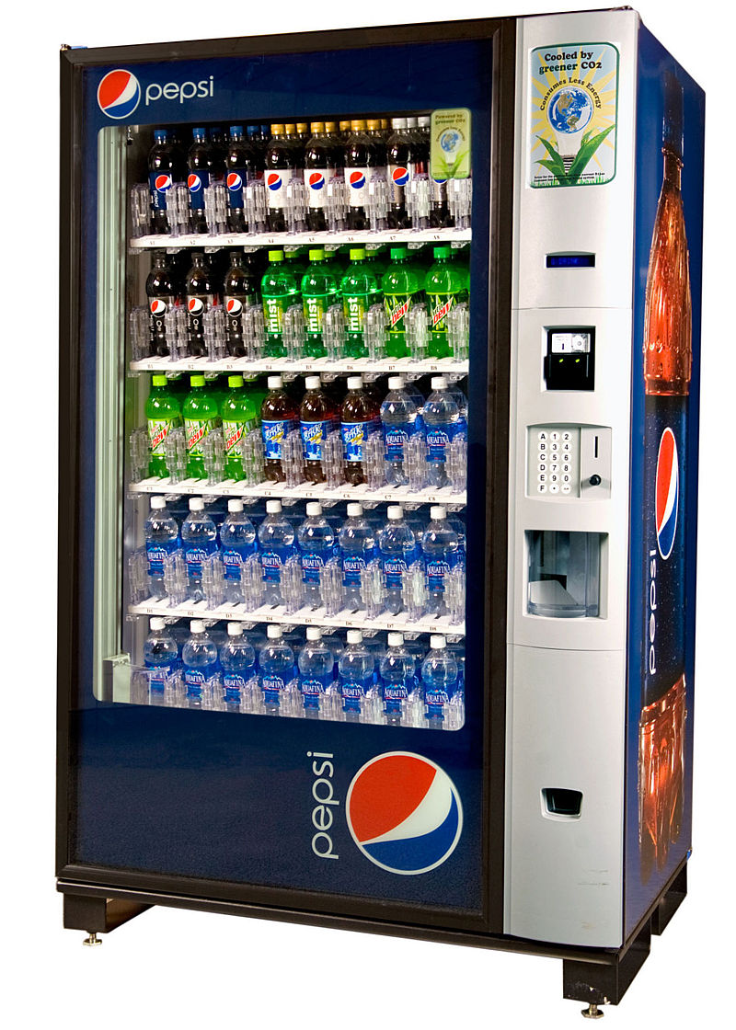
CSE 311: Foundations of Computing
Fall 2014
Lecture 22: Finite State Machines with Output

Slide 2
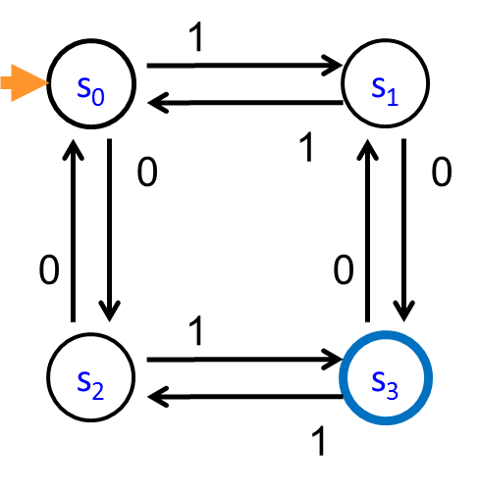
FSM highlights
Finite state machines
States, transitions, start state, final states
Languages recognized by FSMs
0
0
s₀
1
s₁
1
s₂
1
s₃
0
0,1

Slide 3
FSM that accepts strings of a’s, b’s, c’s with no more than 3 a’s

Slide 4
FSM that accepts binary strings with a 1 three positions from the start

Slide 5
FSM that accepts binary strings with a 1 three positions from the end

Slide 6
Strings over {0, 1, 2}*
M₁: Strings with an even number of 2’s
M₂: Strings where the sum of digits mod 3 is 0
s₀
s₁
t₁
t₀
t₂

Slide 7
Strings with an even number of 2’s and a mod 3 sum of 0
s₁t₀
s₀t₁
s₀t₀
s₁t₁
s₁t₂
s₀t₂

Slide 8
3 bit shift register
“Remember the last three bits”
001
1
011
1
0
1
1
1
0
000
1
010
101
0
111
1
0
0
1
0
0
100
0
110

Slide 9
“Remember the last three bits”
0
1
0
1
0
1
0
1
00
01
10
11
1
1
1
0
0
0
0
1
001
1
011
1
0
1
1
1
0
000
1
010
101
0
111
1
0
0
1
0
0
100
0
110

Slide 10
The beginning versus the end
R
0
0,1
s₀
0,1
s₁
0,1
s₂
1
A
0,1
001
1
011
1
0
1
1
1
0
000
1
010
101
0
111
1
0
0
0
1
0
100
0
110

Slide 11
State Machines with Output
“Tug-of-war”
 | Input |  | Output
State | L | R
s₁ | s₁ | s₂ | Beep
s₂ | s₁ | s₃
s₃ | s₂ | s₄
s₄ | s₃ | s₄ | Beep
R
R
R
L
S₁
_{[Beep]}
S₂
S₃
S₄
_{[Beep]}
R
L
L
L

Slide 12
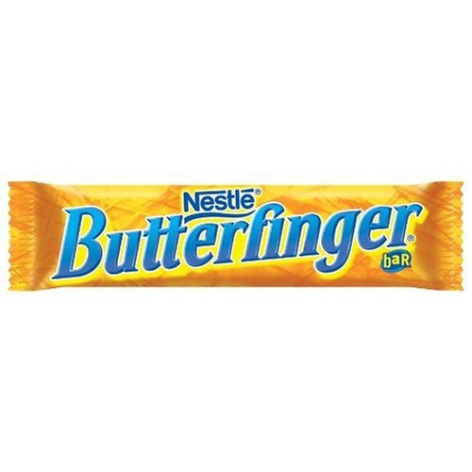
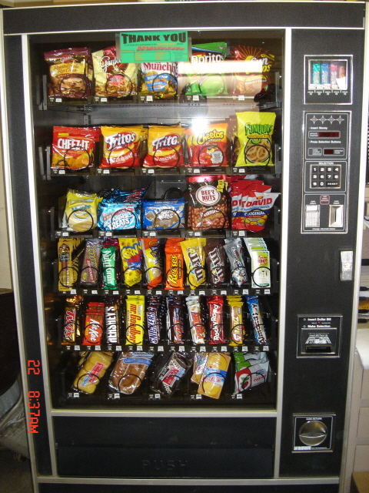
Vending Machine
Enter 15 cents in dimes or nickels
Press S or B for a candy bar

Slide 13
Vending Machine, v0.1
D
D
0
N
5
N
10
N, D
15
B, S
Basic transitions on N (nickel), D (dime), B (butterfinger), S (snickers)

Slide 14
Vending Machine, v0.2
0
D
N
15
D
D
B
0’ [B]
5
10
S
N
N
N
D
15’ [N]
B
S
N
D
0” [S]
Adding output to states: N – Nickel, S – Snickers, B – Butterfinger

Slide 15
Vending Machine, v1.0
B,S
0
D
N
15
B,S
B,S
B,S
D
D
B
D
0’ [B]
5
10
S
N
N
N
N
D
15’ [N]
B
N
B,S
S
D
N
D
0” [S]
N
B
15” [D]
S
D
Adding additional “unexpected” transitions

