Slide 1
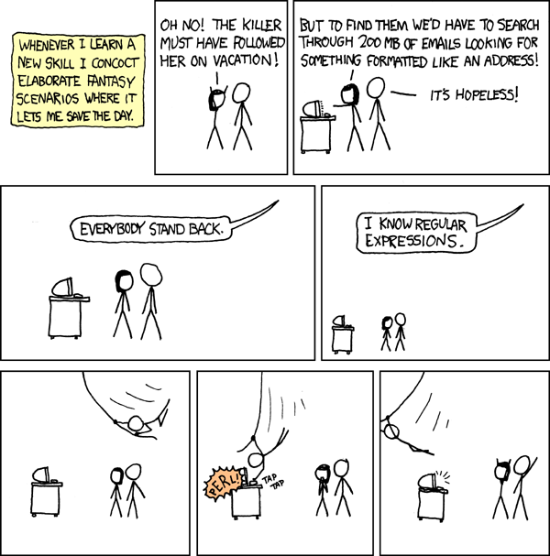
CSE 311: Foundations of Computing
Fall 2014
Lecture 19: Regular Expressions
Context-Free Grammars

Slide 2
Review: each regular expression is a “pattern”
ε matches the empty string
a matches the one character string a
(A ∪ B) matches all strings that either A matches or B matches (or both)
(AB) matches all strings that have a first part that A matches followed by a second part that B matches
A* matches all strings that have any number of strings (even 0) that A matches, one after another

Slide 3
Examples
All binary strings that have an even # of 1’s
All binary strings that don’t contain 101

Slide 4
Limitations of Regular Expressions
Not all languages can be specified by regular expressions
Even some easy things like
Palindromes
Strings with equal number of 0’s and 1’s
But also more complicated structures in programming languages
Matched parentheses
Properly formed arithmetic expressions
etc.

Slide 5
Context-Free Grammars
A Context-Free Grammar (CFG) is given by a finite set of substitution rules involving
A finite set V of variables that can be replaced
Alphabet Σ of terminal symbols that can’t be replaced
One variable, usually S, is called the start symbol
The rules involving a variable A are written as
A → w₁ | w₂ | $⋯$ | w_{k}
where each w_{i} is a string of variables and terminals – that is w_{i} ∈ (V ∪ Σ)∗

Slide 6
How CFGs generate strings
Begin with start symbol S
If there is some variable A in the current string you can replace it by one of the w’s in the rules for A
A → w₁ | w₂ | $⋯$ | w_{k}
Write this as xAy ⇒ xwy
Repeat until no variables left
The set of strings the CFG generates are all strings produced in this way that have no variables

Slide 7
Example Context-Free Grammars
Example: S → 0S0 | 1S1 | 0 | 1 | ε
Example: S → 0S | S1 | ε

Slide 8
Example Context-Free Grammars
Grammar for $\left\{0^{n}1^{n}:n≥0\right\}$
(all strings with same # of 0’s and 1’s with all 0’s before 1’s)
Example: S → (S) | SS | ε

Slide 9
Simple Arithmetic Expressions
E→ E+E | E$∗$E | (E) | x | y | z | 0 | 1 | 2 | 3 | 4
| 5 | 6 | 7 | 8 | 9
Generate (2$∗$x) + y
Generate x+y$∗$z in two fundamentally different ways

Slide 10
Parse Trees
Suppose that grammar G generates a string x
A parse tree of x for G has
Root labeled S (start symbol of G)
The children of any node labeled A are labeled by symbols of w left-to-right for some rule A → w
The symbols of x label the leaves ordered left-to-right
S
S → 0S0 | 1S1 | 0 | 1 | ε
0
S
0
1
S
1
Parse tree of 01110
1

Slide 11
CFGs and recursively-defined sets of strings
A CFG with the start symbol S as its only variable recursively defines the set of strings of terminals that S can generate
A CFG with more than one variable is a simultaneous recursive definition of the sets of strings generated by each of its variables
Sometimes necessary to use more than one

Slide 12
building precedence in simple arithmetic expressions
E – expression (start symbol)
T – term F – factor I – identifier N - number
E → T | E+T
T → F | F$∗$T
F → (E) | I | N
I → x | y | z
N → 0 | 1 | 2 | 3 | 4 | 5 | 6 | 7 | 8 | 9

Slide 13
Backus-Naur Form (The same thing…)
BNF (Backus-Naur Form) grammars
Originally used to define programming languages
Variables denoted by long names in angle brackets, e.g.
<identifier>, <if-then-else-statement>, <assignment-statement>, <condition>
$∷=$ used instead of →

Slide 14
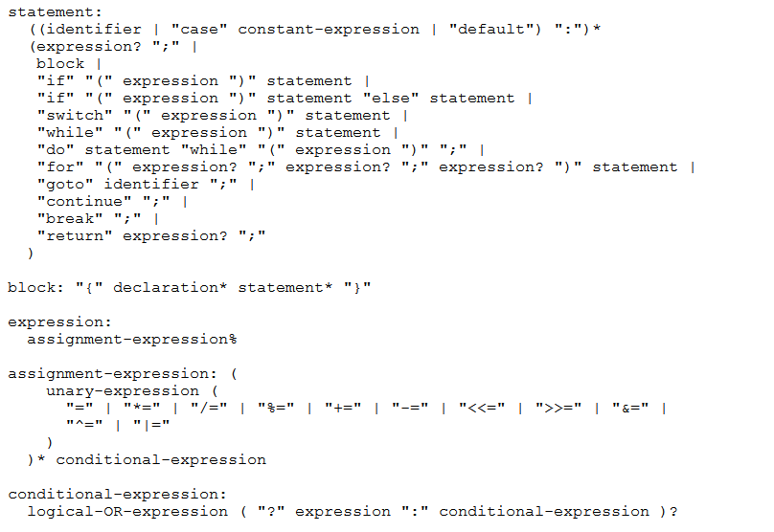
BNF for C

Slide 15
Parse Trees
Back to middle school:
<sentence>$∷=$<noun phrase><verb phrase>
<noun phrase>$∷=$=<article><adjective><noun>
<verb phrase>$∷=$<verb><adverb>|<verb><object>
<object>$∷=$<noun phrase>
Parse:
The yellow duck squeaked loudly
The red truck hit a parked car

